Slide 1
Probabilistic Fatigue Analysis; Assessment of an Environmental Fatigue Thermal Shock Test to Quantify the Deterministic Code Margin
International Seminar on Probabilistic Methodologies for Nuclear Applications
Michael Martin (On behalf of Joe Batten, Keith Wright & Daniel Leary)
24th October 2019
The information in this document is the property of Rolls-Royce plc and may not be copied or communicated to a third party, or used for any purpose other than that for which it is supplied without the express written consent of Rolls-Royce plc.
This information is given in good faith based upon the latest information available to Rolls-Royce plc, no warranty or representation is given concerning such information, which must not be taken as establishing any contractual or other commitment binding upon Rolls-Royce plc or any of its subsidiary or associated companies.

Slide 2
Contents
Introduction
Overview of program
Finite Element Analysis
Input Data and Sampling
Fatigue Initiation
Fatigue Crack Growth
Total Life
Discussion of Results

Slide 3
01
Introduction
Section Content
Background
Requirements
Scope

Slide 4
Introduction
Background
NB-3200 fatigue initiation and R6 defect tolerance assessment methods are highly conservative due to their deterministic nature.
Due to the requirement for margins to be quantified an alternative probabilistic method in conjunction with target reliability is necessary
Requirements
Develop a simplified total fatigue Life Assessment Methodology (LAM).
Benchmark simplified LAM method against test data.
Apply simplified LAM method to a piping component
Scope
The method shall be benchmarked against the Stepped Pipe (SP).
Only stainless sections containing defects on the SP shall be assessed.

Slide 5
02
Overview
Section Content

Slide 6
Simplified LAM Assessment Flow Chart
Start LAM Assessment
FI or FCG
Calculate SIFs Through Wall and Time
Fatigue Crack Growth
Calculate C_{ENV} Through Wall
Run Elastic and Elastic-Plastic FEA
Fatigue Initiation
Calculate Strain Amplitude
Accounting for Crack Closure
Calculate FCG Through Wall
Load Data
Total Life
Sample Assessment Inputs
Calculate Allowable Air Cycles
Calculate FEN
Calculate Allowable PWR Cycles to A₀

Slide 7
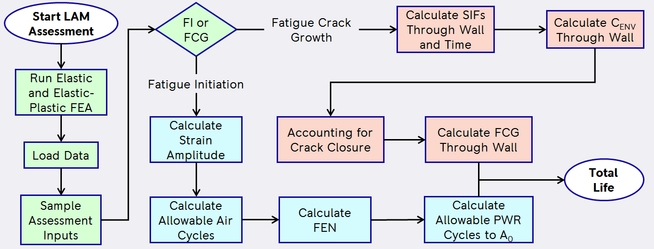
03
Finite Element Analysis
Section Content
Component Geometries
Transient Definitions
Material Data
Validation
FE Results

Slide 8
PVP2004-2748 Geometry
27.4 mm RAD
15.2 mm THK
23.8 mm RAD
11.6 mm THK
20.3 mm RAD
8.1 mm THK
16.7 mm RAD
4.5 mm THK
Component Geometries
Stepped Pipe component geometry has been taken from “PVP2004-2748”
Both the 15.2mm and 11.6mm section thicknesses have been assessed
Pipe slice model used for simplicity
Nine defects were observed in the 15.2mm section
Two defects were observed in the 11.6mm section
12.2 mm RAD
Modelled FE Geometry
Transient applied to this surface
Mesh biased towards wetted surface

Slide 9
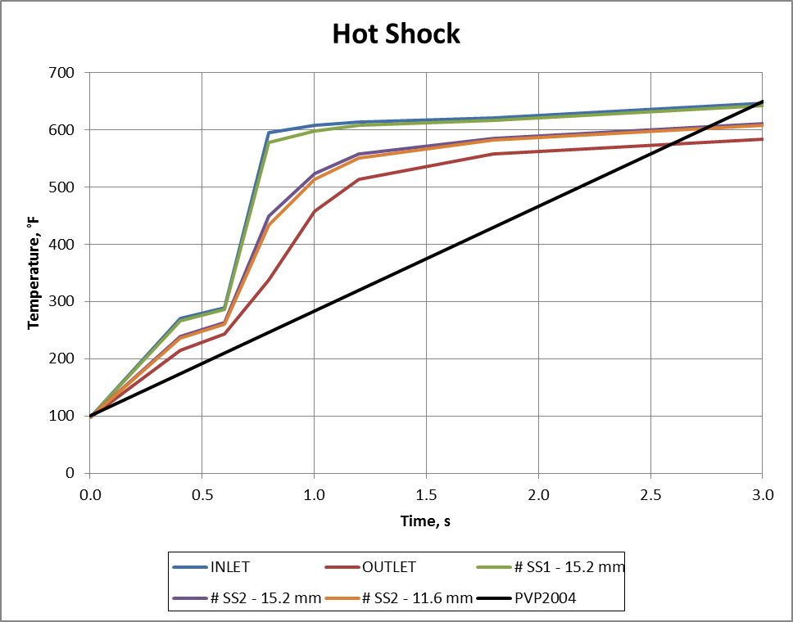
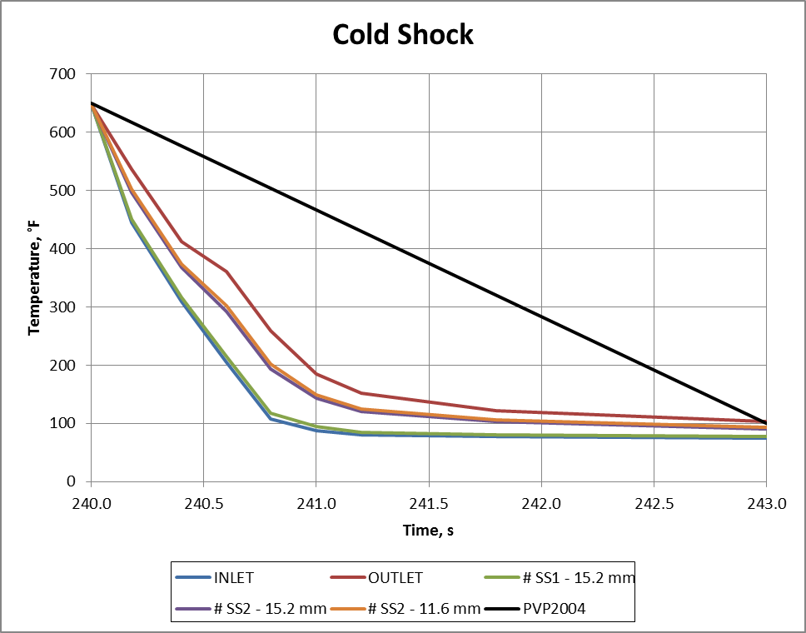
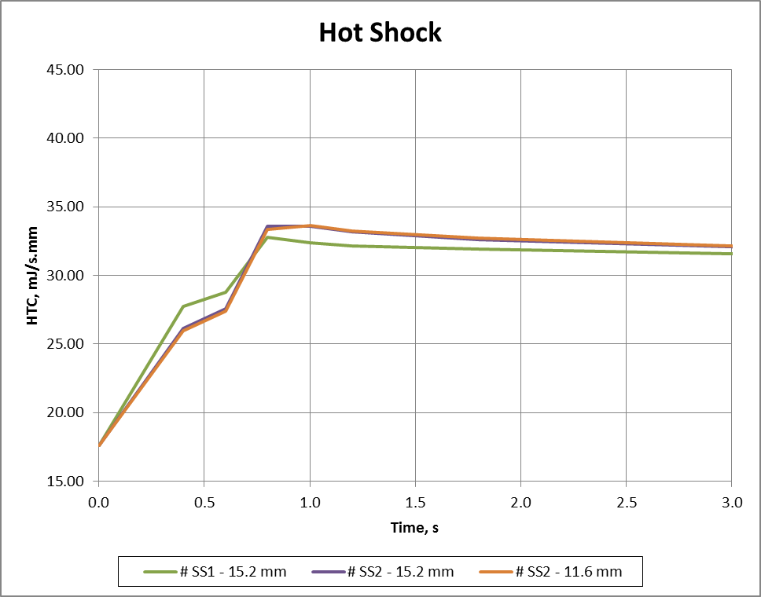
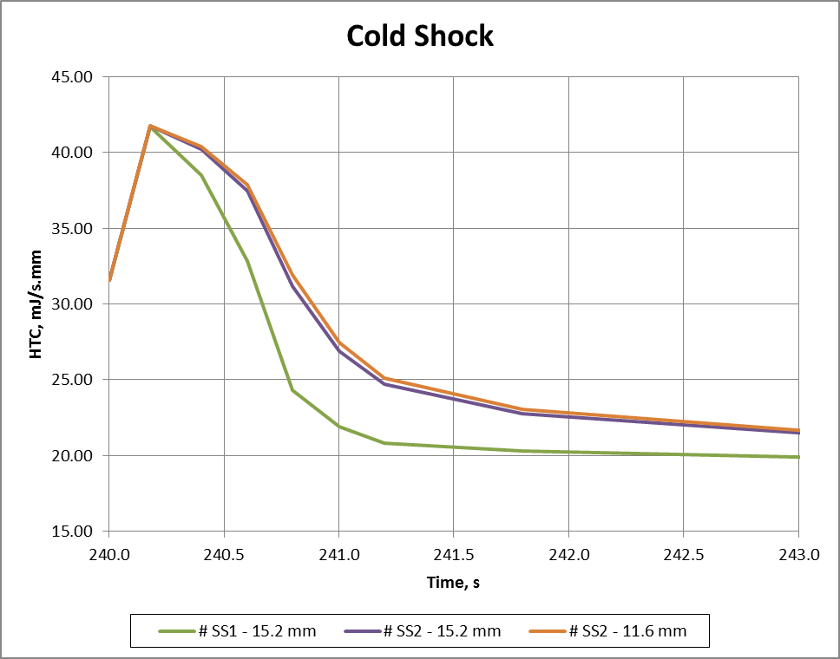
Fluid Transient Definition
Transient Definition
Transient is defined in “PVP2004-2748” and test report
Component subject to 305°C thermal shock (38 – 343°C).
Thermal shocks applied over three seconds.
Hot and cold temperatures held for 237s.
Fluid temperature assumed to vary linearly along length of component
HTCs calculated using Dittus Boelter correlation
Calculated HTCs

Slide 10
Material Data
Predominantly used ASME BPVC 2010 Section II, Part D material data.
There are a few exceptions where we have defined properties from our own testing .
As stated in “PVP2004-2748” the component is manufactured from 304 stainless steel.

Slide 11
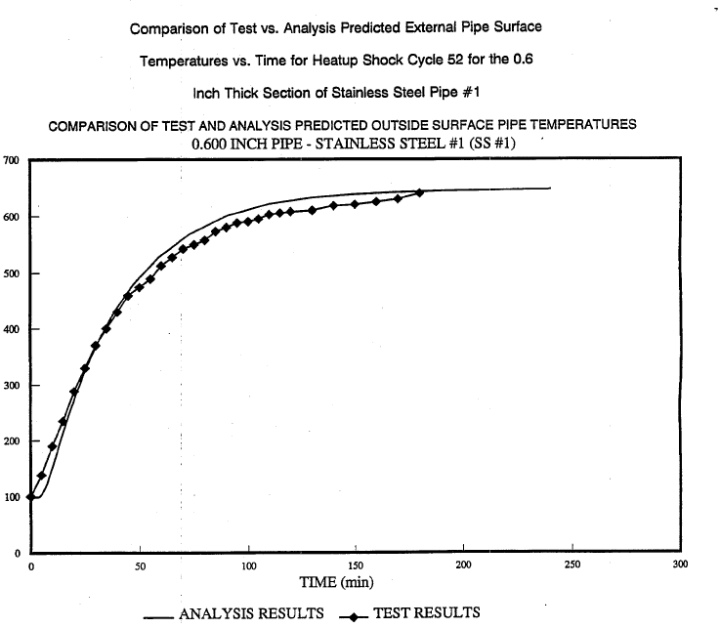
Validation
Hot Shock
Outer wall temperature data reported in “PVP2004-2748” for #SS1 - 15.2mm section.
Thermal analysis verified with comparison to test data for hot and cold shocks.
No test data available for #SS2

Slide 12
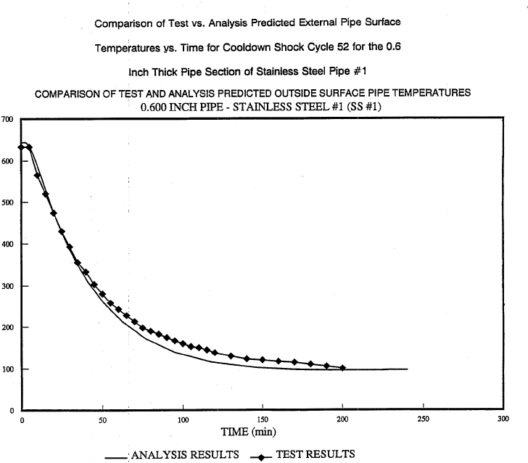
Validation
Cold Shock
Outer wall temperature data reported in “PVP2004-2748” for #SS1 - 15.2mm section.
Thermal analysis verified with comparison to test data for hot and cold shocks.
No test data available for # SS2

Slide 13
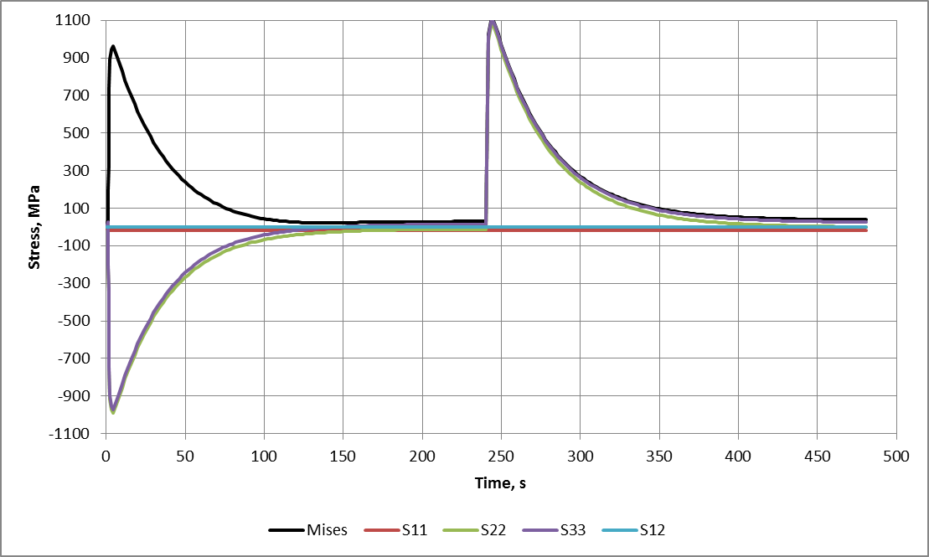
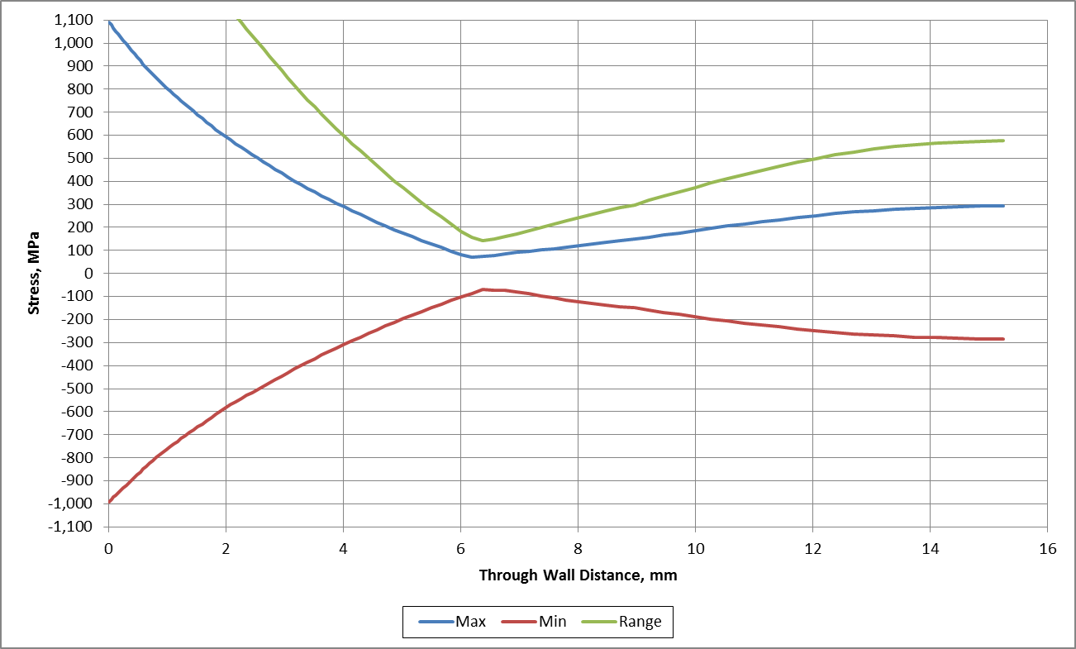
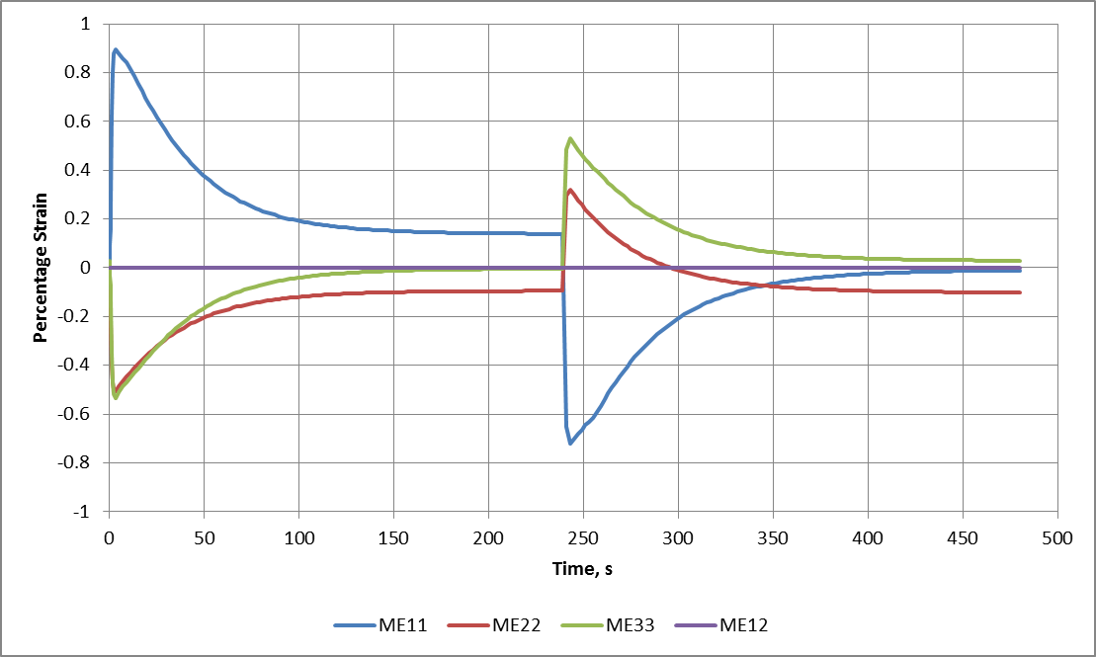
Elastic Stress Results
FE Results
Majority of defects observed in #SS2 which was cycled 2008 times. Therefore this has been analysed.
The stress range quoted in “PVP2004-2748” for #SS1 - 15.2mm section, using a simplified thermal profile was 2032MPa.
Temperature differential is less for #SS2 however actual rate is faster.
The resulting FE stress range is 2080MPa which is comparable noting the aforementioned differences in the analyses.
Elastic-Plastic Stress Results
Last cycle data.
Thermal profile was cycled 20 times to ensure a stabilised strain range was established.

Slide 14
04
Input Data and Sampling
Section Content
FE Output Extractions and Sampling Details
Relevant Formulae
Distributions for 1E+06 Samples

Slide 15
Extracted Fatigue Initiation Data
Data extracted for surface location only.
Elastic and plastic strain histories
Elastic stress histories
Nodal temperature history
Extracted Fatigue Crack Growth Data
Data extracted through wall.
Elastic stress histories
Nodal temperature histories
Reference Data Calculations
Data required to scale various distributions.
Reference data calculated at mean surface temperature.
Young’s modulus, E
Coefficient of thermal expansion, α
Property Sampling
All sampling was completed using truncated distributions to sample within a 95% bound of the data (two tailed).
α – used to scale strain amplitudes for initiation assessments and stresses for FCG stress preconditioning profiles.
E – used to scale SIFs for FCG calculations. Initiation strains are not scaled by E.
Langer Equation A Parameter
FCG Law C2 Parameter
Seeded Cases (Deterministic Runs)
Four cases are seeded into every assessment (requested samples + seeds)
Best Estimate – this is the life prediction obtained when using mean input data.
SJ Estimation – this is the life prediction obtained using SJ input data (excluding stress-strain data)
ASME III Estimation – as SJ Estimation except using Section III strain measure (MTP)
ASME VIII Estimation – as SJ Estimation except using Section VIII strain measure (ESR)
FE Output Extractions and Sampling Details

Slide 16
Young’s Modulus
E (GPa) = -0.0683 * T + 196.23
Normal Distribution, SD = 8.493
97.5% Bound = ± 19.02
Coefficient of Thermal Expansion
Equation for 0 - 20°C
α (x10⁻⁶ m/(m°C)) = -1E-05 * T^2 + 0.0122 * T + 15.3
Normal Distribution, SD = 0.1236
97.5% Bound = ± 0.28
Langer Equation A Parameter
Mean A = 6.891
Lower Bound A = 4.4
Normal Distribution, SD = 0.54
No Bound Used
FCG C2 Parameter
Mode C2 = 1.68E-05
Wiebull Distribution Used
C2 = 1.88E-05 * 10^((2.97 * (-LN(1 - X))^(1 / 18)) – 3)
X is uniformly distributed between 0.01 – 0.99
Provides a 99% Bound
Parameter Correlations
At present Materials Chemistry and Corrosion are unable to provide any correlation between the sampled distributions.
Distribution of α is small therefore sampling based on E would make negligible difference.
Relevant Formulae
The average surface temperature was calculated at ~188°C
Random sampling has been used in script

Slide 17
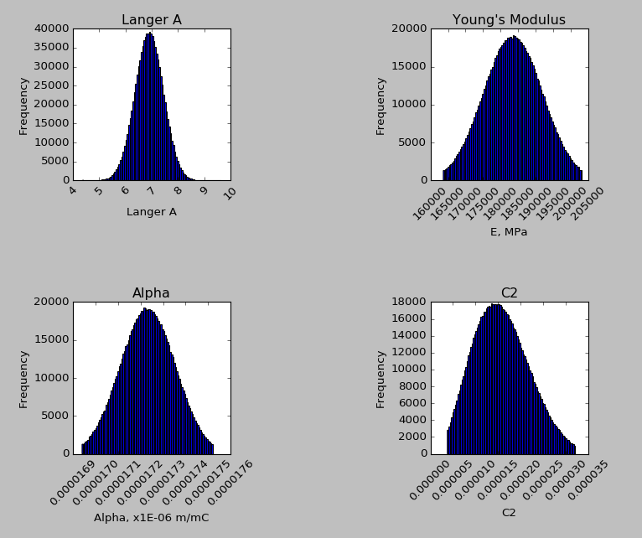
Distributions for 1E+06 Samples
Capping of sampled data evident in obtained input distributions.
For subsequent runs the truncation to data was removed!

Slide 18
05
Fatigue Initiation
Section Content
Strain Calculations
Function Verification
Allowable Cycles
FEN Calculation
SNW Calculation
A0 Cycles Calculation
Initiation Results
#SS1-1
#SS2-1
#SS2-2

Slide 19
Best Estimate Strain Measure - MSPMS
Strain range in the plane of maximum stress. For thermal shocks radial stress is small.
$$∆εBE = MAX(|∆εyy|, |∆εzz|)$$
Safety Justification Strain Measure - ETSR
The FDM prescribes the use of NH-T-1413 strain measure Equivalent Total Strain Range.
$$∆εETSR =\frac{\sqrt{2}}{3}{\left[{\left({∆ε}_{xx}−{∆ε}_{yy}\right)}^{2}+{\left({∆ε}_{yy}−{∆ε}_{zz}\right)}^{2}+{\left({∆ε}_{zz}−{∆ε}_{xx}\right)}^{2}+\frac{3}{2}{{∆ε}_{xy}}^{2}\right]}^{1/2}$$
ASME III Strain Measure - MTP
ASME Section III prescribes the use of the Maximum Total Principal strain range.
$$∆εMTP = MAX(|∆ε1|, |∆ε3|)$$
ASME VIII Strain Measure - ESR
ASME Section VIII prescribes the use of the Effective Strain Range.
$$∆εESR =\frac{∆Sp}{E}+∆ε_{peq}$$
$$∆εpeq =\frac{\sqrt{2}}{3}{\left[{\left({∆εp}_{xx}−{∆εp}_{yy}\right)}^{2}+{\left({∆εp}_{yy}−{∆εp}_{zz}\right)}^{2}+{\left({∆εp}_{zz}−{∆εp}_{xx}\right)}^{2}+\frac{3}{2}{{∆εp}_{xy}}^{2}\right]}^{1/2}$$
Strain Calculations
Principal planes orientated with global axes.
Four strain measure have been calculated.
Only the BE strain measure is used for sampled assessments.
For thermal shocks v = 0.5.
Ranges are calculated at times of maximum and minimum strain conditions.
Only one shear component available in 2D axisymmetric analyses.
MSPMS measure scaled based on ratio of assessment alpha to alpha at average surface temperature

Slide 20
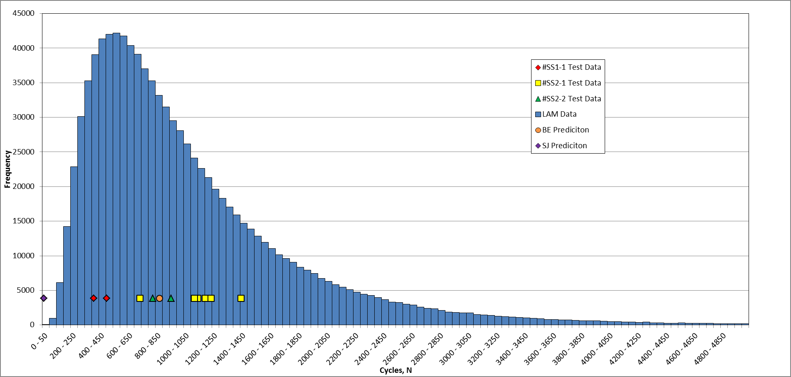
Plot of Initiation Life (a = 0.254 mm)
Results for Stepped Pipe Initiation - #SS2-1
Initiation life data presented in “PVP2004-2748” and test report
Y value for Test, BE and SJ data sets is arbitrary.
BE and SJ data points are not included in the plotted histogram of initiation lives.
Compare to yellow data points (observed defects in #SS2-1)
Method:
Exclude seeded cases (BE, SJ, etc)
Sort initiation cycles smallest to largest
Count down X rows
X = % Confidence * Samples / 100
Read off cycles
 |  | Predicted Cycles to Reliability value:
 |  | 0.1 | 0.01 | 0.001 | 0.0001
Samples | 1E+03 | 102 | - | - | -
 | 1E+04 | 95 | 56 | - | -
 | 1E+05 | 100 | 71 | 50 | -
 | 1E+06 | 100 | 68 | 49 | 37
Prediction for 1E-03 (or 0.1%) consistent with varying sample size at about 100 cycles

Slide 21
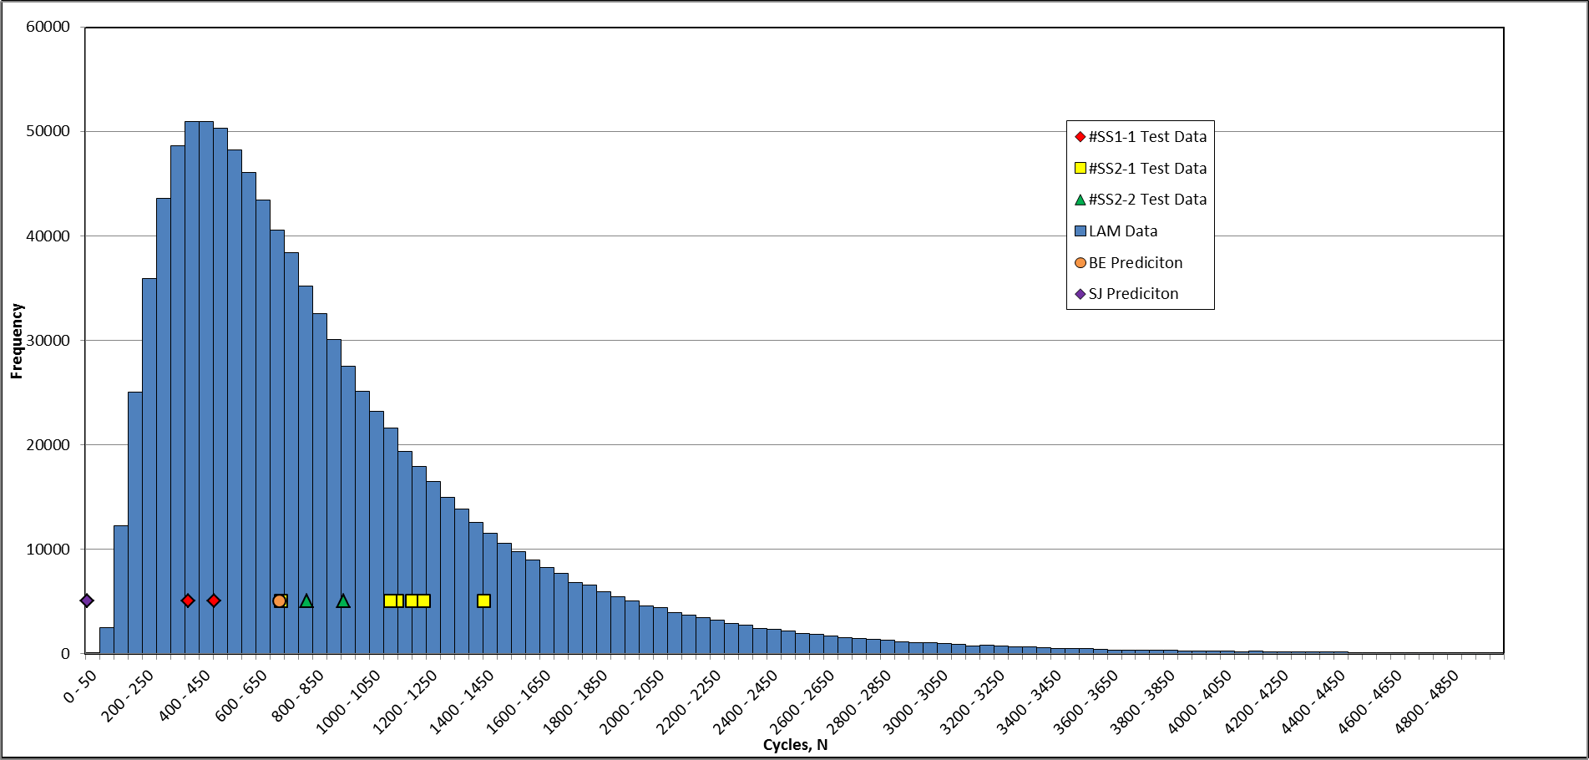
Plot of Initiation Life (a = 0.254 mm)
Results for Stepped Pipe Initiation - #SS1-1
Initiation life data presented in “PVP2004-2748” and test report
Compare to red data points (observed defects in #SS1-1)
Test data (red) appears to fall either side of the mode.
Again the BE prediction is greater than the mode of the LAM initiation data

Slide 22
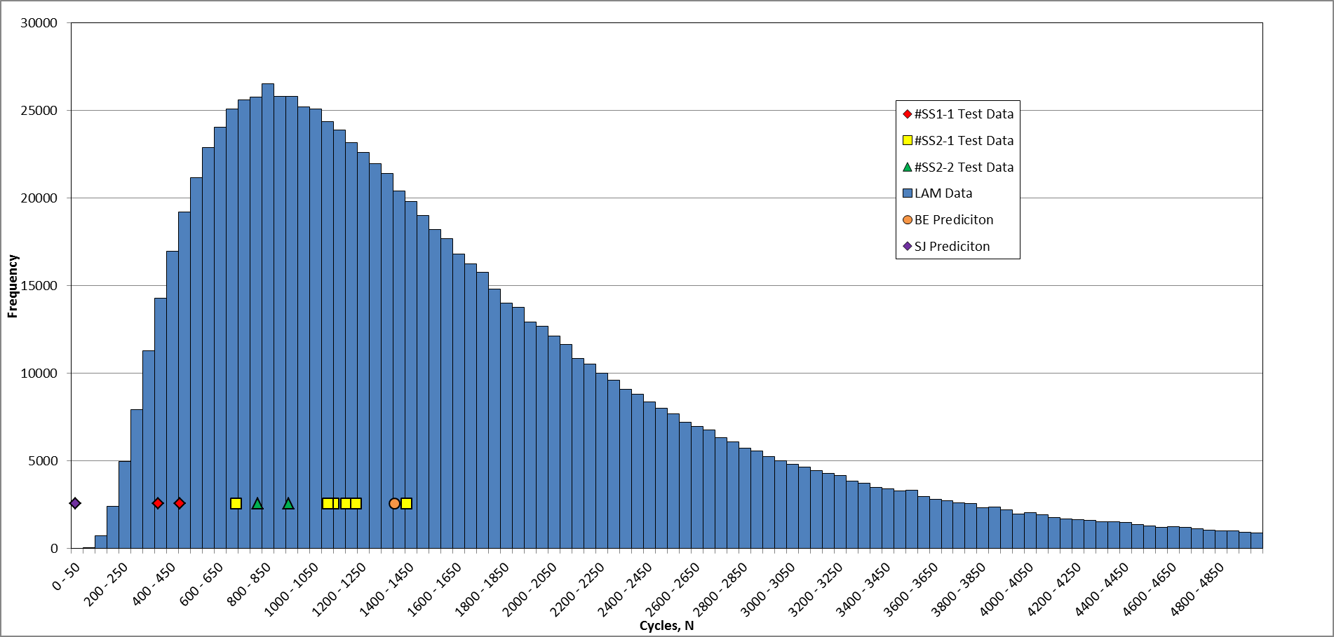
Plot of Initiation Life (a = 0.254 mm)
Results for Stepped Pipe Initiation - #SS2-2
Initiation life data presented in “PVP2004-2748” and test report
Compare to green data points (observed defects in #SS2-2)
Test data (green) appears to fall either side of the mode.
Again the BE prediction is greater than the mode of the LAM initiation data

Slide 23
06
Fatigue Crack Growth
Section Content
API579 SIF solutions
C_{ENV} Calculation
Accounting for Crack Closure
FCG Calculation
FCG Results

Slide 24
07
Total Life
Section Content
Overview of initiation calculation
Input data
Strain calculation
0.25mm SN definition

Slide 25
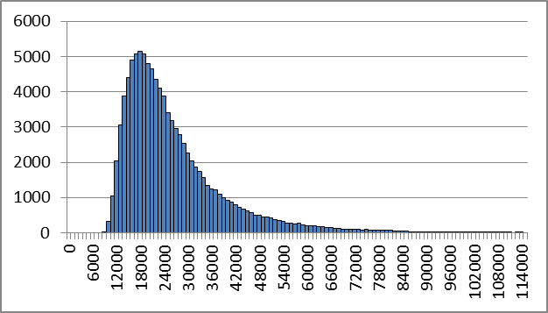
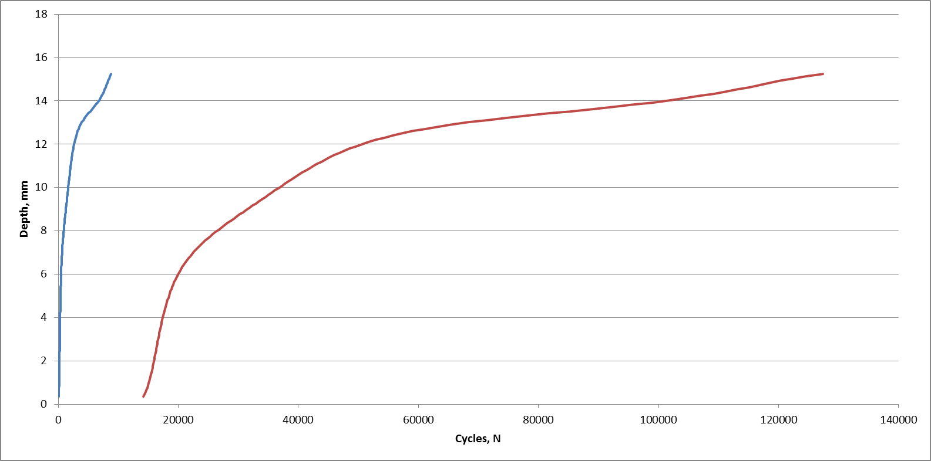
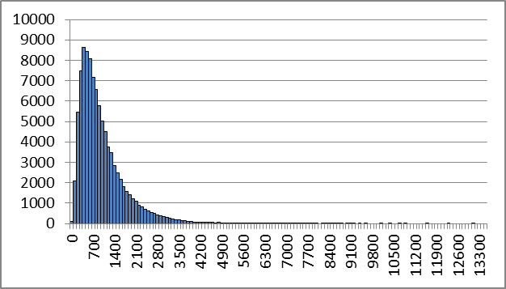
Change in slope indicates uncertainty in reliability of result for crack depths >80% wall thickness
Total Life #SS2-1
Distributions for 100,000 simulations.
Cycles to initiate a defect of 0.254mm with a probability of 1E-04 is 68
Cycles to through wall leak with a probability of 1E-04 is 9807
Blue and red lines indicate the min and max results varying with crack depth. Top RHS is distribution at leakage and lower RHS is distribution at 0.25mm initiation.

Slide 26
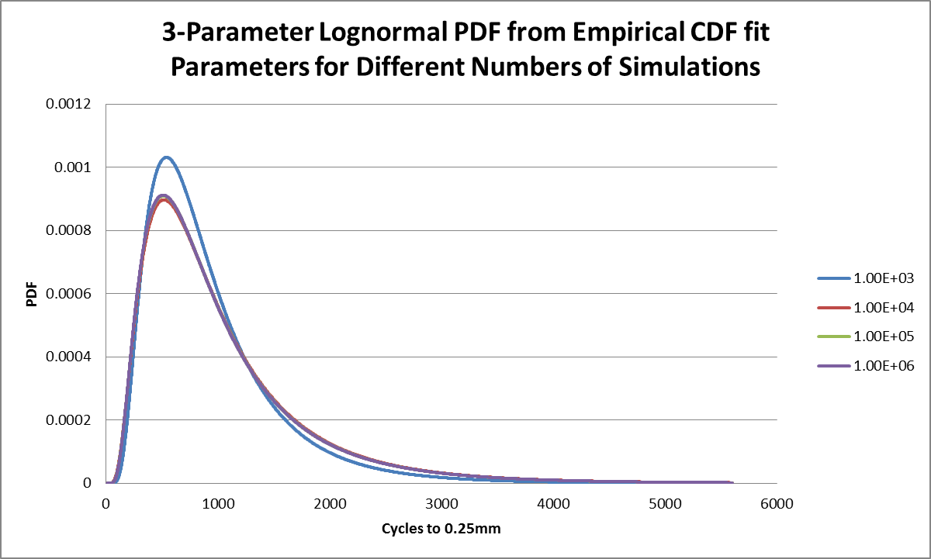

Slide 27
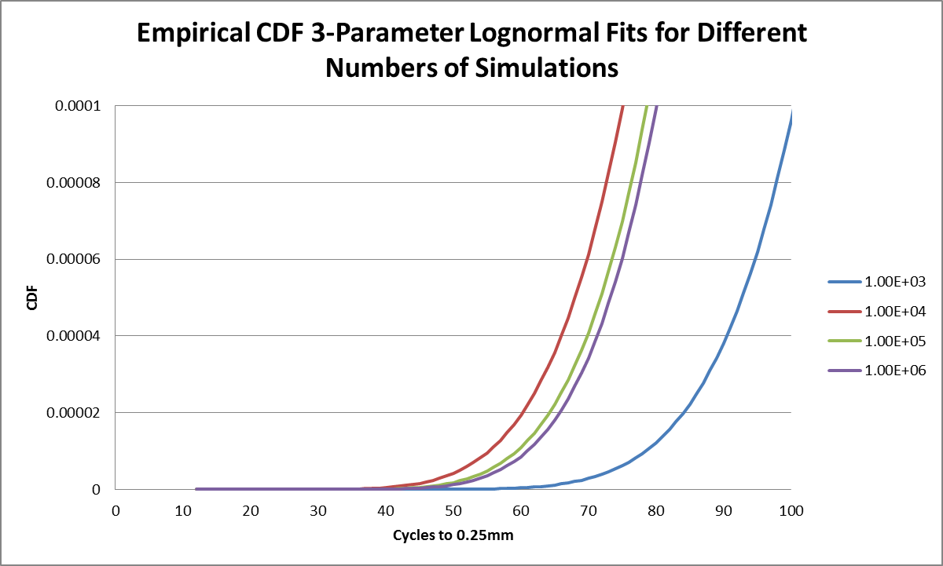

Slide 28
08
Discussion of Results
Section Content
Example 1 – Thick Wall (15mm) Stepped Pipe
Example 2 – Thin Wall (6mm) Pipe

Slide 29
REMINDER OF TOTAL LIFE APPROACH
Depth,
a (mm)
N_{Best Estimate}
N_{allowable}
for particular Target Reliability
Through Wall Leak Distribution
Wall thickness
P_{f}
(Probability of failure)
Possible ISI Experience of Clear Indications
Initiation Distribution
eg
0.25 - 0.5
Cycles, N

Slide 30
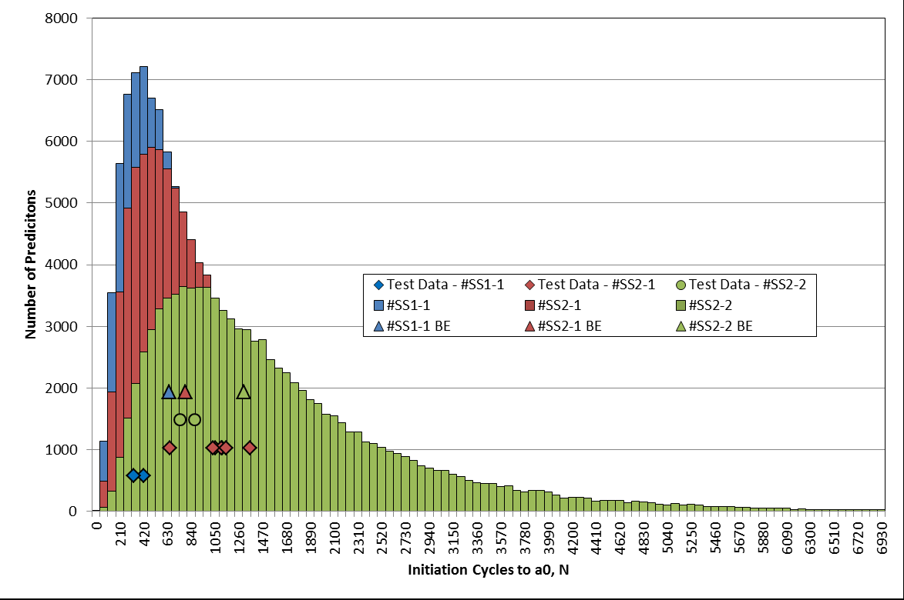
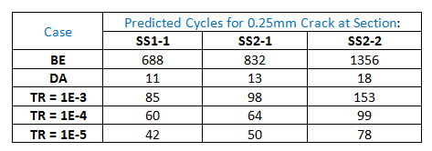
EXAMPLE 1 – Thick Walled Pipe
Stepped Pipe
Predictions (circles and diamonds) agree well with experimental data points for 0.25mm initiated cracks
Best Estimate Predictions (triangles) for the three cases lie to RHS of mode due to distribution shapes

Slide 31
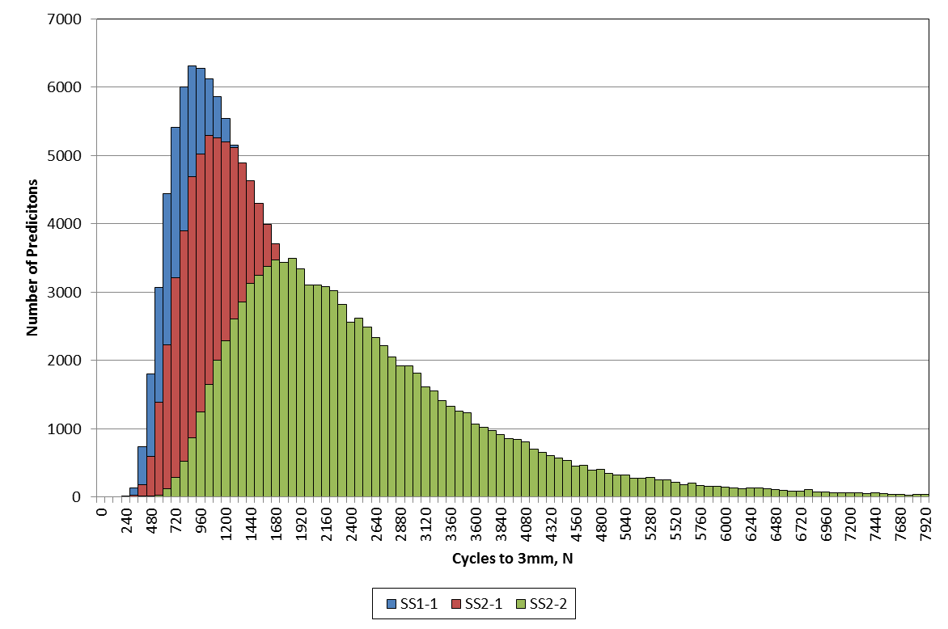
Stepped Pipe
ASME Nureg/CR-6909 result is 33 cycles (to 3mm !)
Implies that the extant DA deterministic methods equates to a quantified target reliability lower than 10⁻⁶
Distributions for Circ Defects Plotted

Slide 32
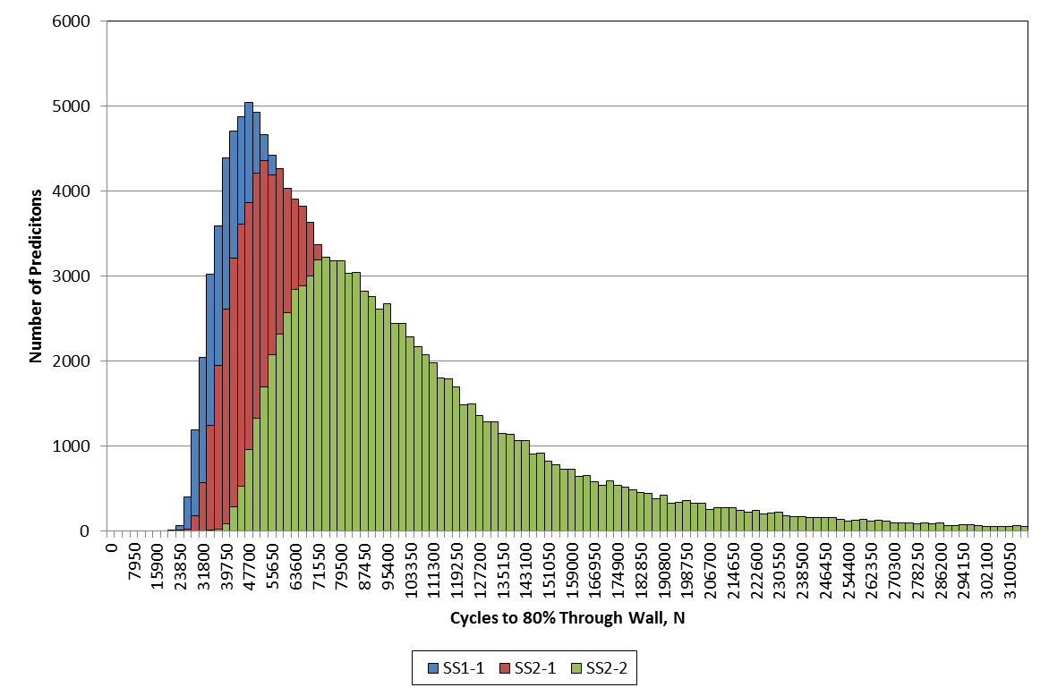
Stepped Pipe
ASME Nureg/CR-6909 result is 33 cycles (to 3mm !)
A Total Life to loss of functionality would allow this to be increased to 10456 cycles (a factor of 250) and still achieve a 10⁻⁵ target reliability against avoidance of leakage
Distributions for Circ Defects Plotted

Slide 33
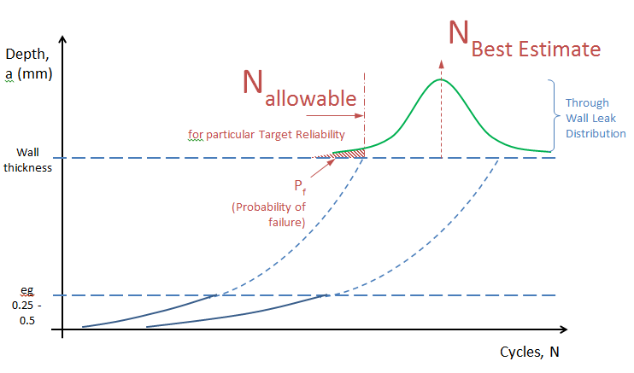
Calibrated Factors on BE Life:
For any target reliability
Factor_{TR} = N_{BE} / N_{allowable}
For 10⁻⁵ target reliability:
Stepped Pipe
Results suggest a single Best Estimate life to leakage (80% thro wall) of similar geometry components, reduced by a factor of say 2.5 would predict a life with a quantified margin equivalent to a 10⁻⁵ target reliability.

Slide 34
Two examples, one thick walled and one thin walled, indicate that the ASME deterministic fatigue methods provide a margin that can be quantified as better than 10⁻⁶
A total life approach (to avoidance of leakage = 80% through wall) provides additional margin. Eg ASME CUF of unity for stepped pipe is 33 cycles when environment considered. Probabilistic prediction to leakage is 25000 cycles (best estimate) or 10000 cycles at a 10⁻⁵ target reliability.
Thick walled specimen total life is 3% initiation (to 0.25mm), 97% FCG. Thin wall specimen total life is 84% initiation (to 0.5mm), 16% FCG. Hence any use of a calibrated factor on BE life needs to be case specific. Geometric similarity for R/t and loading type and magnitude may dictate if factor can be read across.
Significant potential exists with the approach. More validation against other thermal shock loading tests would increase confidence. Further development options identified and ongoing.
Summary

Slide 35
Multi-amplitude loading
Typical assessments contain many different known thermal and pressure transients
Monte Carlo Simulation is a computationally expensive and time-consuming approach to this
Trialling an equivalency method whereby the most life-limiting 3 or 4 transient pairs have occurrence increased to account for damage from other transients (requires full deterministic assessment to be completed first)
Calculating reliability over life of component
Then re-calculating reliability at inspection points using Bayes Theorem
Ongoing work
1E-05
1E-04
Reliability (failures/year)
1E-03
Inspection points
Life Measure

Slide 36
Thank you

