Slide 1
Phase 1 PFM Benchmark of the IAEA CRP I31030 Methodology for Developing Pipe Failure Rates for Advanced Water Cooled Reactors3
Xinjian Duan, Min Wang, Candu Energy Inc., Canada
Klaus Heckmann, GRS, Germany
Robertas Alzbutas, Lithuanian Energy Institute, Lithuania
Dong-Hyun Ahn, KAERI, South Korea
3rd International Seminar on Probabilistic Methodologies for Nuclear Applications
October 22-24, 2019, Rockville, MD, U.S.A

Slide 2

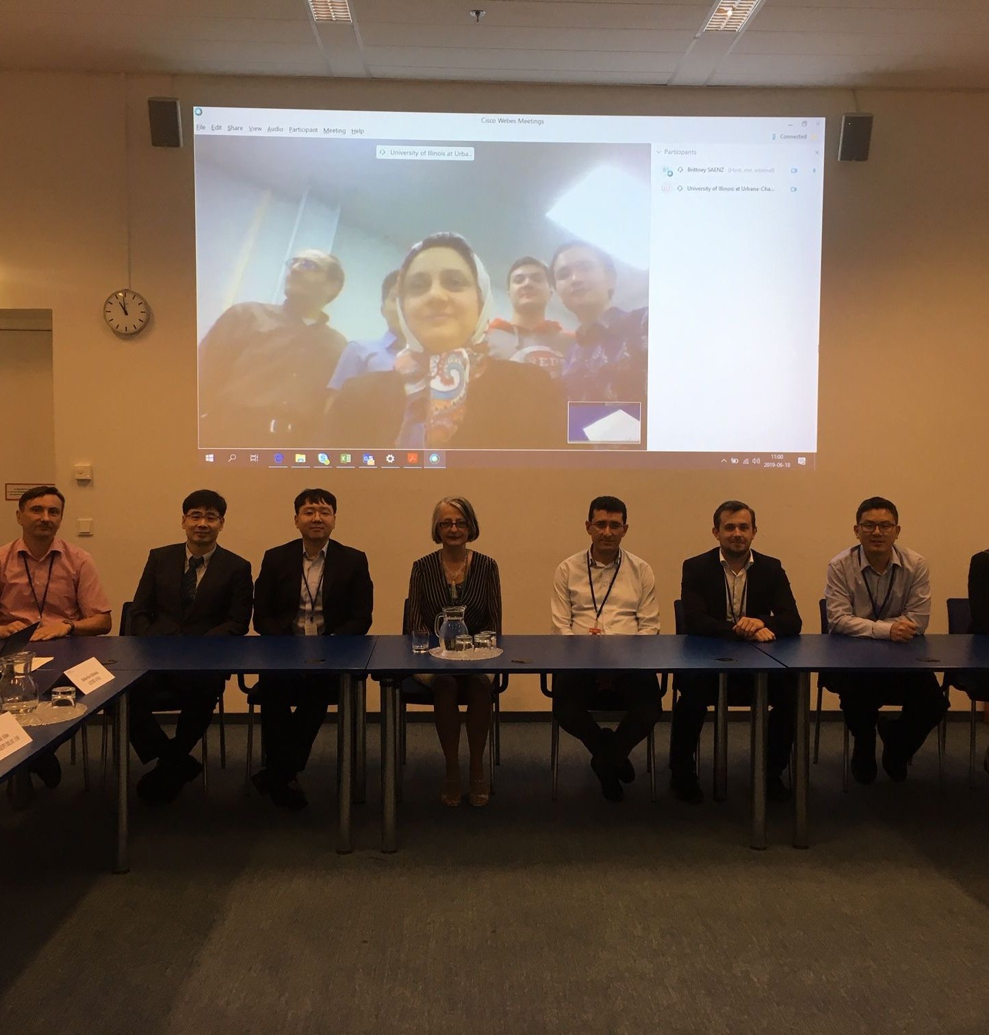
OUTLINE
IAEA CRP I31030: Methodology for Developing Pipe Failure Rates for Advanced Water Cooled Reactors
  Objectives
  Participating Organizations
  Technical Scope
1st Benchmark
  Specification
  Analysis
Concluding Remarks
2nd RCM, Vienna, 2019

Slide 3
OUTLINE
IAEA CRP I31030: Methodology for Developing Pipe Failure Rates for Advanced Water Cooled Reactors
  Objectives
  Participating Organizations
  Technical Scope
1st Benchmark
  Specification
  Analysis
Concluding Remarks
2nd RCM, Vienna, 2019

Slide 4

Objectives of the CRP
Building on current ‘baseline’ – transfer of the know-how from 50+ years of operating WCRs experience to advanced WCRs fostering national excellence and promoting international collaboration among IAEA Member States through the sharing of expertise and participation in benchmark calculations:
  Provide Member States with an open access to a strong technical basis for establishing plant piping reliability parameters in support of the design certification PSA studies, in-service inspection program development, and operational support
  Enable objective evaluation and the benchmark studies by the participating Member States and thus will lead to new knowledge and sharing of research results relevant to prediction of pipe failure rates in newly deployable advanced WCRs
  Develop a “good practices process” for the performance of context-centric piping reliability analyses while recognizing the strengths & limitations of the different methodologies
    Design certification PSA & PSA applications
    Operability determinations
    RIM program development
  Foster national excellence and international cooperation, promote sharing of newly developed knowledge and contribute to capacity building in developing countries

Slide 5
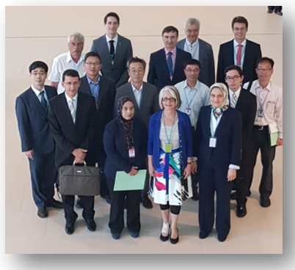
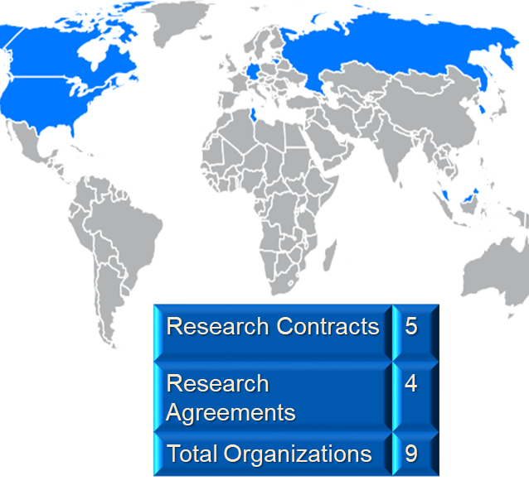
1st RCM, Vienna, 2018
Participating Organizations
Canada
  CANDU Energy Inc.
  Ryerson University
  Canadian Nuclear Safety Commission
Germany
  Gesellschaft für Anlagen- und Reaktorsicherheit (GRS) GmbH
Korea (Republic of)
  Korea Atomic Energy Research Institute (KAERI)
Lithuania
  Lithuanian Energy Institute (LEI)
Malaysia
  Malaysian Nuclear Agency (MNA)
Russia
  Atomenergoproekt, ASE Group
Tunisia
  Tunisian Electric and Gas Company (STEG)
U.S.A.
  Univerisity of Illinois Urbana-Champaign (UIUC)
  Sigma-Phase, Inc.

Slide 6
Technical Scope
Four Activities
  On the basis of the current state-of-knowledge, develop a framework for how to implement a piping reliability analysis task
  On the basis of benchmark results, develop insights & recommendations w.r.t. piping reliability analysis in support of AWCR-centric applications
  Document framework and benchmark results
    IAEA TECDOC
    IAEA Nuclear Energy Series Report
  Conduct Education and Training Workshops

Slide 7
IAEA CRP I30130 – 2018-2022
March 2017 – IAEA Consultants Meeting to define the CRP technical scope, working methods & Schedule
June 2018 – 1st RCM at IAEA
June 2019 – 2nd RCM at IAEA – presentation of results of 1st Benchmark & initial discussions on 2nd Benchmark definition
June 2020 – 3rd RCM at IAEA – presentation of results of 2nd benchmark – planning of remaining tasks
Drafting of TECDOC and Nuclear Energy Series report to begin during the 3rd quarter of 2020

Slide 8
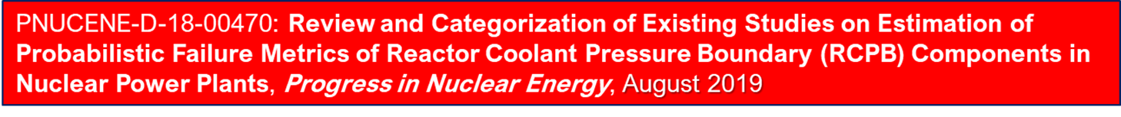
Journal Paper
1st CRP OUTPUT

Slide 9
OUTLINE
IAEA CRP I31030: Methodology for Developing Pipe Failure Rates for Advanced Water Cooled Reactors
  Objectives
  Participating Organizations
  Technical Scope
1st Benchmark
  Specification
  Analysis
Concluding Remarks
2nd RCM, Vienna, 2019

Slide 10
Benchmark Analyses
“Calibration benchmark” based on WCR piping system location for which there exists extensive & well-documented OPEX
        This benchmark was completed in 2019 – evaluation of results is ongoing
Benchmark #2 based on AWCR evaluation boundaries
    RCS Hot Leg dissimilar metal welds
    Pressurizer surge line to RCS Hot Leg branch connection
        No OPEX
        Degradation resistant material – Alloy 690/52/152
        This benchmark has been initiated and is scheduled to be completed during the 2nd quarter 2020

Slide 11
Participating Teams - PFM
Canada (CEI)
  Familiar with multiple PFM codes since 2006
  Performed multiple benchmarks & applications
  Code: PRAISE-CANDU 2.0
Germany (GRS)
  Working with PFM codes since 2001
  Performed multiple benchmarks & applications
  Code: PROST
Lithuania (LEI)
  Familiar with multiple PFM codes since 2000
  Performed multiple benchmarks & applications
  Code: PIFRAP/AutoPIFRAP
  Republic of Korea (KAERI)
  Less than 6-month experience with PFM
  Code: not named yet

Slide 12
Description of the Problem
  System: PWR Chemical & Volume Control System Excess Letdown
  Degradation: SCC
  Environment: RCS Coolant
  Constants:
    Dimensions: Outside diameter (114.0 𝑚𝑚), thickness (10.8 𝑚𝑚)
    Material: austenitic stainless steel weld
    Operating Conditions: Pressure (15.41 𝑀𝑃𝑎), Temperature (345 ℃)
    Operating loads: P_{m}=31.8 𝑀𝑃𝑎, P_{b}+P_{e}=33.7 𝑀𝑃𝑎
    Annual operation time: 8000 ℎ𝑜𝑢𝑟
    Detectable leak rate: 0.3 kg/s
    Crack growth rate (see Slide 13)
    Weld residual stress distribution (see Slide 14)
    Initiation frequency: 4.08×10⁻⁴ per weld per year
  Random variables
    Exponential function for crack length distribution (see Slide 15)
    Probability of detection (see Slide 16)
    Materials properties (Slide 17)

Slide 13
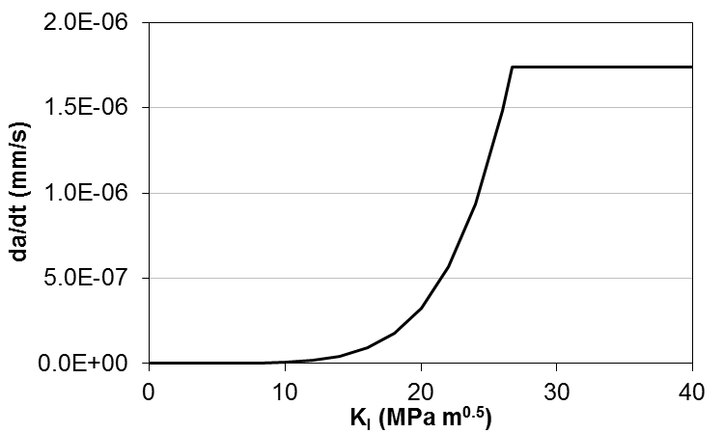

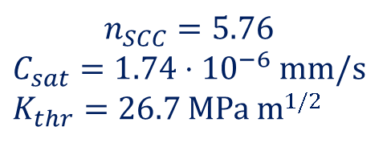
Crack Growth Rate
$$n_{SCC}=5.76$$
$C_{sat}=1.74⋅{10}^{−6}$ mm/s
$K_{thr}=26.7$ MPa m^{1/2}
  $\frac{da}{dt}=\left\{\begin{matrix}C_{SCC}K_{I}^{n_{SCC}} & K_{I}≤K_{thr} \\ C_{sat} & K_{I}>K_{thr}\end{matrix}\right.$
$C_{SCC}=1.05⋅{10}^{−14}$ (MPa m^{1/2})^{-5.76} mm/s

Slide 14
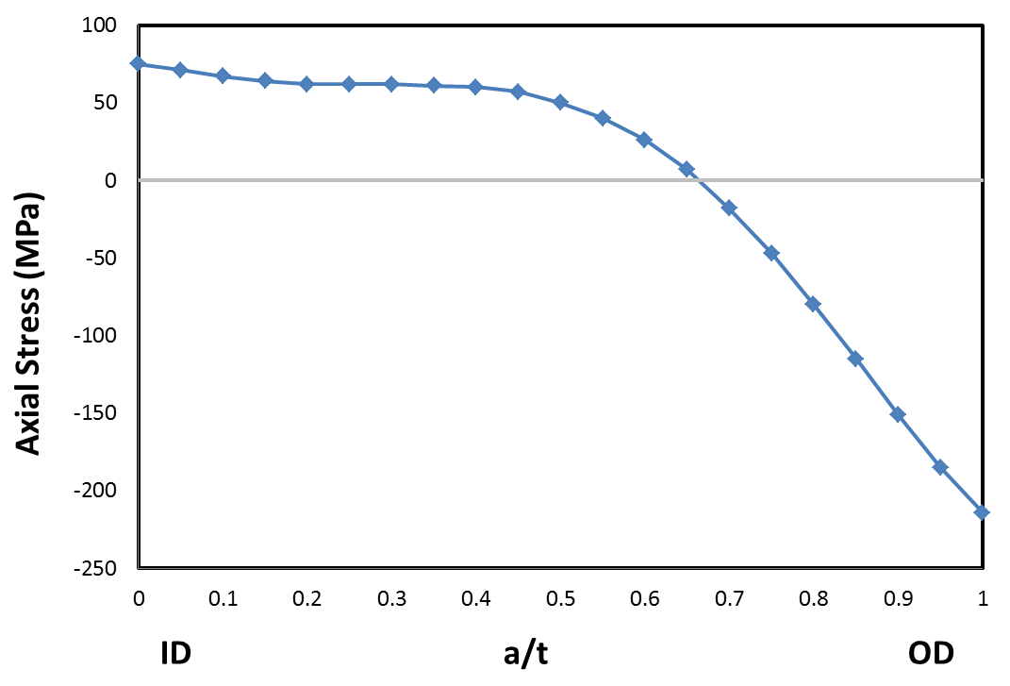
Distribution of WRS
  Constant through-wall WRS distribution

Slide 15
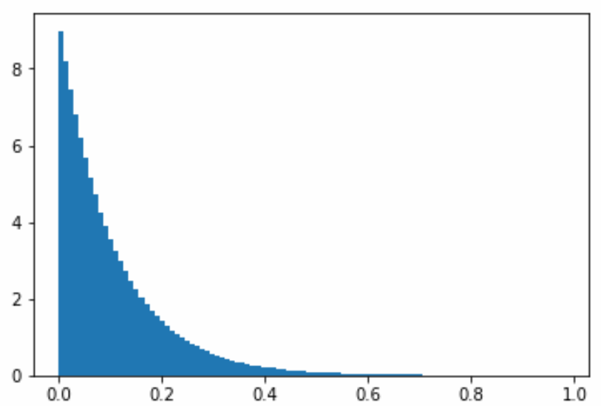







Distribution of Initial Crack Size
  Initial depth: 1 mm
  Exponential crack length distribution
$f= \frac{λ}{2πR_{i}}e^{\left(\frac{−λc_{o}}{2πR_{i}}\right)}{\left(1 − e^{\left(−λ\right)}\right)}^{−1}$, $λ=9.38$
$$a_{o}=1 mm$$
$$2πR_{i}∙f$$
$$a_{o}=1 mm$$
$$c_{o}/2πR_{i}$$

Slide 16
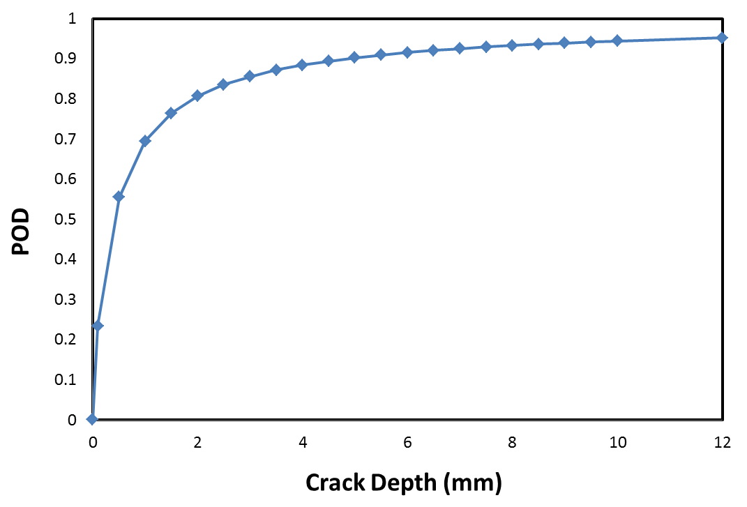


Distribution of POD
  $POD\left(a\right)=\frac{\exp\left(β_{0}+β_{1}\ln{a}\right)}{1+\exp\left(β_{0}+β_{1}\ln{a}\right)}$
$$β_{0}=0.8256$$
$$β_{1}=0.8711$$

Slide 17
Material Properties
  Normal distribution for all random variables
    Yield strength (MPa)
    20°C: 206±21
    300°C: 130±13
    Ultimate strength (MPa)
    20°C: 515±30
    300°C: 495±30
    Fracture toughness (MPa·√m)
    20°C: 239±18
    288°C: 182±14

Slide 18
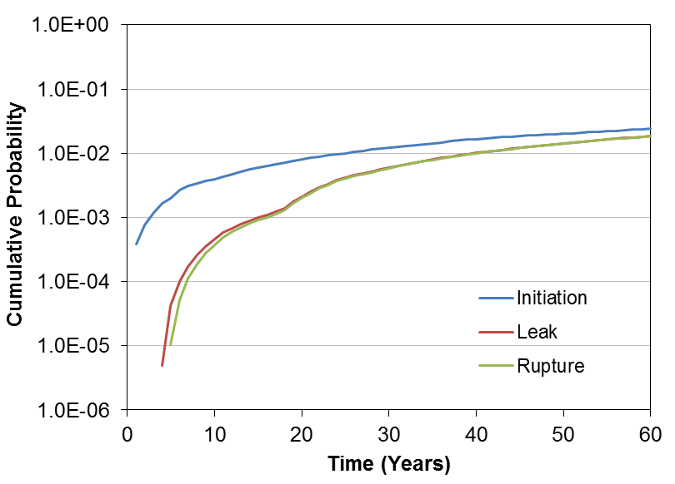
Cumulative Probability
  Calculated using PRAISE-CANDU 2.0
  Base case: no ISI, no leak detection

Slide 19
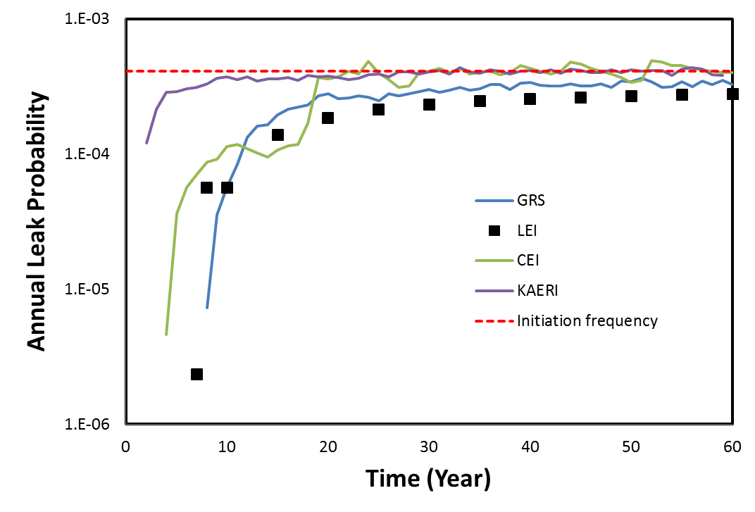
Leak Frequency w/o ISI & LD
  Leak and rupture frequency should approach to the initiation frequency over long term, the results make sense.
  KAERI shows earliest leaks, GRS latest, CRI and LEI in between

Slide 20
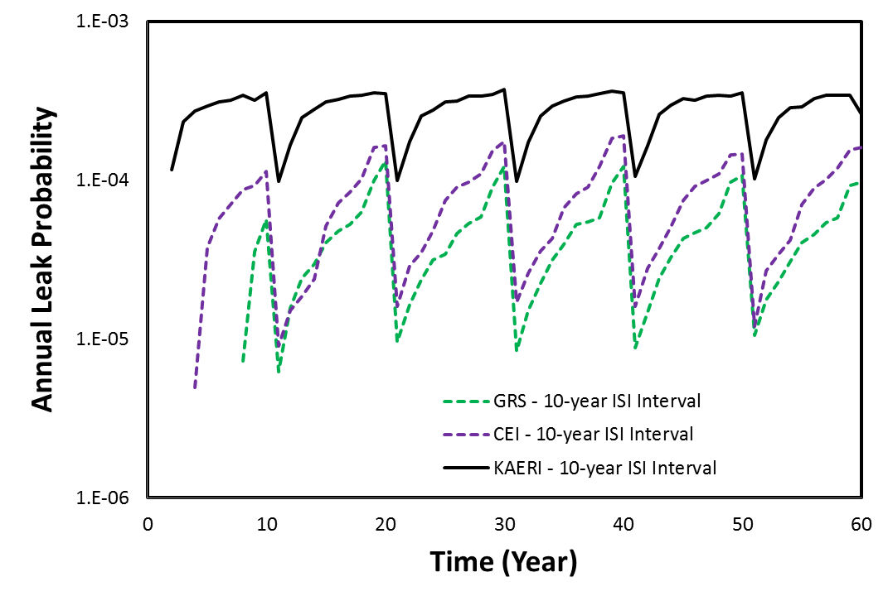
Leak Frequency with 10-year ISI
  GRS and CEI results agree well.

Slide 21
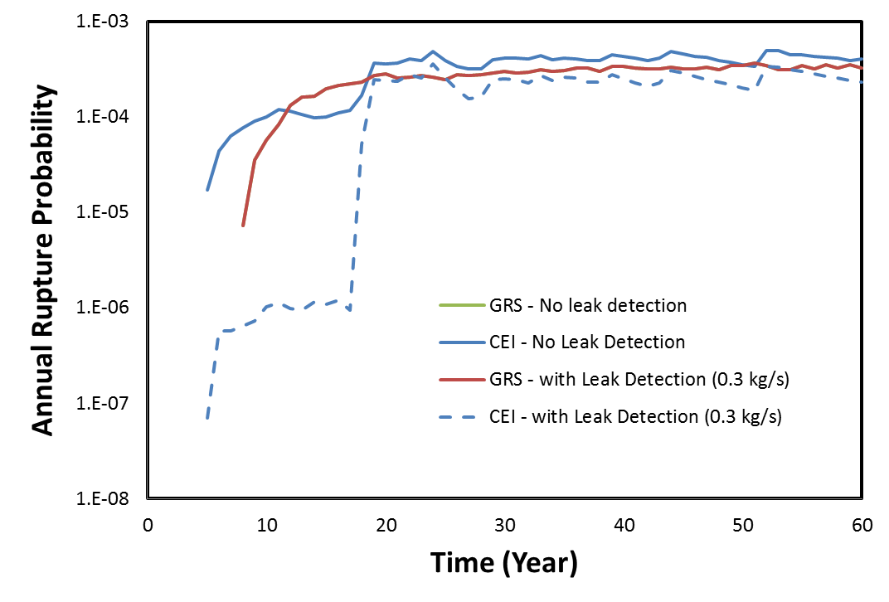
Effect of Leak Detection
  GRS results shows no impact of leak detection
CEI results caused by crack transition

Slide 22
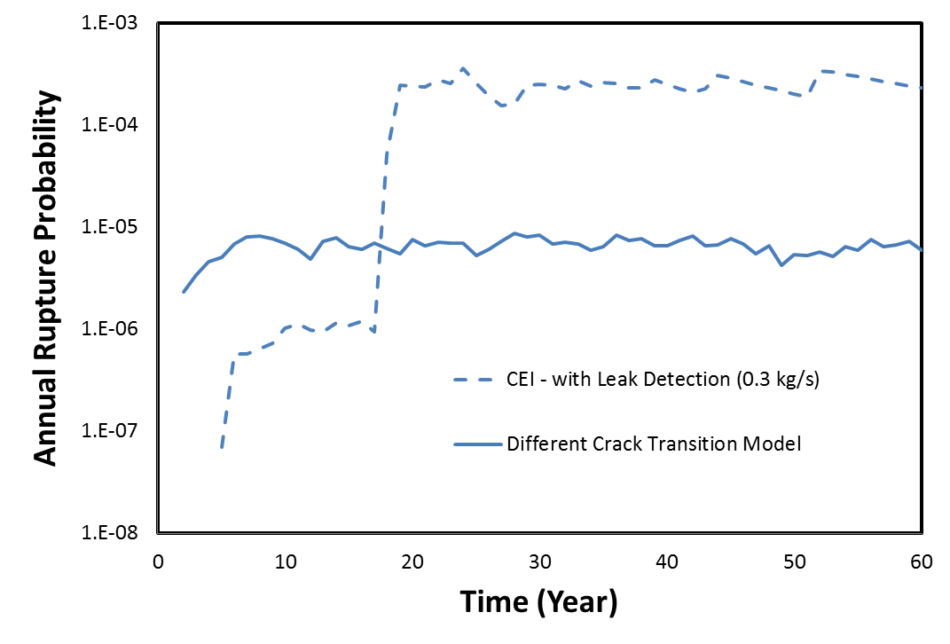
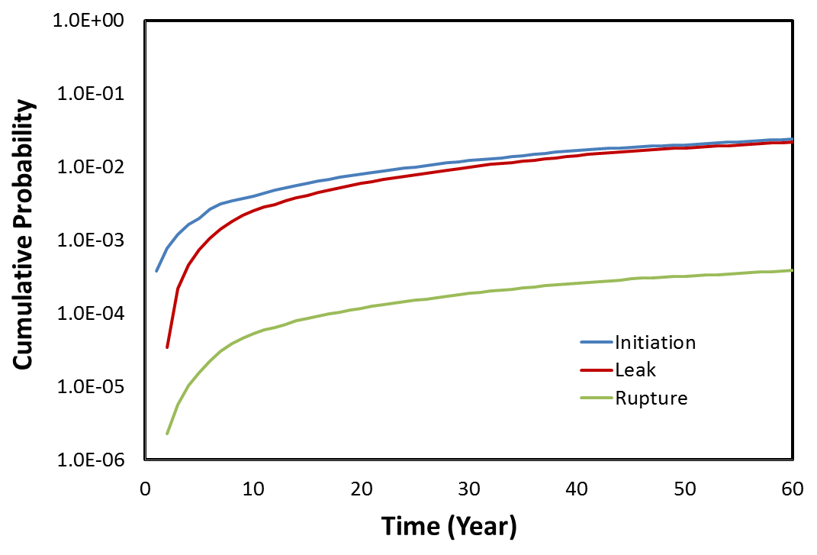
Crack Transition
  When K-solution is invalid for a surface crack, crack length is assumed as 360° . This creates discontinuity in the plot.
Different K-Solutions
With crack transition

Slide 23
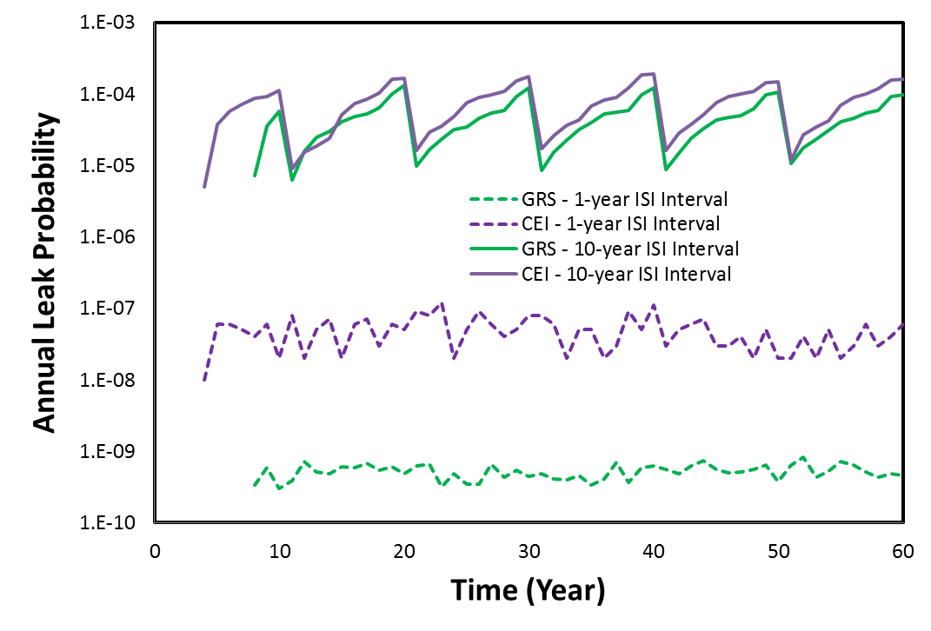
Effect of Inspection Interval
  Dramatic impact of inspection interval, large difference does exist

Slide 24
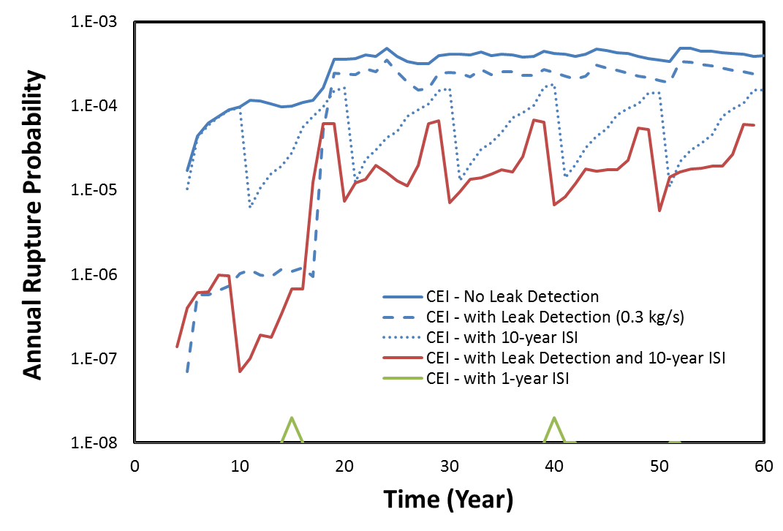
Effect of ISI and LD
  Inspection is a more effective mitigation strategy

Slide 25
Deterministic Calculations
  To better understand the probabilistic results, some deterministic calculations were performed to verify the K-value and critical crack length
  Higher K value results fast crack growth and hence short time to leak
 |  | CEI-FFS-1 | GRS-IWM | GRS-R6
Stress (MPa) |  | 61.2 | 61
K_{a} (deepest point) (MPa·m^{1/2}) |  | 10.33 | 7.85 | 7.72
K_{b} (surface point) (MPa·m^{1/2}) |  | 4.44 | 3.50 | 3.42

Slide 26
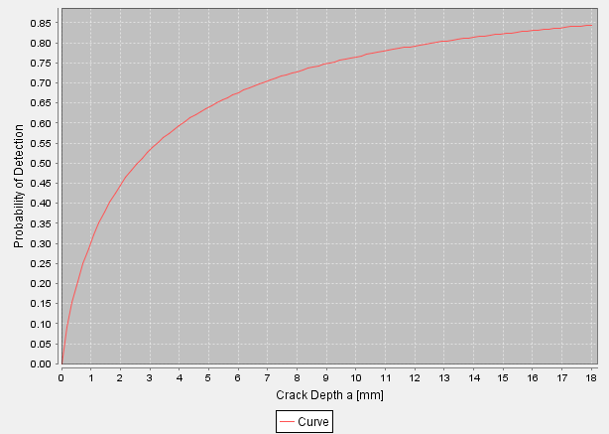
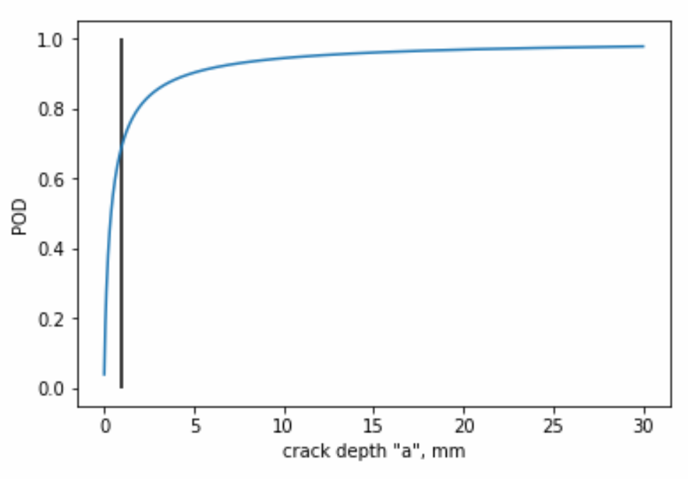
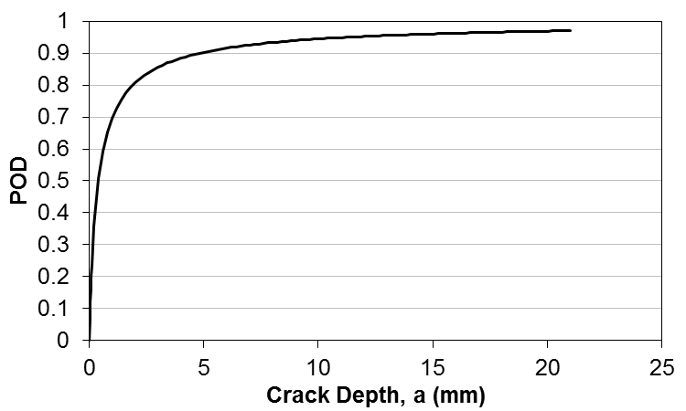
Implementation of PODs
  POD implemented differently, due to the ambiguity in the specification

Slide 27
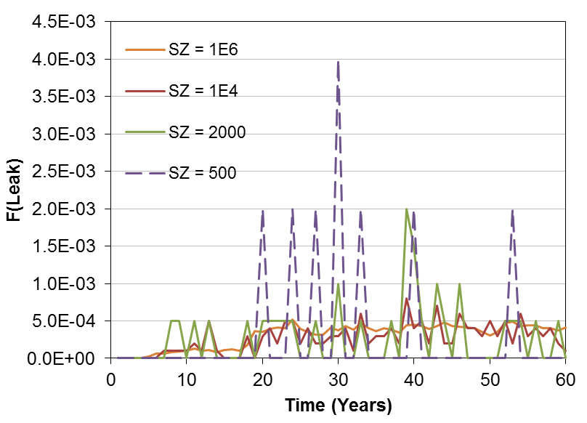
Effect of Sample Size
  Constant initiation frequency (4.08×10⁻⁴ /weld/year) was prescribed
  PRAISE-CANDU adopts physical based initiation model, model calibration required. Sample size is an important consideration.

Slide 28
Comparison of PFM Models
  It is necessary to compare crack modules, as shown below
 | GRS | CEI | KAERI
K for SC | IWM-Report Z 11/95 | ASME FFS-1 2016 | RCC-MR 2007
K for TWC | SINTAP | Journal of Pressure Vessels and Piping, Vol. 79, 2002, pp.385-392 | RCC-MR 2007
Formation of TWC | 100%tw SINTAP Level 1 FAD | >95%tw | >80%tw
Stability Model | The critical crack length from the flow stress concepts of MPA and KWU SINTAP level 1 FAD Crack length of 360° | Net-section collapse J-tearing | Not checked
SC: surface crack
TWC: through-wall crack
FAD: failure assessment diagram

Slide 29
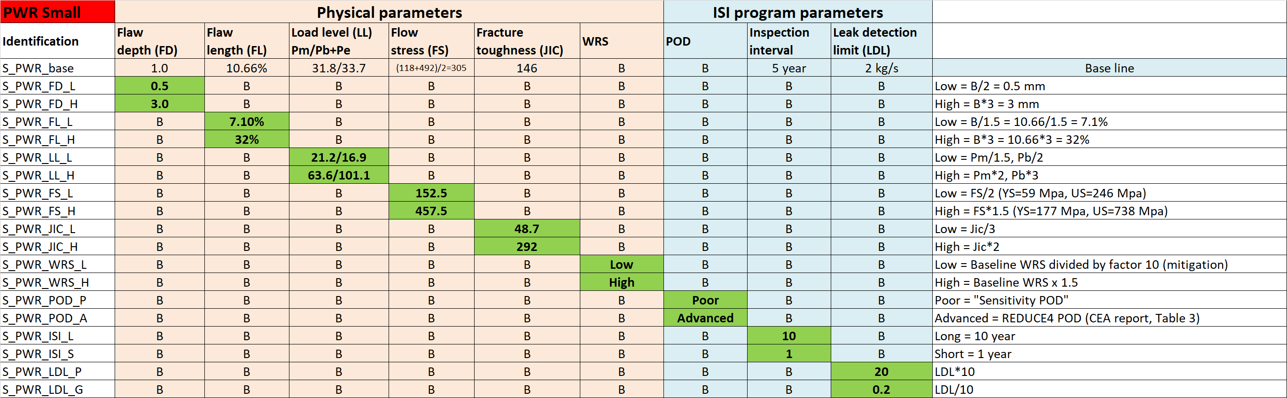
Some Sensitivity Studies
  Performed by LEI

Slide 30
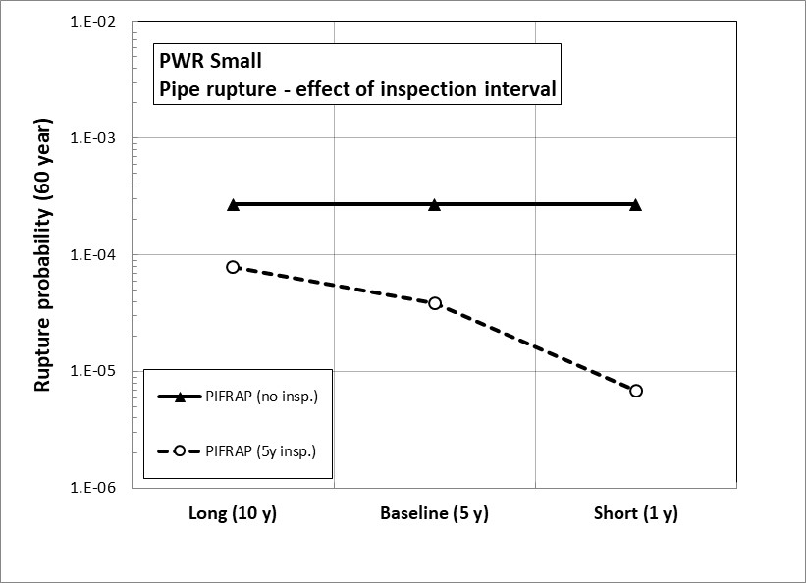
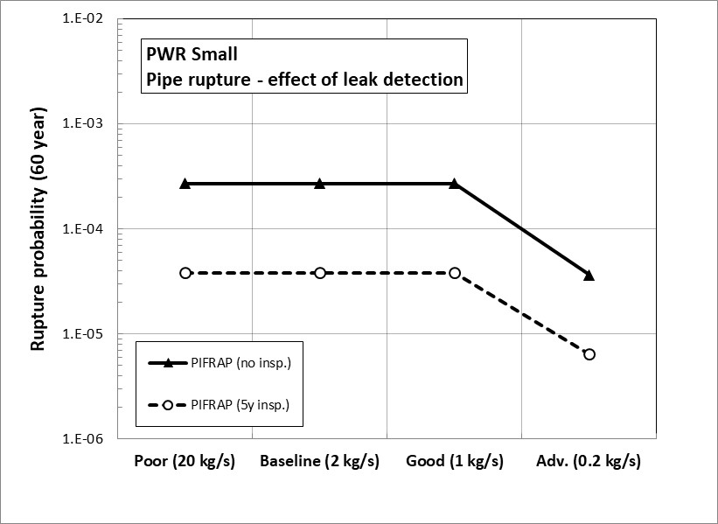
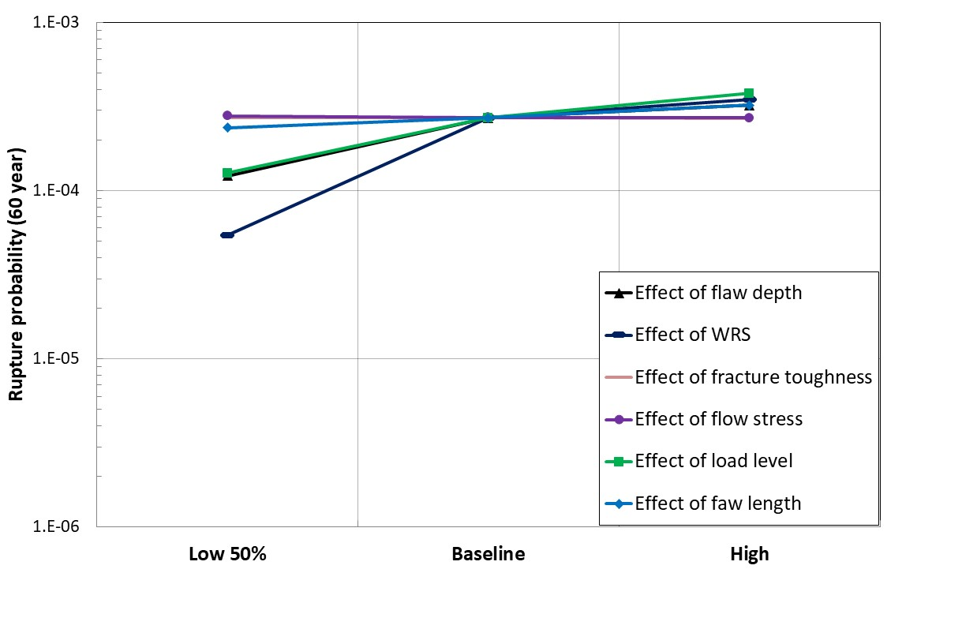
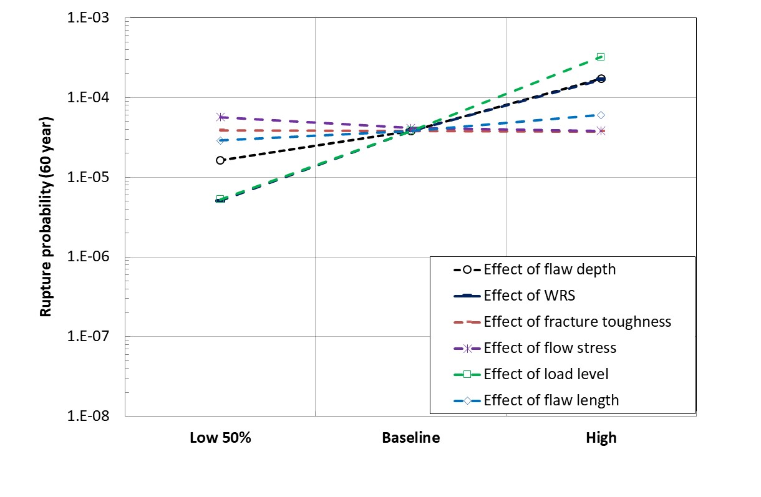
Some Sensitivity Studies
No ISI
5-Year ISI

Slide 31
Ranking of Important Parameters
  Ranking based on impact on rupture probability
  Methodology:
    GRS: E. Roos et al., SMiRT18 , 2005
    CEI-1: D. Somasundaram et al., SMiRT25, 2019.
    CEI-2: X. Duan et al., Nuclear Engineering and Design, V281, 2015
  Ranking of random variable:
    Initial crack length (GRS & CEI-1 rank it as most important)
    Initiation time (CEI-2 ranks it as most important)
    Material properties (Least important from all 3 methods)

Slide 32
OUTLINE
IAEA CRP I31030: Methodology for Developing Pipe Failure Rates for Advanced Water Cooled Reactors
  Objectives
  Participating Organizations
  Technical Scope
1st Benchmark
  Specification
  Analysis
Concluding Remarks
2nd RCM, Vienna, 2019

Slide 33
Concluding Remarks
Much better understanding of the strengths and weakness of the 4 independently developed PFM codes
    Many obvious differences in fracture mechanics models
    Two orders of difference are expected for some leak detection and ISI combinations
    The different results are expected and explainable
Solid basis for the 2nd benchmark case
    To focus on DDM-to-PFM/PPoF benchmark
    All methods tested in 1st benchmark
Lessons learned
    Active task leads are key for the success

Slide 34
Thank You!
For additional information contact:
T.Jevremovic@iaea.org
M.Krause@iaea.org

