Slide 1

Estimation of the Impact of Pipe Diameter on Rupture using xLPR
David L. Rudland, Ph.D.
Senior Level Advisor for Materials
Division of Materials and License Renewal
Office of Nuclear Reactor Regulations
U.S. Nuclear Regulatory Commission
3rd International Seminar on
Probabilistic Methodologies for Nuclear Applications
October 22-24,2019 Rockville, MD.
The view expressed herein are those of the authors
and do not reflect the views of the U.S. Nuclear Regulatory Commission

Slide 2
Purpose
To support ongoing ACRS meetings, verify the pipe rupture frequencies in NUREG-1829, and investigate the impact of pipe diameter on the pipe rupture frequencies using the xLPR code
Tasked with this early summer, results needed end of summer - Limited study due to time constraint

Slide 3
Work Plan
Several NRR/RES staff gathered necessary information and ran xLPR Version 2.
  Seung Min, Dave Dijamco, Rob Tregoning, Matt Homiack
Started with two cases – RPV hot leg-to-nozzle and surge piping-to-nozzle
  xLPR team had complete input deck for RPV hot leg nozzle DM weld
  Difficulty in developing transients for surge line
Many results generated, but this presentations focuses on one set of results

Slide 4
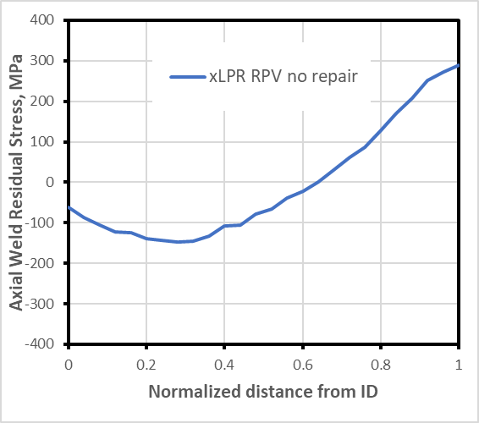
Base input – per xLPR input group
OD=34 inch (864mm), t=2.6 inch (66mm)
Alloy 82/182, Dissimilar metal weld
605F (318C), 2,250 psi (15.5MPa)
Operating load – 20ksi (138MPa) bending, membrane 0.5ksi (3.4MPa)
Earthquake loading considered – 0.0002/yr
Typical transients considered – impact to fatigue trivial
10Yr ISI with no mitigation
1GPM leak detection
PWSCC initiation – Direct Model 1
1.5mm deep, 4.8mm long
Circumferential cracks

Slide 5
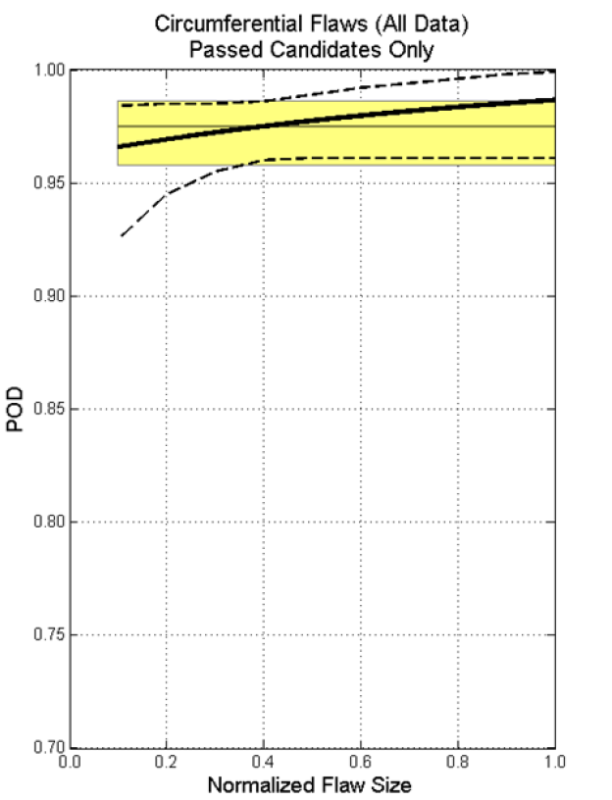
What was random?
Appropriate material and flaw growth properties/parameters – per xLPR input group
Wall thickness, flaw size, temperature – small variations
Weld residual stress
POD – MRP-262 R1

Slide 6
Focus
Quantity of interest was pipe rupture with leak detection and in-service inspection
LOCA results generated but limited presented here
  SBLOCA any leak > 100GPM
  MBLOCA any leak > 1500GPM
  LBLOCA any leak > 5000GPM
Vary diameter keeping R_{i}/t and all other inputs same

Slide 7
xLPR Run-time Issues
Typically used 10,000 realization, but maximum of 100,000 realizations before memory issues
Using PWSCC initiation model – No rupture with leak detection found even with importance sampling on stress and crack growth
Decided to use pre-existing defects, probabilistic results are conditional on the occurrence of the pre-existing defect

Slide 8
Initial Analysis Matrix
Why so many initial flaws?? – This many flaws were needed to get LOCA/Rupture within 10,000 realizations
%cracked = % of circumference with cracks

Slide 9
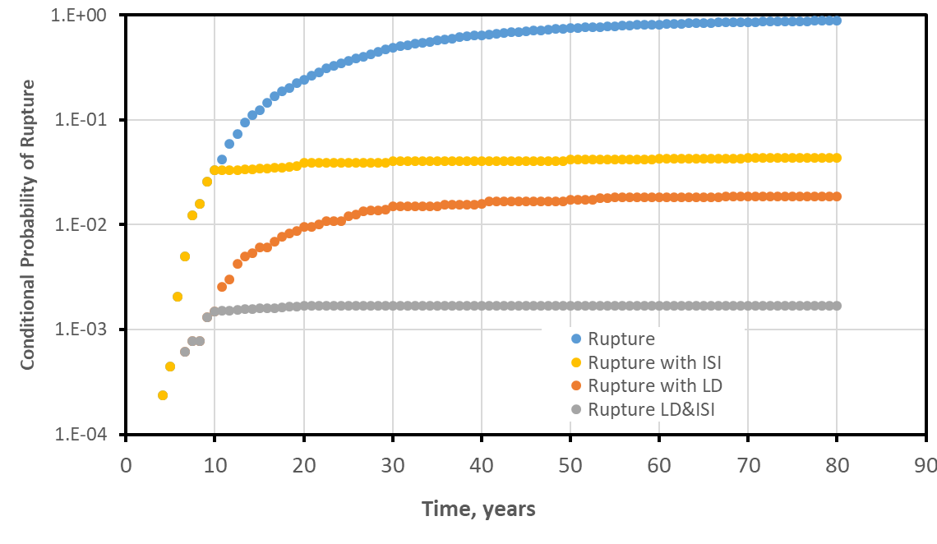
Looking at Rupture – Case 2
10 yr ISI
Large diameter, 5 big cracks

Slide 10
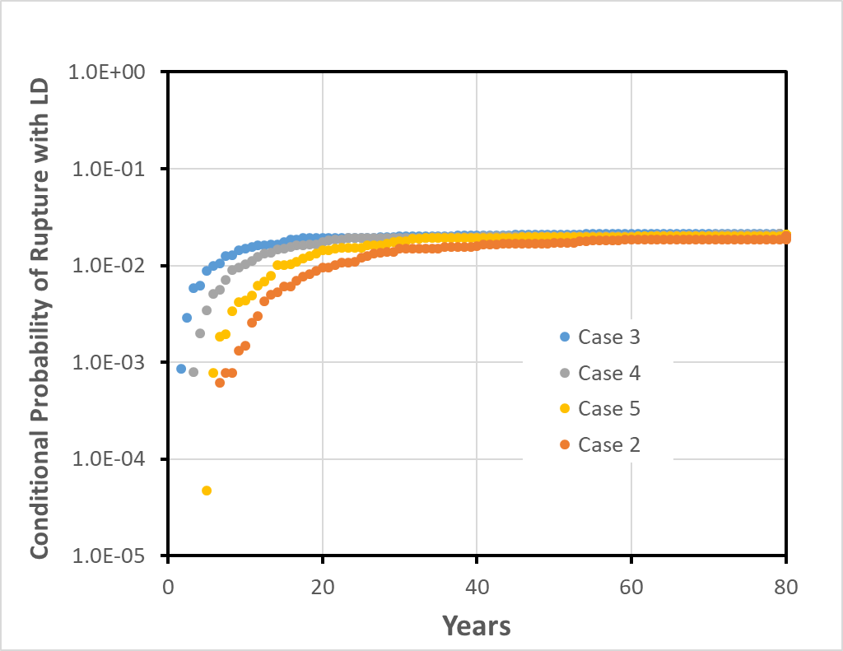
10 year conditional results with LD
Ruptures predicted for only cases with several very large flaws – cracks on 37% of circumference
Decreasing diameter

Slide 11
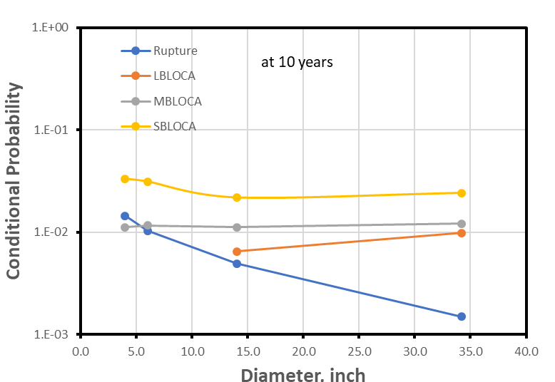
Trend with Diameter
5 big cracks
5 large flaws – for less flaws, rupture probability was <1E-4

Slide 12
Something Different
Cases of rupture with LD were caused by two scenarios
  Surface flaw rupture
  Long surface flaws where crack length > critical TWC length at leakage
Suspected that % circumference cracked tied to rupture
Changed WRS to increase rupture probability – increase chances of long surface flaw

Slide 13
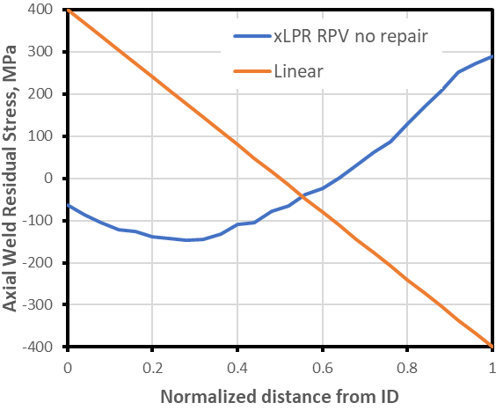
Linear WRS
Changed WRS
Varied crack number and length (1.5mm deep in all cases)
Kept everything else the same
Promotes long surface cracks

Slide 14
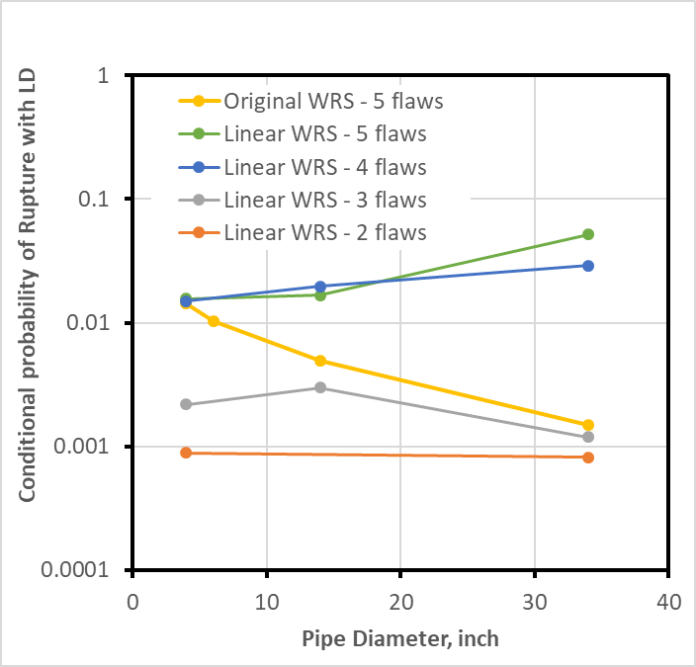
Additional Cases Considered
# cracks | Crack length, mm | %Cracked Circumference | Diameter, inch
3 | 5 | 5 | 4
3 | 10 | 11 | 4
2 | 20 | 15 | 4
3 | 20 | 22 | 4
4 | 20 | 30 | 4
1 | 100 | 37 | 4
5 | 20 | 37 | 4
10 | 10 | 37 | 4
5 | 20 | 11 | 14
3 | 70 | 22 | 14
4 | 70 | 30 | 14
5 | 70 | 37 | 14
3 | 20 | 2.6 | 34
4 | 20 | 3.5 | 34
5 | 20 | 4.3 | 34
2 | 171 | 15 | 34
3 | 171 | 22 | 34
4 | 171 | 30 | 34
5 | 171 | 37 | 34
Less circumference cracked = lower probability

Slide 15
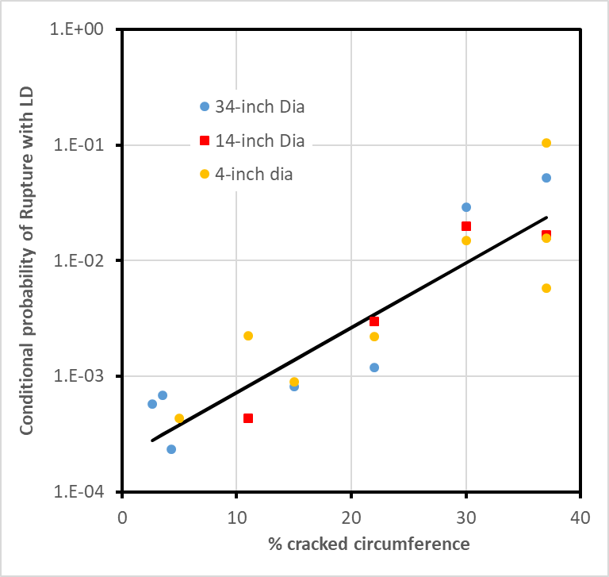
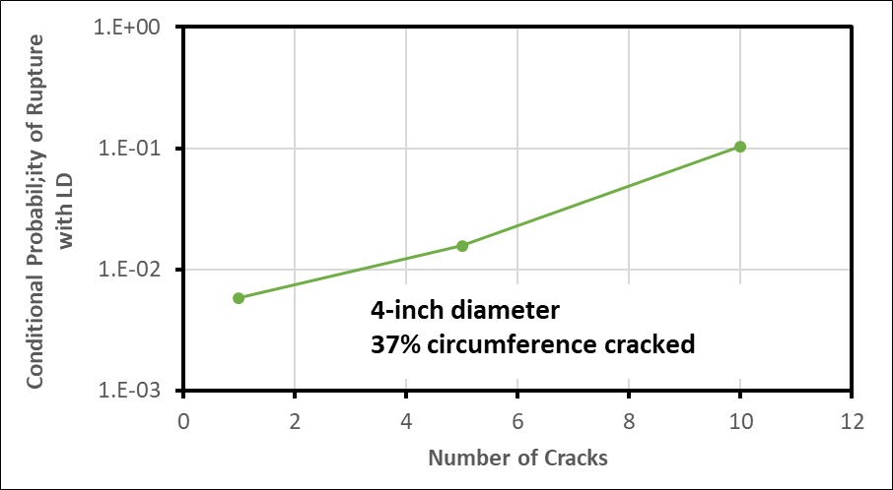
Linear WRS Results
Can we correct cases where we have multiple flaws with the same % circumference cracked?
Probably a function of diameter
Use trend to modify probability results

Slide 16
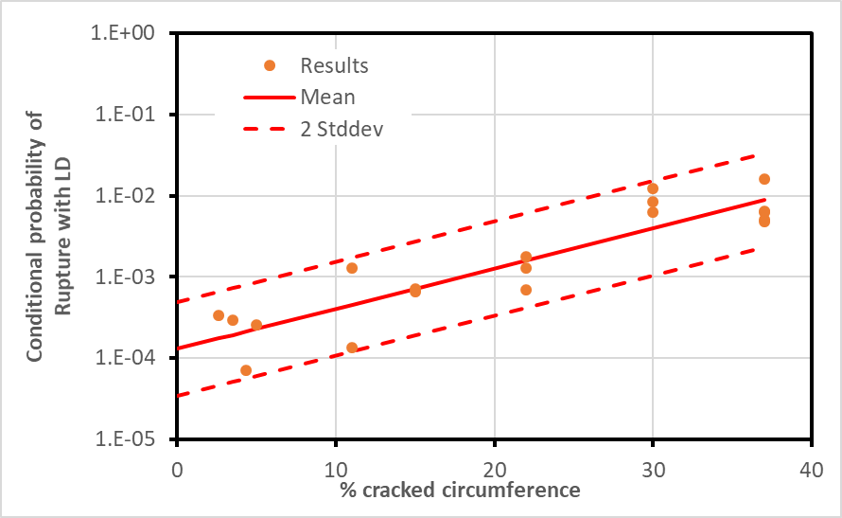
Corrected Results
Corrected to single
crack analyses
One PWSCC crack length (per xLPR inputs) is 0.2% of 34-in pipe circumference and 1.8% of a 4-in pipe circumference

Slide 17
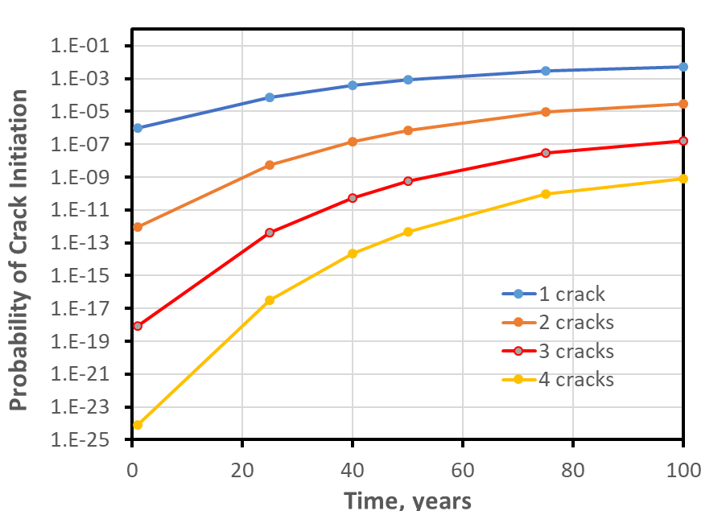
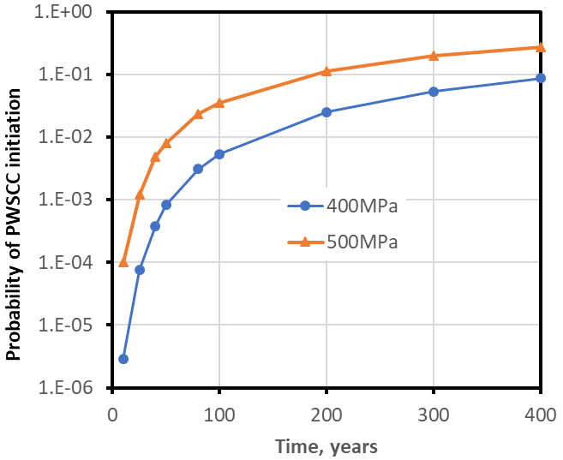
PWSCC initiation
Direct model 1
Used all xLPR inputs, stress=500MPa & 400 MPa, T=318°C
400MPa
At 80 years, probability of crack initiation is 0.25% for 400MPa

Slide 18
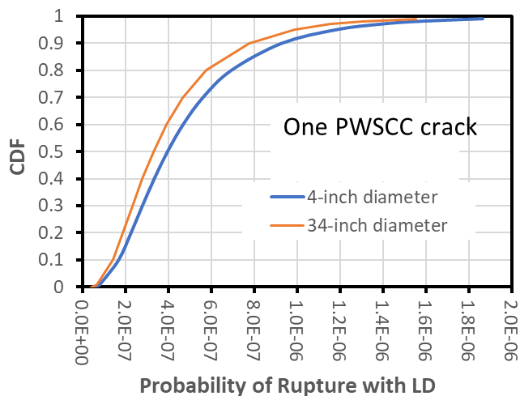
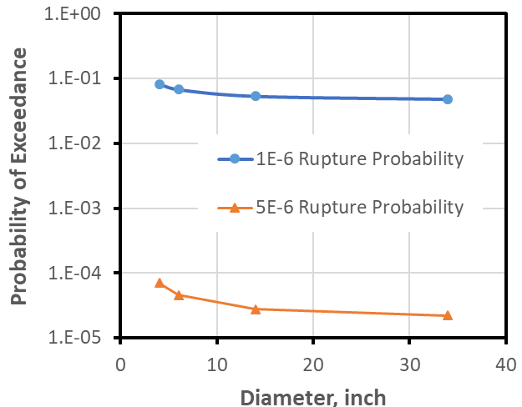
Probability of Rupture
Multiplied conditional probabilities by probability
of crack initiation for single crack at 80 years
Divide these by 80 years to get average rupture frequency
Only slight influence of diameter

Slide 19
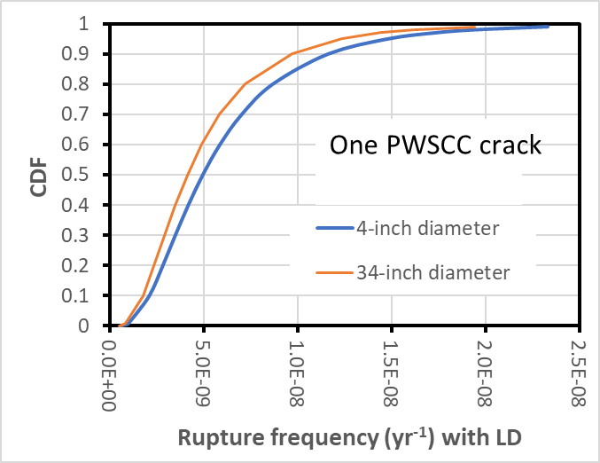
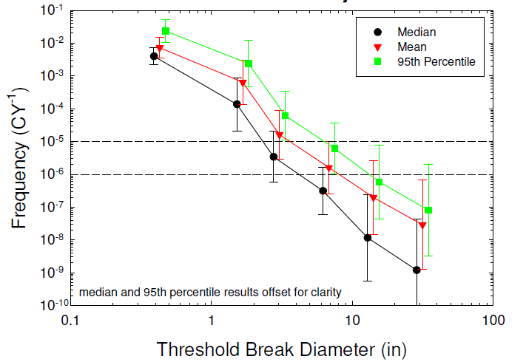
Comparison
This study
NUREG-1829

Slide 20
Conclusion
Assumptions limited or conservative
  PWSCC driven – Circumferential crack only – Multiple cracks
  Very conservative weld residual stress
  Operating loads not varied
  Fatigue ignored
  R/t constant
  No mitigation
Quick analysis results suggest rupture probability driven by % cracked circumference more than diameter – NUREG-1829 appears conservative (higher) relative to the results generated in this study
Many more analyses needed for generic comparison, but analyses using pre-existing cracks may be useful in bounding LBB applicability with active degradation

