Slide 1
ISPMNA-UA_010
Inspection Optimization Justification for PWR Main Steam and Feedwater Nozzles Using Probabilistic Flaw Tolerance Approach
D.J. Shim, D. Somasundaram, C. Lohse, R. Grizzi, T. Cinson, G. Stevens
3rd International Seminar on Probabilistic Methodologies for Nuclear Applications
Rockville, MD, USA
October 23, 2019

Slide 2
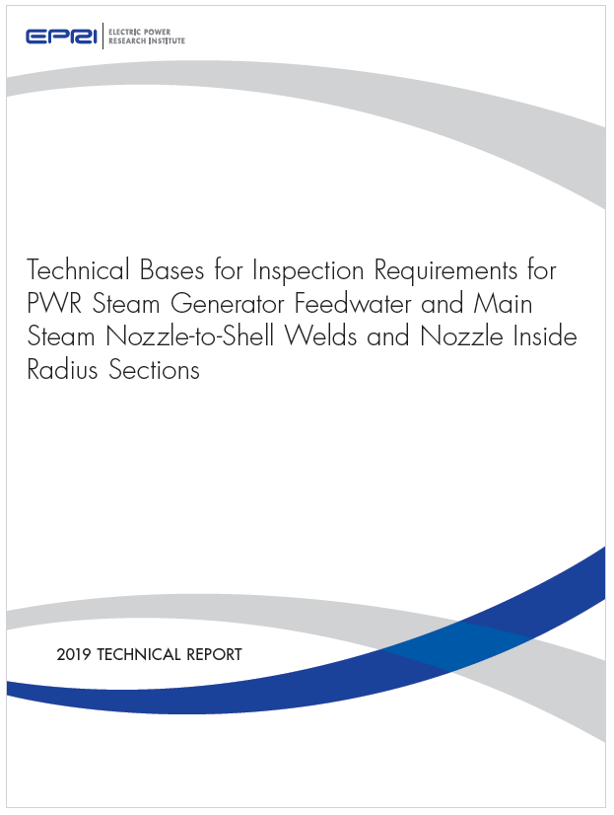
EPRI TR 3002014590
Final Report, April 2019
Summarized in PVP2019-93948

Slide 3
Background
There have been several industry initiatives to provide optimize examination requirements for various items/components (both Class 1 and Class 2 components) in lieu of the requirements in ASME Code Section XI
The ultimate objective of these initiatives is to optimize the examination requirements (through examination frequency reduction, examination scope reduction, or both) while maintaining safe and reliable plant operation

Slide 4
Background (cont’d)
The technical bases for these alternate examination requirements cannot solely rely on plant operating experience and the results of non-destructive examinations performed on the relevant components
To gain acceptance and provide technical merit, they should be couple with deterministic and/or probabilistic flaw tolerance evaluations

Slide 5
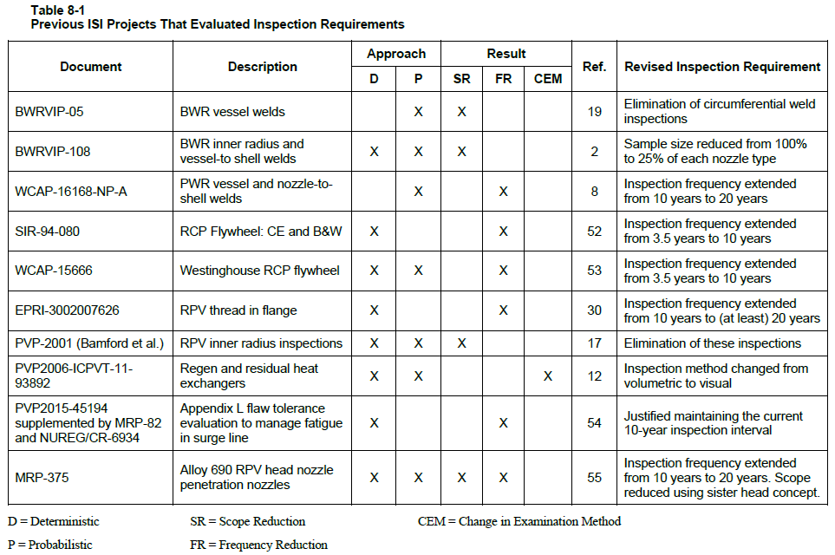
Background (cont’d)
See EPRI TR 3002014590

Slide 6
Background – Present Work
Weld examination requirements on the secondary side of PWR SGs are provided in Table IWC-2500-1 of the ASME Code
Present work focuses on the nozzle-to-shell welds and the inside radius sections of PWR SG feedwater and main steam nozzles, categorized per ASME Code, Section XI (Class 2, Category C-B) as follows:
Item No. C2.21 - Nozzle-to-shell welds
Item No. C2.32 - Nozzle-to-shell welds when inside of vessel is accessible
Item No. C2.22 – Nozzle inside radius section

Slide 7
Background – Present Work (cont’d)
For Item No. C2.21, examination requirements for these components are 100% surface and volumetric examination
For Item No. C2.32 and C2.22, requirements are 100% volumetric examinations
In all cases, the examination is to be performed every 10 years

Slide 8
Objectives
In this work, the current examination requirements for PWR SG feedwater and main steam nozzle-to-shell welds and nozzle inside radius sections are evaluated
The technical bases for various alternative inspection scenarios are established

Slide 9
Approach
Review of inspection history and results
A survey of components in the PWR fleet (U.S. and international)
Selection of representative configurations and operating transients for stress analysis
Flaw tolerance evaluation consisting of probabilistic and deterministic fracture mechanics analyses (development of PFM code)
Results of multiple inspection scenarios and sensitivity studies compared to the U.S. NRC safety goal of 10⁻⁶ failures per year

Slide 10
PFM Software
PROMISE (PRobabilistic OptiMization of InSpEction) developed by SI
PROMISE is subject to formal quality assurance following Structural Integrity assurance procedures, which are in compliance with the requirements of 10CFR50, Appendix B, 10CFR21, and ANSI/ASME NQA-1-1989, 1994, and 2008/2009A and meets the applicable portions of ANSI N45.2

Slide 11
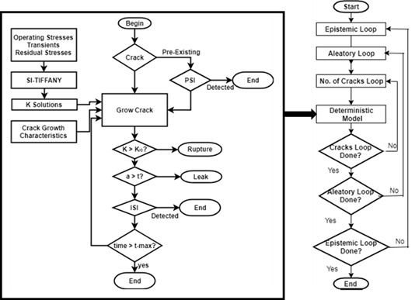
PFM Software (cont’d)
PFM flowchart for PROMISE (Monte Carlo simulation)
Geometry input
Initial flaw distribution
PSI & ISI – POD curve
Applied loads & stresses
Material degradation mechanism
Fracture models
Acceptance criteria

Slide 12
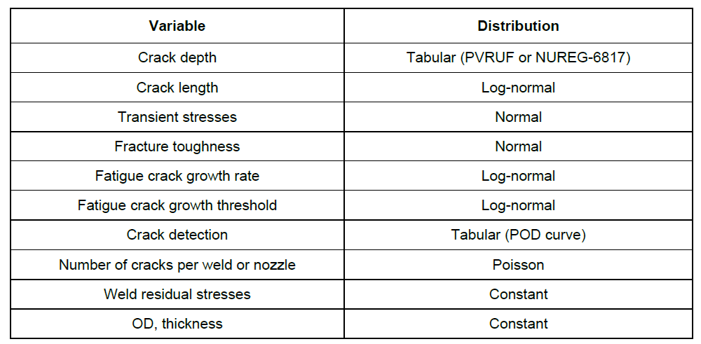
Random Variable Distribution
Notes:
There was not enough data to build correlation between depth and length or aspect ratio. PRAISE considered aspect ratio to be independent of crack depth. In xLPR, the crack depth and crack length are sampled as independent variables. If you assume that deeper cracks are also longer, it could potentially increase the failure probabilities. A disconnect here is that the detection probabilities are only based on the depth.

Slide 13
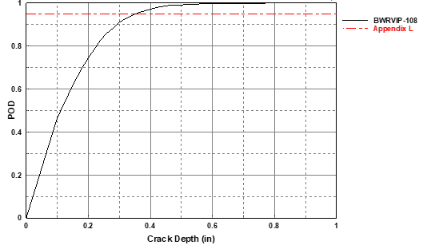
Flaw Distribution and POD Curve
Initial flaw distribution and number of flaws per weld
Based on flaw data from the Pressure Vessel Research User’s Facility (PVRUF) vessel
Number of fabrication flaws
Nozzle-to-vessel welds: 1 flaw per nozzle
Nozzle inside radius section: 0.001 flaws per nozzle
Probability of Detection (POD) Curve
POD curve from carbon steel from Appendix L Technical Basis Document
Composite POD curve from BWRVIP-108

Slide 14
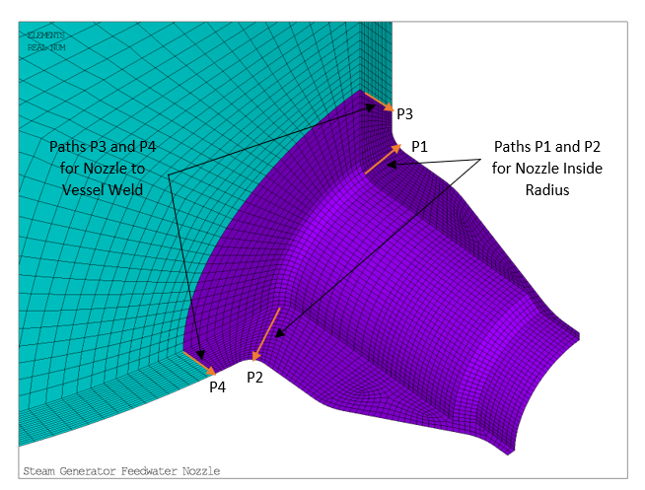
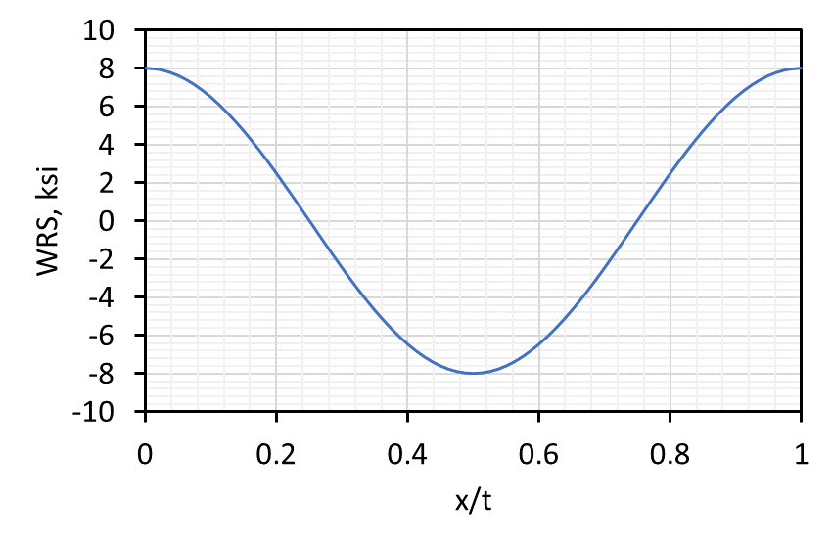
Applied Stresses
Thermal and Pressure transients
FEA performed to determine transient stresses
In the present work, the transient stresses were assumed as a constant value (non-random distribution)
Weld residual stress
Constant cosine residual stress distribution used (consistent with BWRVIP-108)

Slide 15
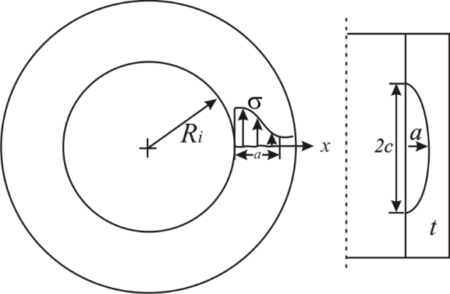
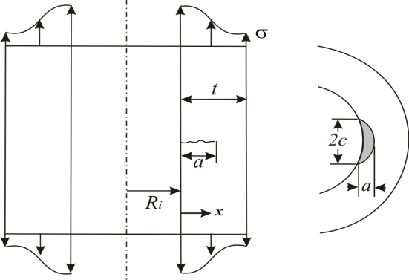
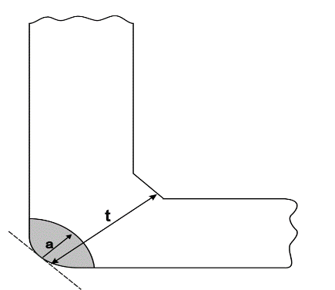
Fracture Models (LEFM)
Semi-elliptical circumferential and axial crack in a cylinder
API-579/ASME-FFS-1
The depth-to-length flaw aspect ratio (a/c) was allowed to vary during crack growth.
Nozzle corner crack
Weight function based solution
The crack was assumed as a circular-arc crack and the aspect ratio was fixed during crack growth

Slide 16
Fatigue Crack Growth Model
Only potential degradation mechanism identified for the main steam and feedwater nozzle-to-shell welds and nozzle inside radius sections was fatigue
Used FCG rate for ferritic steels, as defined in ASME Code, Section XI, Appendix A, Paragraph A-4300
The calculated crack growth rate was considered log-normally distributed consistent with the distribution used in the Extremely Low Probability of Rupture (xLPR) project.

Slide 17
Fracture Toughness
The materials considered are all ferritic steels; hence the fracture toughness curve provided in ASME Code, Section XI, Appendix A (Figure A-4200-1) was used for the evaluation
ASME Code Section XI fracture toughness assumed to be normally distributed with a median of 200 ksi√in and a standard deviation of 5 ksi√in (consistent with BWRVIP-108)

Slide 18
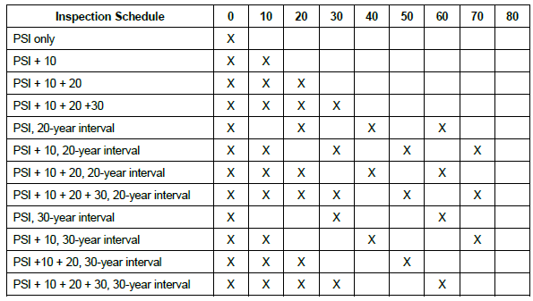
Inspection Schedule
Inspection schedule scenarios considered in the evaluation

Slide 19
Acceptance Criteria
Failure occurs either by rupture or by leak
Leak: a/t > 0.8
Rupture: K_{I} > K_{IC}
The acceptance criterion for the PFM evaluation was that failure frequencies must be less than the NRC safety goal of 10⁻⁶ failures per year
Consistent with criteria used in BWRVIP-05 and BWRVIP-108
Also used in xLPR acceptance criteria document (ML16271A436)
Based on RG 1.174
Notes:
The 10⁻⁶ limit probably relates to limits on Core Damage Frequency (CDF) and Large Early Release Frequency (LERF) which are typically sited as being in the 10⁻⁶ to 10⁻⁷range. For an RPV, it’s reasonable to assume that a vessel failure would lead directly to core damage (Conditional CDF given the rupture = 1). But that’s probably overly conservative for a SG rupture, a pipe rupture, and certainly for leakage as opposed to rupture. In RG 1.174 , it presents allowable risk in terms of ΔCDF and ΔLRF associated with a licensing basis change. (The proposed change in your report in Section XI ISI requirements could be viewed as a licensing basis change.) RG 1.174 states: “When the calculated increase in CDF is very small, which is taken as being less than 10⁻⁶ per reactor year, the change will be considered regardless of whether there is a calculation of the total CDF”. So that might be where the proposed xLPR limit of 10⁻⁶ comes from. But that presupposes a CCDF of 1 for a pipe rupture, which is very conservative.

Slide 20
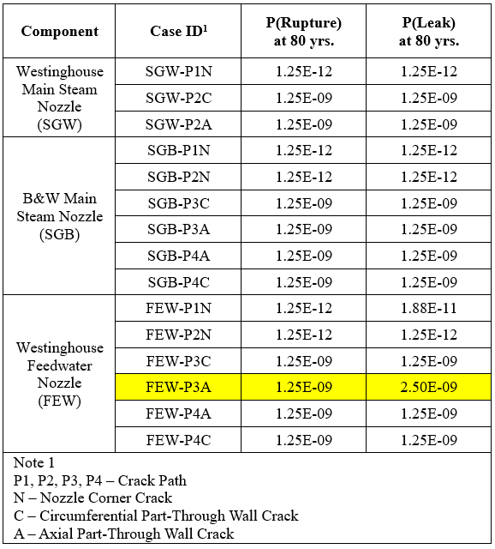
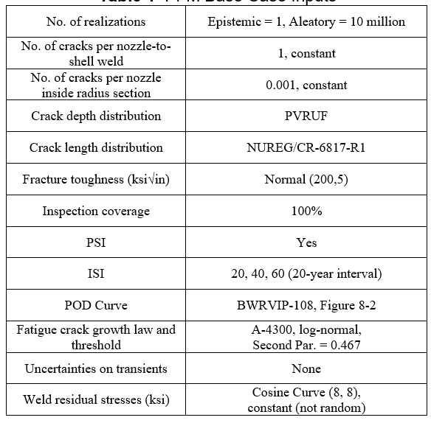
PFM Base Case
Input and output

Slide 21
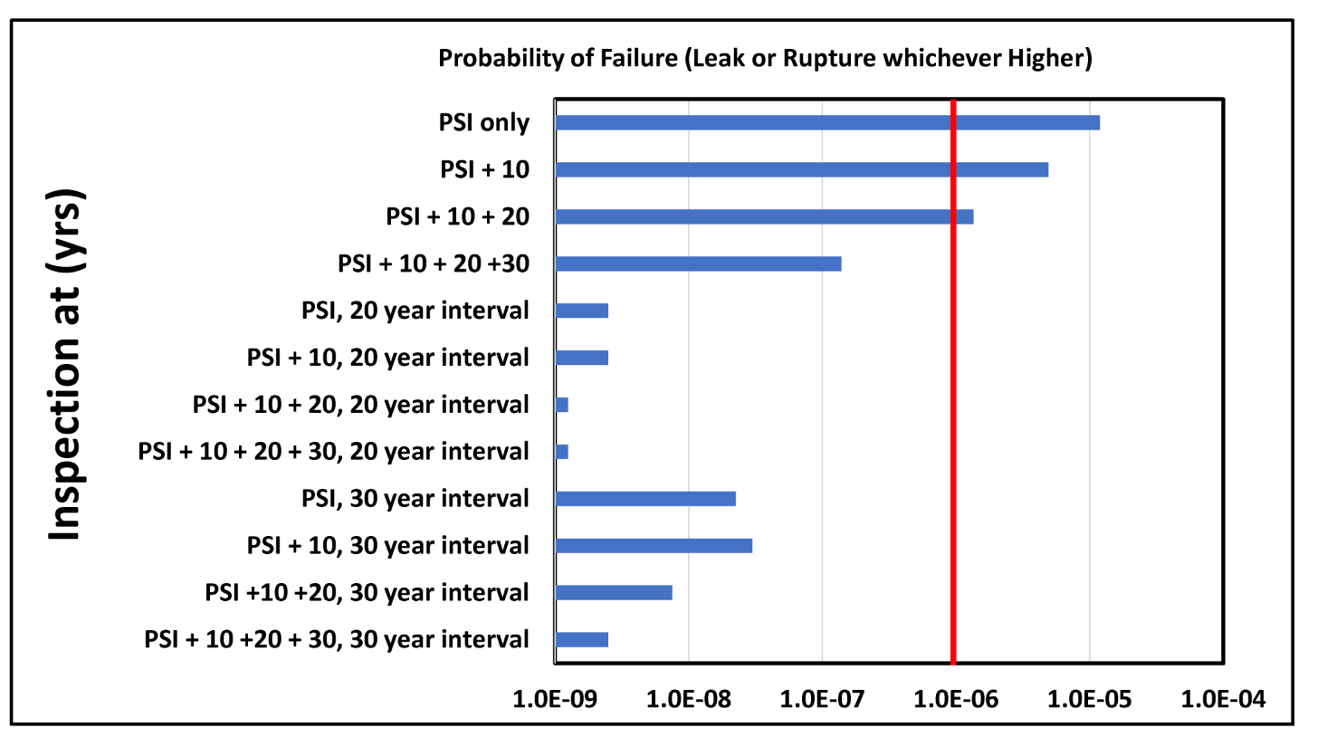
Effect of Inservice Inspection
Effect of ISI on the failure frequency at 80 years (Case FEW-P3A)

Slide 22
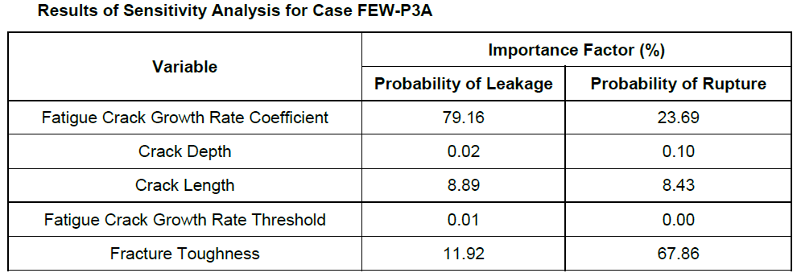
Sensitivity Analysis
The purpose of sensitivity analysis is to identify the random variables that have the most impact on the calculated probabilities (rupture or leakage)
The Degree of Separation Method (DSM) was used to rank the effect of the input variables on the output probabilities

Slide 23
Sensitivity Study
Exploring the specific influence of important parameters and analyzing specific scenarios of interest
Sensitivity studies (‘what if’ scenarios) performed to study the effect of :
Fracture Toughness
Stresses
Initial Crack Depth Distribution
Nozzle Inside Radius Flaw Density
Distribution of Number of Weld Flaws
Crack Size Distribution
Crack Growth Rate
POD Curves
Number of Realizations

Slide 24
Conclusions
PFM analyses were performed on PWR SG main steam and feedwater nozzle welds and inner radius sections to evaluate the bases for various inspection scenarios
The components for PFM evaluation were selected based on a review of the inspection history and the results of an EPRI survey of components in worldwide PWRs
The results revealed that the current ASME Code, Section XI inspection schedules for the PWR SG main steam and feedwater nozzle-to-shell welds and nozzle inside radius sections are conservative
Item Nos. C2.21, C.2.22 and C2.32 in Table IWC-2500-1 (10-year inspections)

Slide 25
Conclusions (cont’d)
The evaluations showed that, after PSI, no other inspections are necessary for 60 years of plant operation to meet the NRC safety goal of 10⁻⁶ failures per year
When an inspection scenario consisting of PSI followed by 20-year ISI inspections is considered, the NRC safety goal is met for 80 years of plant operation

Slide 26
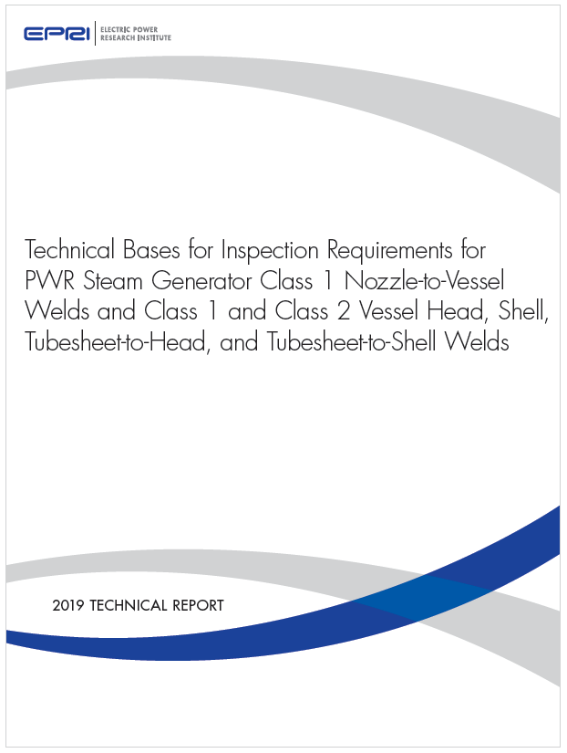
EPRI TR 3002015906
Final Report, October 2019

Slide 27
Backup Slides

Slide 28
Component Selection
For main steam nozzle, both CE and Westinghouse main steam nozzles have similar configurations and geometry
The basic geometry between the B&W and the Westinghouse/CE main steam nozzle design are sufficiently distinct, so the B&W design was evaluated separately
Westinghouse 4-loop configuration selected for analysis:
R/t ratio for the SG vessel: 87.96/3.52 = 25
R/t ratio for the main steam nozzle: 14/6.5 = 2.2
B&W configuration selected for analysis:
R/t ratio for the vessel (at the nozzle location): 75.56/6.63 = 11.4
R/t ratio for the main steam nozzle: 11.13/4.53 = 2.5

Slide 29
Component Selection (cont’d)
B&W feedwater nozzles were not analyzed as they are bolted configurations
For Westinghouse and CE plant designs, the feedwater nozzle sizes and thicknesses were more uniform
Westinghouse 4-loop configuration selected for analysis:
R/t ratio for the SG vessel: 87.96/3.52 = 25
R/t ratio for the feedwater nozzle: 8.25/6 = 1.4

Slide 30
Operating Loads and Transients
For the PWR SG feedwater and main steam nozzles, loads due to thermal and pressure transients were only considered in the fracture evaluations
Crack growth was only considered for normal and upset events because plants are not expected to operate under emergency and faulty conditions (The flaw stability check used pressures and transient conditions that bound all service levels)
The significant transients selected for stress evaluation are listed below:
Heatup and Cooldown
Plant Loading and Unloading
Loss of Load
Loss of Power

Slide 31
Verification of PFM Using DFM
Deterministic fracture mechanics (DFM) evaluations were performed using average parameters to provide verification of the PFM evaluation results
The very low failure frequencies obtained from the PFM evaluations indicated that long operating periods should be obtained from DFM evaluations before failures are predicted

Slide 32
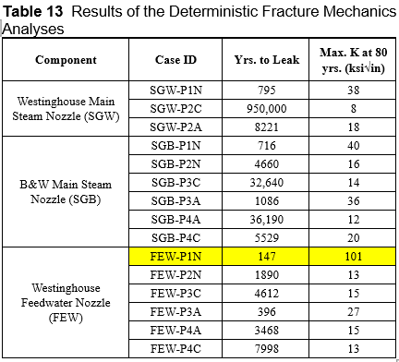
Verification of PFM Using DFM (cont’d)
Constant input values
Initial flaw size from ASME Code, Sec. XI acceptance criteria
pc-CRACK software
Maximum K value slightly exceeds allowable fracture toughness when conservative structural factor of 2 is used

Slide 33
Degree of Separation (DoS) Method
Separate sampled random variables in two sets
Resulted in failure (for example, failure = failed in < 2000 cycles)
Did not result in a failure
Compare the distributions of these two sets
Differences in these distributions is a measure of the sensitivity of that variable to the output
If these two distributions are identical, the output is not sensitive to that variable

Slide 34
DoS Method Concept

