Slide 1


Overview of Benchmark Project on Probabilistic Fracture Mechanics Codes for Piping Applications
4th International Symposium on Probabilistic Methodologies for Nuclear Applications, Nov 1-3, 2022, Leicester University Space Park, UK
Xinjian Duan (SNCL), Min Wang (SNCL), Deepak Somasundaram (SNCL)
Matthew Homiack (USNRC), Christopher Nellis (USNRC),
Robert Tregoning (USNRC)

Slide 2
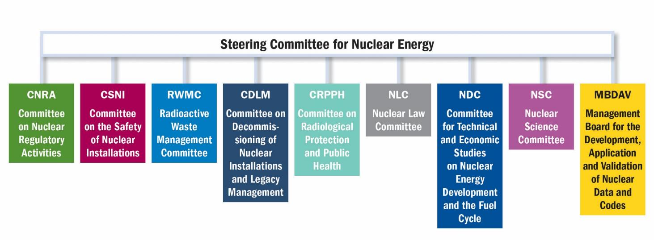
OECD/NEA Committees

Slide 3
Committee on the Safety of Nuclear Installations (CSNI)
Committee on the Safety of Nuclear Installations (CSNI)
CSNI Programme Review Group (PRG)
Working Group on Human and Organizational Factors (WGHOF)
Working Group on Risk Assessment (WGRISK)
Working Group on Fuel Safety (WGFS)
Working Group on Analysis and Management of Accidents (WGAMA)
Working Group on Fuel Cycle Safety (WGFCS)
Working Group on Integrity and Ageing of Components and Structures (WGIAGE)
Working Group on External Events (WGEV)
Subgroup on the Integrity of Metal Components and Structures
Subgroup on the Ageing of Concrete Structures
Subgroup on Seismic Engineering
Working Group on Electrical Power Systems (WGELEC)
Senior Group on Preservation of Key Experimental datasets (SEGPD)
Expert Group on Small Modular Reactors (EGSMR)
Expert Group on Fire (EGFR)

Slide 4
Key Acronyms
BBL | break before leak
CFP | crack face pressure
COD | crack opening displacement
DFM | deterministic fracture mechanics
DP | deterministic problem
ISI | in-service inspection
LBB | leak before break
LD | leak detection
PFM | probabilistic fracture mechanics
POD | probability of detection
PP | probabilistic problem
PRA | probabilistic risk assessment
PSA | probabilistic safety assessment
PWR | pressurized water reactor
PWSCC | primary water stress corrosion cracking
WRS | weld residual stress
QoI | quantity of interest
4

Slide 5

Major Milestones
Flyer distributed during 3rd ISPMNA
Approval of CSNI Activity Proposal Sheet in 2020 June
Call for participants
Questionnaire on PFM code design
Preparation of project plan
Deterministic benchmark case(s)
1st round of DP benchmark case results
2nd round of PP benchmark case results
Optional 3rd round of DP and PP benchmark case results
Present draft report at the 2023 annual meeting
Final report

Slide 6
Objectives of the Project
Understand differences in PFM software design
Understand the role of DFM modules
Reconcile deterministic LBB and PFM
Understand the effectiveness of ISI in reducing failure probabilities
Understand the effectiveness of leak detection in reducing failure probabilities
Explore PFM as input for PRA/PSA
6

Slide 7
List of Participants and PFM Codes
Participants from 15 organizations in 12 countries
14 PFM codes as summarized below
Organization | Code | Version | Organization | Code | Version
CRIEPI, Japan | PEDESTRIAN | 1.1 -> 2.1 | KIWA, Sweden | NURBIT | 6
Emc², USA | PROMETHEUS | 2.0 -> 3.0 | LEI, Lithuania | SACC
Emc², USA | PROLOCA | 7.02 -> 7.04 | MPA, Germany | Xpipe | 3.3-R0a-p1 -> 4.1-R0a-P0
KINS, South Korea | PROLOCA | 7.02 -> 7.04 | NRG, Netherlands | DeMoT | 2.1
PSI, Switzerland | PROLOCA | 7.02 -> 7.04 | SIA, USA | Beyond-PRAISE | 2.1
PSI, Switzerland | PROST | 4.7.3 -> 4.8.3 | SNC, Canada | PRAISE-CANDU | 2.0-> 2.1.1
GRS, Germany | PROST | 4.7.3 -> 4.8.3 | USNRC, USA | xLPR | 2.1 -> 2.2
IPP, Ukraine | SIF-Master | 2.0 -> 2.3 | VTT | VTTBESIM | 0.8
JAEA, Japan | PASCAL-SP | 2

Slide 8
Technical Presentations
Metal Subgroup Annual Update Meeting, 2020 March
Project Kickoff and Review of Questionnaire, 2021 January
Metal Subgroup Annual Update Meeting, 2021 March
1st DP Benchmark Case, 2021 March
2nd DP Benchmark Case, 2021 September
6 PP Benchmark Cases, 2022 February
Metal Subgroup Annual Update Meeting, 2022 March
Final PP Benchmark Results, 2022 October
Conference Presentations
2022 ASME Pressure Vessels and Piping Conference
PVP2022-84724, “Probabilistic Fracture Mechanics Codes for Piping International Benchmark—Part 1: Deterministic Comparisons
26th International Conference on Structural Mechanics in Reactor Technology (SMiRT26)
Th.2.H.5, Assessment of International Probabilistic Fracture Mechanics Code Models and Capabilities for Piping Applications
4th International Symposium on Probabilistic Methodologies for Nuclear Applications
BM_01, Overview of CNSI Benchmark Project on Probabilistic Fracture Mechanics Codes for Piping Applications

Slide 9
Comparaison of PFM Codes

Slide 10
Description of Benchmark Problems
Fictitious butt-weld fabricated from Alloy 182 in a PWR coolant system that is susceptible to PWSCC
Problems designed to provide a meaningful quantitative comparison among the various PFM codes. Certain inputs were selected either for convenience or simplicity, to accommodate the range of capabilities of the various codes involved in study, or to reduce computational requirements.
DP-01: simplified linear WRS
DP-02: more realistic 3rd order polynomial WRS
PP-01 through PP-06: based on DP-02 with two random variables, crack growth rate and WRS; effects of leak detection and ISI are also credited
DP-03: no WRS
PP-07: based on DP-03 with one random variable, crack growth
10

Slide 11
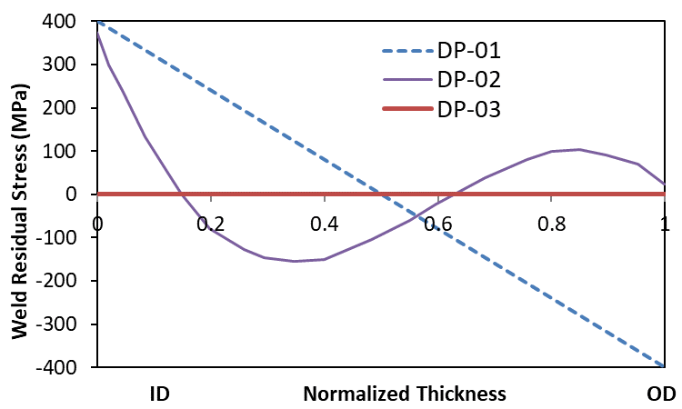
DFM Analysis Matrix
PFM Analysis Matrix
Problem | WRS
DP-01 | Linear
DP-02 | 3rd Polynomial
DP-03 | No WRS
Problem | Growth Rate | WRS | Leak Detection | Inspection
PP-01 | Random | Deterministic | No | No
PP-02 | Random | Deterministic | Yes | No
PP-03 | Deterministic | Random | No | No
PP-04 | Deterministic | Random | Yes | No
PP-045* | Deterministic | Random | No | Yes
PP-05 | Deterministic | Random | Yes | Yes
PP-06 | Random | Random | Yes | Yes
PP-07 | Random | No WRS | No | No
*PP-045 was not part of the benchmark, it was added for this presentation only

Slide 12
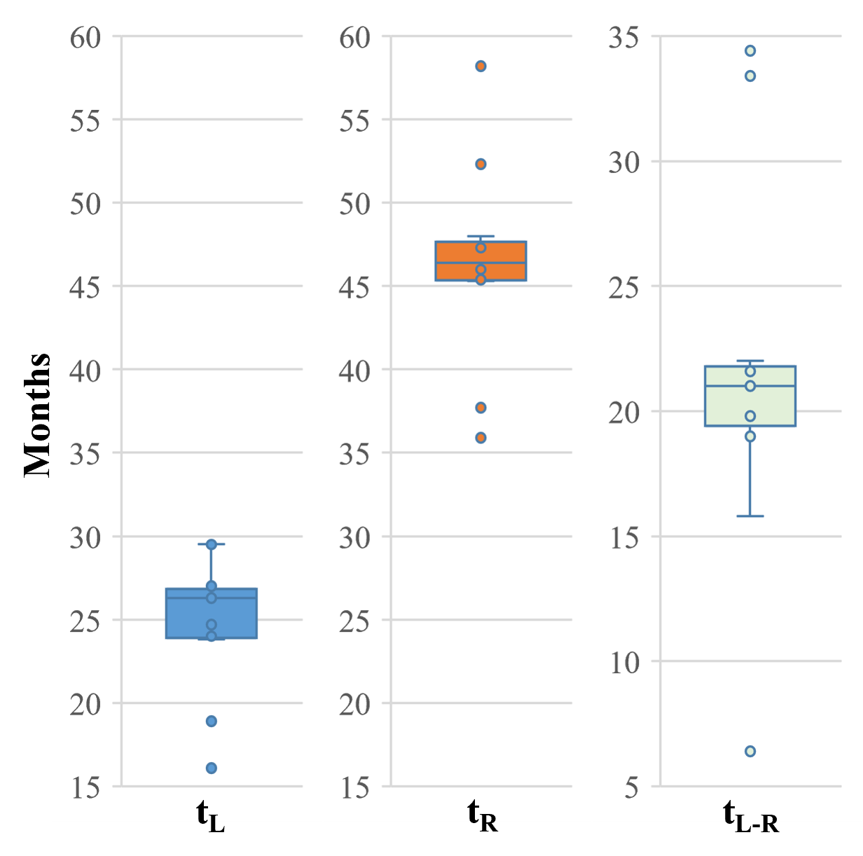
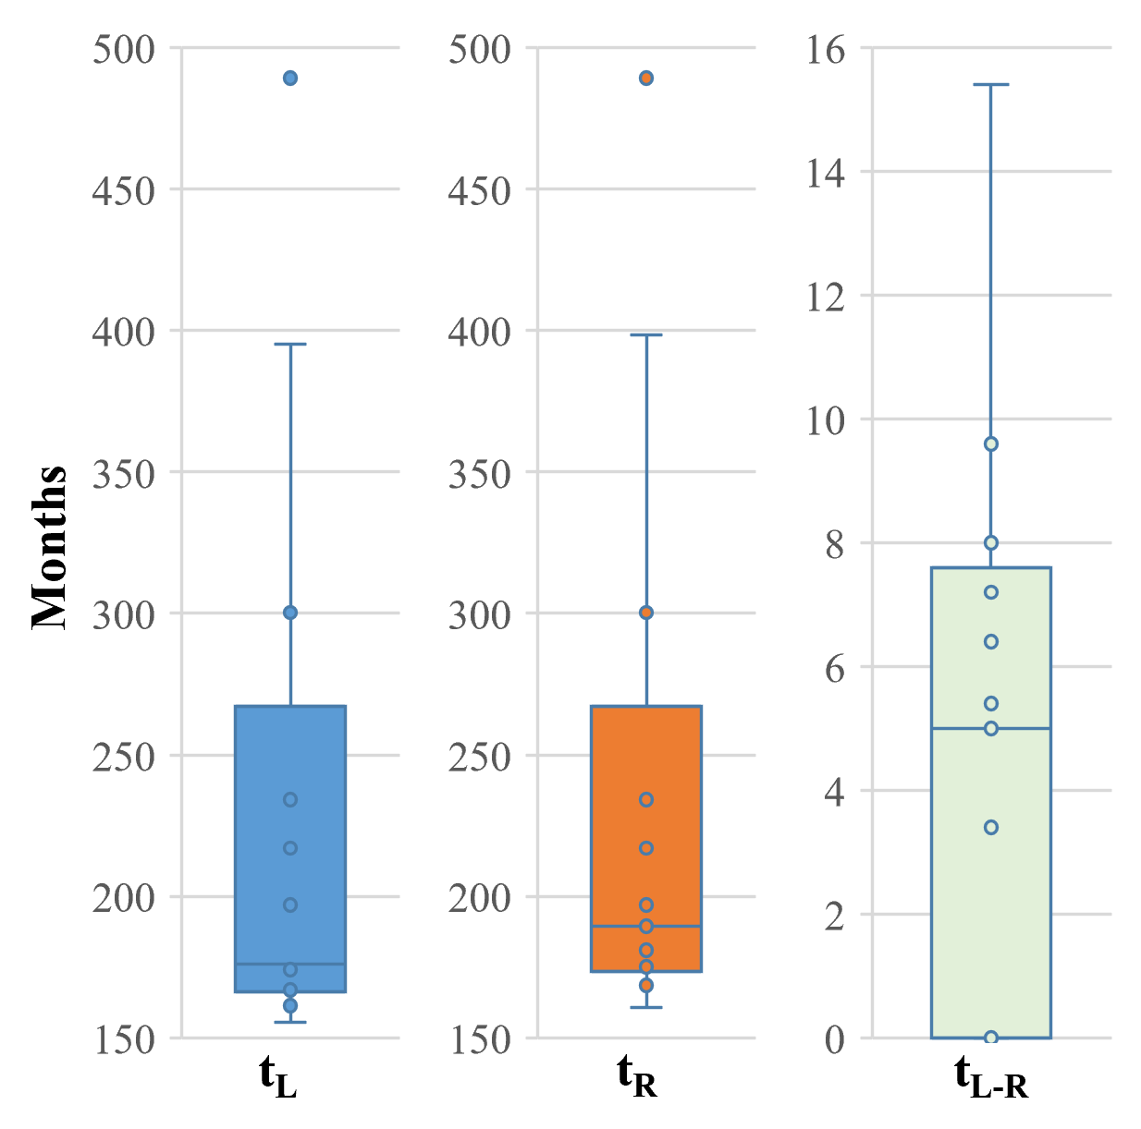
Comparison of DFM Results
Pending submission of participant results
DP-01 DP-02 DP-03
t_{L}: time to leakage; t_{R}: time to rupture; t_{L-R}: time between leakage and rupture
12

Slide 13
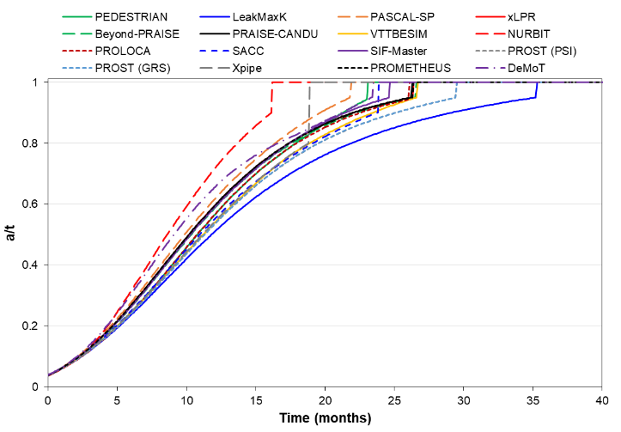
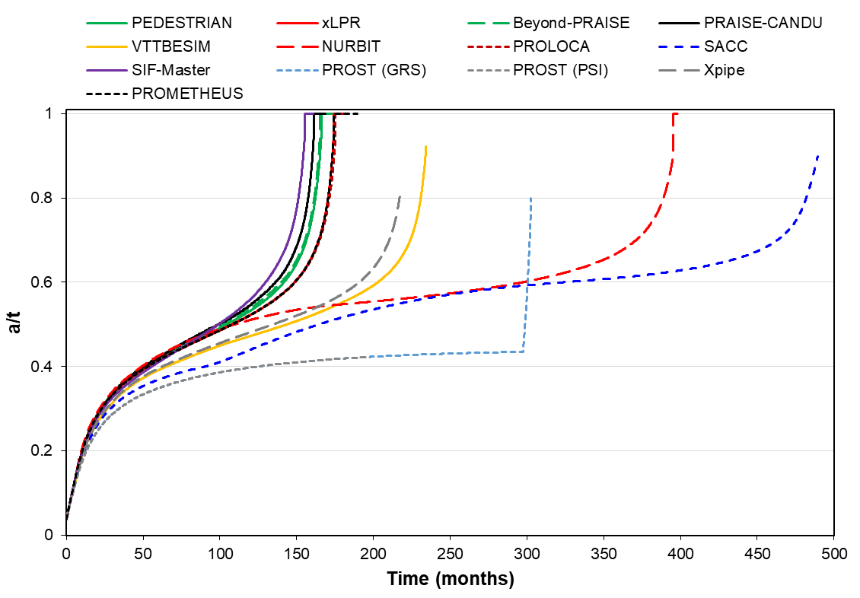
Comparison of Surface Crack Growth
DP-01 DP-02

Slide 14
Surface Crack Transition to Through-wall Crack Models
Equivalent length
(same inside diameter length)
Equivalent area
(smaller inside diameter length)
Natural transition

Slide 15
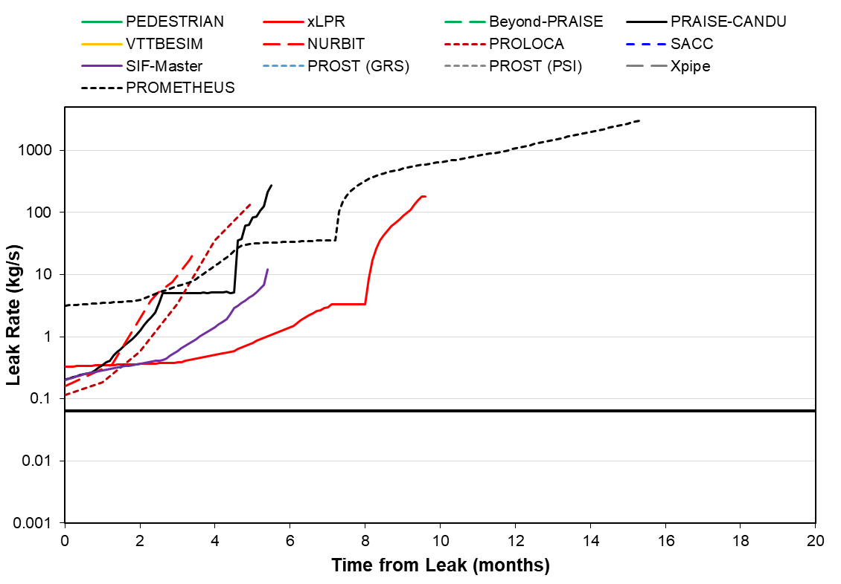
DP-02 Time History Plot - Leak Rate
Large differences in leak rate
Assumed leak detection limit of 0.063 kg/s

Slide 16
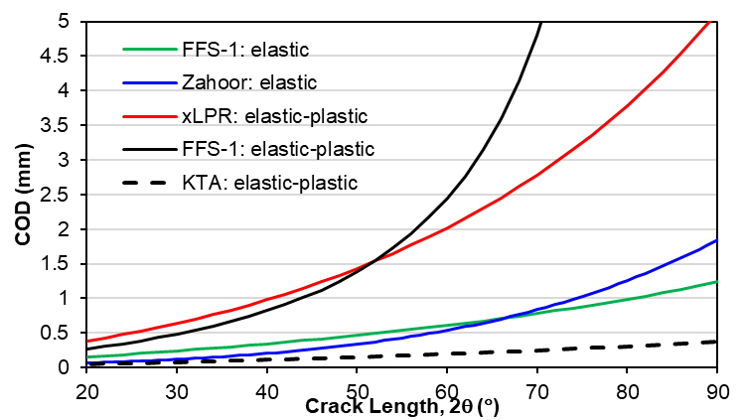
Comparison of COD Solutions
For a large diameter pipe (OD: 573.7 mm, thickness: 30.71 mm)
Loads extracted from the piping model

Slide 17
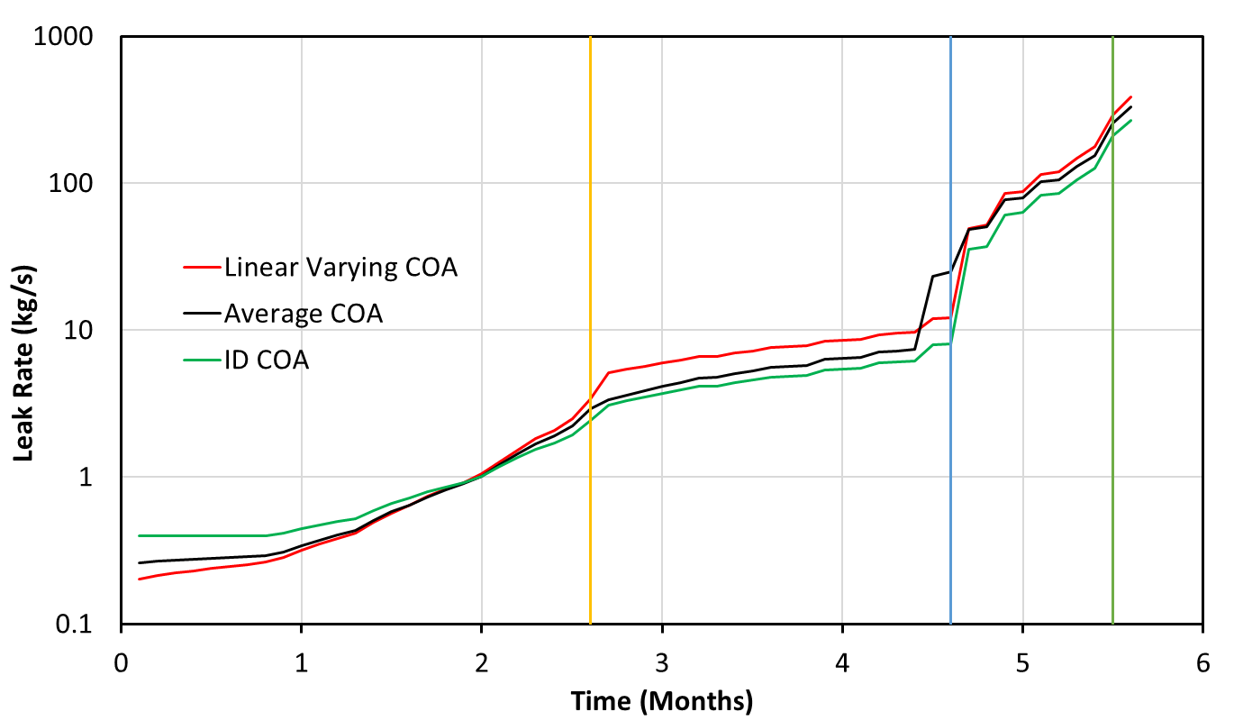
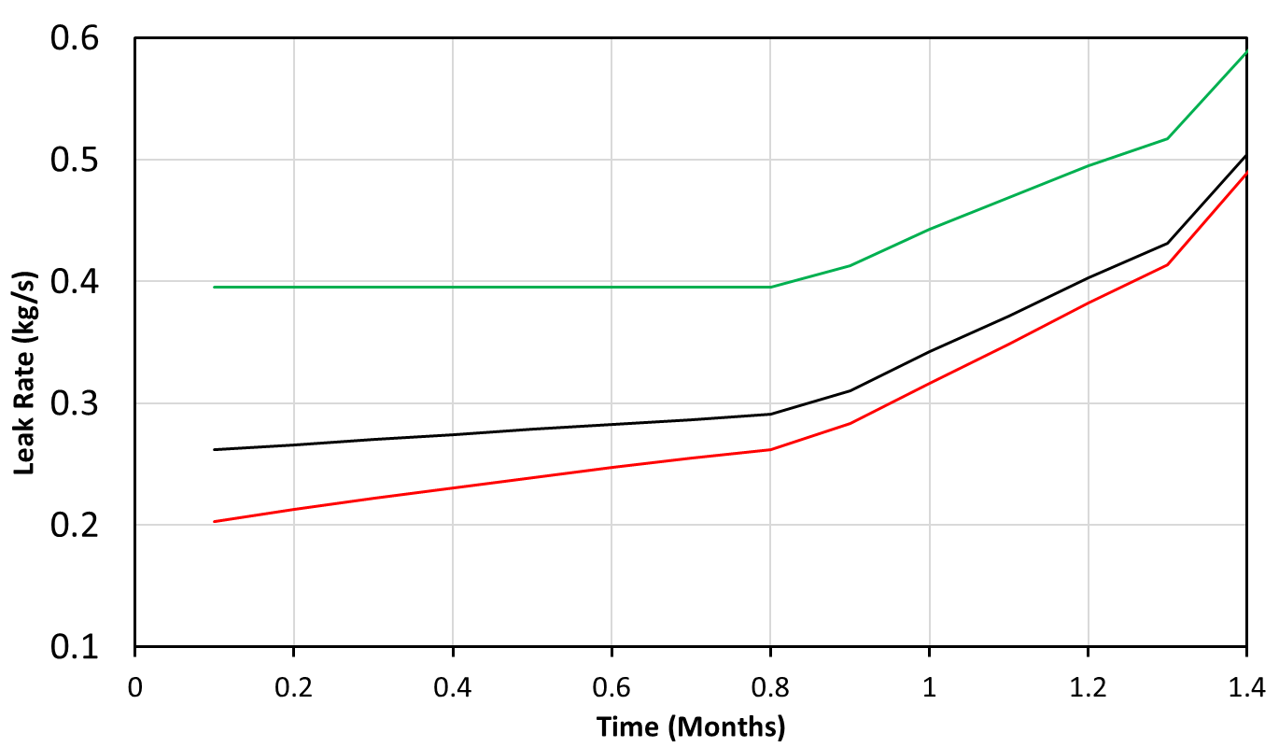
Comparison of Leak Rate Characterization

Slide 18
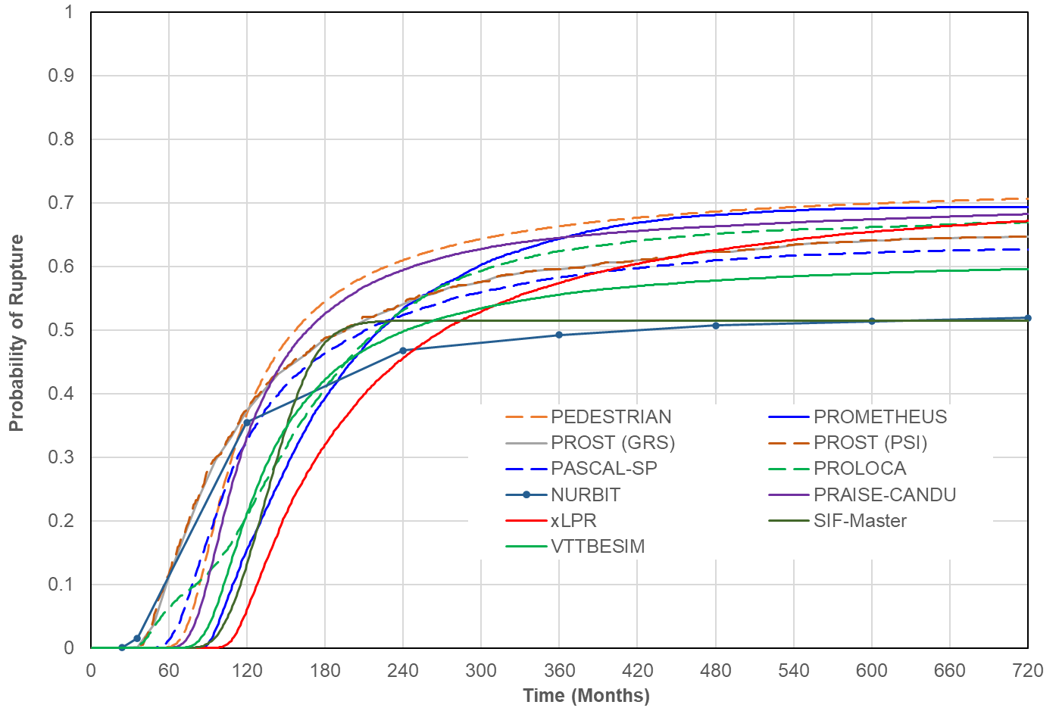
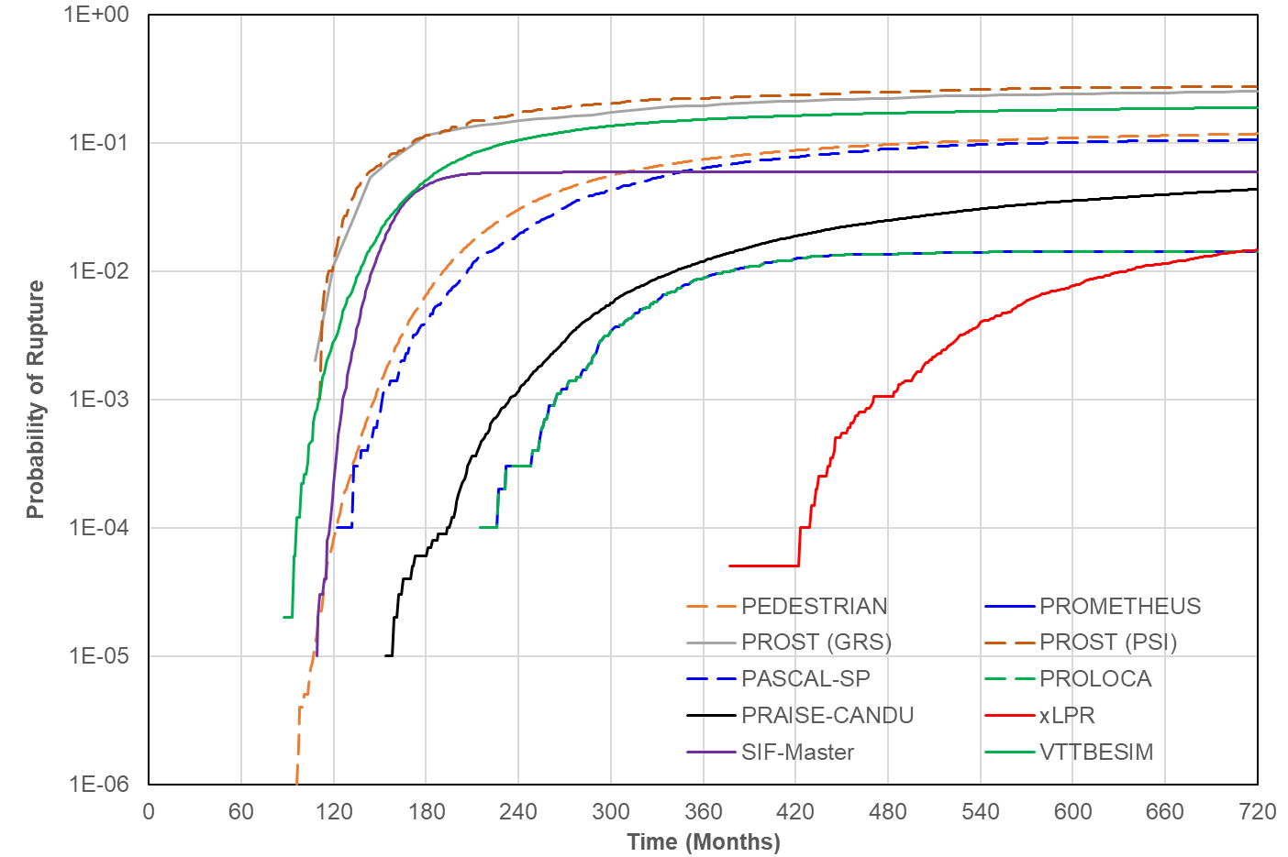
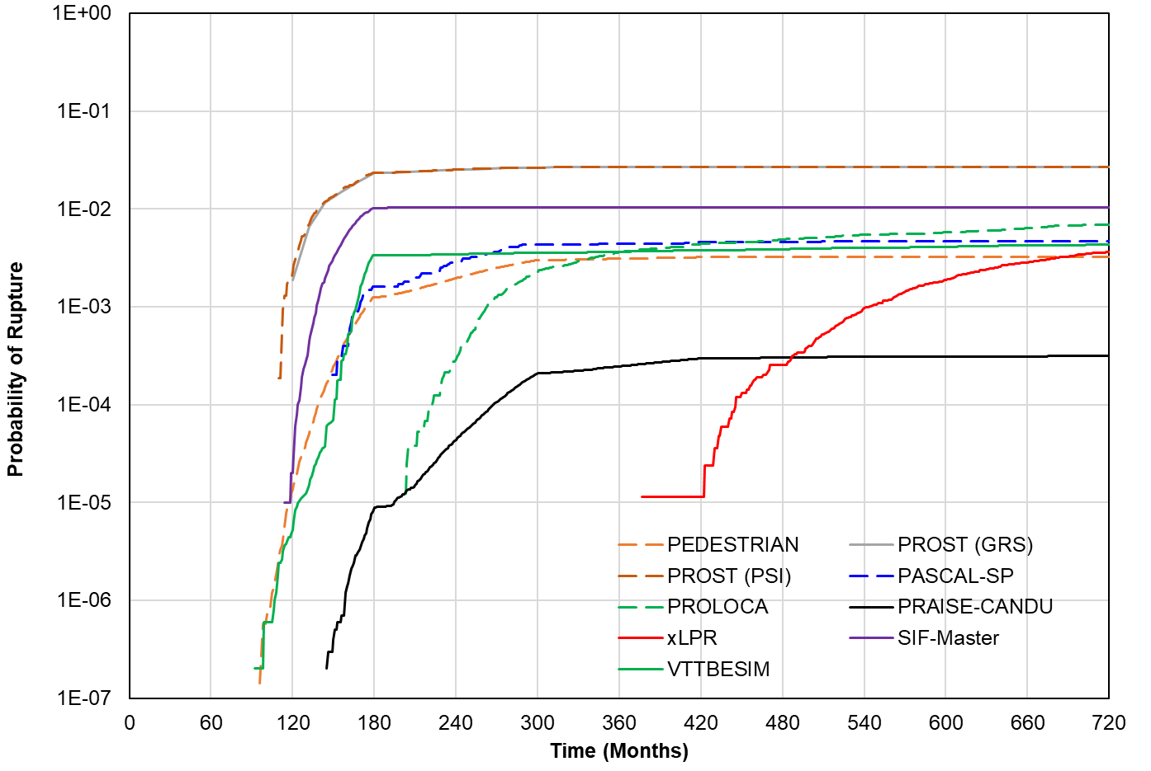
Comparison of PFM Results
QoI: probability of rupture
PP-03 as base case, WRS as random variable, w/o ISI and LD
PP-03 PP-04 (with LD) PP-05 (with ISI and LD)

Slide 19
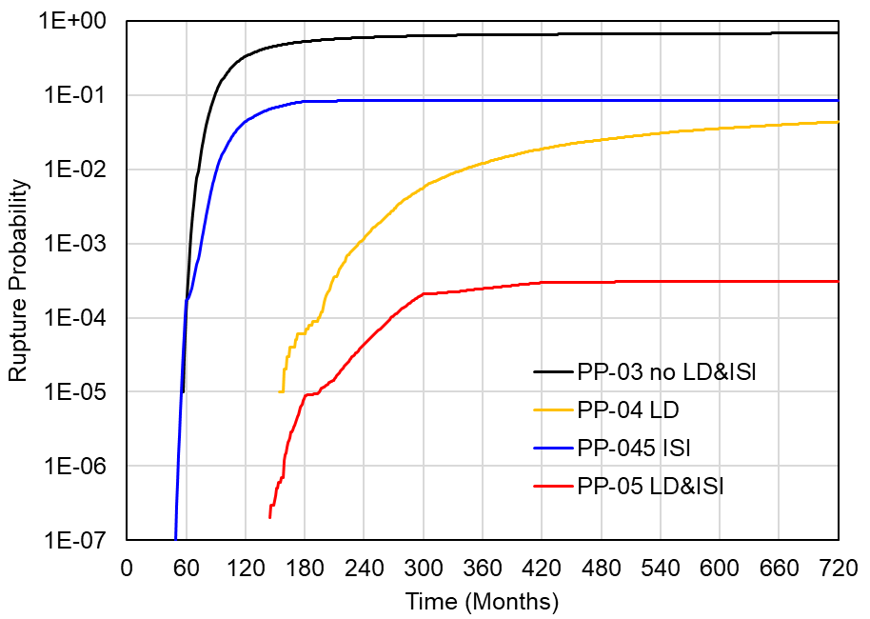
Further Exploration with PRAISE-CANDU
Effect of LD, ISI, and combination of both LD and ISI
Dependent/independent ISI (independent: re-sampling at each inspection)
Effect of ISI and LD Different ISI Implementation

Slide 20
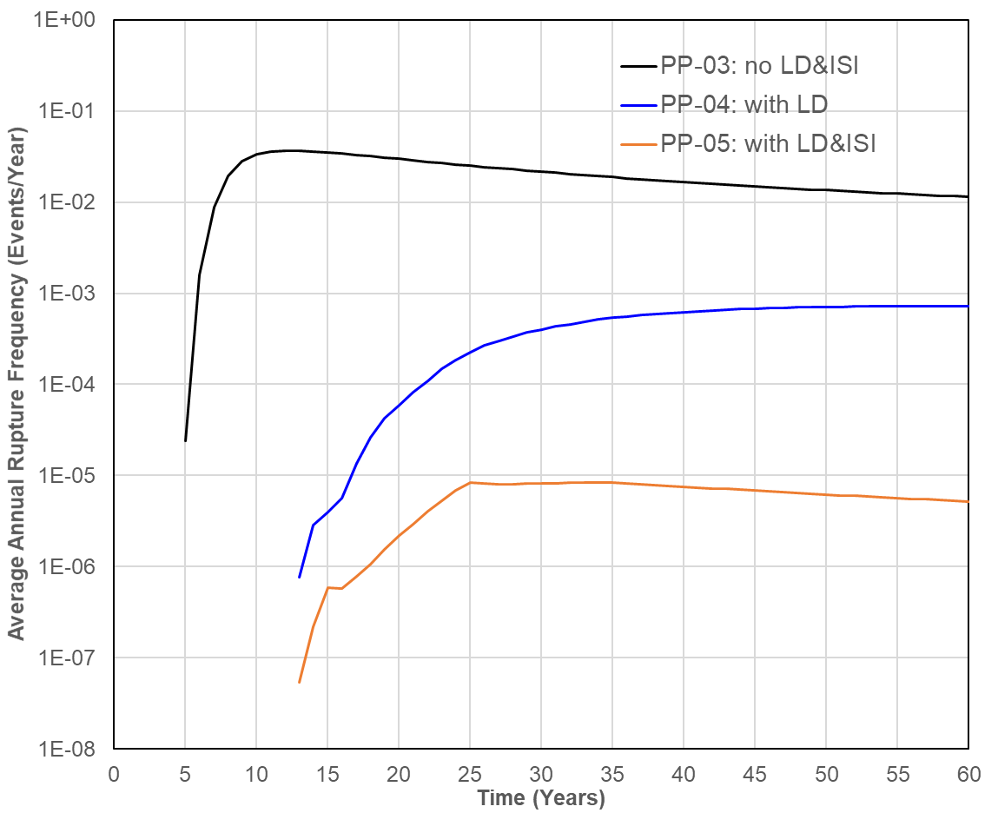
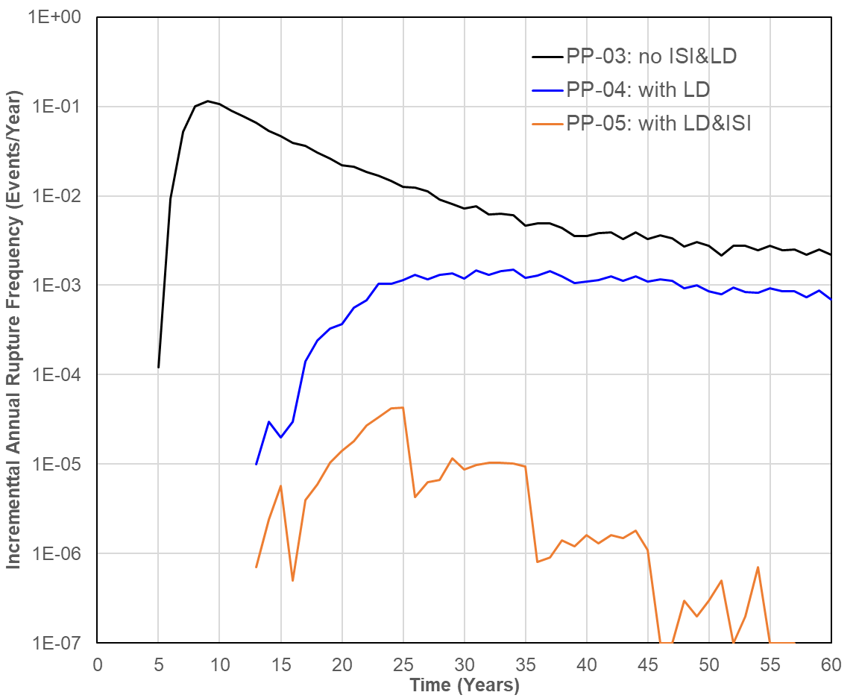
Calculation of Annual Frequency
Method 1: Average annual frequency p(t_{a})/t_{a}
Method 2: Incremental annual frequency [p(t_{a}+1)-p(t_{a})]/[1-p(t_{a})]
Average Annual Frequency Incremental Annual Frequency

Slide 21
Summary
    Excellent participant support and engagement
    Project is progressing as planned
    Extensive knowledge has been gained
      Comprehensive summary of fracture mechanics models
      Quantitatively assessed the effects of modeling differences among various PFM codes under a set of controlled problems
      WRS profile is an important set of inputs for PWSCC problems
      Large variations were observed in the leak rate predictions, which were attributed to differences in the stress-intensity factor, COD, crack transition, and leak rate models

Slide 22
Acknowledgement
    Thanks to all the participants and their sponsoring organizations for supporting this project.

