Slide 1
Comparison of Probabilistic Fracture Mechanics and Extended Finite Element Method Based Natural Crack Growth in Large Bore Piping Nickel-Based Alloy 182 Weld
D. Leary¹, Y. Shi¹, X. Duan¹, M. Wang¹,
P. Dillström²
¹ Candu Energy Inc., a Member of the SNC-Lavalin Group, ² Kiwa Technical Consulting AB

Slide 2
Contents
Acronyms
Background
PFM Benchmark DP-02 Description
NEA CNSC XFEM Benchmark Project
Methods for Defining WRS
XFEM Natural Crack Growth Validation
XFEM Analysis of DP-02
NURBIT Natural Crack Growth
Discussion on DP-02 Results
Comments of XFEM Based Natural Crack Growth
Conclusions

Slide 3
Acronyms
CNSI Committee on the Safety of Nuclear Installations
FEA Finite Element Analysis
FFS Fitness for Service
LBB Leak-Before-Break
NEA Nuclear Energy Agency
PFM Probabilistic Fracture Mechanics
PWSCC Primary Water Stress Corrosion Cracking
WRS Weld Residual Stress
XFEM eXtended Finite Element Method

Slide 4
Background
Fitness-for-Service (FFS) demonstrated through simplified deterministic assessments augmented with conservative structural factors to account for uncertainty.
Increased demand for demonstrating adequate margins on structural integrity beyond the original component design basis life.
Development of more advanced analysis methods required.
Probabilistic Fracture Mechanics (PFM) allows for the use of a risk-informed decision-making process when evaluating the operational limits of components or systems.
Determination of failure mechanism, i.e., leak-before-break or break-before-leak, is crucial from an operability perspective.
Ongoing PFM benchmark led by the Nuclear Energy Agency (NEA) Committee on the Safety of Nuclear Installations (CSNI) Working Group on Integrity and Ageing of Components and Structures (WGIAGE).
Round-robin results obtained for various PFM codes for Primary Water Stress Corrosion Cracking (PWSCC) cases.
Large difference in surface crack growth was observed, especially against FEA based analysis.
XFEM analysis performed to further investigate outlier results.
Notes:
PHTS piping subject to various degradation mechanisms (PWSCC)
Original design basis lives based on conservatively biased Code based deterministic methods
PFM codes used deterministic models with stochastic inputs to generate distribution of component life

Slide 5
PFM Benchmark DP-02 Description
Alloy 182 butt-weld in Pressurized Water Reactor (PWR) piping.
Radial-circumferential semi-elliptical surface flaw in weld centerline.
Plant representative 3rd order through-wall WRS profile
Internal pressure, axial force and global bending moment.
PWSCC growth law.
R_{i} = 150 mm, t = 40 mm
a= 1.5 mm, c = 3.0 mm
Pressure = 15.5 MPa
Axial Force = 5 kN
Global Bending Moment = 99 kN·m
WRS Profile = 3rd order polynomial
Notes:
Part of PFM benchmarking is comparing deterministic models used
Results obtained for linear and realistic WRS profiles. Good agree for former. Good agreement to 50%tw, increased scatter beyond although comparable for the latter.
FE based NURBIT agrees for linear but significantly deviates beyond 50%tw, only just demonstrating LBB

Slide 6
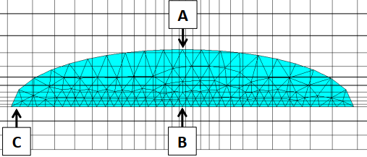
NEA CNSI XFEM Benchmark Project
Plant life extension increases probability of detecting flaws.
Efficient and effective tool for fracture analysis required.
Benchmark led by NEA CSNI.
Investigate XFEM implementation within commercial codes.
Recommend good practices and limitations of XFEM approach.
18 participant organizations.
XFEM crack definition and FE realization

Slide 7
Methods for Defining WRS
Plastic approach
Plastic deformation introduced through application of a temperature distribution.
Resetting temperature removes thermal strains.
Resulting residual stress field is insensitive to pipe boundary condition.
Requires closed crack condition.
Elastic thermal approach
Residual stress field generated using constant application of temperature distribution.
Boundary condition and mesh dependent.
Initial stress approach
Residual stress field generated through relaxation of initial stress field.
Requires closed crack condition.

Slide 8
XFEM Natural Crack Growth Validation
Abaqus based natural crack growth using iterative static analyses.
XFEM crack definition updated after each increment based on user defined growth law.
Planar flaw assumption.
WRS applied using elastic thermal approach.
Verified against independent natural crack growth calculations using traditional focused mesh approach.
Natural crack growth results for focused mesh (left) and XFEM (right) based analyses
Y. Shi, X. Duan, M. Wang, Modeling of Natural Crack Growth with XFEM, Transactions, SMiRT-25, Charlotte, NC, USA, August 4-9, 2019.

Slide 9
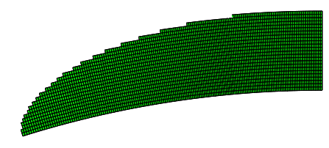
XFEM Analysis of DP-02 (1 of 5)
Half symmetry plane pipe model.
Abaqus linear stress elements (C3D8) used.
Limited mesh convergence study performed to determined appropriate mesh quality (element size approx. 0.5 mm local to crack).
Axial and global bending loads applied through DLOAD subroutine.
Static thermal field defined using UTEMP subroutine.
Example of reference crack mesh for XFEM analysis

Slide 10
XFEM Analysis of DP-02 (2 of 5)
Method of WRS application is highly mesh dependent.
Iterative WRS calibration performed.
Average absolute deviation from target WRS profile is <5 MPa.
Maximum deviation occurs close to internal and external pipe surfaces.

Slide 11
XFEM Analysis of DP-02 (3 of 5)
XFEM capable of capturing changes in local stress intensity factors.
Tunneling occurs as local stress intensity factors increase as crack approaches surface.

Slide 12
XFEM Analysis of DP-02 (4 of 5)
Results comparable to analytical models but deviate at depth.
Normalized depth crack growth
Normalized surface crack growth

Slide 13
XFEM Analysis of DP-02 (5 of 5)
XFEM surface stress intensity factors oscillation due to reducing mesh quality.
Depth stress intensity factors
Surface stress intensity factors

Slide 14
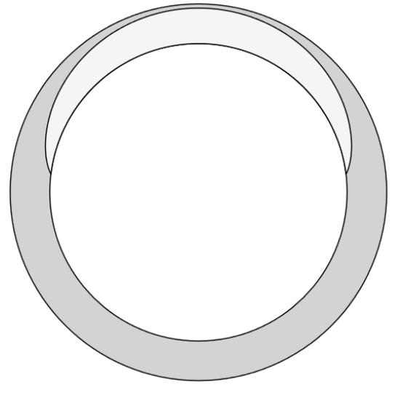
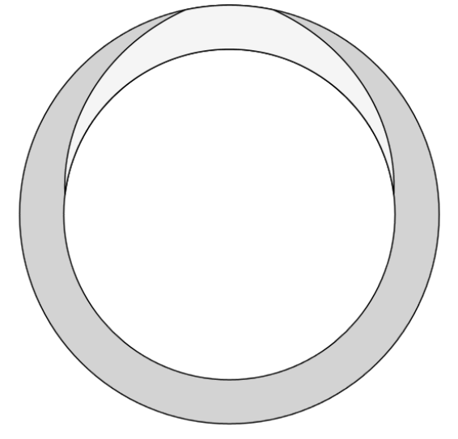
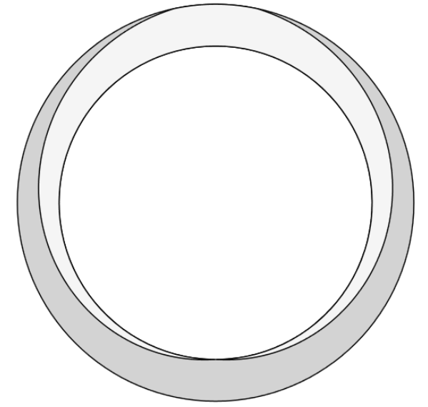
NURBIT Natural Crack Growth
In-house KIWA natural crack growth code using focused meshing.
WRS applied using elastic initial stress approach with crack faces tied (closed).
Two calculation methods available, however, both are restricted to idealized semi-elliptical cracks.
Relaxation of WRS possible, although typically only observed during large plasticity.
Tunneling effects not captured.
NURBIT Simplified
Leakage at 204 Months
NURBIT Advanced
Leakage at 395 Months

Slide 15
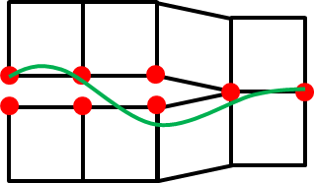
Discussion on DP-02 Results
Approximately 50% of PFM codes predicted LBB, XFEM and NURBIT also predict LBB.
Analytical fracture models and NURBIT do not capture influence of local stress intensity factors close to surface, however present XFEM analysis does.
Resulting tunneling phenomenon is primary cause for difference between XFEM and NURBIT results.
XFEM and NURBIT surface growth comparable. Analytical solutions less reliable for longer cracks due to solution limits.
XFEM and analytical models cannot capture WRS redistribution, although considered a minor effect for elastic cases.
Crack face pressure predominantly effects growth rates at depth for deeper cracks.
WRS redistribution can be modelled using traditional FEA fracture modelling
Initial stress introduced with crack closed
Crack opened allowing for stress redistribution

Slide 16
Comments of XFEM Based Natural Crack Growth
Pros
Insertion of cracks within complex geometries is greatly simplified leading to reduction in modelling time.
Results largely comparable to reference analytical solutions.
Changes in local stress intensity factors can be captured, allowing for non-linear crack extension.
Surface growth more reliable than analytical solutions for longer cracks
Cons
Only as good as the modelling assumptions.
Dense mesh required to achieve reliable results.
WRS application method limits use of adaptive meshing.
Increased computational expense for large XFEM domains.
Additionally smoothing of results along crack front required.
WRS redistribution for deeper cracks not possible due to inability to define closed crack condition as initial state

Slide 17
Conclusions
FE approaches (XFEM and NURBIT) both support LBB conclusion for DP-02 benchmark case.
Impact on PFM assessments:
Changes in local stress intensity factors are important.
Exclusion of tunneling phenomenon may result in over prediction of life.
Leak-before-break more likely than break-before-leak.
Treatment of WRS likely important for faulted conditions.
Benefit of compressive WRS may be over-estimated in cases of significant plasticity.
For PFM benchmarking, supplemental FE analysis is useful for identifying limitations in the underlying analytical models.

