Slide 1
State-of-the-art of probabilistic PTS analysis
(APAL‘s review)
Presentation at 4th ISPMNA
Ralf Tiete, Framatome GmbH

Slide 2
Content
Introduction
Overview of tools for probabilistic PTS analysis
Additional information
Conclusions for definition of state-of-the-art

Slide 3
1. Introduction

Slide 4
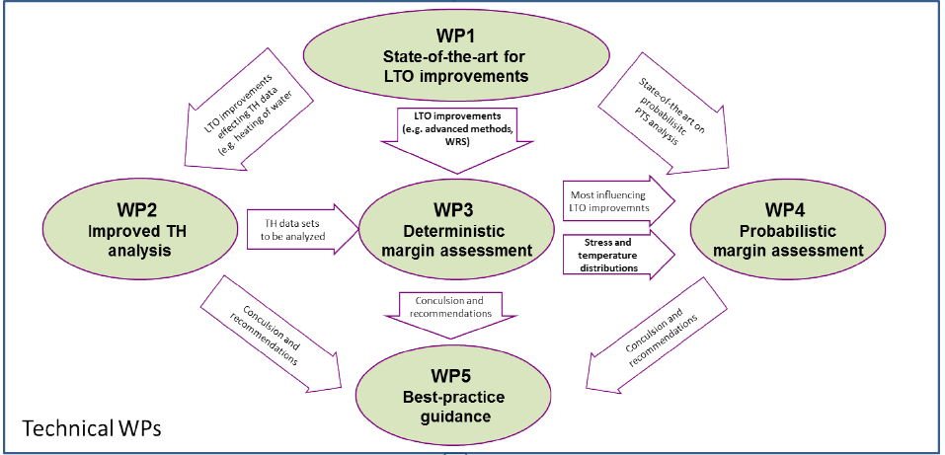
Introduction (1/3)
APAL: Advanced PTS Analysis for LTO
  Duration: Oct. 2020 – Sept. 2024
  16 partner (14 European + 2 international partner)
  5 technical WPs
Objective: Development of a guideline for advanced PTS Analysis in the scope of long-term operation (LTO)
  Increase acceptance of advanced methods (like probabilistic assessment)
  Quantification of impact (by deterministic and probabilistic approach) of
    Identified LTO improvements
    TH uncertainties
    Advanced methods
  Summarize recommendations and conclusions from performed benchmarks

Slide 5
Introduction (2/3)
Task 1.4: State-of-the-art of probabilistic PTS analysis
  Collection of experience on probabilistic PTS analysis and on tools and software currently used for probabilistic assessments
  Additional information provided for better understanding of specific topics and methods
  Simple benchmark performance to illustrate some issues when dealing with probabilistic PTS analysis
  Recommendations and conclusions as well as possible improvements for use of probabilistic PTS analysis

Slide 6

Introduction (3/3)
Detailed information are provided in WP1 public summary report
https://apal-project.eu/news/latest-insights-into-possible-impacts-on-the-results-of-pressurised-thermal-shock-analyses

Slide 7
2. Overview of tools for probabilisitc PTS analysis

Slide 8
Software and tools
Software and tools used by different partner
Partner | Tool/Software | Remark
UJV | PROVER (in-house) | Based on FAVOR and adjusted for VVER
FRA-G | In-House | modular based
PSI | FAVOR | v16.1
IPP | SIF-Master (in-house) | new version under development
KIWA | ISAAC | Probabilistic part = in-house
Tecnatom | FAVOR | v16.1
BZN | In-House | under development
JSI | FAVOR | v16.1
IRSN | In-House | under development
OCI | FAVOR | v16.1
JAEA | PASCAL | v4
GRS | PROST

Slide 9
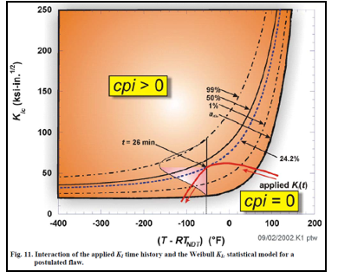
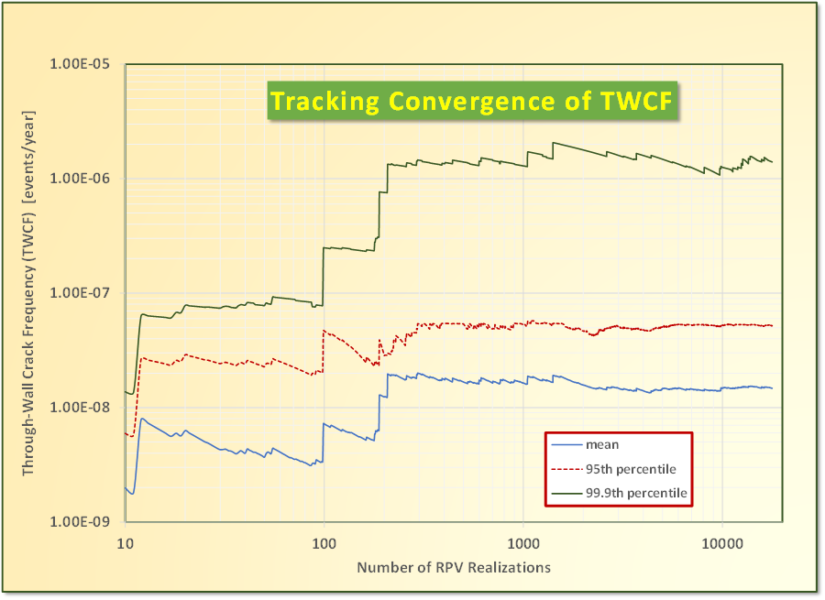
Methods for calculation of probability
Most tools use Monte-Carlo method
  General: Each Monte-Carlo run gives “0” or “1” and finally CPI = Initiation Events / #MC runs
  FAVOR/PROVER: Each Monte-Carlo run gives probability of initiation CPI = max_{t} cpi(t), because fracture toughness remains as distribution (due to aleatory uncertainty)
Some tools use:
  FORM/SORM
  MC with importance sampling
Convergence criterion for Monte-Carlo are not given explicitly
  Application of FAVOR/PROVER: Evaluation of mean/quantile value

Slide 10
Methods for sampling of input data
Sampling a normal distributed value
  General: Box-Muller transformation
  Also: Forsythe’s method
Sampling a log-normal distributed value is based on sampling the logarithm as normal distributed value
Sampling from other distributions:
  Common: Inverse transform method, i.e. x = F⁻¹(p) with F(x) distribution function and p = U(0;1)
Importance sampling: Sampling around the most probable point of failure (determined by FORM)
Combination of epistemic and aleatory uncertainties
  Sampling of epistemic uncertainties and aleatory uncertainties (initiation and arrest) remain
  Numerical integration to combine epistemic and aleatory uncertainties
Latin hypercube sampling to cover the whole range of input data (instead of random sampling)

Slide 11
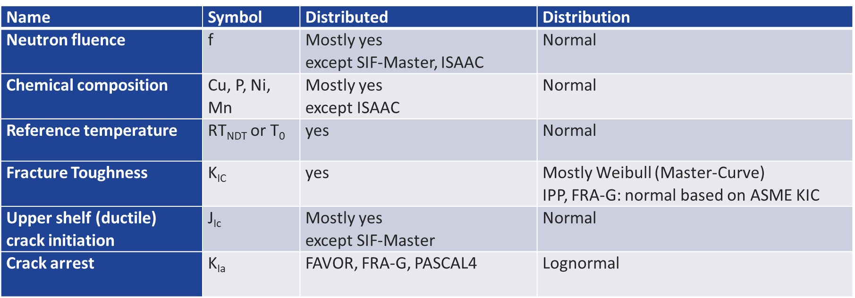
Distributed parameters
There exists a common understanding which kind of distribution to be used for which kind of data

Slide 12
Stress and temperature calculation (1/2)
Temperature and stress calculations are pre-processing assessments (3D or 1D) and it is common practice to transfer transient temperature and stress variation over wall thickness at relevant location to probabilistic fracture mechanics
Complementary (and especially for nozzle cracks) elastic-plastic FE calculations with crack are used to determine SIF
SIF-Master (IPP):
  Use exact analytical expressions for the thick-walled cylinders in combination with “indirect” solution method for the nonstationary temperature task in axisymmetric formulation with the method of further stress calculation (based on PVP2014-28997)
  Accuracy of the model is improved by separate temperature calculations for “cold” plume and “hot” rest of the reactor

Slide 13
Stress and temperature calculation (2/2)
Consideration of cold plume effect
  In general the consideration of cold plume effect is depending on the TH analysis performed and the resulting TH data used for stress and temperature calculation
  3D temperature and stress calculation and elastic-plastic FE with crack are appropriate to assess effect of cold plume
    Requirement: TH data from mixing code or from CFD
  1D temperature and stress calculation
    Use of coolant temperature and HTC in cold plume from mixing calculations
    → appropriate temperature for inside cold plume, but stresses below cold leg are not calculated appropriate
  SIF-Master (IPP):
    Separate temperature calculations for “cold” plume and “hot” rest of the reactor
    Stress task for the “hot” part is calculated. Obtained axial “hot” strain is used as a constant loading for stress calculations of cold plume
  Cold plume effect is evaluated by simplified formulations

Slide 14
Events considered
 | Brittle Initiation | Ductile Initiation | Ductile crack growth | Crack Arrest | Crack interaction | WPS
PROVER | yes | yes | no | no | no | no
FAVOR | yes | yes | yes | yes | no ⁽¹⁾ | yes
ISAAC | yes | yes | yes | no | no | no
SIF-Master | yes | no | no | no | no | no
FRA-G in-house | yes | yes | no | yes | no | yes
PASCAL4 | yes | yes | yes | yes | no | yes
PROST | yes | yes | yes | no | no | no
(1): Chemistry re-sampling for multiple flaws
Failure criteria:
  Initiation = Failure
  Through-wall cracking (usually 80%-90% of thickness) = Failure
  Plastic collapse (in addition to through-wall cracking) = Failure

Slide 15
Type of flaws and SIF solutions
Common: Use of analytical SIF solutions taking into account stresses from linear-elastic FE calculations
Some Tools also include plastic correction (analytical)
 | Surface cracks | Underclad cracks | Embedded cracks
PROVER | no | yes | yes
FAVOR | yes | no | yes
ISAAC | yes | no | yes
SIF-Master | yes | yes | yes
FRA-G in-house | yes | yes | yes
PASCAL4 | yes | yes | yes
PROST | yes | no | no

Slide 16
Flaw distribution
General approaches for size and orientation (all tools):
  Flaw depth: log-normal or exponential distribution
  Flaw length: log-normal or exponential distribution (Aspect ratio: log-normal or normal distributed)
  Orientation: Uniform (only relevant if multiple flaws are assessed)
Flaw density:
  FAVOR:
    Surface cracks: Exponential distribution
    Embedded cracks: Poisson distribution (distinction between small and large embedded flaws in weld and base metal)
  Underclad cracks: Information are given in NUREG 1806, but no explicit distribution
Use of “simulation tools” to generate distributions (size and/or density)

Slide 17
3. Additional Information

Slide 18
Aleatory and epistemic uncertainty
Epistemic uncertainty is related to limited data and knowledge to describe the correct (unknown) value of a parameter
  Epistemic uncertainty can therefore be reduced by increasing the state of knowledge
  Epistemic uncertainty in material properties is mainly related to the limited number of available test material, constraint or implicit bias
Aleatory uncertainty is due to the randomness of a process or parameter
  Aleatory uncertainty is irreducible and describes the randomness of the parameter
  In the scope of probabilistic fracture mechanics assessments, aleatory uncertainty is mostly related to material properties because of inhomogeneity or material variability
  FAVOR: Aleatory uncertainties (initiation and arrest) remain
  → Impact on CPI and CPF (mean value, tolerance bounds)
  PASCAL v4: Numerical integration to combine epistemic and aleatory uncertainties

Slide 19
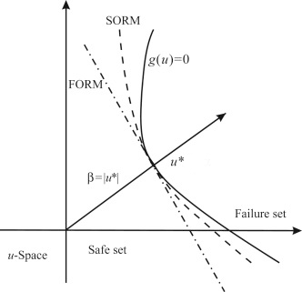
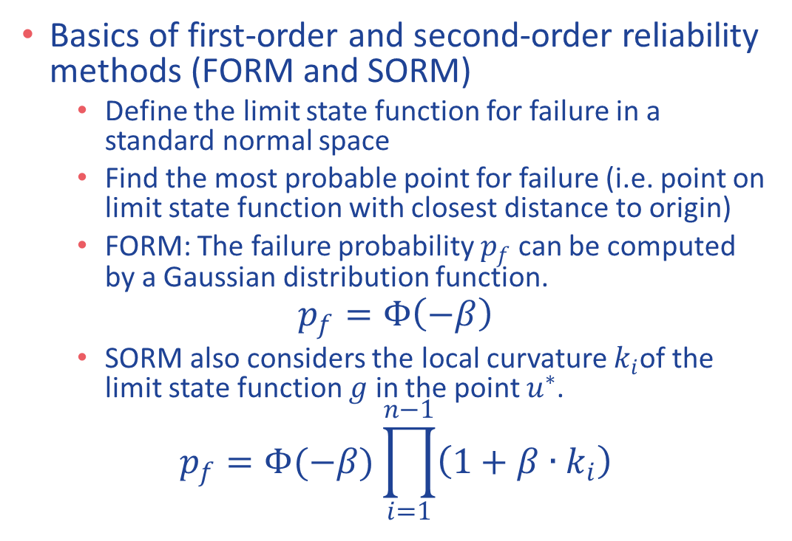
Description of FORM/SORM
Basics of first-order and second-order reliability methods (FORM and SORM)
  Define the limit state function for failure in a standard normal space
  Find the most probable point for failure (i.e. point on limit state function with closest distance to origin)
  FORM: The failure probability $p_{f}$ can be computed by a Gaussian distribution function.
$$p_{f}=Φ\left(−β\right)$$
  SORM also considers the local curvature $k_{i}$of the limit state function $g$ in the point $u^{∗}$.
$$p_{f}=Φ(−β)\prod_{i=1}^{n−1}{\left(1+β∙k_{i}\right)}$$

Slide 20
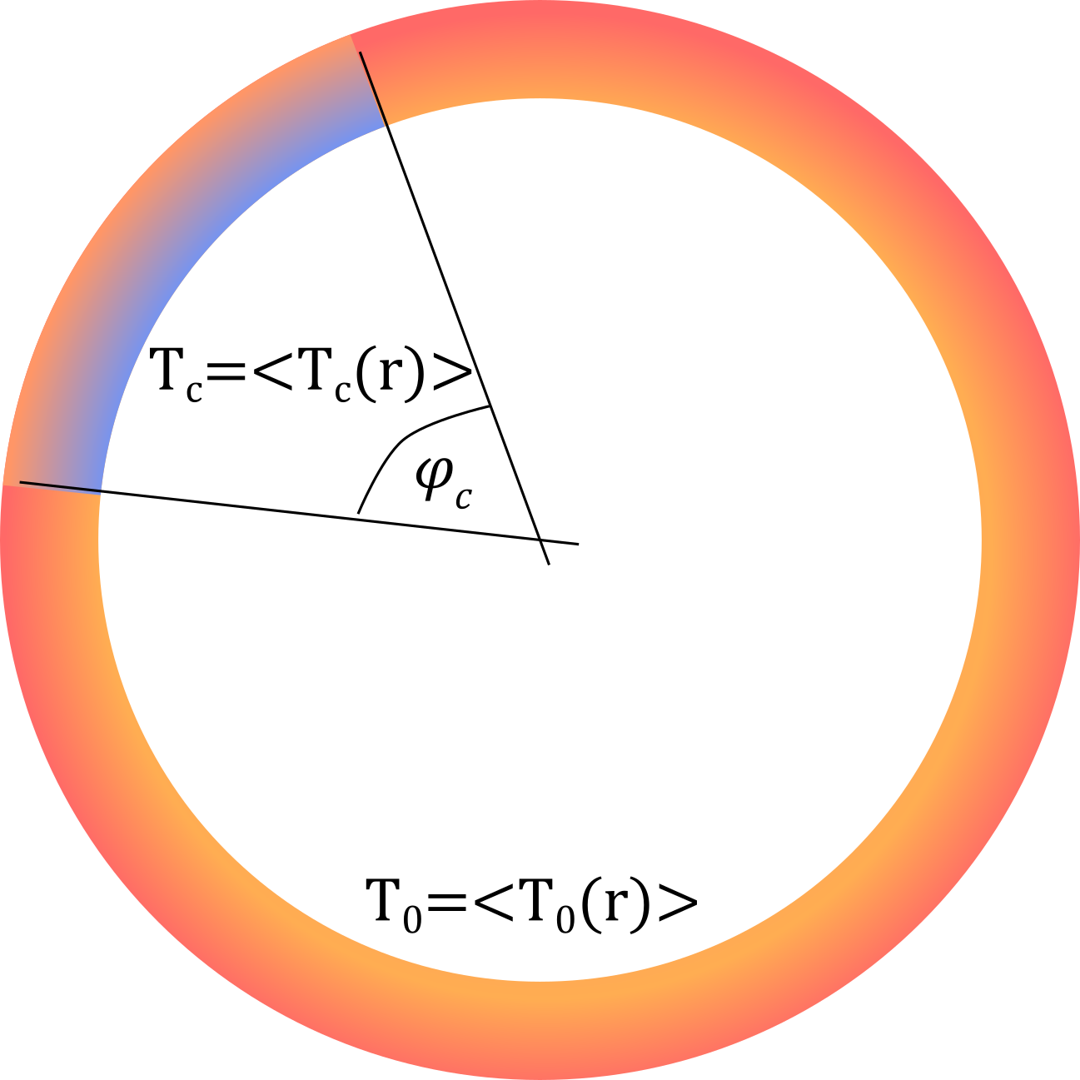
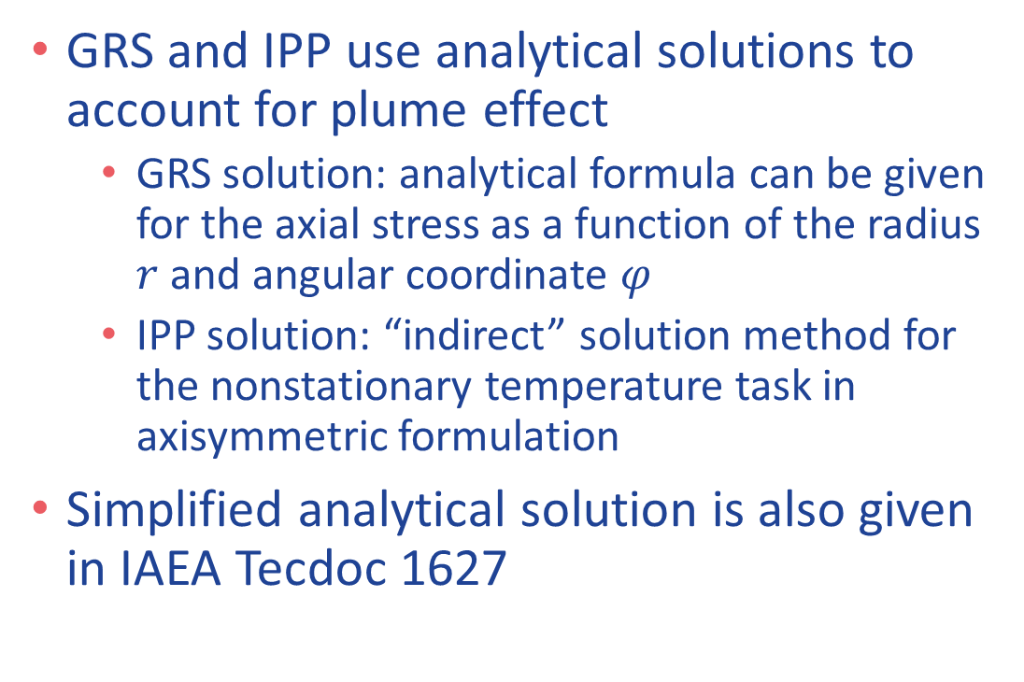
Analytical formula to account for plume effect
GRS and IPP use analytical solutions to account for plume effect
  GRS solution: analytical formula can be given for the axial stress as a function of the radius $r$ and angular coordinate $φ$
  IPP solution: “indirect” solution method for the nonstationary temperature task in axisymmetric formulation
Simplified analytical solution is also given in IAEA Tecdoc 1627

Slide 21
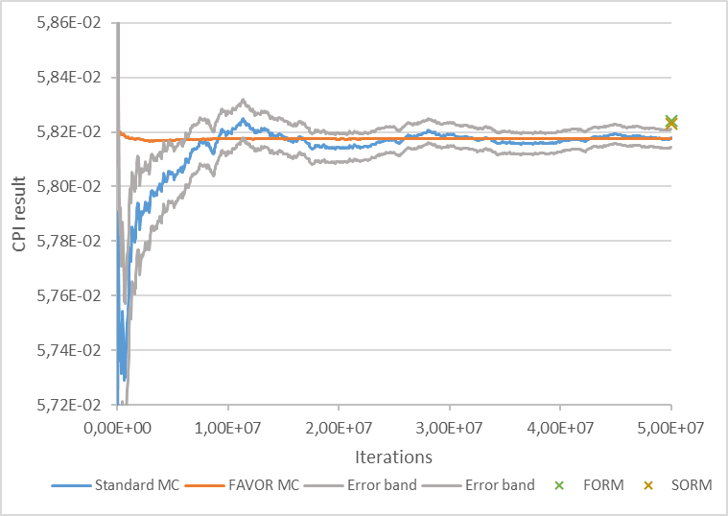
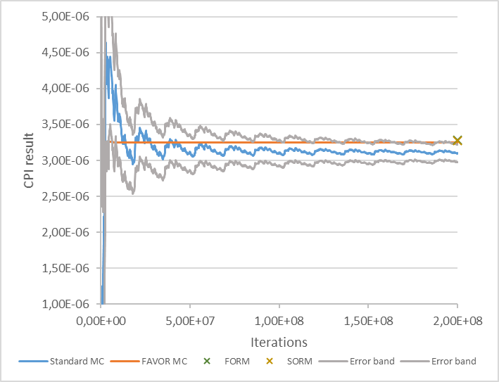
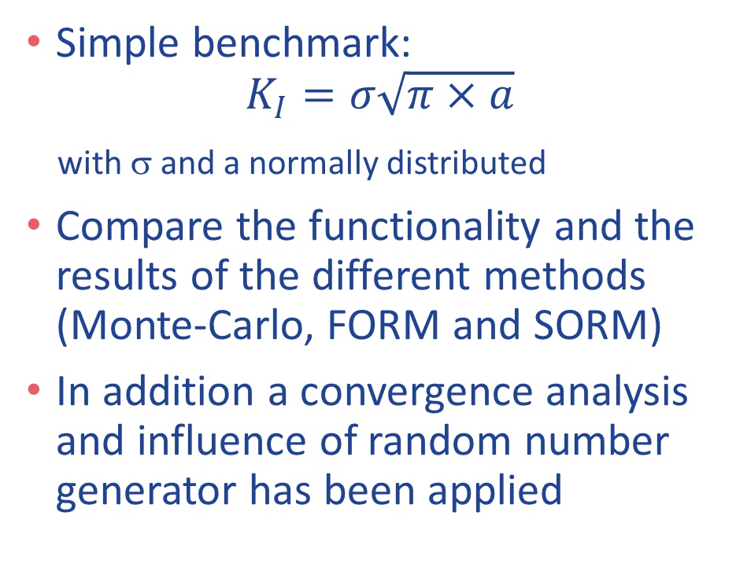
Simple benchmark
Comparison and Convergence of different methods
FORM/SORM less exact for higher probabilities
Simple benchmark:
$$K_{I}=σ\sqrt{π×a}$$
with σ and a normally distributed
Compare the functionality and the results of the different methods (Monte-Carlo, FORM and SORM)
In addition a convergence analysis and influence of random number generator has been applied
Repeating results due to limitation of random number generator

Slide 22
4. Conclusions for definition of state-of-the-art

Slide 23
Methods for probabilistic PTS analysis (1/2)
Common practice to use Monte-Carlo method for calculation of probability
  All uncertainties are sampled
  → Each MC run gives either “failure” or “non-failure”
  Fracture toughness and arrest toughness are not sampled, they remain as distribution (due to aleatory uncertainties)
  → Mean value and standard deviation of probability related to aleatory uncertainties
  (It should be mentioned, that the standard deviation related to these aleatory uncertainties is not an indicator for the convergence of the Monte-Carlo method
Convergence of the Monte-Carlo method is an important issue that needs to be addressed as it provides information on how accurate the result is
  It is recommended to address the convergence of a Monte-Carlo method by a quantification of the coefficient of variation, and/or standard error
Appropriate random number generator is needed to ensure an adequate result not impacted by the limitation of the sequence of random numbers
  Commonly used is the Mersenne Twister Algorithm and other self-made algorithms

Slide 24
Methods for probabilistic PTS analysis (2/2)
FORM and SORM are commonly used probability estimation methods
  Calculation of initiation or failure probability
  Sensitivity study to quantify the impact of different input data
  Importance Sampling
If FORM/SORM is used for calculation of probability of initiation or failure for PTS analysis, some inherent uncertainties due to the method remain:
  Error in finding most probable point
  Goodness of first-order or second-order approximation
  Transformation into standard normal space by inverse sampling
  Approximation for limit state function with no closed solution

Slide 25
Methods for sampling
For sampling of data the following methods are commonly used:
  Sampling from (standard) normal distribution: Box-Muller transformation
  Sampling from log-normal distribution: Sampling the logarithm as normal distributed value
  Sampling from arbitrary distribution: Inverse transform method, i.e. x = F⁻¹(p) with F(x) distribution function and p = U(0;1) uniformly distributed between 0 and 1
In order to ensure a representative covering of all possible sets of distributed input data, sampling methods like Latin hypercube sampling or orthogonal sampling can be used
  This becomes important, when the number of distributed input data is large and both aleatory and epistemic uncertainties are considered
  For typical probabilistic PTS analysis with more than 10⁶ Monte-Carlo runs and less than 10 sampled input data, a random sampling is sufficient

Slide 26
Events considered
It is obvious that brittle crack initiation is always considered as “main” event
  Without crack arrest, inherent safety margin in the RPV failure probability exists
For an appropriate determination of RPV failure probability, it is common practice to assess crack arrest and possible re-initiation after arrest
  RPV failure = crack reaches a pre-defined fraction of the RPV wall
  The use of an appropriate pre-defined fraction should be verified (e.g. instability of remaining ligament)
  Common understanding that a value in the range of 75% to 90% is appropriate for PTS assessment
  Some tools use net-section collapse of the remaining ligament directly in addition to the use of a pre-defined fraction of the RPV wall
Although a potential ductile fracture initiation might be of minor importance for a PTS analysis, it should also be taken in account
  It becomes more important when crack arrest is considered, because crack re-initiation may occur in warmer regions of the RPV wall
  Consideration should be done either by explicitly considering ductile fracture initiation as an event in the probabilistic approach or by a case-specific evaluation of relevance of ductile fracture initiation by a deterministic approach

Slide 27
Fracture mechanics models
For probabilistic PTS analysis it is common practice to use the well-established fracture mechanics models from deterministic analysis, especially
  stress intensity factor solutions
  limit load analysis for cracked structures
  ductile crack growth
It is common understanding that several solutions are adequate for the case of interest, but with different amount of inherent margin
Fracture mechanics models like brittle or ductile fracture initiation or crack arrest are more or less related to the distributions used for the material properties

Slide 28
Treatment of loading
Temperature and stress calculations (3D or 1D) are usually pre-processing assessments for probabilistic PTS
Most tools are assessing a single location of the RPV (e.g. core weld) with a representative stress and temperature distribution
It is possible uses to combine several loading regions of the RPV by post-processing
The consideration of cold plume effect for probabilistic PTS analysis is done in many different ways
  For 1D FE: Temperature input for inside plume → appropriate temperature, but non-conservative stresses
  Simplified formula for stresses (requirement: appropriate temperature for inside plume)
  3D FE: Temperature and HTC is mapped from 3D TH data → appropriate temperature and stresses

Slide 29
Distributed Parameters and flaw distribution
For most relevant input data there exists a common understanding which kind of distribution to be used for which kind of data
Concerning postulated flaws it is common practice to assess inner surface (trough clad), embedded and/or underclad cracks
A common understanding exists for flaw size distributions
An explicitly assessment of multiple flaws is possible with some tools, although an assessment will be possible anyway by post-processing

Slide 30

Thanks for your attention and now time for questions…

