Slide 1
Surrogate Modelling and Uncertainty Quantification of Crystal Plasticity Finite Element Simulations
Hugh Dorward
Matthew Peel
Mahmoud Mostafavi
University of Bristol, Department of Mechanical Engineering

Slide 2
Introduction and outline
Surrogate modelling process and approaches.
Surrogate modelling applications.
Applications to crystal plasticity finite element modelling.
Illustrative example – grain size effect of polycrystals:
Creating the surrogate model.
Leveraging the model for forward and inverse uncertainty quantification.
Concluding remarks.

Slide 3
Some context
Probabilistic methods can allow detailed quantification of uncertainties in plant design.
This can have applications across the design including structural integrity, thermal hydraulics, fuel modelling.
Surrogate models are one such method. They allow less computationally expensive evaluation of models while accounting for different sources of uncertainty in the prediction.

Slide 4
The surrogate modelling process
Complex Model
Output Variables
$$y=f\left(X\right)$$
$$y_{1}$$
$$y_{2}$$
.
.
$$y_{N}$$
Training from N model evaluations
Input Variables
$$X_{1}$$
$$X_{2}$$
.
.
$$X_{N}$$
Training Data
Validation
Predicted Output
$${\hat{y}}_{1}$$
$${\hat{y}}_{2}$$
.
.
$${\hat{y}}_{N}$$
Surrogate Model
$$y=\hat{f}\left(X\right)$$

Slide 5
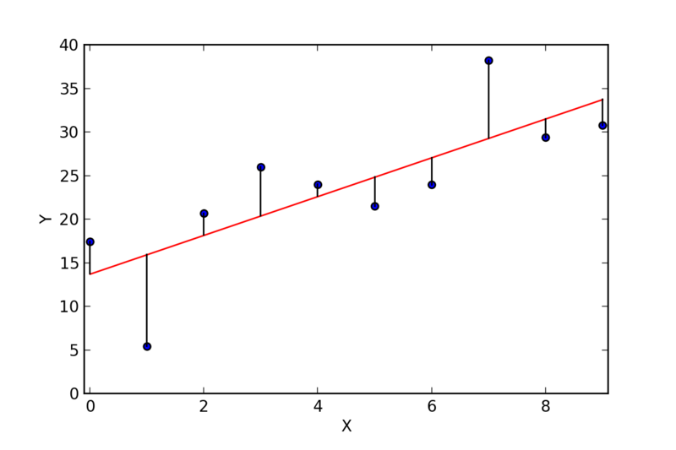
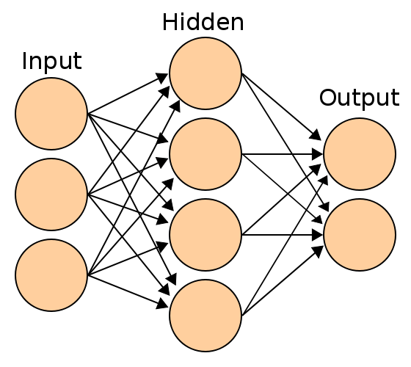
Types of surrogate
Linear models
Polynomial models
Support vector regression
Neural networks
Random forest regression
Gaussian process regression/Kriging
Linear regression model
Example decision tree, the building block of random forest algorithms
Example neural network architecture

Slide 6
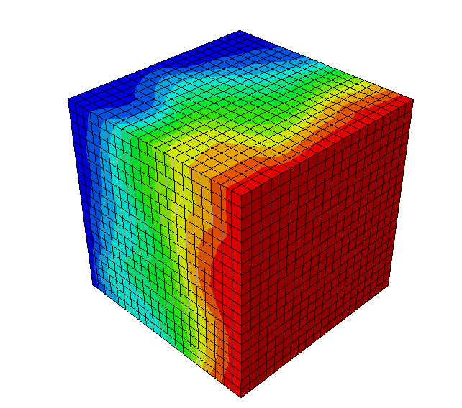
Applications
Sensitivity Analysis
Uncertainty quantification
Calibration
Bridging modelling length scales
Input Random Variables
Output Response PDF
Surrogate Model
$$y=\hat{f}\left(X\right)$$
$$x_{1}$$
$$x_{2}$$
$$\hat{y}$$
Computational Model

Slide 7
Crystal plasticity finite element modelling
Mesoscale model which accounts for the microstructure of a material.
Promising for developing accurate predictions particularly for applications such as weld microstructures.
However, models can be very computationally expensive and simulations are typically limited to small volumes of material.
Therefore, promising for a large number of surrogate modelling applications.

Slide 8
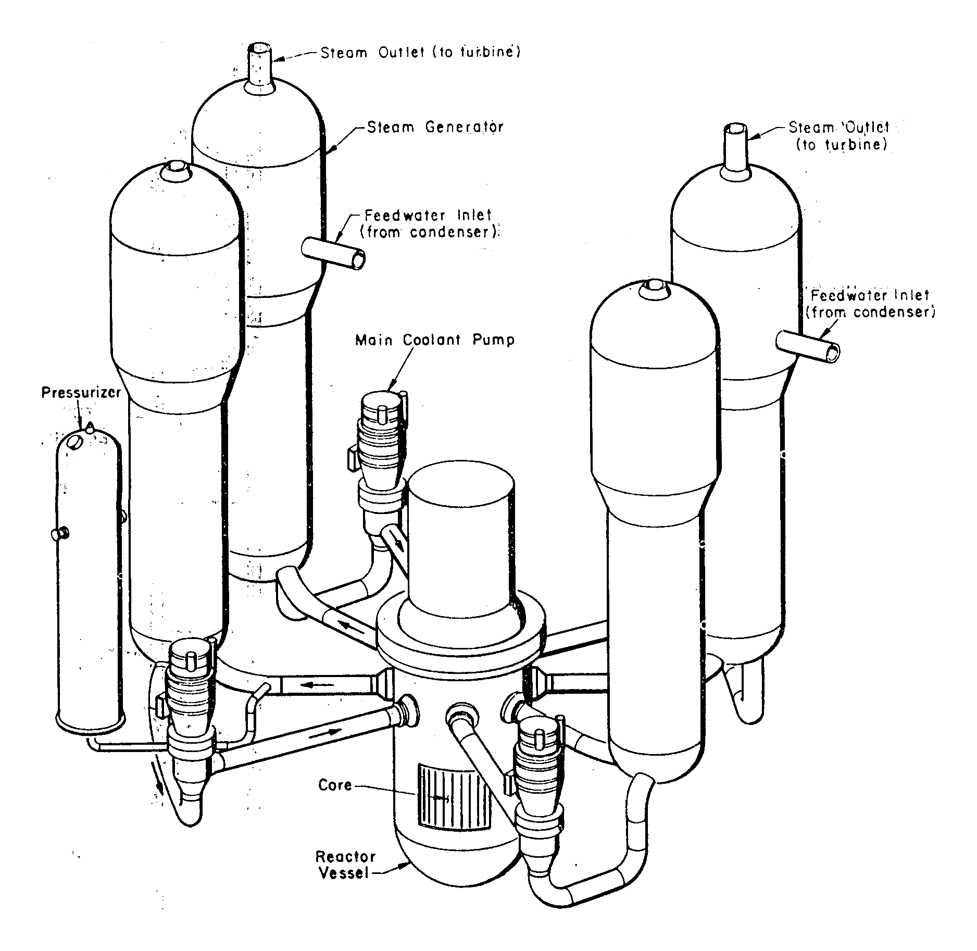
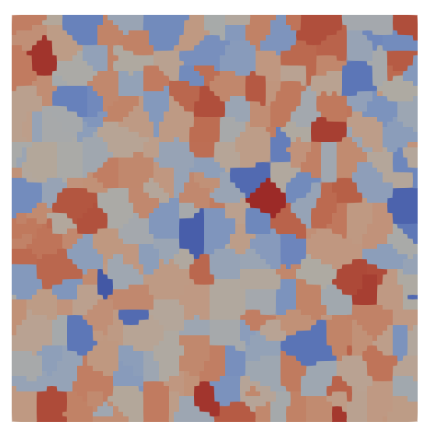
Crystal plasticity finite element modelling
Parent
HAZ
Fusion zone
²Mokhtarishirazabad et al. 2021
¹WASH-1400 report 1975
US Nuclear Regulatory Commission, 1975. Reactor safety study-an assessment of accident risks in US commercial nuclear power plant. WASH-1400.
Mokhtarishirazabad, M., Simpson, C., Kabra, S., Horne, G., Palmer, I., Moffat, A., Truman, C., Knowles, D. and Mostafavi, M., 2021. Evaluation of fracture toughness and residual stress in AISI 316L electron beam welds. Fatigue & Fracture of Engineering Materials & Structures, 44(8), pp.2015-2032.

Slide 9
Illustrative example – the grain size effect in a polycrystal RVE
The grain size effect on the yield strength is well described by the Hall-Petch relationship:
$$σ_{y}=σ_{y,0}+\frac{k}{\sqrt{d}}$$
Strain gradient crystal plasticity is able to inherently account for this effect.
A surrogate model of this crystal plasticity model is developed relating grain size to yield stress.
This example demonstrates how uncertainty can be treated within a surrogate modelling framework.

Slide 10
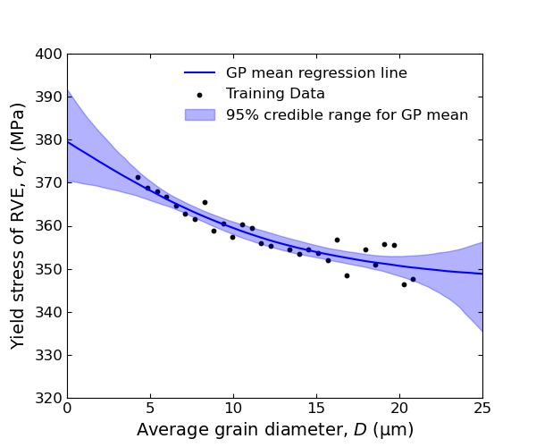
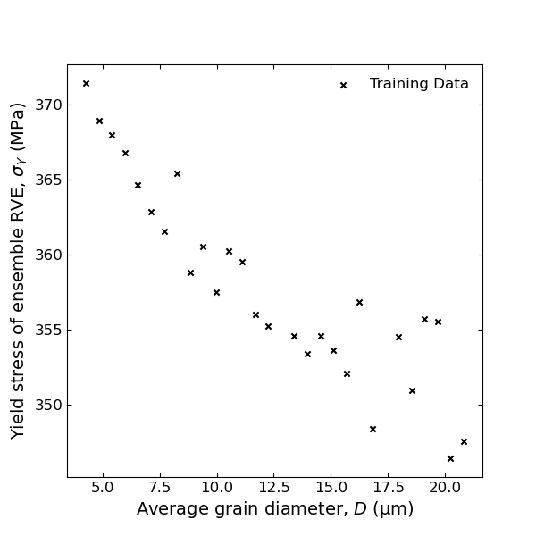
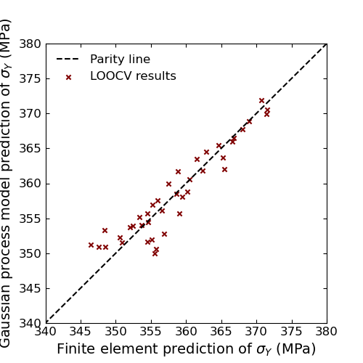
Constructing the surrogate
.
.
.

Slide 11
Separating aleatoric and epistemic uncertainty
There are two important types of uncertainty involved with the model:
Aleatoric uncertainty:
Due to statistical variation between the RVEs
Equivalent to random noise one would expect to see in physical experiment
Epistemic uncertainty:
Uncertainty in the model itself
An estimate for the epistemic model uncertainty is captured in the covariance matrix of the Gaussian process

Slide 12
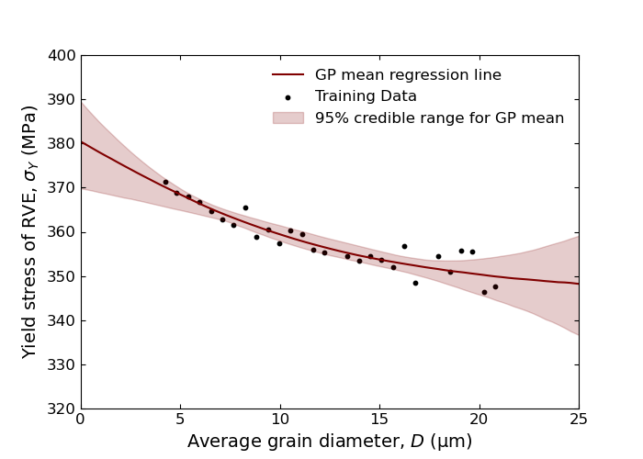
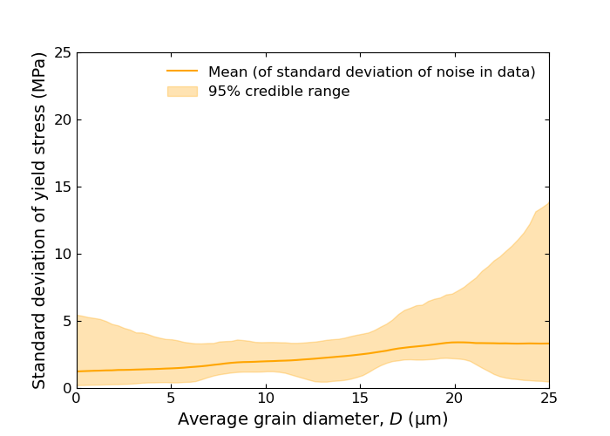
Latent model
For homoscedastic noise:
$$y=\hat{f}\left(x\right)+ ε$$
$$ε\sim 𝒩(0,σ^{2})$$
For heteroscedastic noise:
$$y=\hat{f}\left(x\right)+ ε(x)$$
$$ε\sim 𝒩(0,σ^{2}(x))$$

Slide 13
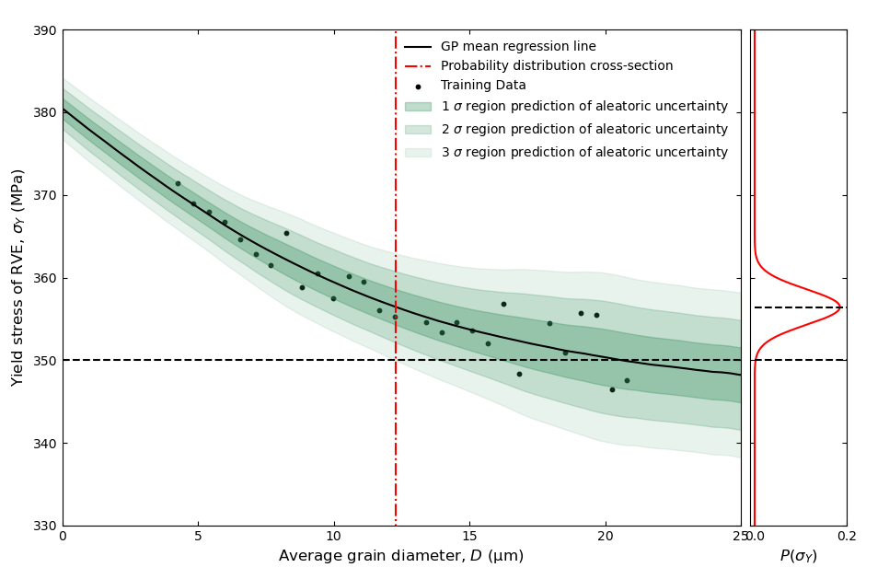
Forward & inverse uncertainty quantification
Propagating uncertainty through the surrogate model to account for aleatoric and epistemic uncertainty is much quicker than evaluating the finite element model.
The separation of uncertainties allows relatively simple evaluation of inverse statistical problems.
I.e. – aleatoric uncertainty allows quantification in the confidence of a certain outcome.

Slide 14
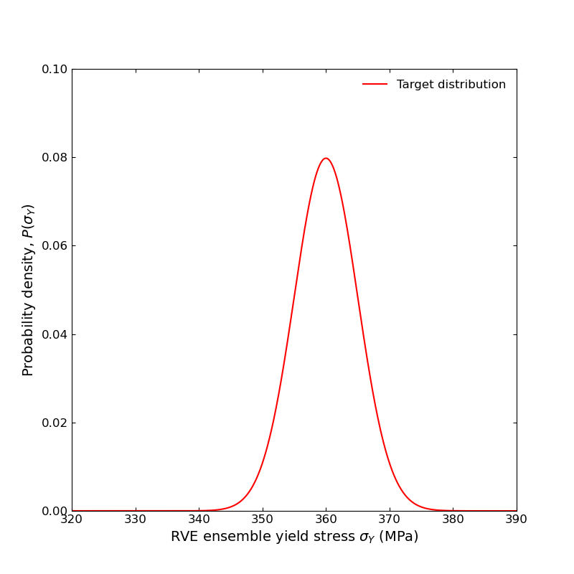
General probabilistic inverse problem
?

Slide 15
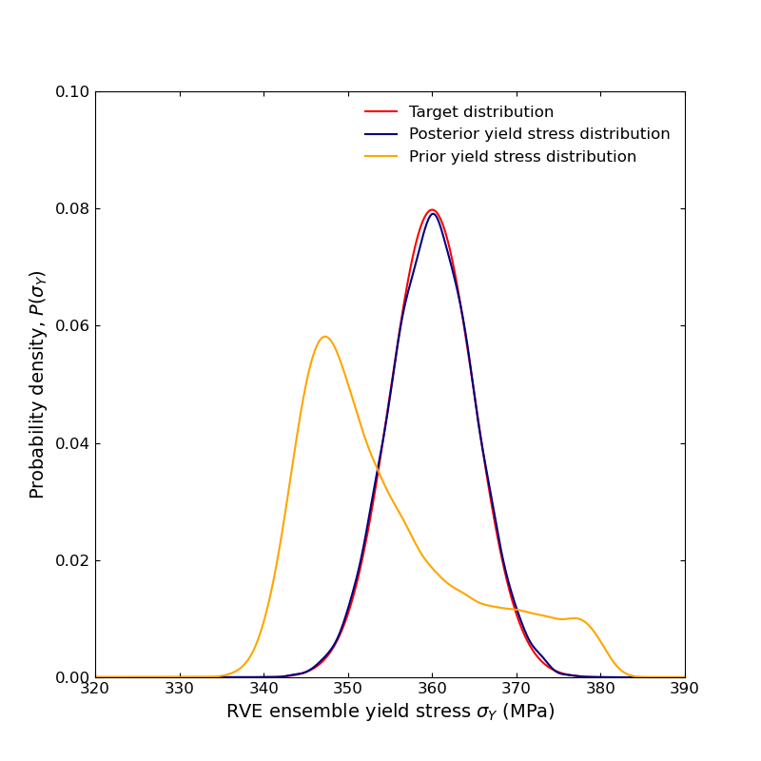
General probabilistic inverse problem

Slide 16
Concluding remarks
This example demonstrates the power of surrogate modelling methods:
Can solve problems that would be computationally prohibitive
Allows thorough treatment of uncertainties
Future work:
Calibration of crystal plasticity model parameters under uncertainty
Surrogate modelling applications to bridge the lengthscale between material microstructure and macroscopic response

Slide 17
Thank you for your attention
hugh.dorward@bristol.ac.uk

