Slide 1
FAVPRO NRC’s New Probabilistic RPV Integrity Assessment Tool
Patrick Raynaud
Senior Materials Engineer
U.S. Nuclear Regulatory commission
Patrick.Raynaud@nrc.gov

Slide 2
Disclaimer
This presentation was prepared as an account of work sponsored by an agency of the U.S. Government. Neither the U.S. Government nor any agency thereof, nor any of their employees, makes any warranty, expressed or implied, or assumes any legal liability or responsibility for any third party’s use, or the results of such use, of any information, apparatus, product, or process disclosed in this presentation, or represents that its use by such third party would not infringe privately owned rights. The views expressed in this paper are not necessarily those of the U.S. Nuclear Regulatory Commission.

Slide 3
Acknowledgements
U.S. NRC
Chris Ulmer, Chris Nellis
Archaeologic Inc.
Damian Rouson, Karla Morris, Brad Richardson, Kate Rasmussen, Giovanni Facco
NUMARK Associates, Inc.
Terry Dickson, Marvin Smith, Andrew Dyszel

Slide 4
Past: FAVOR-v16.1
Developed and issued by ORNL late 2016
Legacy Fortran
FAVOR = FAVLOAD + FAVPFM + FAVPOST
3 executables
Information passed via formatted text files
Serial and sequential code
Software Quality Assurance (SQA) gaps
ML20017A171
ML20017A170

Slide 5
Past: FAVOR-v16.1 SQA
Assessment of SQA documentation revealed gaps
FAVOR was developed under ORNL SQA program, but documentation lost in time
What we had:
Small integration test suite: 27 cases with poor coverage
Theory and User manuals
Many reports on FAVOR documenting its use and benchmarking
What was missing:
SQA documentation
Good descriptions of source code structure
Source code version control

Slide 6
Vision and Goals for FAVOR Modernization
Completely refactor the code to create an improved tool with equivalent capabilities, written in modern Fortran
GOALS
Maintainability
SQA and V&V improvements (testing and documentation)
Modularity (make the code adaptable, enable easier feature addition)
Modern programming:
Object-oriented code
Parallel code (performance improvements)
Maximize automation for testing and documentation
Merge the 3 sub-codes into 1 program: FAVPRO
Use State-of-Practice tools and libraries
GitHub: source control
Fortran Package Manager for building and testing
Veggies/Garden: unit testing framework
Java Script Object Notation [JSON] for I/O

Slide 7
Present: FAVOR-v20.1.12
CMake build system
Source code improvements:
Convert to free form ‘.f90’ files
Modularization
Begin removal of obsolete Fortran
Testing improvements:
New integration tests for better coverage (58 tests)
A few unit tests
Automatically run testing on GitHub for all code changes
Documentation
Automatically generate developer documentation
FORD: Fortran Documenter
Detailed code descriptions from source parsing
Created new SQA documents:
SQAP: ML21180A161
CMMP: ML21180A167
SRD: ML21246A230
SDD: ML22132A068
Created new Manuals:
User Manual: ML21175A301
Theory Manual: ML21175A300

Slide 8
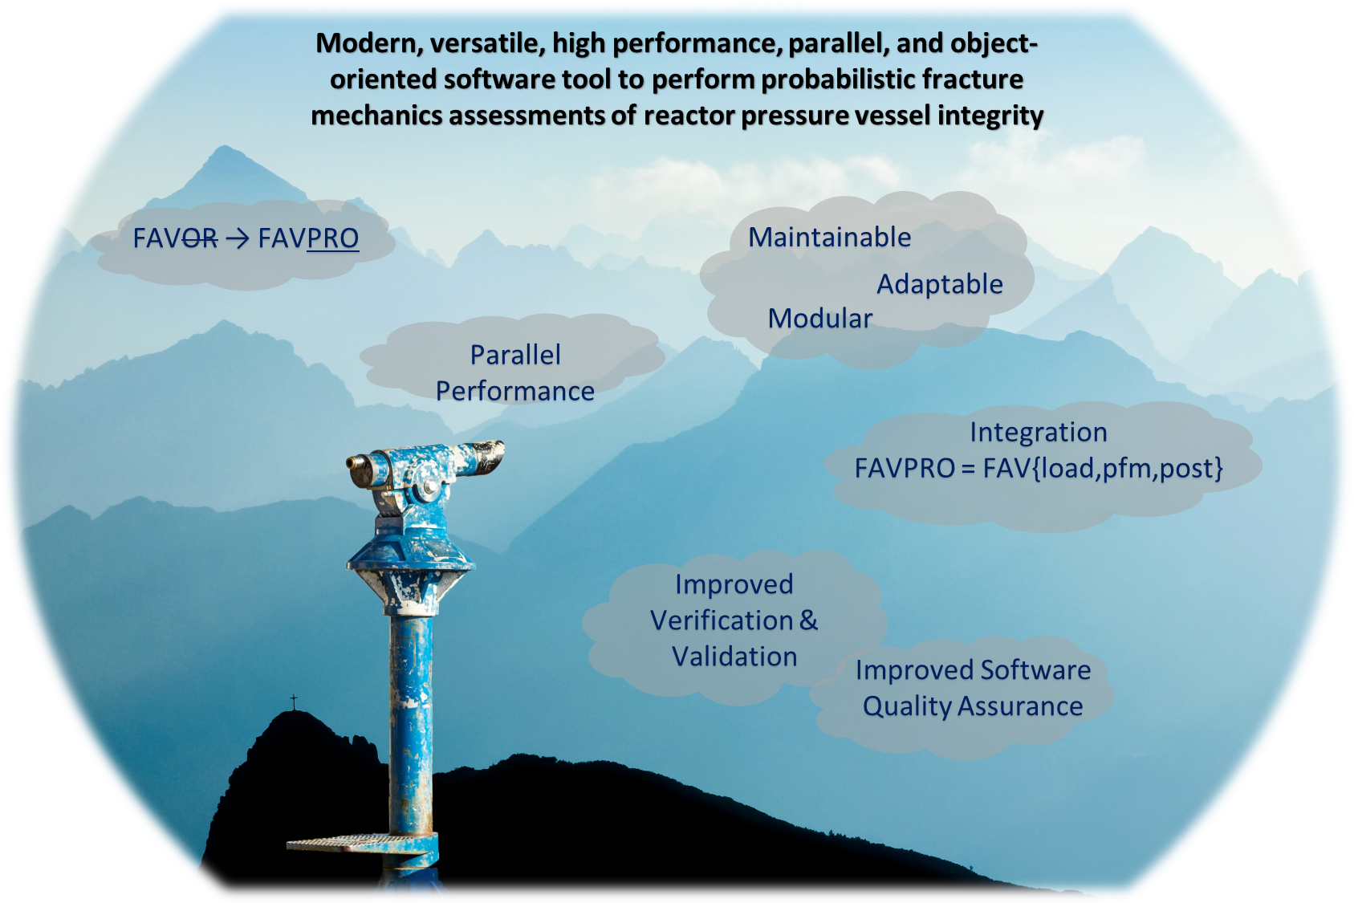
Future: FAVPRO

Slide 9
FAVPRO: Leveraging the Modern Fortran Ecosystem
Fortran has a growing user community and there is renewed interest in the language
Fortran 2018 is a modern object-oriented parallel programming language
High performance for scientific and engineering computations (one of the best)
We use the following libraries
fpm: Fortran Package Manager as the building and testing system
veggies/garden for unit test development
assert: assertion utility -> prerequisite checks
quaff: quantities for Fortran -> unit tracking
rojff: return of JSON for Fortran -> JSON interface
erloff: errors and logging for Fortran
iso_varying_string: implementation of Fortran ISO_VARYING_STRING

Slide 10
FAVPRO: Development Status
JSON I/O mostly implemented (ongoing)
Full modularization complete
Refactoring ongoing: goal is 100% in the next year
Corrected minor bugs with little impact on the results
Move towards object-oriented functional programming (ongoing)
Merge the 3 sub-programs to reduce/remove intermediate I/O (2/3 complete)
Parallelization: the last step (not yet started)

Slide 11
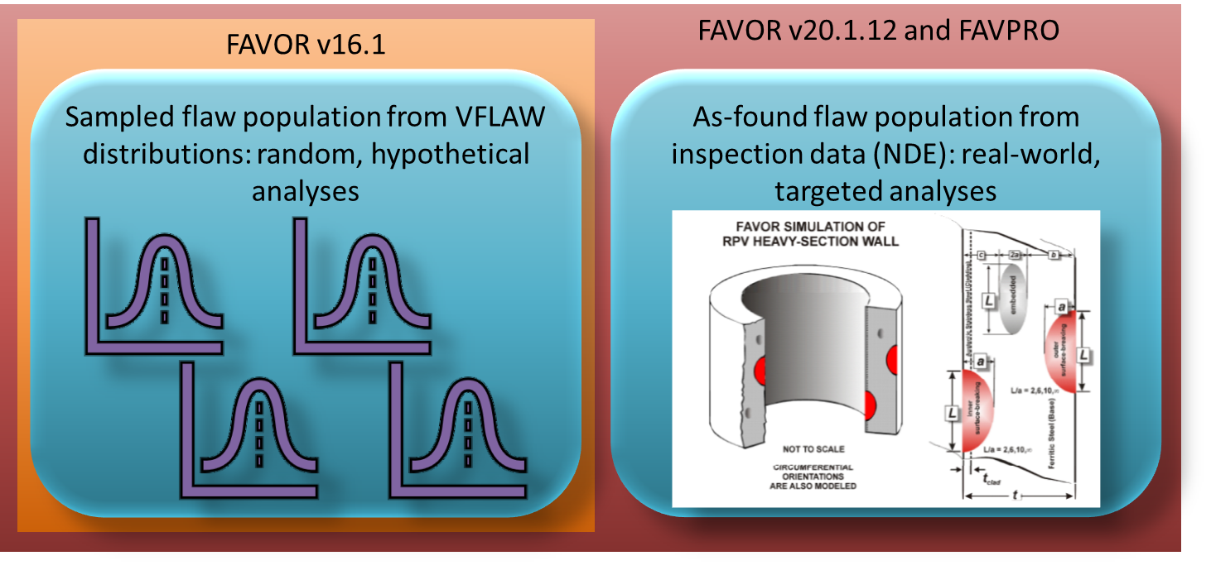
FAVPRO Features: As-Found Flaw Population

Slide 12
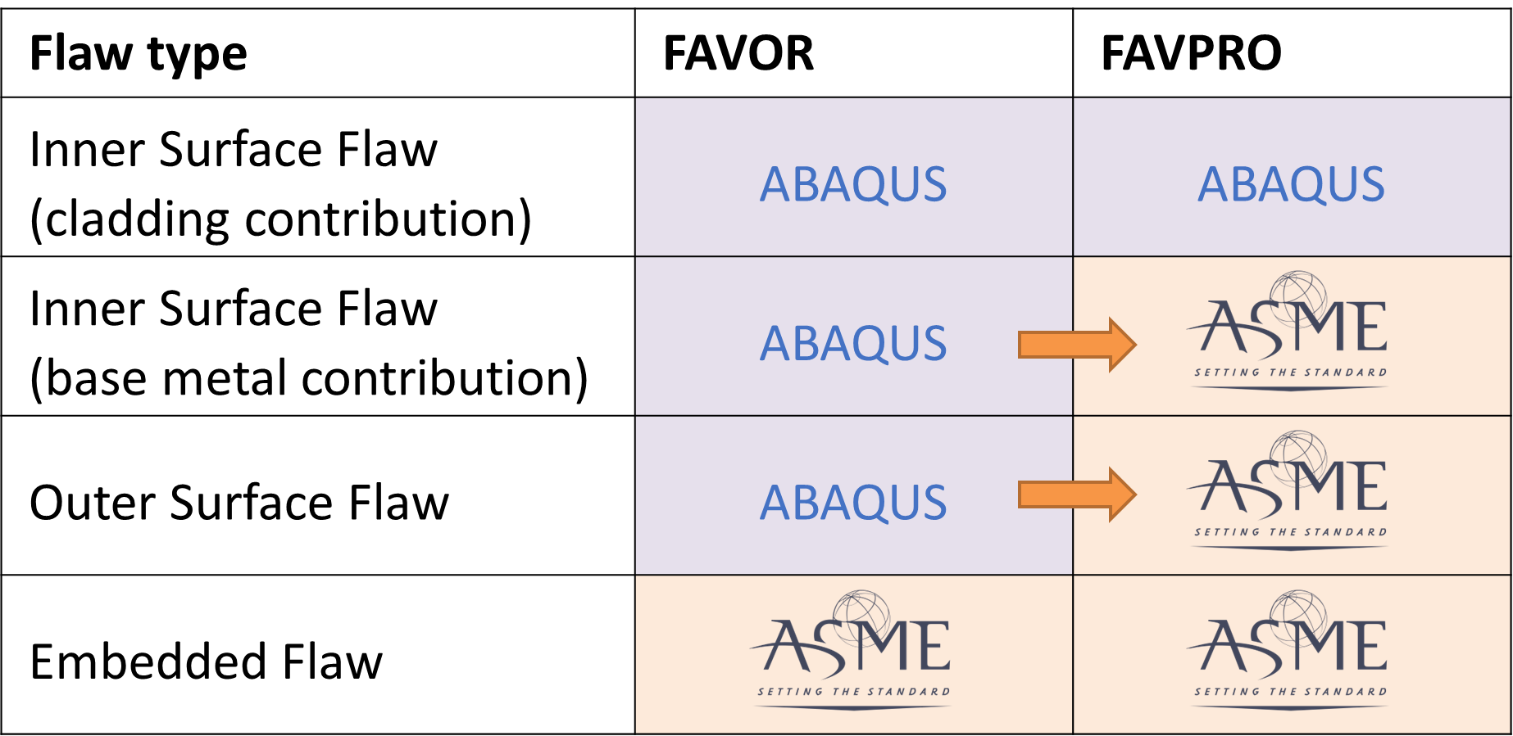
FAVPRO Features: Increased Use of ASME Standard

Slide 13
FAVPRO Features: New Embrittlement Trend Curves (ETC)
Currently available ETC
RG-1.99 Rev. 2
EONY 2000 and 2006
To be consolidated into latest EONY model (2013?)
Kirk 2007, Radamo 2007, and Kirk+Radamo 2007
Early versions of ASTM E-900 model: to be removed
Add ‘mainstream’ embrittlement trend curves to the FAVPRO options
ASTM E-900
Japanese model (update to JEAC4201, recently presented at FONTEVRAUD-10)
French model (2011: FONTEVRAUD-7, or more recent if available)

Slide 14
FAVOR/FAVPRO User Group
To obtain FAVOR and/or FAVPRO:
Fill out the NRC Codes NDA
Once approved, the code executables and input generator are downloaded via NRC’s BOX service
All approved users become members of the User Group
Regular meetings (first meeting on 5/19/22-5/20/22), then short virtual updates (3-6 months), one longer meeting annually (format TBD)
Newsletters
New code versions
User input to the development team is encouraged (bugs, new features, etc.)
Cost: free!
Could change at some point, but not in immediate future
What about source code?
Can be obtained on special case-by-case basis, pending approval of special request
Send any FAVOR/FAVPRO questions to Patrick.Raynaud@nrc.gov

Slide 15
Summary and Perspectives
FAVPRO is a new tool to replace FAVOR
Enhanced SQA pedigree and testing
Modern, modular, parallel code for enhanced performance, enhanced user experience, and enhanced adaptability
New features:
As-found flaw modeling
Standard conforming K solutions where possible (ASME)
New embrittlement trend curves to reflect the latest standards and research
FAVPRO is a robust and resilient foundation that can be built upon to add new models, new probabilistic functionality, new materials, and new physical models to adapt to the rapidly evolving nuclear technology landscape

Slide 16
For questions about FAVPRO Patrick.Raynaud@nrc.gov

