Slide 1
History and Progress of Probabilistic Methodologies in Japan
Haruko Sasaki
Nov. 2022
Regulatory Panel for 4th International Symposium on
Probabilistic Methodologies for Nuclear Application
The evolving perception of probabilistic applications in the nuclear regulatory environment.

Slide 2
PFM; History and Progress
[1987-]
The Japan Welding Engineering Society (JWES) stared to pay attention to the usefulness of PFM.
[1996-]
PFM sub committee of JWES has been conducting surveys and applied research on PFM-related technology from 1996.
Japan Atomic Energy Agency (JAEA) started to build PFM Code “PASCAL”.
[2018]
The Japan Electric Association (JEA) was established PFM standard as “JEAC4640 Calculation Guideline for Failure Frequency of Reactor Pressure Vessel Based on Probabilistic Fracture Mechanics”.

Slide 3
[2018]
Through the NRA technical evaluation of JSME ISI Code, PFM by PASCAL4 of JAEA was used for one of technical basis for regulatory decision.
[2019]
Licensees declared the following;
Work on the probabilistic fracture mechanics evaluations for RPV through taking the activities of the United States and other countries as a reference.
Calculate CDF using PFM based on the results of non-destructive testing of reactor pressure vessels.
Change the ISI program of welded joints for general parts of RPV based on the CDF.
[2021]
As preparation for Licensee’s ISI program change, NRA staff started to establish a guideline for evaluation of the licensee's ISI program change.
NRA staffs consider that validity of input model, data are important.

Slide 4
Background
PFM requires POD model, Crack Growth Rate etc. as input.
POD model was proposed and applied to the PFM analysis.
Technical issue
In the previous POD model, the POD has been calculated from average results of multiple test teams.
Though there is plural regression coefficients of the model theoretically, uncertainty analysis has been conducted limitedly.
Due to data used to determine the regression coefficients was few and coefficients to arbitrary values was fixed, uncertainty has been affected by them.
Summary
Uncertainty could be reduced by using the Hit/Miss type data to determined the regression coefficients of the POD model.
In the POD model of this case, the coefficient α (capability of inspector) has a greater effect than β (detection limit) on the cumulative failure probability.

Slide 5
POD Model
POD data from JNES UTS project (350A pipe)
✓Input POD for UT with model equation
→Modeled as a function of defect height
○:Detected
×：Not detected
Defect height a (mm) | Inspector | Inspector B | Inspector C | Inspector D | Inspector E | Inspector F | POD Ave.
 | A | B | C | D | E | F
2.0 | ○ | ○ | ○ | ○ | ○ | ○ | 1
2.1 | ○ | ○ | ○ | ○ | ○ | ○ | 1
3.9 | ○ | ○ | ○ | ○ | ○ | ○ | 1
2.4 | ○ | ○ | ○ | ○ | ○ | ○ | 1
2.0 | ○ | ○ | ○ | ○ | ○ | ○ | 1
2.4 | ○ | ○ | ○ | ○ | ○ | ○ | 1
0.6 | ○ | × | × | × | × | × | 0.17
3.6 | ○ | ○ | ○ | ○ | ○ | ○ | 1
3.3 | ○ | ○ | ○ | ○ | ○ | ○ | 1
1.4 | ○ | ○ | ○ | ○ | ○ | ○ | 1
2.7 | ○ | ○ | ○ | ○ | ○ | ○ | 1
0.7 | × | × | × | × | × | × | 0
Exponential function model
$$POD(a)=1−exp[−α\left(a−β\right)]$$
POD[-]
α
α：capability of inspector
β： Detection limit
β
Defect height a[mm]
Hit/Miss type：72 data
Ave. type：
12 data
K.Mizuta et al. , “Effect of Uncertainty in Regression Coefficients in POD Models on PFM Analysis”, 18th Academic conference of Japan Society of Maintenology, 2022.

Slide 6
$$POD(a)=1−exp[−α\left(a−β\right)]$$
POD model：95％ Confidential interval（α）
POD[-]
POD[-]
Hit/Miss type
Ave. type
Defect height a[mm]
Defect height a[mm]
POD model：95％ Confidential interval （β）
POD[-]
Hit/Miss type
POD[-]
Ave. type
Defect height a[mm]
Defect height a[mm]
Uncertainty could be reduced by using the Hit/Miss type data to determined the regression coefficients of the POD model.
K.Mizuta et al. , “Effect of Uncertainty in Regression Coefficients in POD Models on PFM Analysis”, 18th Academic conference of Japan Society of Maintenology, 2022.

Slide 7
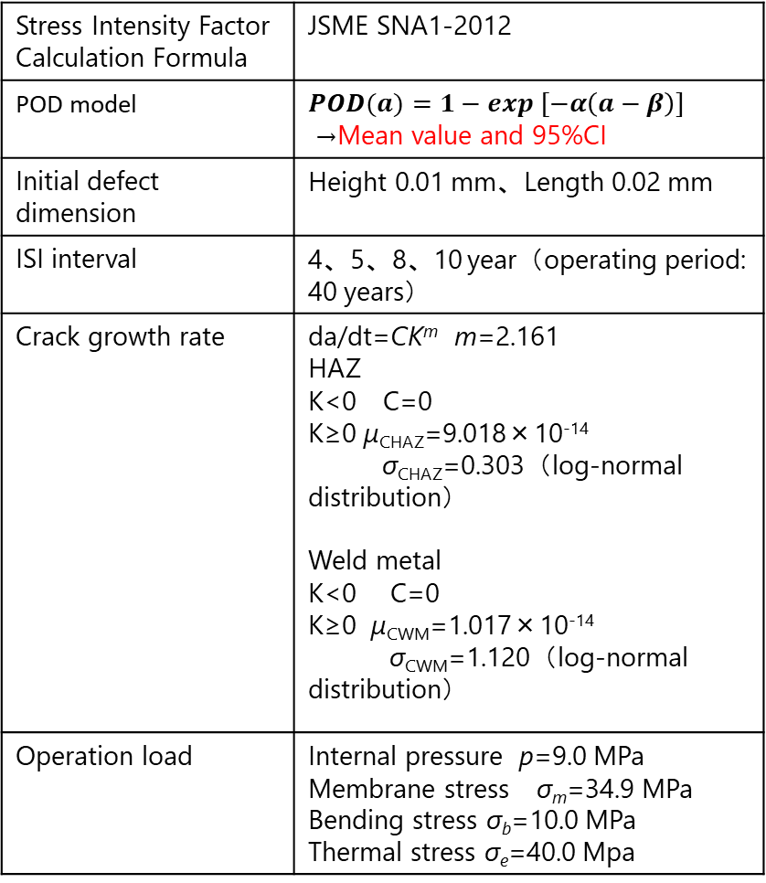
PFM：Conditions
Input of PFM
Stress Intensity Factor Calculation Formula | JSME SNA1-2012
POD model | $$POD(a)=1−exp [−α\left(a−β\right)]$$ →Mean value and 95%CI
Initial defect dimension | Height 0.01 mm、Length 0.02 mm
ISI interval | 4、5、8、10 year（operating period: 40 years）
Crack growth rate | da/dt=CK^{m} m=2.161 HAZ K<0 C=0 K≥0 μ_{CHAZ}=9.018×10⁻¹⁴ σ_{CHAZ}=0.303（log-normal distribution） Weld metal K<0 C=0 K≥0 μ_{CWM}=1.017×10⁻¹⁴ σ_{CWM}=1.120（log-normal distribution）
Operation load | Internal pressure p=9.0 MPa Membrane stress σ_{m}=34.9 MPa Bending stress σ_{b}=10.0 MPa Thermal stress σ_{e}=40.0 Mpa
Target：Primary Loop Recirculation system piping
Outer surface
Weld metal
HAZ
SCC
Inner surface
Pipe spec
Target pipe | 400A
Piping diameter | 406.4mm
Thickness | 26.2mm
Material | SUS316L
K.Mizuta et al. , “Effect of Uncertainty in Regression Coefficients in POD Models on PFM Analysis”, 18th Academic conference of Japan Society of Maintenology, 2022.

Slide 8
PFM results
Cumulative Failure Probability [crack⁻¹]
Cumulative Failure Probability [crack⁻¹]
Inspection Interval [years]
Inspection Interval [years]
Effect of α
Effect of β
In the POD model of this case, the coefficient α (capability of inspector) has a greater effect than β (detection limit) on the cumulative failure probability.
K.Mizuta et al. , “Effect of Uncertainty in Regression Coefficients in POD Models on PFM Analysis”, 18th Academic conference of Japan Society of Maintenology, 2022.

Slide 9
[2022]
NRA Commission chair mentioned about new technique development at regular committee meeting;
For example, in-service inspection (ISI) interval can be determined according to the risk by PFM.
From the perspective of the regulatory authority, inspections can be made more effective, and from the licensee's perspective, unnecessary inspections can be eliminated.
There are benefits for both.
Academic side is positive to PFM.
Licensee explained;
Consider PFM for RPV referred to efforts in the United States and other countries.
Evaluate the CDF of RPV by PFM based on the results of RPV UT that will be conducted in this inspection interval.
Consider reviewing the frequency of examination of UT for RPV based on the evaluation results.

