Slide 1
Panel Session:
The Evolving Perception of Probabilistic Applications in the Nuclear Regulatory Environment
David L. Rudland
Senior Technical Advisor for Materials
Office of Nuclear Reactor Regulation
U.S. Nuclear Regulatory Commission
2022 International Symposium on Probabilistic Methods for Nuclear Applications
Leicester University Space Park, Leicester LE4 5SP UK
November 1-3, 2022

Slide 2

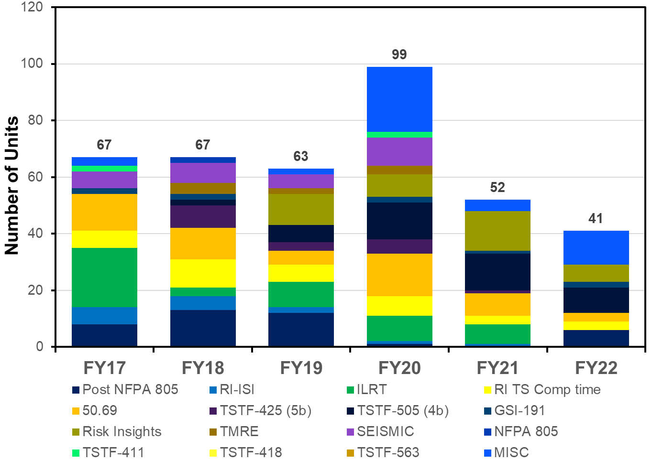


Becoming a Modern Risk-informed Regulator
60 FR 42622 – 1995
PRA policy statement
NRC evolving to be more efficient
and effective regulator
Many initiative underway at NRC to transform our way of doing business
Panel Session:
The Evolving Perception of Probabilistic Applications in the Nuclear Regulatory Environment
2

Slide 3







Becoming a Modern Risk-informed Regulator
FOCUS AREAS
INITIATIVES
Our People
Accepting
Risk
Technology Adoption
Career Enhancement
Accepting Risk
Agency Desired Culture
Technology
Signposts and Markers
Innovation
Innovation
Process Simplification
9
Panel Session:
The Evolving Perception of Probabilistic Applications in the Nuclear Regulatory Environment
3

Slide 4

Licensing Reviews and Emergent Issues
Process defined
RIMA under development
LIC-206, others
Risk-Informed
License Basis
Changes
(RD 1.174/RG 1.200
Requests with PFM
Process defined
LIC-504
Need adequate, consistent information and confidence in results
TSTF-505 Risk-informed
Completion times
Acceptability
Risk/PRA
NFPA-805 Risk-informed
Fire Protection
Emergent issues?
Risk information
submitted outside of the formal risk-informed licensing basis change process
10CFR 50.69
SSC Categorization
Relief Requests
5b Risk-informed
Surveillance Frequencies
Risk-informed
Inservice Inspection
Deterministic
Reviews
Qualitative
Reliance on Licensee Risk Information
Quantitative
Panel Session:
The Evolving Perception of Probabilistic Applications in the Nuclear Regulatory Environment
4

Slide 5

Recent Applications of PFM for Passive Components
Extending ISI interval to more than 10 years for
  Steam generator
  Pressurizer
  Heat exchangers
Extension to 20 years has been approved in the past
Extension beyond 20 years needs further justification
Some licensee are seeking to delay inspections for remainder of licensed life
Recently published Regulatory Guide 1.245
Panel Session:
The Evolving Perception of Probabilistic Applications in the Nuclear Regulatory Environment
5

Slide 6
Risk Informed Materials Assessment
Regulatory guidance providing framework for submitting and reviewing materials engineering applications with Risk informed decision-making (RIDM) aspects
Ambitions
Challenge
Status
Goal
Guidance would provide key aspects to include in high-quality submittals as well as the interaction between these key aspects as they may relate to NRC review decisions.
NRC Staff lead project
Existing NRC RIDM guidance focused on use of PRA
RIDM guidance for passive component integrity not available
Handling of uncertainties lacks guidance
Project officially initiated
NRC staff developing internal draft concepts
Public participation in project is planned
Panel Session:
The Evolving Perception of Probabilistic Applications in the Nuclear Regulatory Environment
6

Slide 7

7

