Slide 1




4th International Seminar on Probabilistic Methodologies for Nuclear Applications
1-3 November 2022
Leicester, UK
TOWARDS THE DESIGN OF RESILIENT AND SAFE
NUCLEAR SYSTEM WITH IMPRECISE PROBABILITY
Centre for intelligent infrastructure
Civil and Environmental Engineering
Edoardo PATELLI, Enrique MIRALLES DOLZ, Ander GRAY, T.V. SANTHOSH

Slide 2
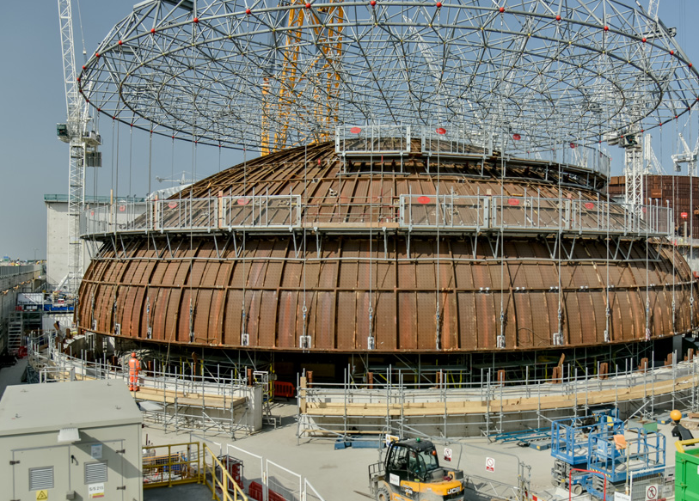
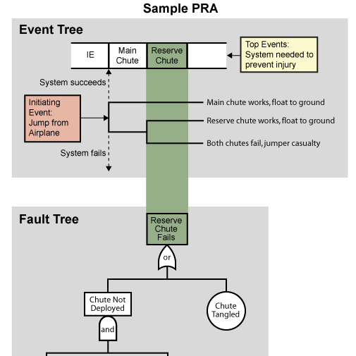
Nuclear power plant
Methodologies, licensing, and regulation of "matured" engineering systems are well established

Slide 3

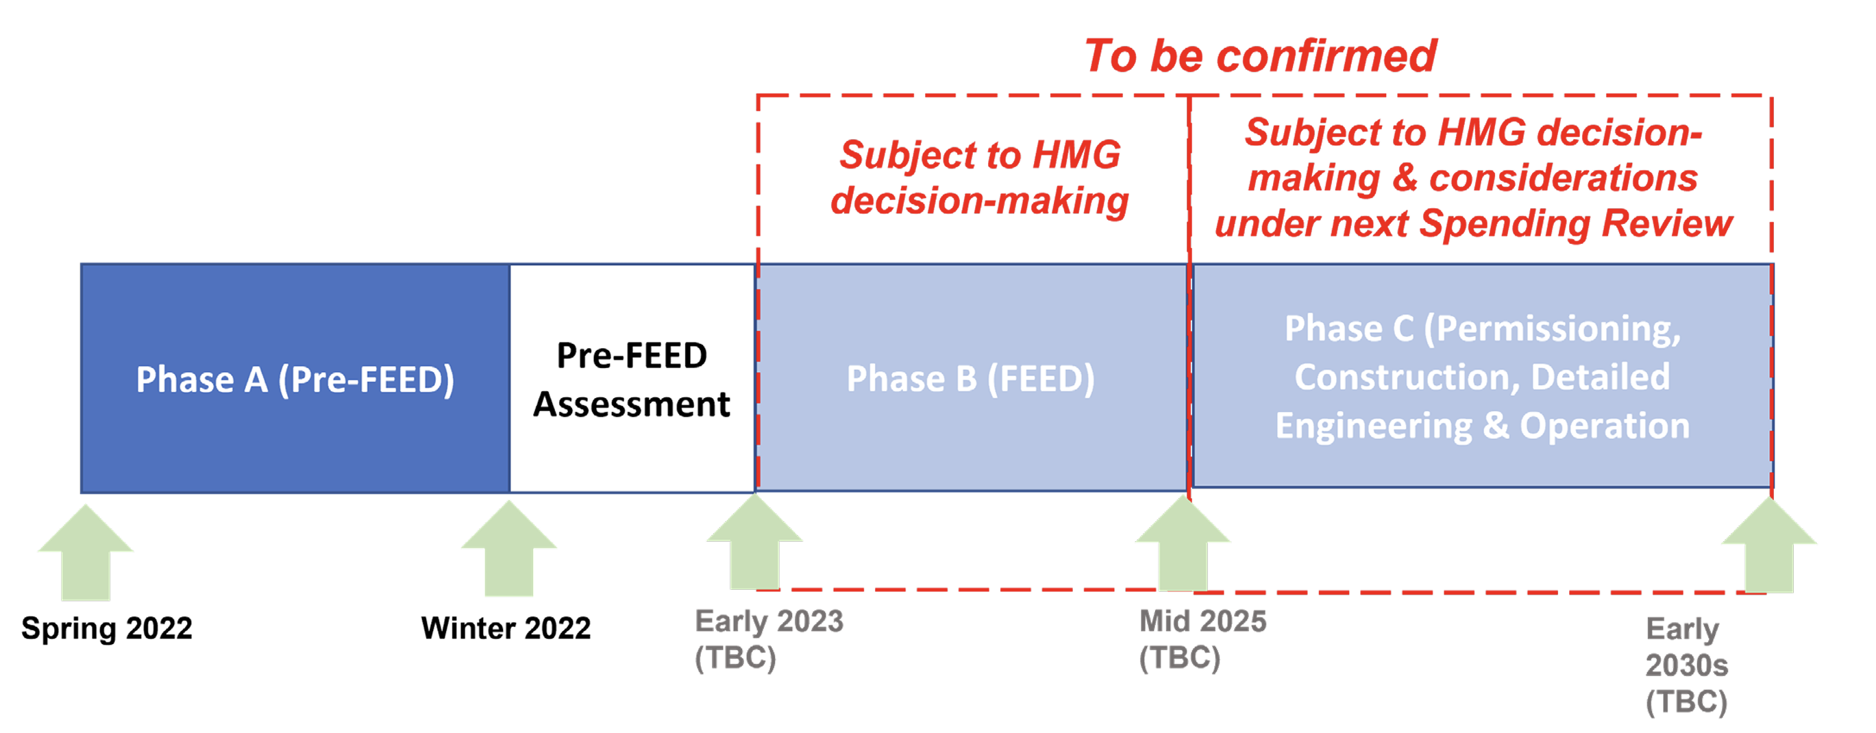
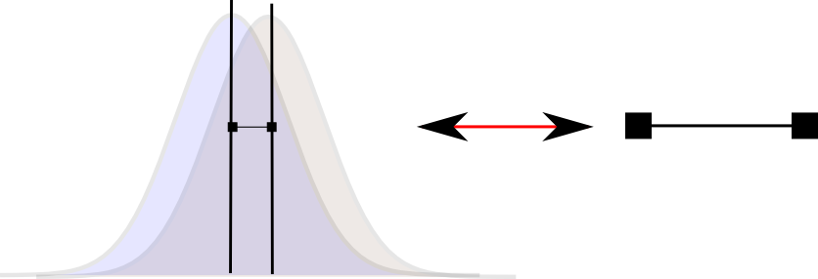
Next generation plants
HTGR demonstration programme

Slide 4



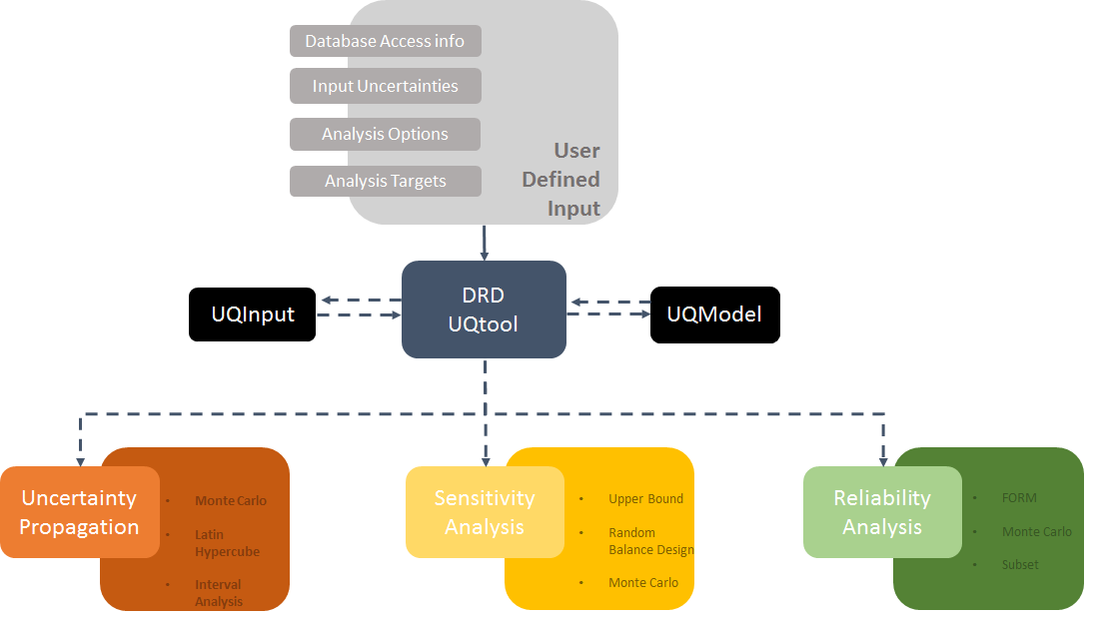

Digital Reactor Design
Not a digital twin, yet
It is a fusion of models and data that evolves over time
Challenges
Output Accuracy Estimation
Computational Costs
Software Integration
Our contributions
Uncertainty Propagation
Sensitivity Analysis
Reliability Analysis
Notes:
4

Slide 5

The data problem
Data overflow and data shadowing
Data availability is expect to increase
Cheap sensors, tracking and logs, surveillance
Are the data relevant?
Are we measuring the right thing?
Machine learning and AI should support uncertainty characterisation
Data robustness and trustfulness
Data tempering and malicious injection of false data

Slide 6

The knowledge problem
Engineering shadowing
Know your limits
A digital twin will never be a perfect replica of the physical world
Digital twins to support the understanding of engineering problem (Explainability, Transparency and Provability)
Uncertainty propagation should be an embedded feature in the digital twin and UQ a by-product
Lack of standard, legal framework and old technology
Notes:
Capacity to be demonstrated

Slide 7
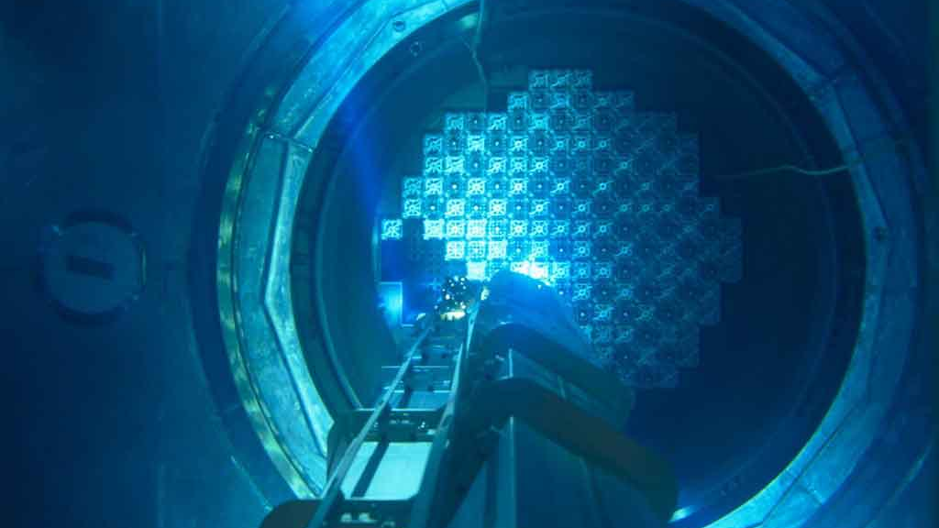
Towards safe and resilient systems
This Photo by Unknown Author is licensed under CC BY-NC-ND

Slide 8

… from risk-led to resilience-led
With too many risks and complexity of modern systems we should be focused on consequences rather than causes.
Traditional, quantitative, probabilistic, approach to risk is no longer valid for modern times
“There is a strong argument for moving from a risk to a resilience-based model”

Slide 9
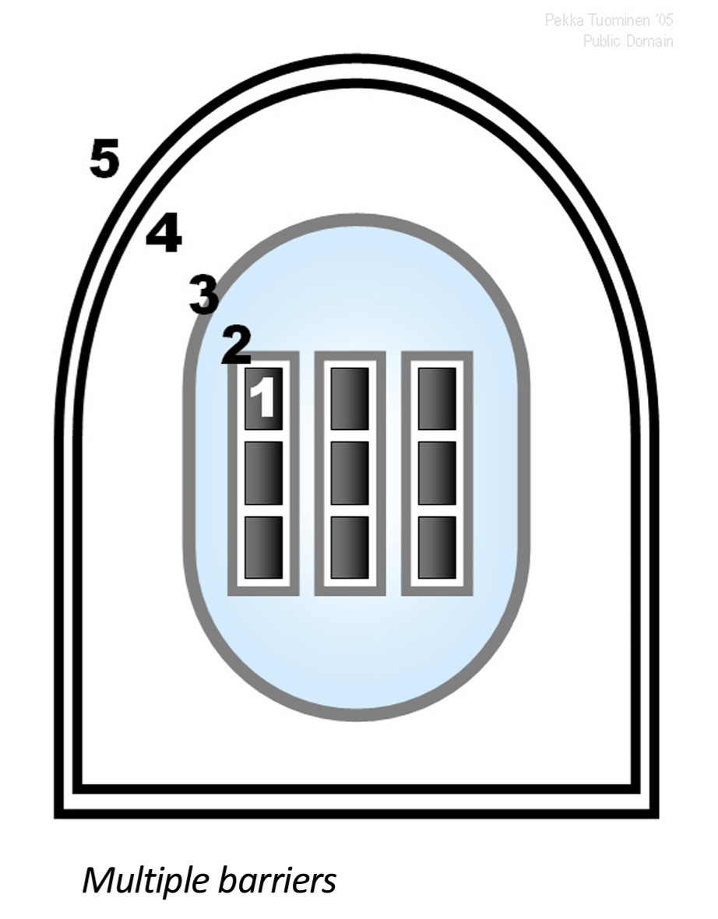
Robustness for improved safety
What about unknown unknowns?
Avoiding things that go wrong (Erik Hollnagel)
Part of the “Defense in Depth”
Safety margin*
Design-basis accident and worst-case credible accident*
Fragility analysis**
Probability safety assessment
* Does not include quantification of the probability
** Decoupling system response from the hazard

Slide 10
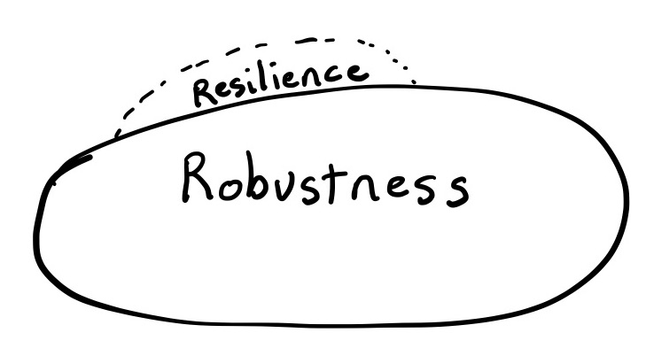
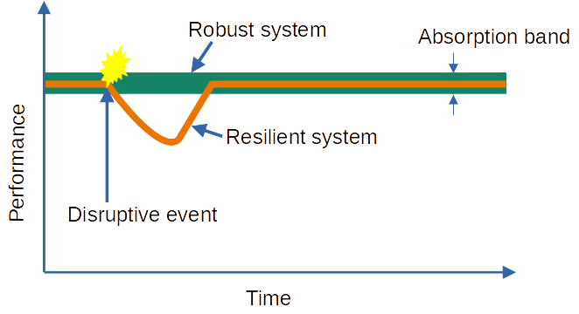
Resilience engineering
Changes focus from the negative to the positive attributes
Credit David Woods
It is the characteristic of being able to adapt under stress or faults in order to avoid failure
Absorbed (anticipate)
Mitigate (monitor)
Recovery (respond)
Adapt (learn)

Slide 11
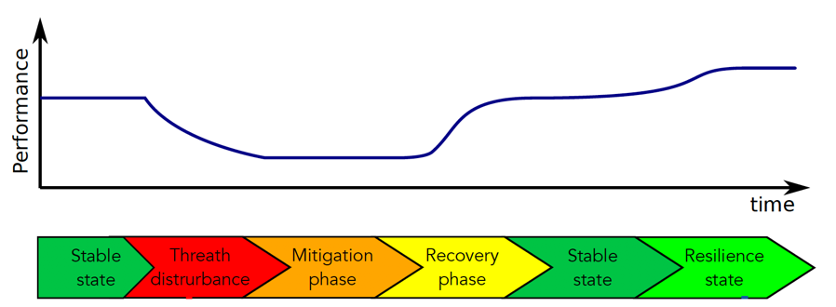
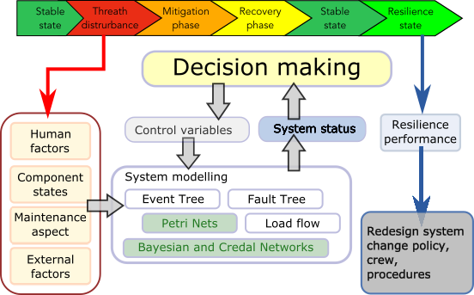
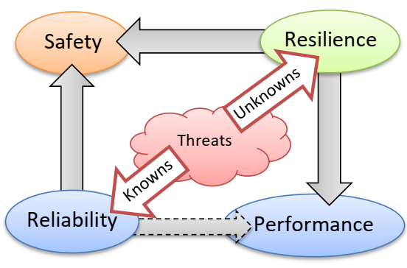
Measuring resilience
Which performance to use?
“Safety” vs “productivity”
Digital twin

Slide 12
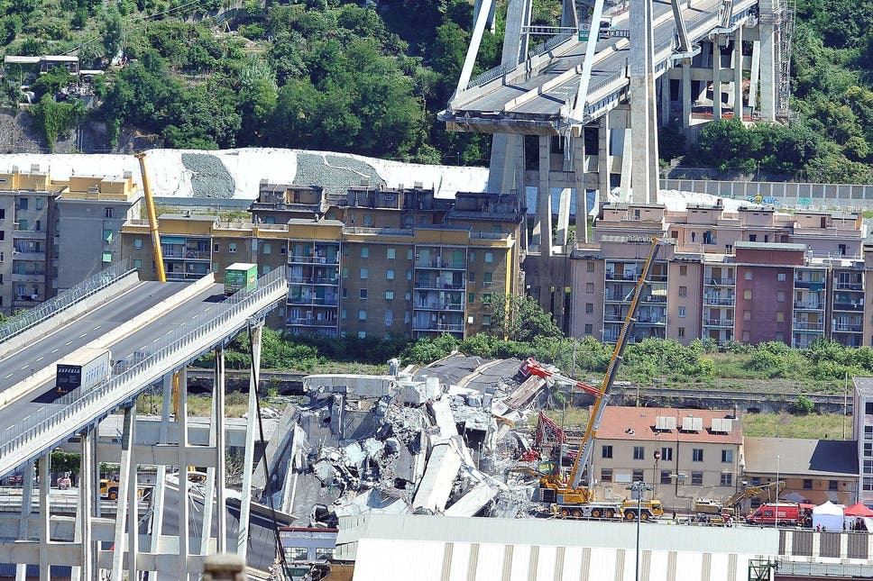
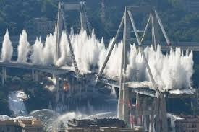
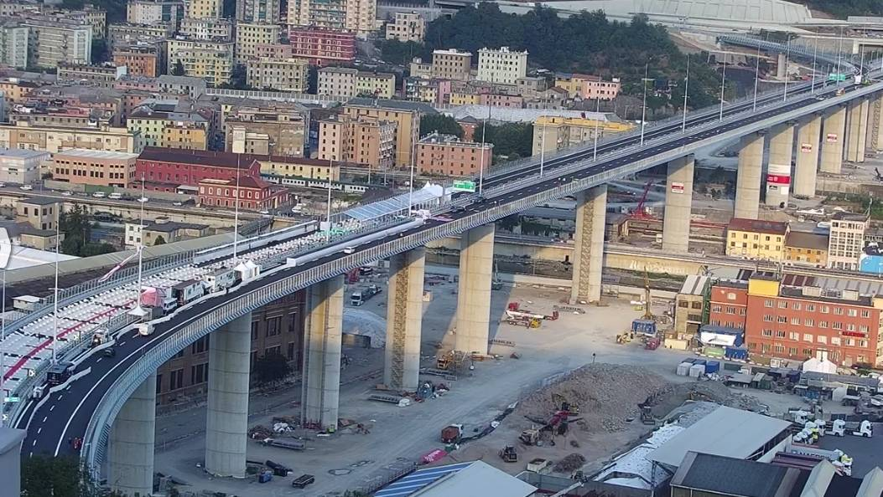
Everything is resilient
Collapsed 14 August 2018, Reopen to the traffic on the 4 August 2020

Slide 13
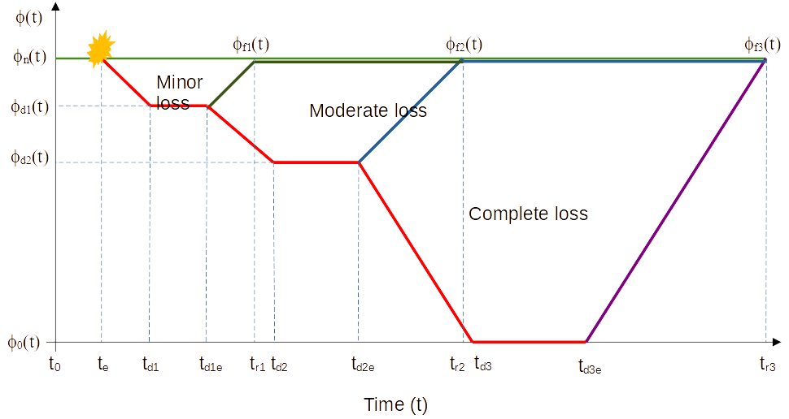
Measuring Resilience
PSA: probability of the threats X consequences.
Resilience: capability of the system to recover the system
Resulting performance states
Which path do we need to consider?
Notes:
The system is designed to remove the heat generated in the calandria due to fission reaction in a typical nuclear reactor. The pumps take suction from the calandria and deliver back to the calandria through a set of heat exchangers and isolation valves.
For the successful operation of the system, at least two out of three pumps and heat exchangers with associated valves are needed to ensure continuous heat removal.
Reliability doesn’t consider the dynamic repair aspects unlike resilience which has significant effect on overall performance.
As the resilience strongly depends on many factors including human and organisational factors, the recovery time is proportional to the decision making and task execution.

Slide 14
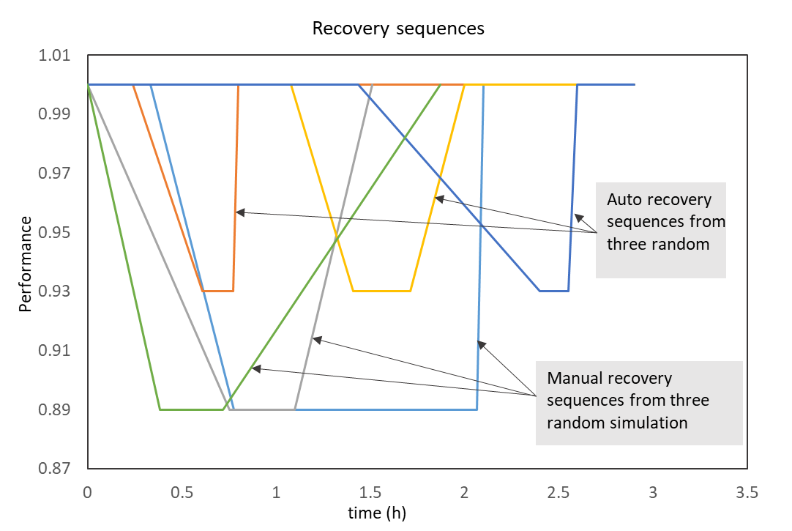
Measuring Resilience with safety
Safety level depends on the number of remaining safety measures to manage the disruptive event (e.g. auto setback function, manual setback function and a complete shutdown recovery)
Resilience can be measured as the
number of possible recovery paths (options) that are still available
to recover the system.
Notes:
The system is designed to remove the heat generated in the calandria due to fission reaction in a typical nuclear reactor. The pumps take suction from the calandria and deliver back to the calandria through a set of heat exchangers and isolation valves.
For the successful operation of the system, at least two out of three pumps and heat exchangers with associated valves are needed to ensure continuous heat removal.
Reliability doesn’t consider the dynamic repair aspects unlike resilience which has significant effect on overall performance.
As the resilience strongly depends on many factors including human and organisational factors, the recovery time is proportional to the decision making and task execution.

Slide 15
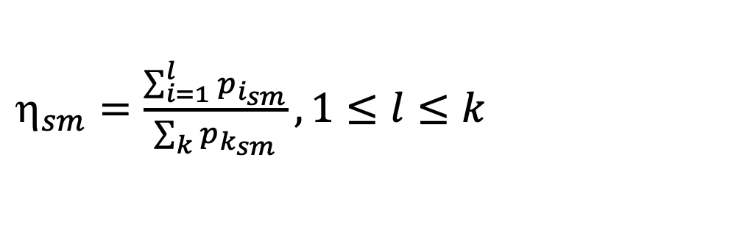
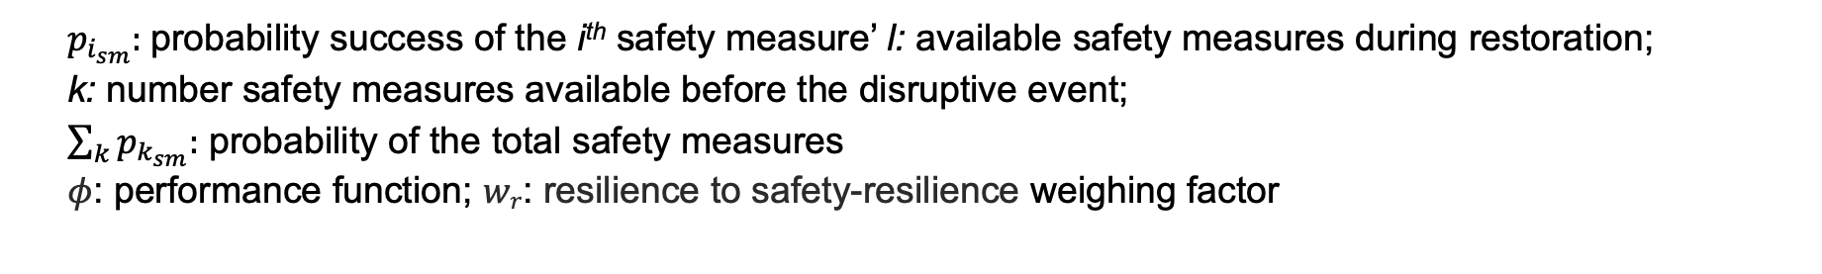
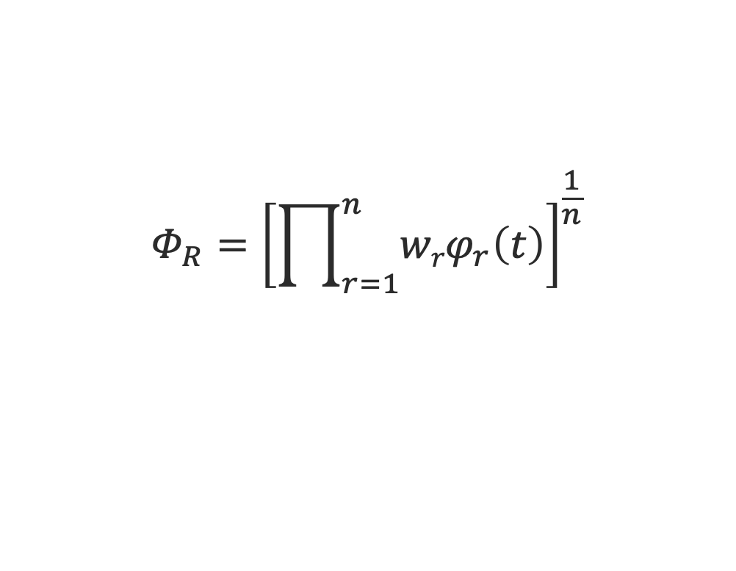
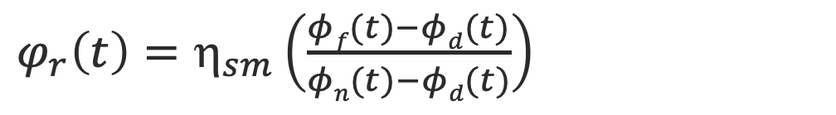
Integrated resilient metric
$_{sm}=\frac{\sum_{i=1}^{l}{p_{i_{sm}}}}{\sum_{k}{p_{k_{sm}}}}, 1≤l≤k$
Safety measure resilience factor
Resilience of each recovery sequence
$φ_{r}\left(t\right)=η_{sm}\left(\frac{φf(t)−φd(t)}{φn(t)−φd(t)}\right)$
Total resilience
$$Φ_{R}={\left[\prod_{r=1}^{n}{{wrφ}_{r}\left(t\right)}\right]}^{\frac{1}{n}}$$
$p_{i_{sm}}:$probability success of the i^{th} safety measure’ l: available safety measures during restoration;
k: number safety measures available before the disruptive event;
$\sum_{k}{p_{k_{sm}}:}$ probability of the total safety measures
$φ$: performance function; $wr$: resilience to safety-resilience weighing factor
Notes:
The system is designed to remove the heat generated in the calandria due to fission reaction in a typical nuclear reactor. The pumps take suction from the calandria and deliver back to the calandria through a set of heat exchangers and isolation valves.
For the successful operation of the system, at least two out of three pumps and heat exchangers with associated valves are needed to ensure continuous heat removal.
Reliability doesn’t consider the dynamic repair aspects unlike resilience which has significant effect on overall performance.
As the resilience strongly depends on many factors including human and organisational factors, the recovery time is proportional to the decision making and task execution.

Slide 16
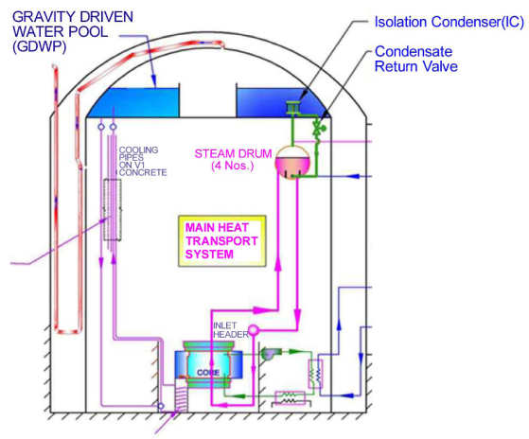
Case study advanced nuclear reactor
Regulating system
  4 regulating rods
  4 shim rods
  8 absorber rods
Primary shutdown system
12 mechanical rods (similar to shim rods)
Secondary shutdown system
12 tubes with liquid poison
A threat causing failure of one of the control rods
Regulation system is expected to recover from either auto setback recovery or by manual setback
Notes:
Geometric mean of all the recovery sequences with associated weightage for each successful recovery.

Slide 17
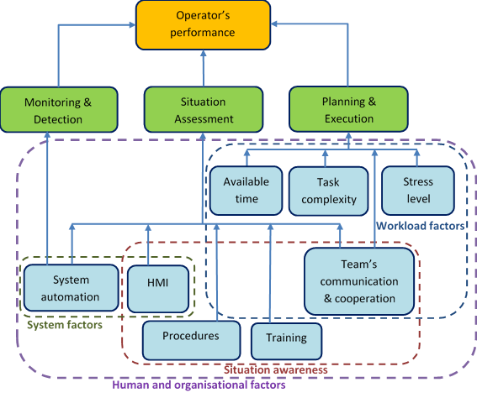
Recovery model and human factor
Threat
RRS
Control rods
Initial system state
Threat detection
Sensing mechanism
Yes
No
New system state
Yes
Actuate auto recovery
Shim rods
No
Yes
Actuate manual recovery
No
Human factors
Emergency shutdown
Operator intervention
No
Restart system
Human & organizational factors
Yes
No
Damage state
Shutdown systems
Notes:
Geometric mean of all the recovery sequences with associated weightage for each successful recovery.

Slide 18
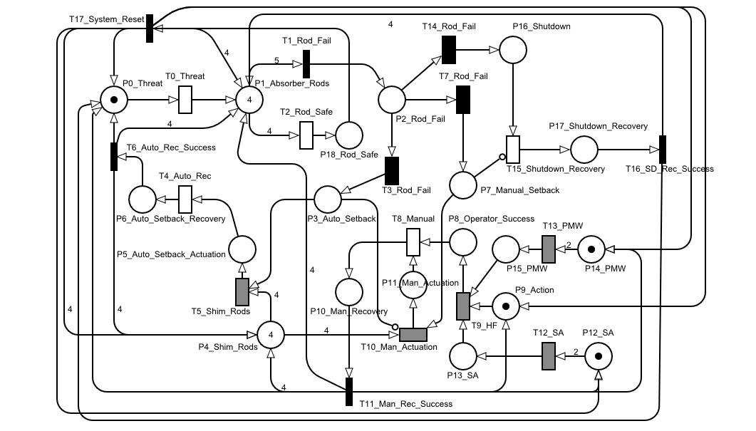
Petri net model
Macchiato software
by University of Nottingham
Threat simulation
Control rod model
Shutdown recovery model
Human factor model
Auto recovery model
Manual recovery model
18
Notes:
Geometric mean of all the recovery sequences with associated weightage for each successful recovery.

Slide 19
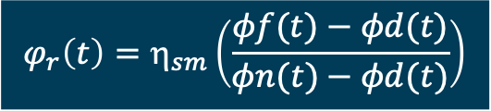
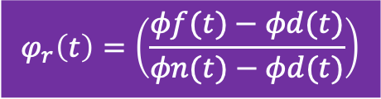
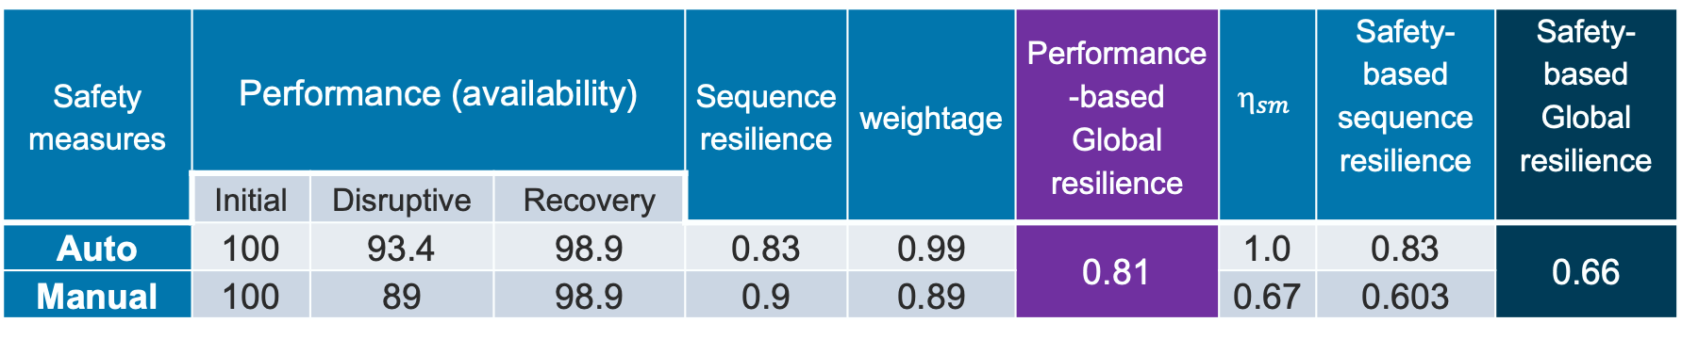
Selected results
Practically impossible to compute manually the resilience for each successful sequence
The recovery time obtained from the Petri net model
10⁶ simulation performed
$$φ_{r}\left(t\right)=\left(\frac{φf(t)−φd(t)}{φn(t)−φd(t)}\right)$$
$$φ_{r}\left(t\right)=η_{sm}\left(\frac{φf(t)−φd(t)}{φn(t)−φd(t)}\right)$$
Safety measures | Performance (availability) |  |  | Sequence resilience | weightage | Performance-based Global resilience | $$_{sm}$$ | Safety-based sequence resilience | Safety-based Global resilience
 | Initial | Disruptive | Recovery
Auto | 100 | 93.4 | 98.9 | 0.83 | 0.99 | 0.81 | 1.0 | 0.83 | 0.66
Manual | 100 | 89 | 98.9 | 0.9 | 0.89 |  | 0.67 | 0.603
Notes:
Geometric mean of all the recovery sequences with associated weightage for each successful recovery.

Slide 20
Resilience and data
Learning from adversity and becoming better able to avoid and manage future stresses
Resilience Engineering requires a lot of data and data analytics for real-time analysis, state identification and prognostic, automatic decision making

Slide 21

Dealing with imprecision

Slide 22
Aleatory vs Epistemic uncertainty
Variability vs. Imprecision
Epistemic uncertainty is the “controllable” uncertainty
Aleatory uncertainty is the remaining uncertainty after As Low As Reasonable Archivable (ALARA) campaign is performed to characterise the uncertainty
Epistemic uncertainty measures the error from the modelled uncertainty to the ”true” uncertainty
Joshua Kaizer (US Nuclear Regulatory Commission)
In principle, probability theory can describe both (some say)
but it mixes and confuses observed data and subjective belief

Slide 23
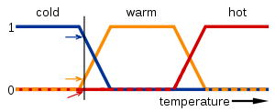
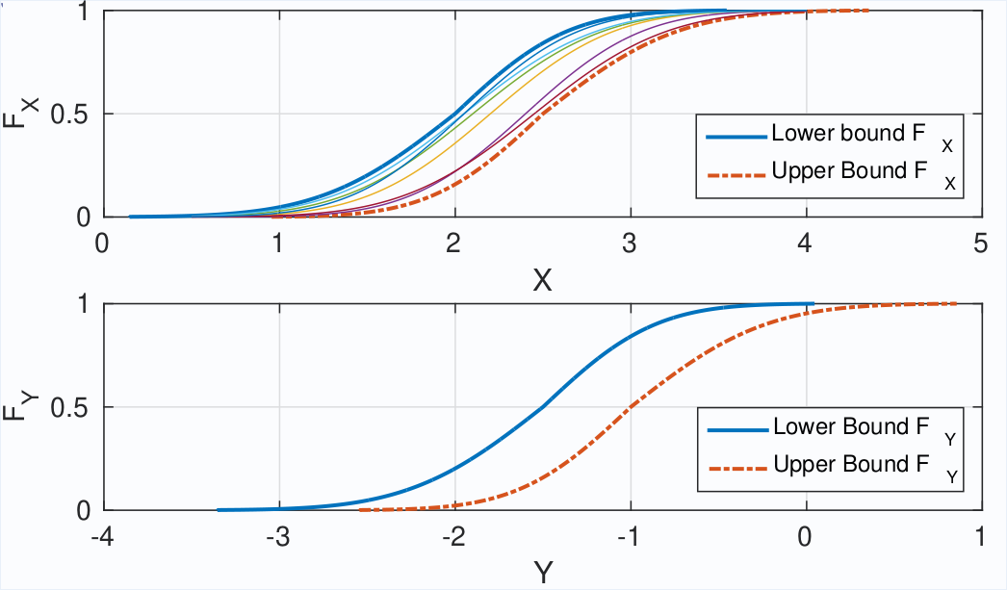
Imprecise probability
Model incertitude as a set of possible values
Interval analysis and
Fuzzy variable
Modelling epistemic uncertainty
Dempster-Shafer structure
Different probability masses associated to distinct intervals
Probability boxes
Combine aleatory and epistemic uncertainty
p₂
p₁
p₃
x

Slide 24
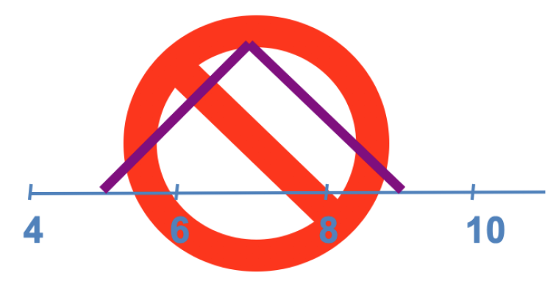
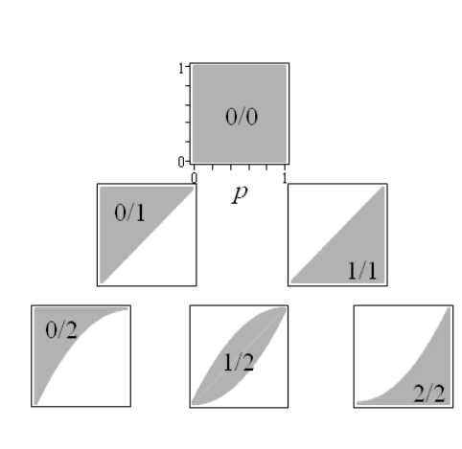
Computing with confidence
Suppose A is in [2,4] and B is in [3,5]
What about the sum A+B?
The right answer is [5,9]
Including confidence intervals
  1/10 is different than 100/1000
  No observations is different
  than 0 probability

Slide 25
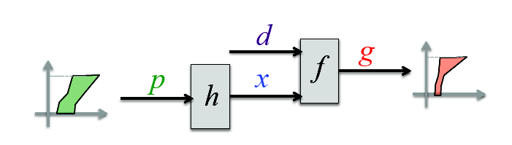
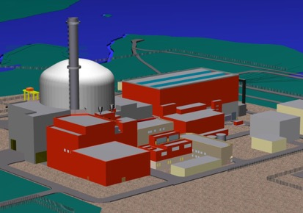
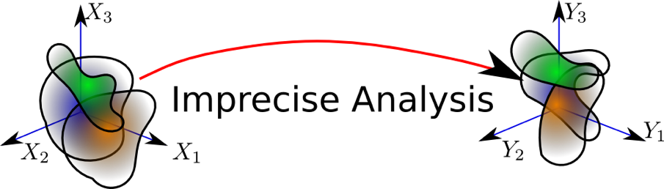
Computational challenges
Propagate uncertainty and incertitude without mixing/confusing
Patelli, E., Alvarez, D.A., Broggi, M., de Angelis, M., 2015. Uncertainty management in multidisciplinary design of critical safety systems.
J. of Aerospace Information Systems 12, 140–169 https://doi.org/10.2514/1.I010273

Slide 26
Computing with imprecise probabilities

Slide 27
Computational tools
Probability Theory
Interval Arithmetic
ProbabilityBoundsAnalysis.jl
MomentArithmetic.jl
ZoneArithmetic.jl
(p-box arithmetic)
(moment arithmetic)
(Subintevalization)

Slide 28
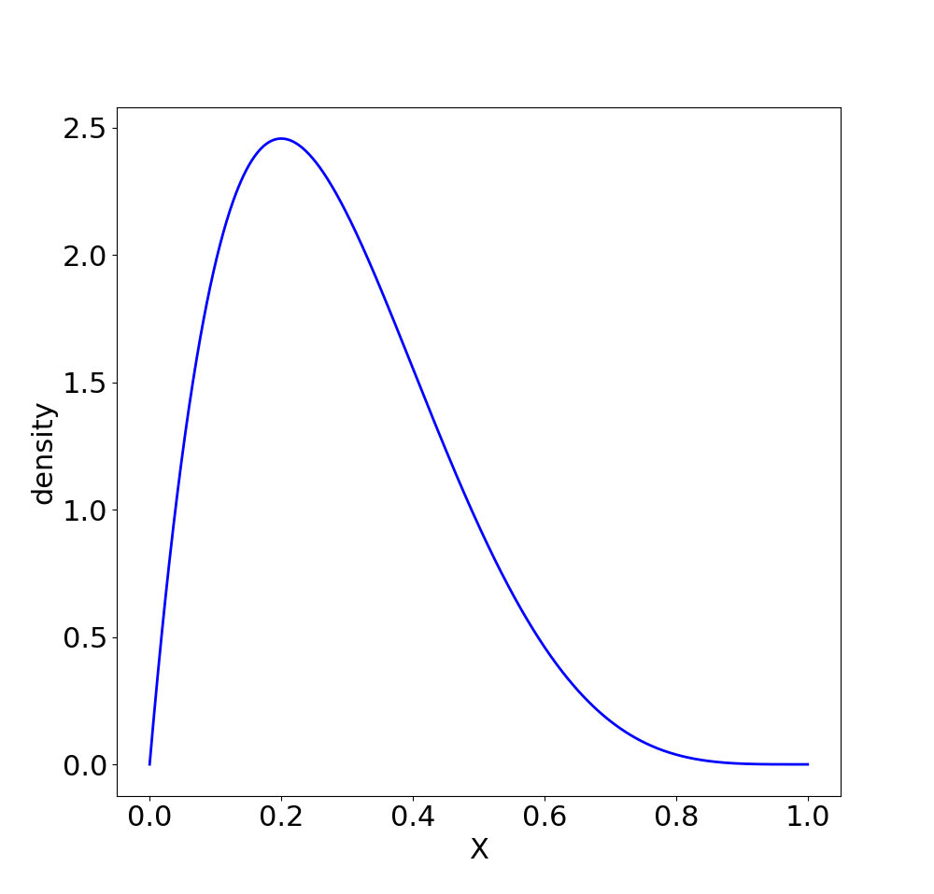
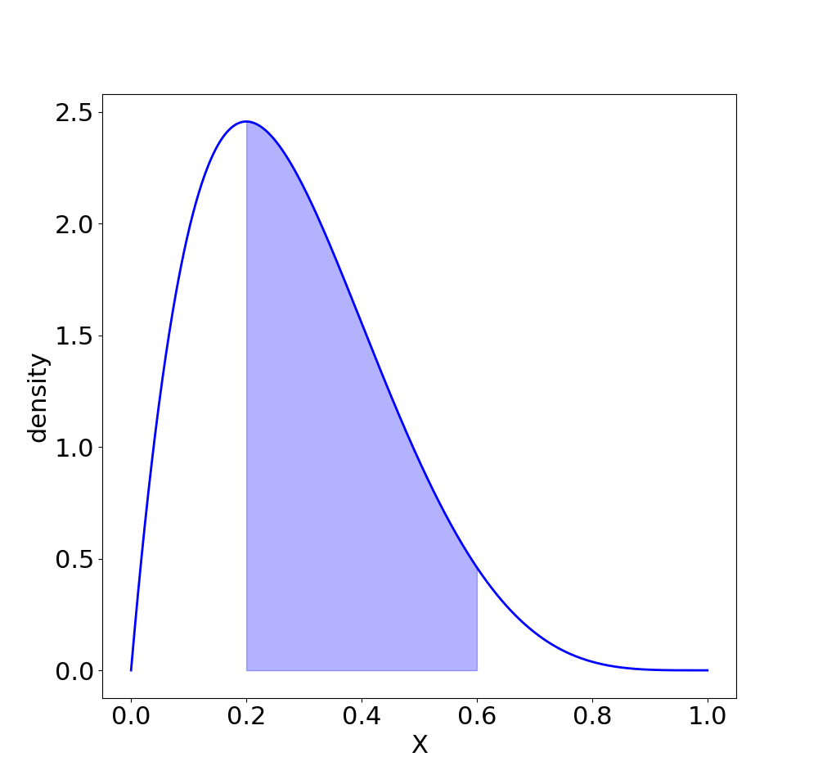
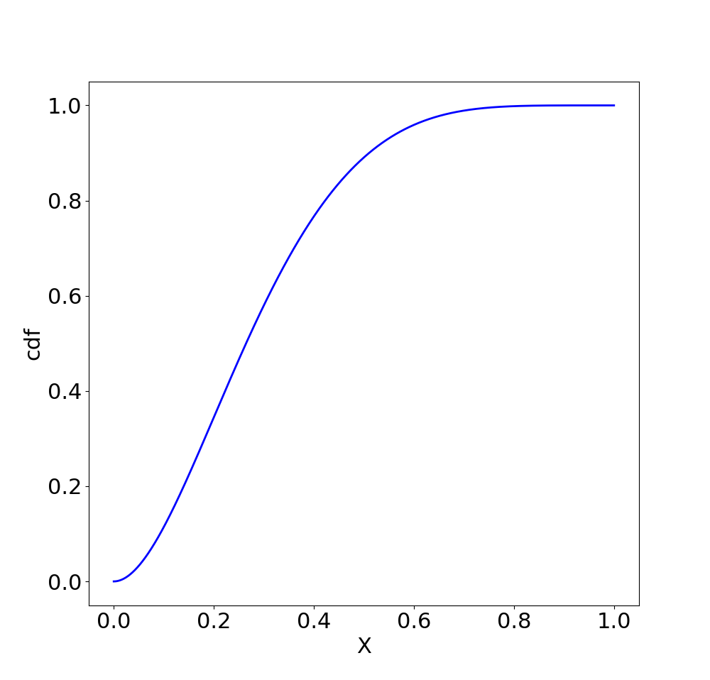

Slide 29
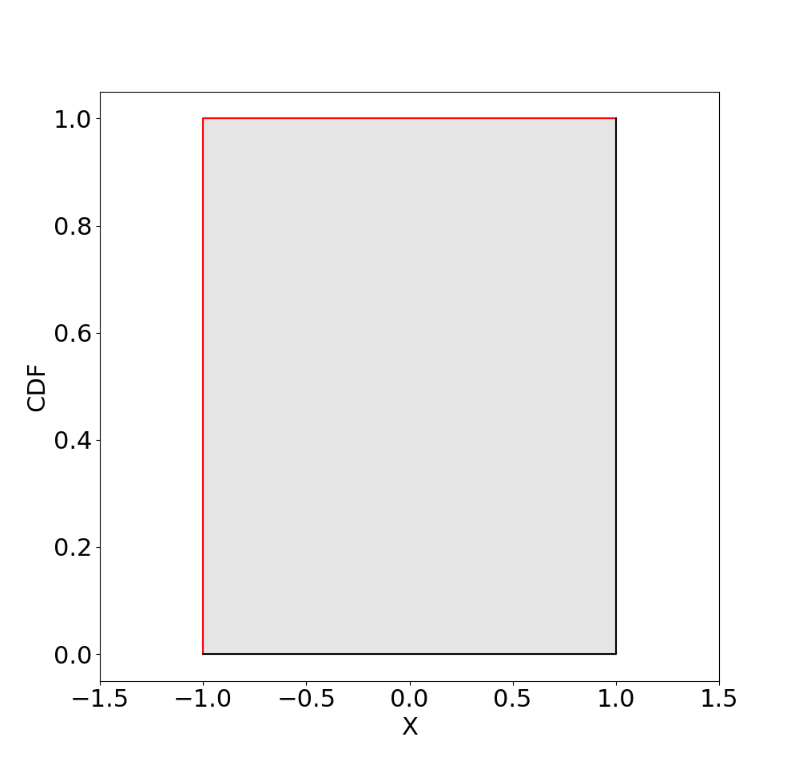
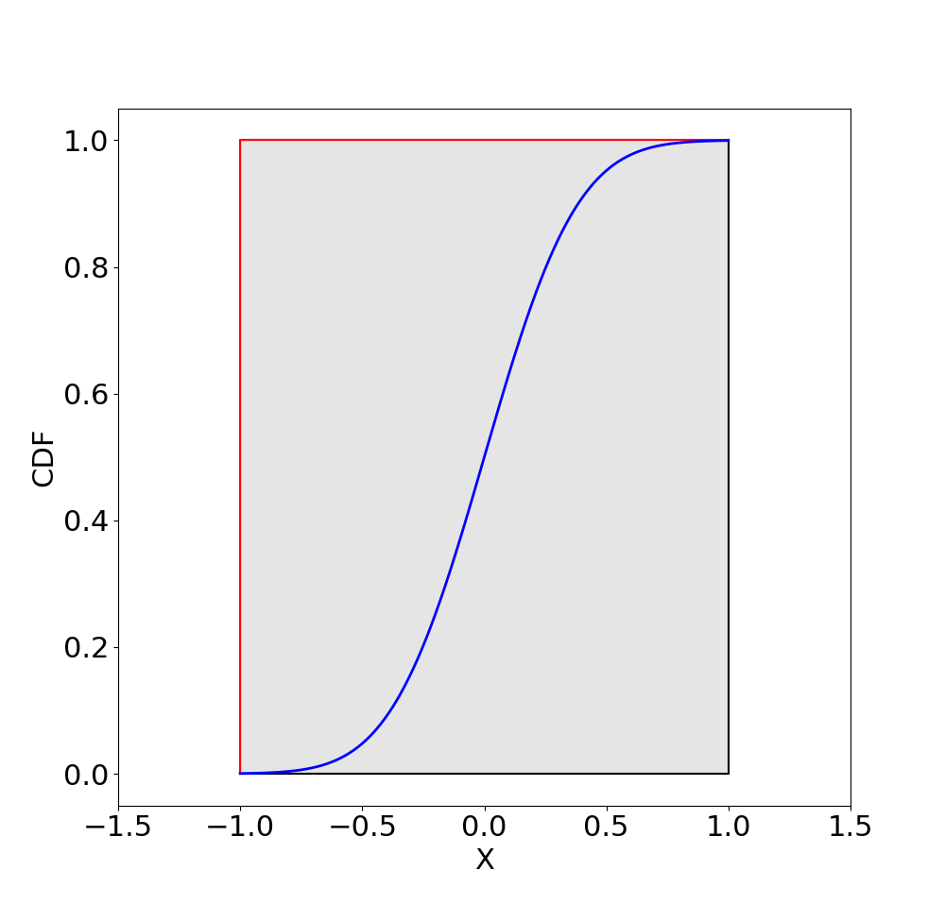
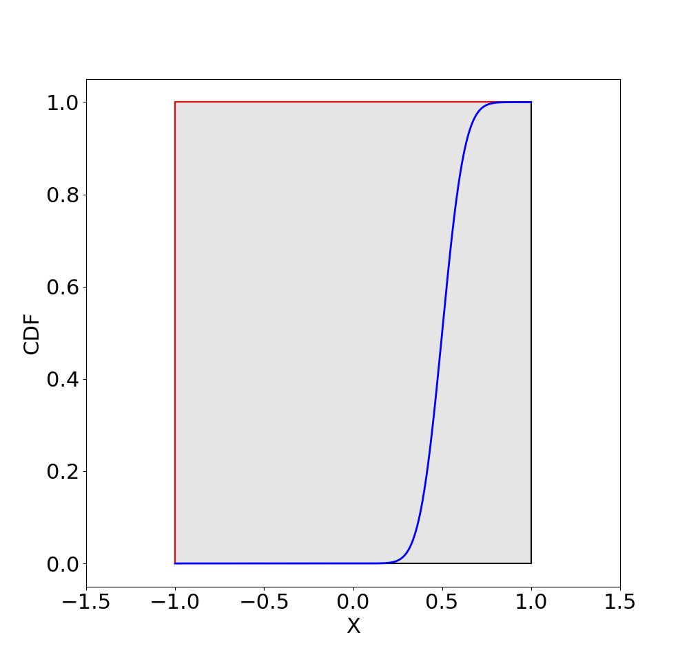
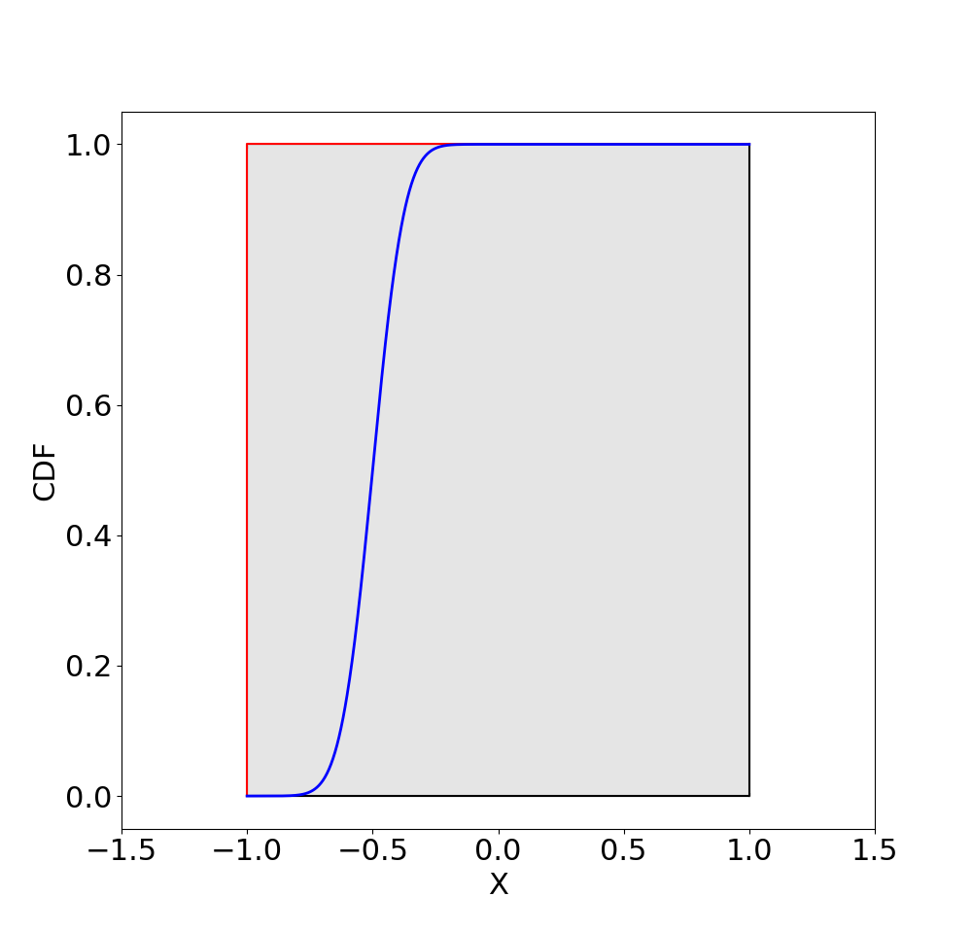
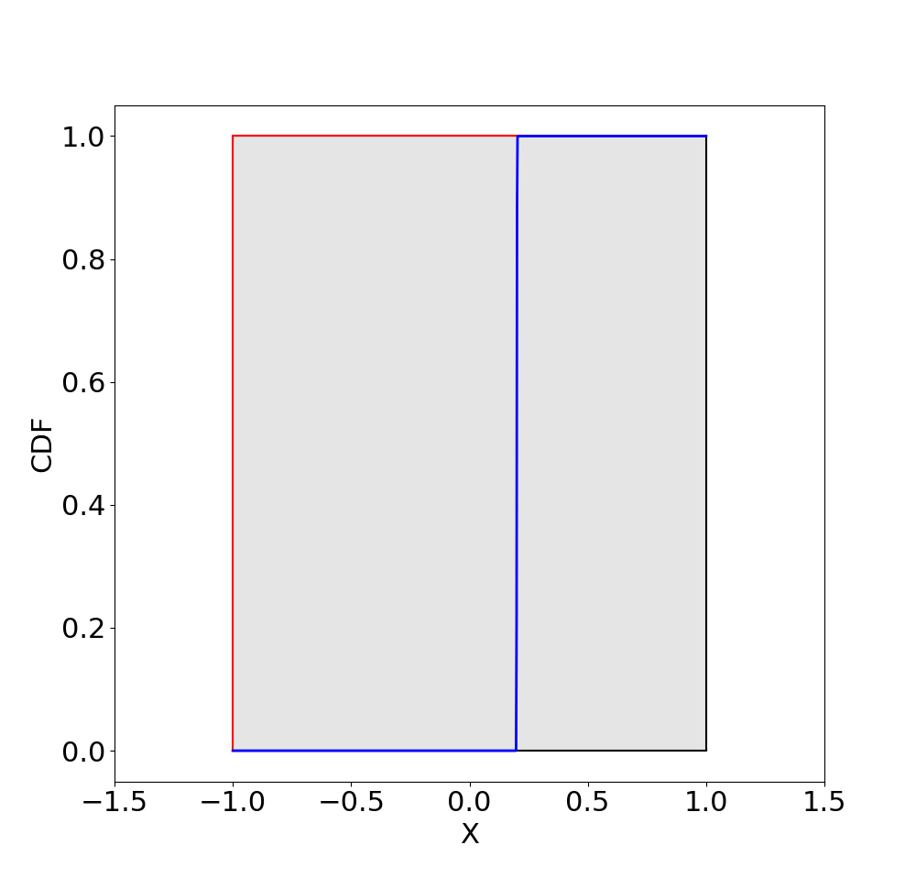
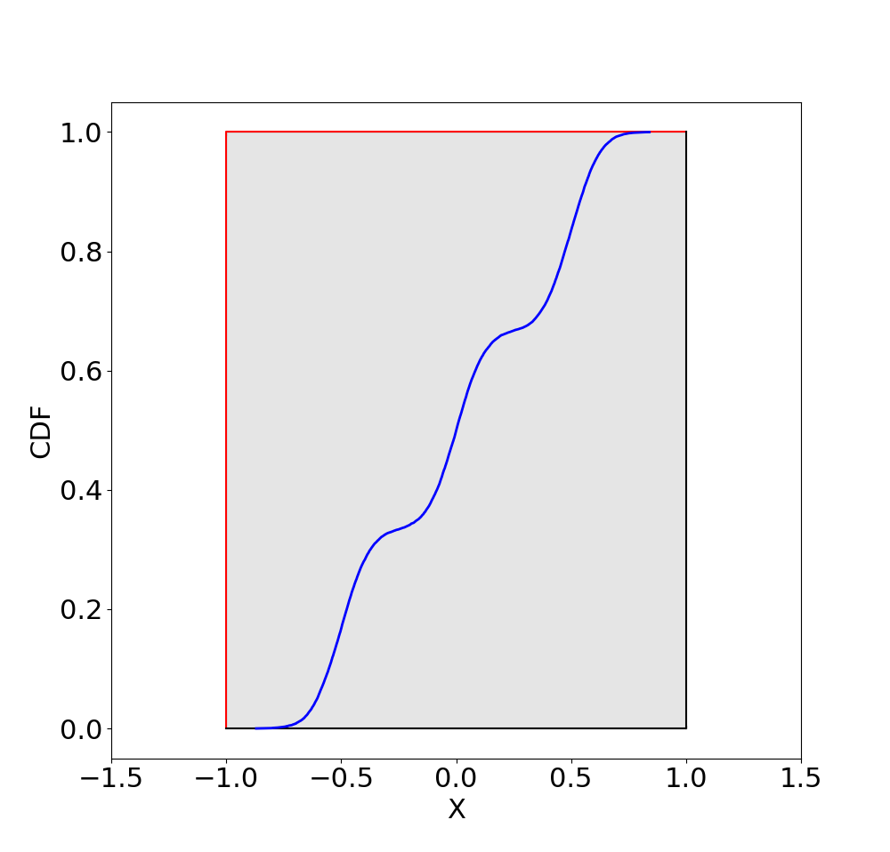
Intervals

Slide 30
Intervals

Slide 31
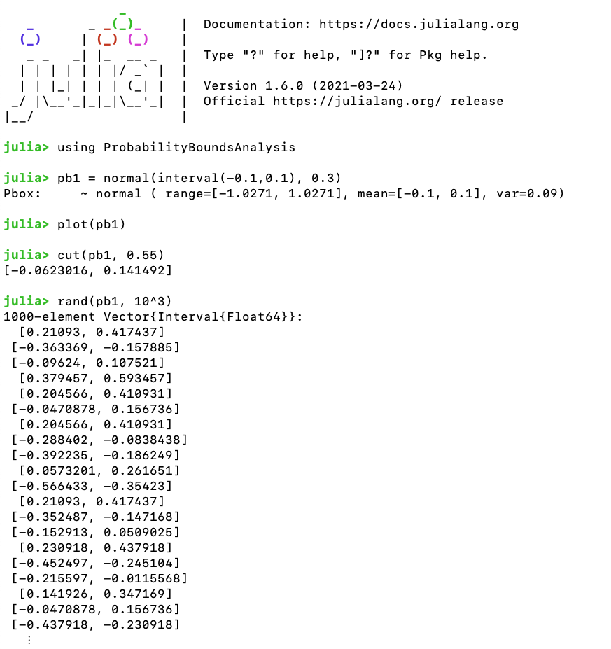
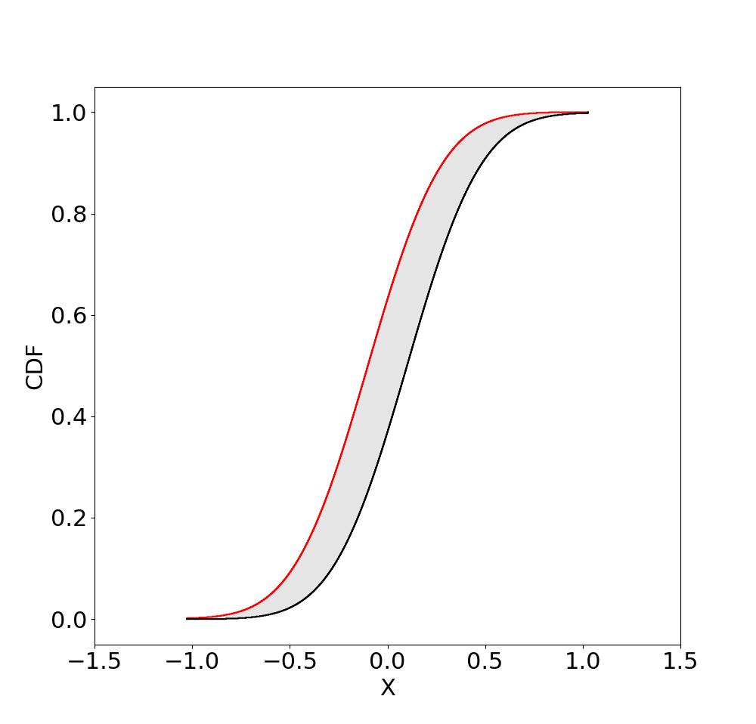
Probability boxes

Slide 32
Probability boxes

Slide 33
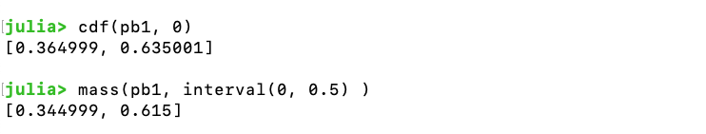
Probability boxes

Slide 34
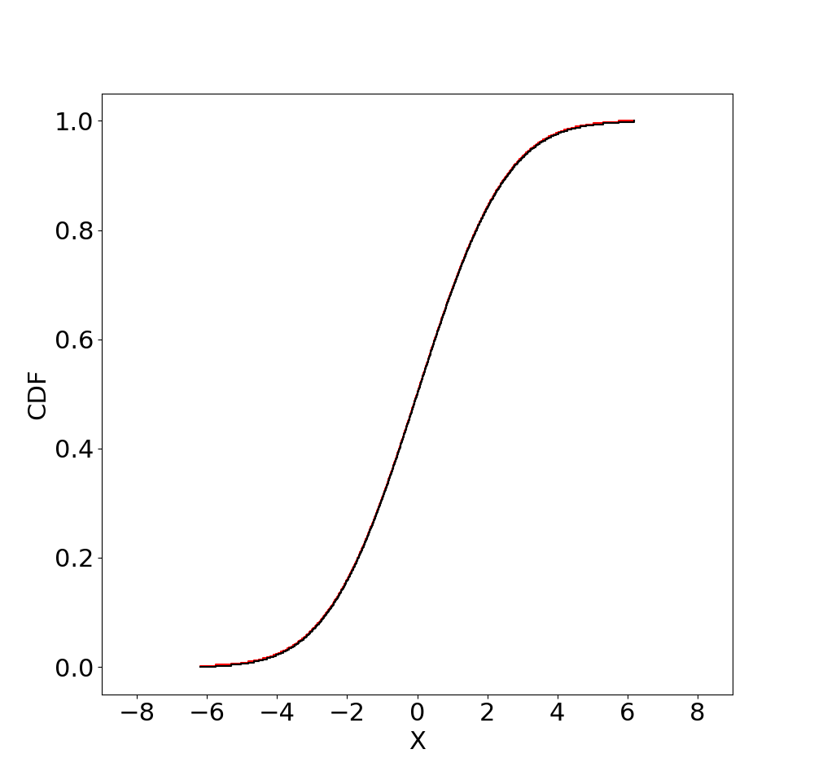
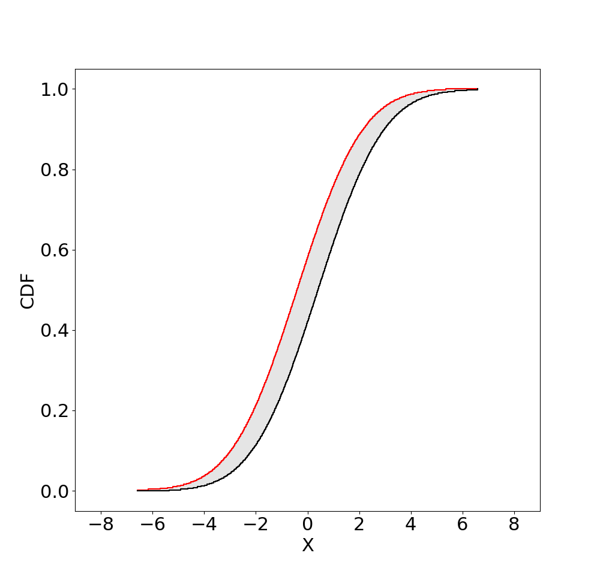
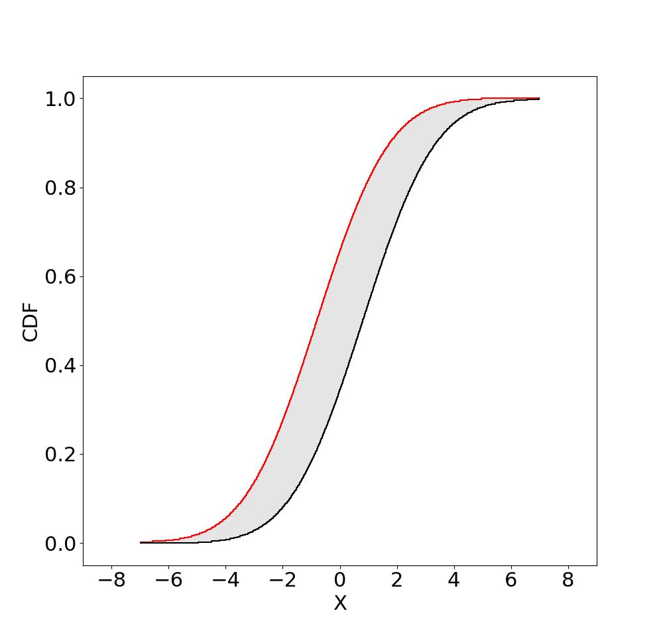
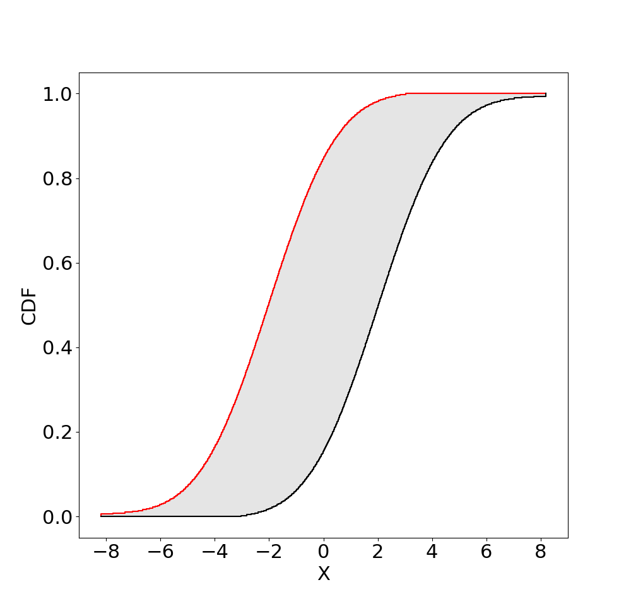



Probability boxes
More precision
Less stochasticity

Slide 35
















Distributions with imprecise parameters
Normal
Uniform
Beta
Gamma
$$μ∈\left[0,1\right], σ∈[2,3]$$
$$U_{1}∈\left[0,1\right], U_{2}=3$$
$$α∈\left[0.7, 1\right], β∈[3,4]$$
$$α∈\left[5, 6\right], β=2$$
Lognormal
Exponential
Chi squared
Cauchy
$$μ∈\left[2,3\right], σ∈[1,5]$$
$$λ∈\left[0.4,0.6\right]$$
$$k∈\left[20,50\right]$$
$$α∈\left[1,100\right], β=1$$

Slide 36






Binary operations
$$A$$
$$B$$
$$C$$

Slide 37
What if we do not have a distribution?

Slide 38
First order error propagation
In probability theory called “Moment propagation”
Propagates mean & variance through mathematical expressions
Although widely used, requires a lot of assumptions, and does not inform about distribution shape
    Requires stochastic independence
    Moments must be perfectly known
    Gives no information about tails without distribution assumption
    Only accurate for near-linear models
        Bad for risk analysis
Pessimism from Cullen and Frey (1999)

Slide 39

Moment arithmetic
https://doi.org/10.1016/j.ijar.2022.04.001
Generalisation with the following:
        Independence between variables need not be assumed
        Moment propagation formulae may be evaluated with intervals
        Assumptions about input distributions is no longer necessary
        Works for non-linear functions
Computer arithmetic on random variable’s range, mean and variance
7 binary operations: +, -, *, /, ^, min, max
9 unary operations: rescale, shift, exp, log, ln, 1/x, $x^{2}$, $\sqrt{x}$, $\left|x\right|$
For independence and unknown dependence (Fréchet)

Slide 40



Moment arithmetic
Arithmetic with independence
Yields intervals
Rigorous formulas for least and greatest possible values
Interval arithmetic
Arithmetic without dependence assumptions (Fréchet)

Slide 41

Compute with missing information
Mean and variance bounds can be estimated from range
Mean and variance bounded from ranges
Tighter variance when mean is given
Given mean is too wide
Inconsistent mean
Inconsistent variance

Slide 42


Bounds of CDF

Slide 43

Arithmetic tables with intervals
Even starting with point estimates for means and variances, the moment arithmetic tables formulas generally yields interval results.
EX, VX, and bounds can be intervals
Repeated variables
Subintervalisation: $n^{m}$ interval calculations
Since only 2 variables are intervals, subintervalisation works well
$n ≈15 ;m=2$

Slide 44





Dependent variables
X
Even if X and Y are non-dependent, Z and X are dependent
Y
Z
$$ρ_{ZX}=0.7072$$

Slide 45



Zone arithmetic
      https://github.com/AnderGray/ZoneArithmetic.jl
$$Z=X+Y$$
$$Z_{X1}=\left[−1,−0.99\right]+[−1, 1]$$
Y
$$J_{Z,X_{1}}=Z ∩Z_{X1}$$
X
Z
X

Slide 46



Tracking dependencies
$$\left[0, 8\right]$$
$$\left[0, 8\right]$$
B
Dependencies can be tracked in a graph
A
C
E
The nodes are variables (intervals)
$$\left[0, 8\right]$$
$$\left[−1, 1\right]$$
D
The edges are dependencies (zones)
$$\left[0, 16\right]$$
When a new variable is calculated, it’s added and linked in the graph

Slide 47

Dependence tracking

Slide 48

Dependence tracking with subintervals

Slide 49
Compute risk with missing information
1
If the mean is 10 and the variance is 2, best-possible bounds on the chance the variable is bigger than any value is given by this p-box.
Exceedance risk
Prob(15 < X) ∈ [0, 0.08]
0
-10
0
10
20
30
The chance that a normal random variable with mean 10 and variance 2 is bigger than 15 is only 0.000203

Slide 50




Risk analysis
https://doi.org/10.1007/978-3-031-08971-8_64
Independence (of events) is often assumed it can have dramatic consequences.

Slide 51
What if we only have a black box?

Slide 52


Advanced Monte Carlo methods
Rare event simulation
Efficient approached able to deal with imprecision
Advanced line sampling
Subset simulation
Sequential Monte Carlo based algorithm
de Angelis, M., Patelli, E., Beer, M., 2015. Advanced line sampling for efficient robust reliability analysis. Structural safety 52, 170–182. https://doi.org/10.1016/j.strusafe.2014.10.002
Au, S.K., Patelli, E., 2016. Subset Simulation in finite-infinite dimensional space. Reliability Engineering & System safety 148, 66–77. https://doi.org/10.1016/j.ress.2015.11.012
Lye, Adolphus, Alice Cicirello, and Edoardo Patelli. ‘Advanced Sampling Methods for Solving Bayesian Model Updating Problems: A Tutorial’. Mechanical Systems and Signal Processing 159 (2021): 107760. https://doi.org/10.1016/j.ymssp.2021.107760.
Notes:
52

Slide 53


Computing with confidence
Dealing with uncertainty in digital twins
Reliable and robust surrogate models
Interval predictor models / Interval Neural Network
Regression models which predict an interval with a confidence level
Trained with minibatch gradient descent in TensorFlow, cost O(minibatch size)
Works with imprecise training data
Sadeghi, J., Angelis, M. de, Patelli, E., 2019. Efficient training of interval Neural Networks for imprecise training data. Neural Networks 118, 338–351. https://doi.org/10.1016/j.neunet.2019.07.005
Notes:
Therefore we need robust algorithms and computational methods able to deal with uncertainty. This is one of the my main area of research: dealing with uncertainty.
Developing robust and reliable computational tools able to deal with different representation of the uncertainty from bad data, expert elicitation till no data.
These tools in turns allow to construct what is called a credible digital replica of our infrastructure that using data from sensors and prior knowledge of the systems allows to monitor and control the behaviour of structures and systems, providing adaptation capability. However this can only be done if the uncertainties and the unknowns are taken explicitly into account and their effects are quantified.
Reliable and efficient approaches are also needed to reduce the computational cost of the analysis making the computational task sustainable. Robust techniques that require very few assumptions has been developed including interval neural networks and robust Bayesian neural networks.

Slide 54




Summary
Imprecise probability allows to deal with lack of knowledge and imprecision without unjustified assumptions
Rigorous propagation of uncertainty exist (intrusive and non-intrusive) and freely available libraries
Resilience is an additional metric
but allows to handle unknowns

Slide 55



Contacts: Edoardo Patelli
X THE PLACE OF USEFUL LEARNING
Edoardo.patelli@strath.ac.uk
#EdoardoPatelli
www.cossan.co.uk
Acknowledgment: Scott Ferson

