Slide 1
Probabilistic Structural Integrity Analysis for Advanced Modular Reactors
Dr Henry Cathcart, Dr James M Finley
Frazer-Nash Consultancy
PM 03, ISPMNA 2022

Slide 2
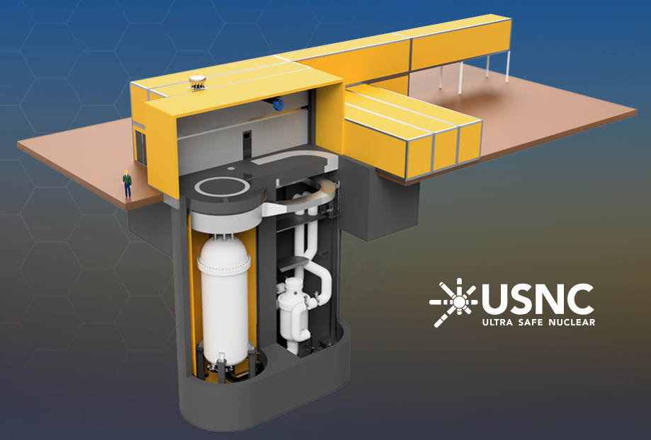
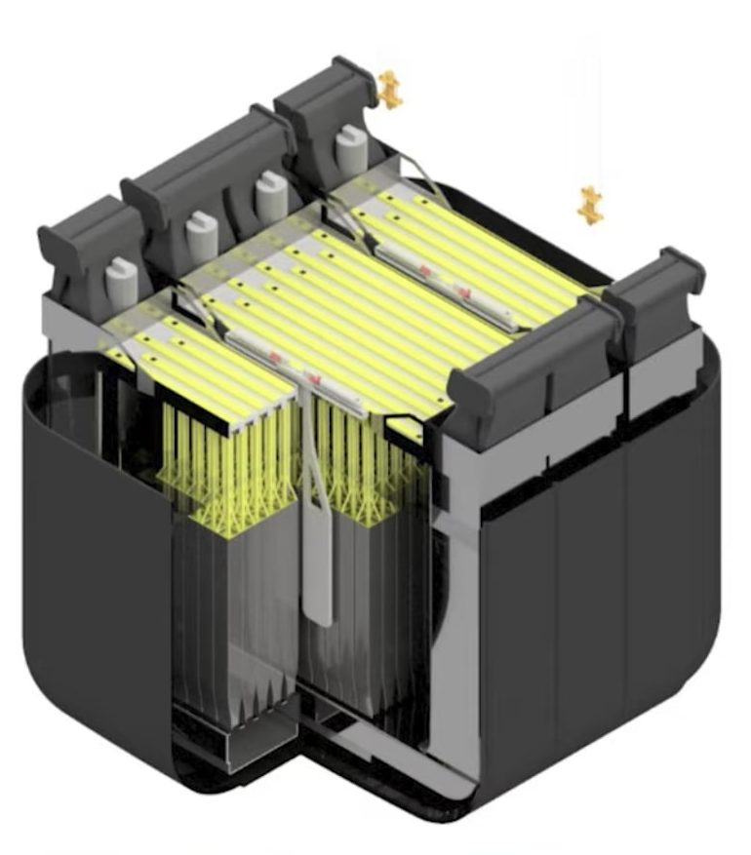
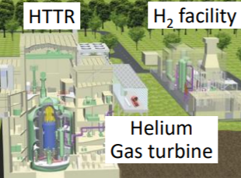
AMRs, SMRs, and the increased focus on structural integrity
Advanced Modular Reactors (AMRs) and Small Modular reactors (SMRs) are a key technology to help reduce carbon emissions worldwide by 2050.
However, a recent report by the Henry Royce Institute and Frazer-Nash highlighted that further research and development is required to overcome structural integrity challenges associated with increased reactor temperatures.
It is therefore important to focus on developing new structural integrity methods to enable us to reduce our greenhouse gas emissions and global warming.
USNC
Moltex
JAEA

Slide 3
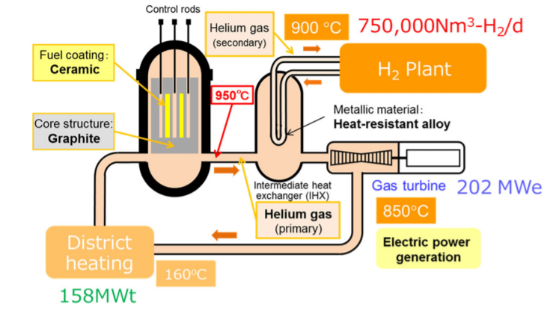
Why probabilistic lifing analysis?
Next generation nuclear reactor designs will likely need to be designed to operate at very high temperatures.
Current lifing methods are deterministic, with knock-downs to account for uncertainty.
Deterministic methods often lead to design conservatism, but also unclear whether optimistic in some cases.
Probabilistic methods can directly account for uncertainty, giving a more accurate solution.

Slide 4
Requirements for probabilistic structural integrity analysis
Robustness
The method must be able to produce accurate results under a variety of conditions.
Trekoverland.com

Slide 5
Requirements for probabilistic structural integrity analysis
Robustness
The method must be able to produce accurate results under a variety of conditions.
Accuracy
The method must calculate the probability of failure with little or no error.
High accuracy, Low precision
LinkedIn

Slide 6
Requirements for probabilistic structural integrity analysis
Robustness
The method must be able to produce accurate results under a variety of conditions.
Accuracy
The method must calculate the probability of failure with little or no error.
Precision
The method must be capable of calculating probabilities of failure to a high number of decimal places.
High accuracy, High precision
LinkedIn

Slide 7
Requirements for probabilistic structural integrity analysis
Robustness
The method must be able to produce accurate results under a variety of conditions.
Accuracy
The method must calculate the probability of failure with little or no error.
Precision
The method must be capable of calculating probabilities of failure to a high number of decimal places.
Efficiency
The method must be able to predict probability of failure in a reasonable time, using few resources.
New York Times

Slide 8
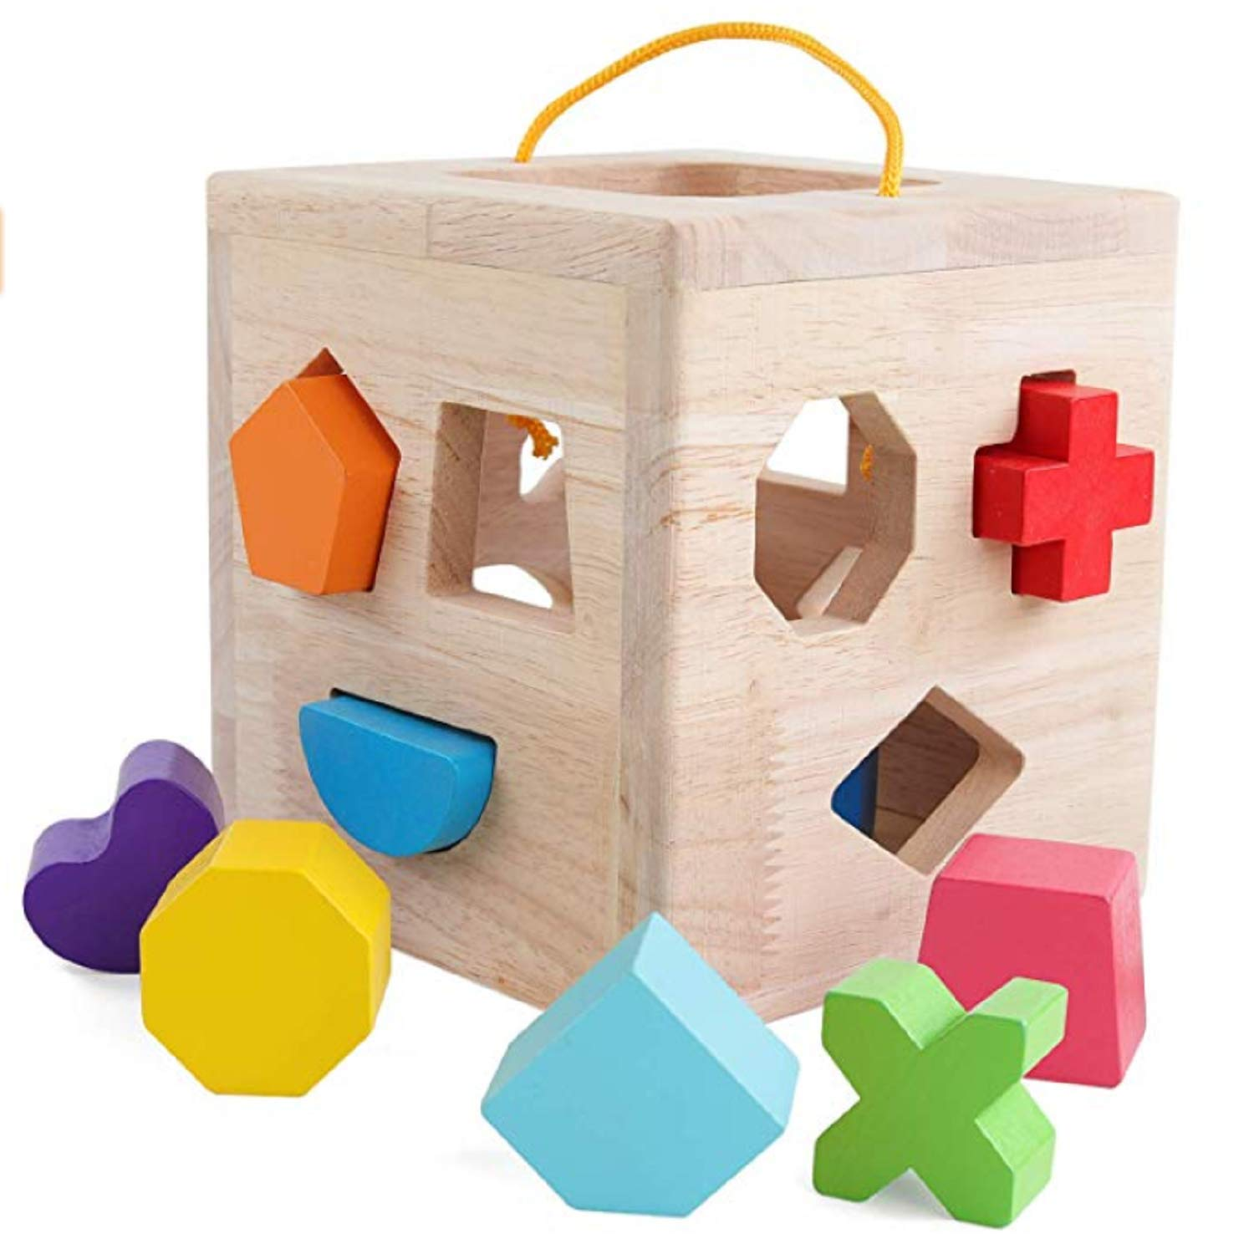
Requirements for probabilistic structural integrity analysis
Robustness
The method must be able to produce accurate results under a variety of conditions.
Accuracy
The method must calculate the probability of failure with little or no error.
Precision
The method must be capable of calculating probabilities of failure to a high number of decimal places.
Efficiency
The method must be able to predict probability of failure in a reasonable time, using few resources.
Ease of use
The method must be easy to implement.
Amazon

Slide 9
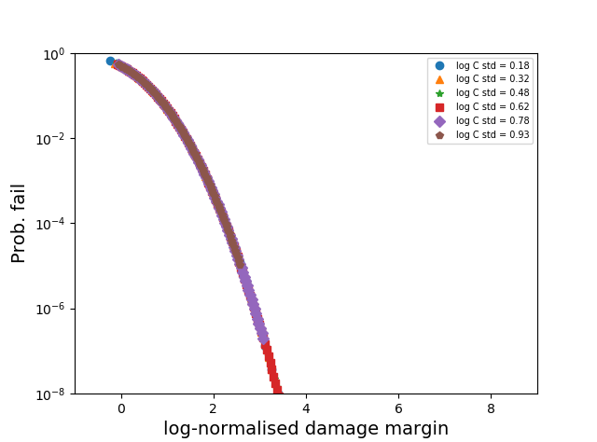
Contents
Pseudo-stochastic simulation
Monte Carlo and surrogate Monte Carlo simulation

Slide 10
Contents
Pseudo-stochastic simulation
Monte Carlo and surrogate Monte Carlo simulation

Slide 11
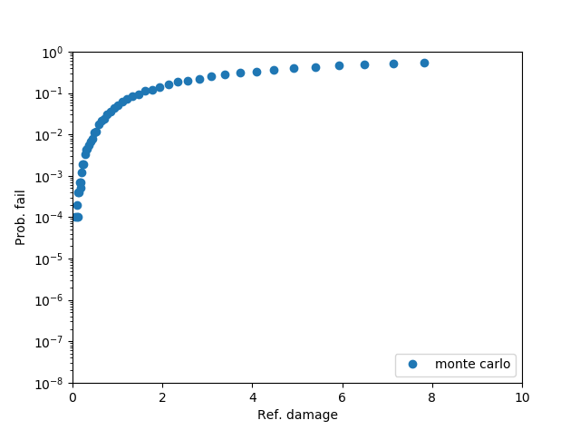
Pseudo-stochastic methods: general procedure
Aim to create a “lookup curve” that other engineers can use to read across the probability of failure.
Probability of failure
Pseudo-stochastic metric

Slide 12
Pseudo-stochastic methods: general procedure
Aim to create a “lookup curve” that other engineers can use to read across the probability of failure.
Probability of failure
Pseudo-stochastic metric

Slide 13
Pseudo-stochastic methods: general procedure
Aim to create a “lookup curve” that other engineers can use to read across the probability of failure.
Probability of failure
Pseudo-stochastic metric

Slide 14
Pseudo-stochastic methods: general procedure
Aim to create a “lookup curve” that other engineers can use to read across the probability of failure.
Pseudo-stochastic damage metric calculated from combination of best estimate damage, and damage from 95th percentile confidence interval values for stochastic inputs (more to come).
Probability of failure calculated using a more accurate and precise method (e.g. Monte Carlo). This curve is created just once, thus reducing future effort for the probabilistic analysis.
Probability of failure
Pseudo-stochastic metric

Slide 15
Pseudo-stochastic methods: general procedure
Aim to create a “lookup curve” that other engineers can use to read across the probability of failure.
Pseudo-stochastic damage metric calculated from combination of best estimate damage, and damage from 95th percentile confidence interval values for stochastic inputs (more to come).
Probability of failure calculated using a more accurate and precise method (e.g. Monte Carlo). This curve is created just once, thus reducing future effort for the probabilistic analysis.
Probability of failure
Requirement | RAG rating
Robustness | G
Accuracy
Precision
Efficiency
Ease of use
Pseudo-stochastic metric

Slide 16
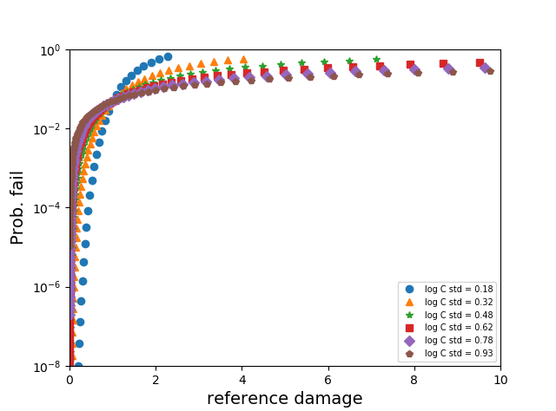
Pseudo-stochastic methods: general procedure
Aim to create a “lookup curve” that other engineers can use to read across the probability of failure.
Pseudo-stochastic damage metric calculated from combination of best estimate damage, and damage from 95th percentile confidence interval values for stochastic inputs (more to come).
Probability of failure calculated using a more accurate and precise method (e.g. Monte Carlo). This curve is created just once, thus reducing future effort for the probabilistic analysis.
Probability of failure
Requirement | RAG rating
Robustness | R
Accuracy
Precision
Efficiency
Ease of use
Pseudo-stochastic metric

Slide 17
Sandbox testing: the Miller-Norton creep law
A simplified creep law to start:
Computationally cheap to evaluate many times
Probability of failure can be solved analytically (using the probability chain rule for multiple stochastic variables)
Can use this to test various pseudo-stochastic methods
$$ε_{cr}=\frac{C∙σ^{n}∙{\tilde{t}}^{m+1}∙e^{\frac{−Q}{R∙T}}}{m+1}$$

Slide 18
Sandbox testing: the Miller-Norton creep law
A simplified creep law to start:
Computationally cheap to evaluate many times
Probability of failure can be solved analytically (using the probability chain rule for multiple stochastic variables)
Can use this to test various pseudo-stochastic methods
$$ε_{cr}=\frac{C∙σ^{n}∙{\tilde{t}}^{m+1}∙e^{\frac{−Q}{R∙T}}}{m+1}$$
Stochastic variable | Assumed distribution
$C$ (MPa^{-n}.s^{-(m+1)}) | Log-Normal
$σ$ (MPa) | Normal
$n$ (-) | Normal
$m$ (-) | Normal
$Q$ (kJ/mol) | Normal
$$T (°K)$$ | Normal

Slide 19
Pseudo stochastic method 1: reference damage method
Calculate the best estimate damage
$$D_{BE}=\frac{μ_{logC}∙{μ_{σ}}^{μ_{n}}∙{\tilde{t}}^{μ_{m}+1}∙e^{\frac{−μ_{Q}}{R∙μ_{T}}}}{(μ_{m}+1)∙\tilde{ε_{cr}}}$$
For each stochastic variable, calculate $D_{i}$, i.e. the damage where the stochastic variable is set to
$$μ_{i}±1.65∙σ_{i}$$
Calculate the reference damage as the expected damage plus the root-sum-square of the additional stochastic damage
$$D_{RD}=D_{BE}+\sqrt{\sum_{i=1}^{N}{{\left(D_{i}−D_{BE}\right)}^{2}}}$$

Slide 20
Testing robustness: changes to mean of stochastic variables (reference damage method)
$$ε_{cr}=\frac{C∙σ^{n}∙{\tilde{t}}^{m+1}∙e^{\frac{−Q}{R∙T}}}{m+1}$$
Variable | Mean | Standard deviation
$$logC$$ | [-16, -12] | 0.5
$$σ$$ | [50, 800] | 0.0
$$n$$ | [1, 2] | 0.0
$$m$$ | [-0.1, -0.5] | 0.0
$$Q$$ | [50, 400] | 0.0
$$T$$ | [50, 800] | 0.0

Slide 21
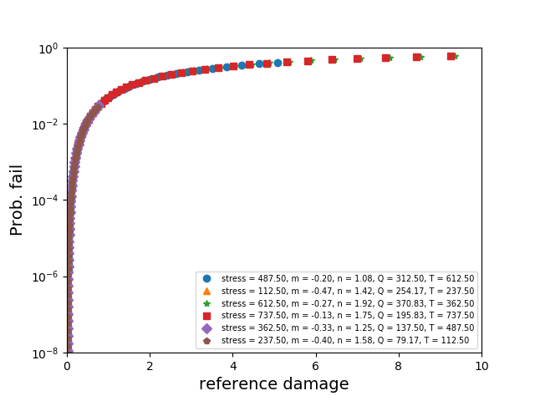
Testing robustness: changes to mean of stochastic variables (reference damage method)
$$ε_{cr}=\frac{C∙σ^{n}∙{\tilde{t}}^{m+1}∙e^{\frac{−Q}{R∙T}}}{m+1}$$
Variable | Mean | Standard deviation
$$logC$$ | [-16, -12] | 0.5
$$σ$$ | [50, 800] | 0.0
$$n$$ | [1, 2] | 0.0
$$m$$ | [-0.1, -0.5] | 0.0
$$Q$$ | [50, 400] | 0.0
$$T$$ | [50, 800] | 0.0

Slide 22
Testing robustness: changes to variance of stochastic variables (reference damage method)
$$ε_{cr}=\frac{C∙σ^{n}∙{\tilde{t}}^{m+1}∙e^{\frac{−Q}{R∙T}}}{m+1}$$
Variable | Mean | Standard deviation
$$logC$$ | [-16, -12] | [0.1, 1.0]
$$σ$$ | 425 | 0.0
$$n$$ | 1.5 | 0.0
$$m$$ | -0.3 | 0.0
$$Q$$ | 225 | 0.0
$$T$$ | 425 | 0.0

Slide 23
Testing robustness: changes to variance of stochastic variables (reference damage method)
$$ε_{cr}=\frac{C∙σ^{n}∙{\tilde{t}}^{m+1}∙e^{\frac{−Q}{R∙T}}}{m+1}$$
Variable | Mean | Standard deviation
$$logC$$ | [-16, -12] | [0.1, 1.0]
$$σ$$ | 425 | 0.0
$$n$$ | 1.5 | 0.0
$$m$$ | -0.3 | 0.0
$$Q$$ | 225 | 0.0
$$T$$ | 425 | 0.0

Slide 24
Testing robustness: changes to variance of stochastic variables (reference damage method)
$$ε_{cr}=\frac{C∙σ^{n}∙{\tilde{t}}^{m+1}∙e^{\frac{−Q}{R∙T}}}{m+1}$$
Requirement | RAG rating
Robustness | R
Accuracy
Precision
Efficiency
Ease of use
Variable | Mean | Standard deviation
$$logC$$ | [-16, -12] | [0.1, 1.0]
$$σ$$ | 425 | 0.0
$$n$$ | 1.5 | 0.0
$$m$$ | -0.3 | 0.0
$$Q$$ | 225 | 0.0
$$T$$ | 425 | 0.0

Slide 25
Pseudo stochastic method 2: damage margin method
Calculate the best estimate damage
$$D_{BE}=\frac{μ_{logC}∙{μ_{σ}}^{μ_{n}}∙{\tilde{t}}^{μ_{m}+1}∙e^{\frac{−μ_{Q}}{R∙μ_{T}}}}{(μ_{m}+1)∙\tilde{ε_{cr}}}$$
For each stochastic variable, calculate $D_{i}$, i.e. the damage where the stochastic variable is set to
$$μ_{i}±1.65∙σ_{i}$$
Calculate the damage margin as the logarithm of the difference in damage between the fully-damaged and expected damaged state, scaled by the root sum square of the logarithm of the additional stochastic damage
$$D_{LNDM}=\frac{−\log_{10}{(D_{BE})}}{\sqrt{\sum_{i=1}^{N_{c}}{{\left(\log_{10}{(D_{i})}−\log_{10}{(D_{BE})}\right)}^{2}}}}$$

Slide 26
Testing robustness: changes to variance of stochastic variables (damage margin method)
$$ε_{cr}=\frac{C∙σ^{n}∙{\tilde{t}}^{m+1}∙e^{\frac{−Q}{R∙T}}}{m+1}$$
Variable | Mean | Standard deviation
$$logC$$ | [-16, -12] | [0.1, 1.0]
$$σ$$ | 425 | 0.0
$$n$$ | 1.5 | 0.0
$$m$$ | -0.3 | 0.0
$$Q$$ | 225 | 0.0
$$T$$ | 425 | 0.0

Slide 27
Testing robustness: changes to variance of stochastic variables (damage margin method)
$$ε_{cr}=\frac{C∙σ^{n}∙{\tilde{t}}^{m+1}∙e^{\frac{−Q}{R∙T}}}{m+1}$$
Variable | Mean | Standard deviation
$$logC$$ | [-16, -12] | [0.1, 1.0]
$$σ$$ | 425 | 0.0
$$n$$ | 1.5 | 0.0
$$m$$ | -0.3 | 0.0
$$Q$$ | 225 | 0.0
$$T$$ | 425 | 0.0

Slide 28
Testing with a more advanced creep law
The same tests were repeated for the High Temperature Behaviour of Austenitic Stainless Steels (HTBASS) creep law
Much more complex creep law, with high levels of non-linearity and interactions between variables
Creep ductility is strain rate, stress, and temperature dependent
Variable | Mean | Standard deviation
$$σ$$ | [600, 800] | [2, 20]
$$T$$ | [400, 700] | [2, 20]
$$Z$$ | [2.7, 3] | [0.03, 0.1]
$$E$$ | [1.7 E+5, 1.9E+5] | [1.5E+3, 1.0E+4]
$${\dot{ε}}_{c}=\exp\left(−\frac{Q_{p}}{RT}\right){\left( ε_{c}+Dε_{\text{pl}}\right)}^{\left(x_{0}+x_{1}T\right)}{\overline{σ}}^{T^{β}}+C_{0}\exp\left(−\frac{Q_{s}}{RT}\right){\overline{σ}}^{{\left(\frac{T}{T_{n}^{′}}\right)}^{γ}}$$

Slide 29
Testing with a more advanced creep law
The same tests were repeated for the High Temperature Behaviour of Austenitic Stainless Steels (HTBASS) creep law
Much more complex creep law, with high levels of non-linearity and interactions between variables
Creep ductility is strain rate, stress, and temperature dependent
Variable | Mean | Standard deviation
$$σ$$ | [600, 800] | [2, 20]
$$T$$ | [400, 700] | [2, 20]
$$Z$$ | [2.7, 3] | [0.03, 0.1]
$$E$$ | [1.7 E+5, 1.9E+5] | [1.5E+3, 1.0E+4]
$${\dot{ε}}_{c}=\exp\left(−\frac{Q_{p}}{RT}\right){\left( ε_{c}+Dε_{\text{pl}}\right)}^{\left(x_{0}+x_{1}T\right)}{\overline{σ}}^{T^{β}}+C_{0}\exp\left(−\frac{Q_{s}}{RT}\right){\overline{σ}}^{{\left(\frac{T}{T_{n}^{′}}\right)}^{γ}}$$

Slide 30
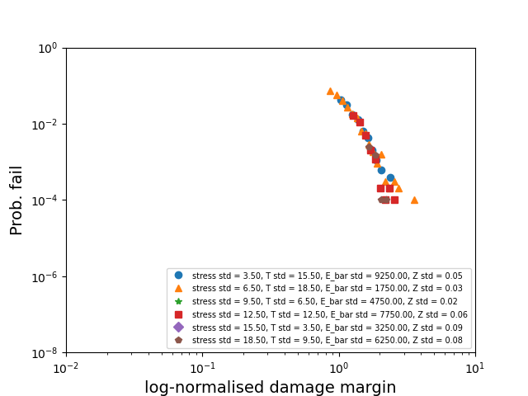
Testing with a more advanced creep law

Slide 31
Testing with a more advanced creep law
Requirement | RAG rating
Robustness | A
Accuracy
Precision
Efficiency
Ease of use

Slide 32
Testing with a more advanced creep law
Requirement | RAG rating
Robustness | A
Accuracy | A
Precision | A
Efficiency | G
Ease of use | G

Slide 33
Summary: pseudo-stochastic probabilistic integrity analysis
Aimed to create a “lookup curve” for easy calculation of failure probabilities

Slide 34
Summary: pseudo-stochastic probabilistic integrity analysis
Aimed to create a “lookup curve” for easy calculation of failure probabilities
Aiming to avoid pseudo-stochastic methods that do not create a single, robust look-up curve.
Requirement | RAG rating
Robustness | R
Accuracy
Precision
Efficiency
Ease of use

Slide 35
Summary: pseudo-stochastic probabilistic integrity analysis
Aimed to create a “lookup curve” for easy calculation of failure probabilities
Aiming to avoid pseudo-stochastic methods that do not create a single, robust look-up curve.
The log-normalised damage margin method is both sensitive and robust to changes in mean values and variance of the stochastic variables

Slide 36
Summary: pseudo-stochastic probabilistic integrity analysis
Aimed to create a “lookup curve” for easy calculation of failure probabilities
Aiming to avoid pseudo-stochastic methods that do not create a single, robust look-up curve.
The log-normalised damage margin method is both sensitive and robust to changes in mean values and variance of the stochastic variables
This behaviour persists when applied to more complex creep laws (such as HTBASS)
Requirement | RAG rating
Robustness | A
Accuracy | A
Precision | A
Efficiency | G
Ease of use | G

Slide 37
Contents
Pseudo-stochastic simulation
Monte Carlo and surrogate Monte Carlo simulation

Slide 38
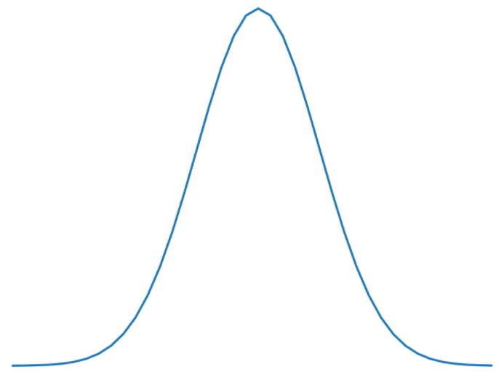
Classical Monte Carlo analysis
Monte Carlo analysis generally follows these steps:
Take $n$ samples from the input distribution(s).
Calculate the damage $D_{i}$ for each sampled set of inputs.
Approximate the probability of failure via $P_{fail}=\frac{\sum_{i=1}^{n}{y_{i}}}{n}, where y_{i}=\left\{\begin{aligned}1, if D_{i}≥\tilde{D} \\ 0, otherwise \end{aligned}\right.$, and $\tilde{D}$ is the maximum allowable damage until failure.
P(x)
x

Slide 39
Classical Monte Carlo analysis
Monte Carlo analysis generally follows these steps:
Take $n$ samples from the input distribution(s).
Calculate the damage $D_{i}$ for each sampled set of inputs.
Approximate the probability of failure via $P_{fail}=\frac{\sum_{i=1}^{n}{y_{i}}}{n}, where y_{i}=\left\{\begin{aligned}1, if D_{i}≥\tilde{D} \\ 0, otherwise \end{aligned}\right.$, and $\tilde{D}$ is the maximum allowable damage until failure.
P(x)
x
Requirement | RAG rating
Robustness | G
Accuracy | G
Precision | A
Efficiency | R
Ease of use | G

Slide 40
Surrogate Monte Carlo analysis
Monte Carlo analysis is an accurate but time consuming method to calculate the probability of failure.
Takes a long time due to many repeats of computationally intensive equations.
Aim: make computationally tractable by training a surrogate model on the creep law, and use it as part of a Monte Carlo analysis to predict the probability of failure.
Specifically, Gaussian process regression has promise as a surrogate model, due to its high accuracy, precision, and generality.
Create training data
Train surrogate model
Perform Monte-Carlo analysis using surrogate model

Slide 41
Surrogate model: Gaussian process regression
A non-parametric approach
Instead of trying to tune parameters for an assumed curve type (e.g. a cubic), we are trying to find all possible functions that are consistent with the observed data.

Slide 42
Surrogate model: Gaussian process regression
A non-parametric approach
Instead of trying to tune parameters for an assumed curve type (e.g. a cubic), we are trying to find all possible functions that are consistent with the observed data.
sklearn

Slide 43
Surrogate model: Gaussian process regression
A non-parametric approach
Instead of trying to tune parameters for an assumed curve type (e.g. a cubic), we are trying to find all possible functions that are consistent with the observed data.
sklearn

Slide 44
Surrogate model: Gaussian process regression
A non-parametric approach
Instead of trying to tune parameters for an assumed curve type (e.g. a cubic), we are trying to find all possible functions that are consistent with the observed data.
Surrogate model (posterior distribution): predicted distribution of output y* given chosen inputs, observed outputs and observed inputs
$$p\left(y_{∗}|x_{∗},X,y\right)=\int{p\left(y_{∗}|{f,x}_{∗}\right)}∙p\left(f|X,y\right)df$$
Prior: probable output given each Gaussian distribution and chosen inputs
Marginal likelihood: probability that each Gaussian distribution fits the observed data
sklearn

Slide 45
Training and validation of the GPR surrogate
Create some training data, which contains the creep damage for various combinations of inputs.

Slide 46
Training and validation of the GPR surrogate
Create some training data, which contains the creep damage for various combinations of inputs.
Fit a GPR model to the training data,

Slide 47
Training and validation of the GPR surrogate
Create some training data, which contains the creep damage for various combinations of inputs.
Fit a GPR model to the training data,
check its generality using a validation data set

Slide 48
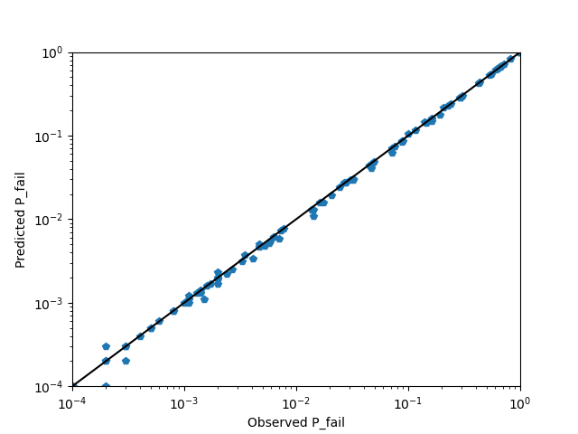
GPR surrogate Monte Carlo vs classical Monte Carlo
Use the GPR creep model as a surrogate creep model in a Monte-Carlo analysis
Compare the results to those created using the HTBASS creep law and Monte-Carlo

Slide 49
GPR surrogate Monte Carlo vs classical Monte Carlo

Slide 50
GPR surrogate Monte Carlo vs classical Monte Carlo
Requirement | RAG rating
Robustness | G
Accuracy | G
Precision | A
Efficiency | A
Ease of use | A

Slide 51
Summary: surrogate Monte Carlo analysis
Aimed to create a surrogate method for performing Monte-Carlo analysis with low computational cost
P(x)
x

Slide 52
Summary: surrogate Monte Carlo analysis
Aimed to create a surrogate method for performing Monte-Carlo analysis with low computational cost
GPR model fitted well to HTBASS creep law, with good accuracy and generality

Slide 53
Summary: surrogate Monte Carlo analysis
Aimed to create a surrogate method for performing Monte-Carlo analysis with low computational cost
GPR model fitted well to HTBASS creep law, with good accuracy and generality
Accuracy of surrogate Monte-Carlo analysis shown to be comparable to that of conventional Monte-Carlo

Slide 54
Summary: surrogate Monte Carlo analysis
Aimed to create a surrogate method for performing Monte-Carlo analysis with low computational cost
GPR model fitted well to HTBASS creep law, with good accuracy and generality
Accuracy of surrogate Monte-Carlo analysis shown to be comparable to that of conventional Monte-Carlo
Runtime of new method is almost 2000 times faster than conventional Monte-Carlo

Slide 55
Conclusion
Requirement | Classical Monte Carlo | Reference Damage | LNDM | Surrogate Monte Carlo
Robustness | G | A | G | G
Accuracy | G | A | A | G
Precision | A | A | A | A
Efficiency | R | G | G | A
Ease of use | G | G | G | A

Slide 56
Thank you
Dr Henry Cathcart
Group Leader
Frazer-Nash Consultancy
j.finley@fnc.co.uk

