Slide 1
Assessing Passive Components with Risk-Informed Thinking
David L. Rudland
Senior Technical Advisor for Materials
Office of Nuclear Reactor Regulation
U.S. Nuclear Regulatory Commission
2022 International Symposium on Probabilistic Methods for Nuclear Applications
Leicester University Space Park, Leicester LE4 5SP UK
November 1-3, 2022

Slide 2
Risk-informed Decision Making
Integrated Decision Making
Defense-in-depth
Safety Margins
Increase in risk or CDF is small
Monitoring
Change meets current regulation
Objective is integrated decision making
Key is risk informed not risk based
Use of risk insights for passive component integrity – How to assess components not modelled in PRA?
Can PFM be used for regulatory discussions outside of RIDM?
2

Slide 3
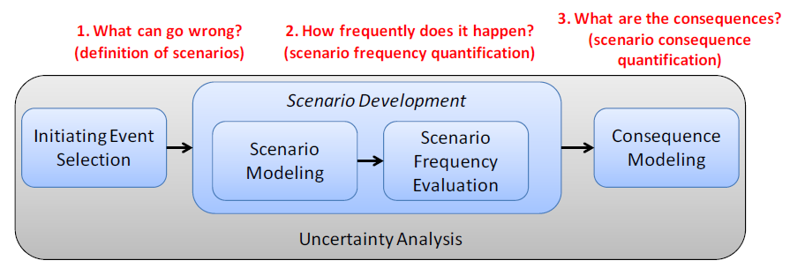
Use of Probabilistic Fracture Mechanics
Formalized review process for risk-informed decision making
No Formalized review process for risk-informed decision making – Should we follow similar process??
Probabilistic Fracture Mechanics (PFM) is being used
Requests for Inspection Relief
LOCA Frequencies
LBB
Others?
3

Slide 4
Risk-Informed Licensing
Other licensing actions
Guidance/
Process
needed
Where are the passive component integrity assessments?
4

Slide 5

Licensing Reviews and Emergent Issues
Process defined
Process under development
LIC-206, others
Risk-Informed
License Basis
Changes
(RD 1.174/RG 1.200
Requests with PFM
Process defined
LIC-504
Need adequate, consistent information and confidence in results
TSTF-505 Risk-informed
Completion times
Acceptability
Risk/PRA
NFPA-805 Risk-informed
Fire Protection
Emergent issues?
Risk information
submitted outside of the formal risk-informed licensing basis change process
10CFR 50.69
SSC Categorization
Relief Requests
5b Risk-informed
Surveillance Frequencies
Deterministic
Risk-informed
Inservice Inspection
Reviews
Qualitative
Reliance on Licensee Risk Information
Quantitative
5

Slide 6

Past Applications of PFM
Biggest Major Program successes:
  Risk-informed Inspection for Piping
  Elimination of BWR reactor pressure vessel circumferential weld inspections
  Pressurized thermal shock analysis for reactor pressure vessel
Reasons for success
  Computer code bases were technically adequate (V&V) – staff was able to fully review code or had similar code for confirmatory analyses
  All Principles of risk informed decision making were assessed
  In many cases, deterministic and probabilistic analyses were used as basis
  Sensitivity/uncertainty analyses used to demonstrate impact of important variables
6

Slide 7

Current Applications of PFM
Extending ISI interval to more than 10 years for
  Steam generator
  Pressurizer
  Heat exchangers
Extension to 20 years has been approved in the past
Extension beyond 20 years needs further justification
Some licensee are seeking to delay inspections for remainder of licensed life
7

Slide 8
Risk-informed Modifications to Inspection
Degradation occurs where the conditions necessary for a particular mechanism exist – typical ISI programs are not focused.
Locations that have a higher failure potential with a significant consequence of that failure (i.e., risk) can be targeted for inspection
NRC uses a risk-informed decision-making methodology to determine impact
But we only know what we learned from operational history
Integrated Decision Making
Defense-in-depth
Safety Margins
Increase in risk or CDF is small
Monitoring
Change meets current regulation
Assessing Passive Components with Risk-Informed Thinking
8

Slide 9

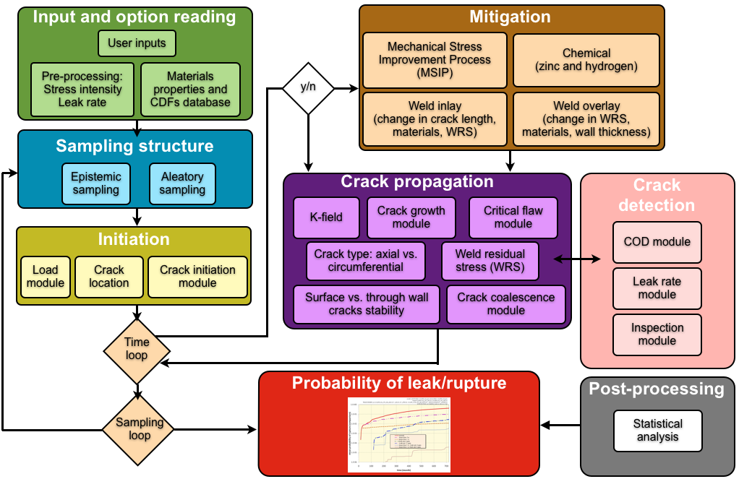
Using Risk Arguments for Inspections
What if we are wrong?
Additional degradation
Unknown behavior
9

Slide 10
Operational History
The potential for new mechanisms must be considered
Due to IGSCC
6 years/mechanisms
Chance of failure
1.5 years/
mechanisms
Burn-in
Maturity
Wear-out
Assessing Passive Components with Risk-Informed Thinking
10

Slide 11
Risk Arguments for ISI
Probabilistic fracture mechanics and other advanced analytical techniques model the state-of-the-art with the current-day knowledge
Modelling the unknown is always a major question and limitation of these analyses
Monitoring provides the necessary feedback
Analysis (PRA, PFM, etc)
Result
Snapshot in time
Monitoring
Real time Results
November 1-3, 2022
11

Slide 12
How Much Performance Monitoring is Enough?
Many components in US plants are in the “maturity” phase
Examinations are primarily confirming operating experience and monitoring for novel degradation
Strategies such as primary/expansion (MRP-227) or fleet coordination (WCAP-16168) may be adequate to demonstrate performance monitoring
Statistical techniques may be used to define minimum inspection required to find unique degradation
Assessing Passive Components with Risk-Informed Thinking
12

Slide 13

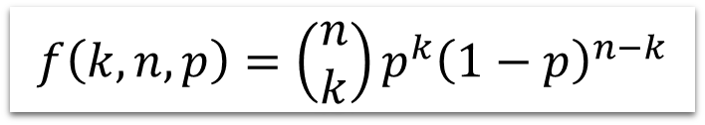


Binomial Distribution
$$f\left(k,n,p\right)=\left(\begin{matrix}n \\ k\end{matrix}\right)p^{k}{\left(1−p\right)}^{n−k}$$
The binomial distribution is frequently used to model the number of successes in a sample of size n drawn with replacement from a population of size N
Can be used to find # of inspections needed to find a crack
Only a function of the number of inspections and the % cracked
Does not demonstrate the impact of sample size
Very easy to use
$$\left(\begin{matrix}n \\ k\end{matrix}\right)=\frac{n!}{k!\left(n−k\right)!}$$
k= number of successes (cracks found) , n=number of trials (inspections)
p= probability of success on an individual trial (% of population cracked)
If k=0 then this is the probability of no successes is:
$$f\left(n,p\right)={\left(1−p\right)}^{n}$$
and therefore, the probability of at least one success is
$$1−f\left(n,p\right)$$
13

Slide 14
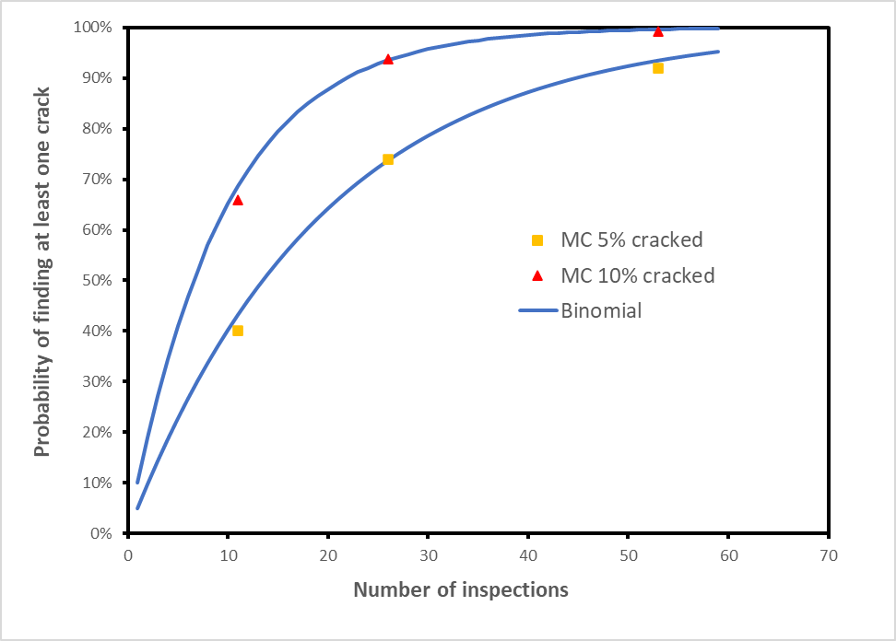
Monte Carlo Analysis
Sample a weld population with x% cracked
Sample Inspection of y% of welds
Same idea can be developed through a MC analysis
Allows maximum flexibility in analysis
Binomial response can be recreated
p=count/n
MC Loop, n realizations
yes
no
Done?
Loop on weld population
no
Done?
yes
inspected?
no
yes
cracked?
no
For large populations
yes
count=count+1
14

Slide 15
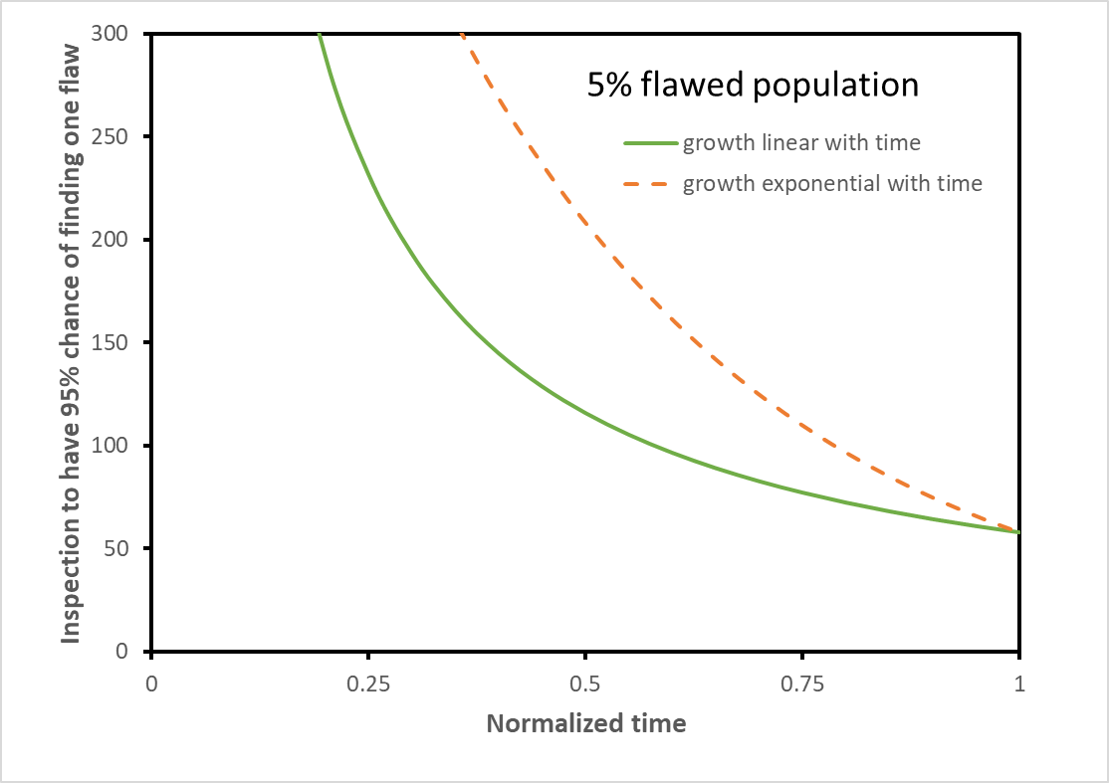
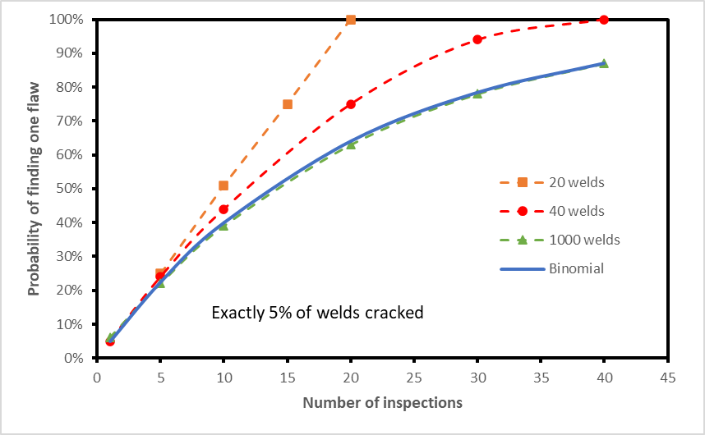
Examples
Impact of small sample size
Binomial solution versus time
15

Slide 16
Performance Monitoring Program
A modified binomial solution, with time correction, may be sufficient to design a conservative inspection program
Correcting the binomial solution is just a rough approximation and may be non-conservative in the number of inspections needed to find a growing crack
A detailed MC analysis can better define the response, and can model crack growth and inspections directly
Small sample size makes it difficult to define a conservative inspection program
Leveraging other similar materials to expand the weld population should be considered
16

Slide 17
Risk Informed Materials Assessment
Regulatory guidance providing framework for submitting and reviewing materials engineering applications with Risk informed decision-making (RIDM) aspects
Ambitions
Challenge
Status
Goal
Guidance would provide key aspects to include in high-quality submittals as well as the interaction between these key aspects as they may relate to NRC review decisions.
NRC Staff lead project
Existing NRC RIDM guidance focused on use of PRA
RIDM guidance for passive component integrity not available
Handling of uncertainties lacks guidance
Project officially initiated
NRC staff developing internal draft concepts
Public participation in project is planned
Assessing Passive Components with Risk-Informed Thinking
17

Slide 18
Summary
Risk-informed decision-making is being used to propose certain changes in requirements for passive components
NRC uses integrated decision making considering the five principles of risk-informed decision making in determining impacts
When modifying inspection intervals using PFM as the basis, performance monitoring provides the necessary feedback to demonstrate continued adequacy of the analyses.
Statistical methods is one option in designing a performance monitoring program
18

Slide 19


