Slide 1
RG-1.245 and NUREG/CR-7278
U.S. NRC Guidance on Probabilistic Fracture Mechanics for Regulatory Applications
Patrick Raynaud
Senior Materials Engineer
U.S. Nuclear Regulatory commission
Patrick.Raynaud@nrc.gov

Slide 2
Disclaimer
This presentation was prepared as an account of work sponsored by an agency of the U.S. Government. Neither the U.S. Government nor any agency thereof, nor any of their employees, makes any warranty, expressed or implied, or assumes any legal liability or responsibility for any third party’s use, or the results of such use, of any information, apparatus, product, or process disclosed in this presentation, or represents that its use by such third party would not infringe privately owned rights. The views expressed in this paper are not necessarily those of the U.S. Nuclear Regulatory Commission.

Slide 3
Acknowledgements
U.S. NRC
  David Rudland, David Dijamco, Stephen Cumblidge
Sandia National Laboratory (SNL)
  Lauren Hund, John Lewis, Nevin Martin, Mike Starr, Dusty Brooks, Adah Zhang, Remi Dingreville, Aubrey Eckert, Josh Mullins
Engineering Mechanics Corporation of Columbus (Emc²)
  Cedric Sallaberry, Bob Kurth

Slide 4
Development of Guidance for PFM Regulatory Applications
Purpose: Develop regulatory guidance to improve regulatory outcomes for licensing actions related to the use of PFM
Desired Outcome
  Increase quality of licensee applications
  Increase predictability and consistency of staff reviews
  Enhance and expand the utilization of PFM tools
External Engagement
  2019 International Seminar on Probabilistic Methods for Nuclear Applications
    Co-organized with CNSC (Canada), held in Rockville, MD, 22-24 October 2019
    Over 80 attendees from a dozen countries
    Next meeting planned for 2021 in England (Organized by Rolls Royce)
  Public meetings held in December 2017 and October 2018
  Discussions with EPRI during annual Materials Meeting

Slide 5
NRC’s Final PFM Guidance Documents
RG-1.245: “Preparing Probabilistic Fracture Mechanics Submittals” (ML21334A158)
NUREG/CR-7278: “Technical Basis for the use of Probabilistic Fracture Mechanics in Regulatory Applications” (ML22014A406)
Supporting Documents
  TLR-RES/DE/REB-2021-15: Application of Probabilistic Analysis Techniques in Mechanical Integrity Assessments (ML21267A473)
  TLR-RES/DE/REB-2021-16: Probabilistic Fracture Mechanics Application: FAVOR Case Study (ML21267A469)

Slide 6
Regulatory Guide 1.245, Revision 0
[RG-1.245 Rev.0]
Graded approach to prepare PFM submittals
  Analysis and documentation categories for each topic to be covered in a PFM application
  Characteristics of underlying regulatory application dictate breadth and depth of submittal contents
General Principles
  Higher safety significance
  Higher complexity
  Higher level of novelty
Submittals
Clarity
Consistency
PFM Analyses
Application Specific
Flexibility
More analyses, more documentation
Higher burden to create defensible and rigorous evidence

Slide 7
RG-1.245 Graded Approach Example: SQA and V&V Categories
Category | Description | Submittal Guidelines
QV-1 | Code used in NRC-approved application
QV-1A | Exercised within previously validated range | Demonstrate code applicability within the validated range.
 |  | Describe features of the specific application where the code is validated and applicable (i.e., areas of known code capability).
QV-1B | Exercised outside of previously validated range | Provide evidence for the applicability of the code to the specific application with respect to the areas of unknown code capability.
 |  | Describe features of the specific application where the code has not been previously validated and applied (i.e., areas of unknown code capability).
QV-1C | Modified | Give an SQA summary and V&V description for modified portions of the code.
 |  | Demonstrate that the code was not “broken” as a result of changes.
 |  | Make detailed documentation available for further review upon request (audit).
QV-2 | Commercial off-the-shelf software designed for the specific purpose of the application | Demonstrate code applicability.
 |  | Describe the software and its pedigree.
 |  | Make software and documentation available for review upon request (audit).
QV-3 | Custom code | Summarize the SQA program and its implementation.
 |  | Provide a basic description of the measures for quality assurance, including V&V of the PFM analysis code as applied in the subject report.
 |  | For very simple applications, possibly provide the source code instead of standardized SQA and V&V.
 |  | Include separate deterministic fracture mechanics analyses to support other validation results, as appropriate for a given application.

Slide 8
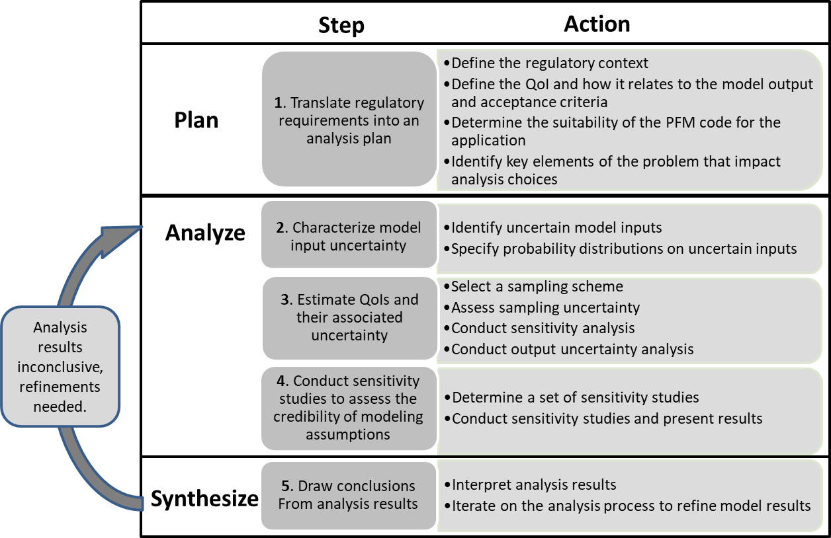
NUREG/CR-7278: RG-1.245 Technical Basis
Additional details on graded approach to PFM
Proposed process to conduct PFM analyses

Slide 9

NUREG/CR-7278: Compendium of Useful Methods for Establishing Confidence in PFM Analyses
Translating Regulatory Requirements into an Analysis Plan
  Separation of Aleatory and Epistemic Uncertainty
Model Input Uncertainty Characterization
  Statistical Distribution Fitting
  Preserving Physical Relationships between Inputs
Forward Propagation of Input Uncertainty
  Simple Random Sampling
  Latin Hypercube Sampling
  Importance Sampling
  First- and Second-Order Reliability Methods
  Convergence Analysis
  Closed-Form Metric for Simple Random Sampling Uncertainty in a Probability Estimate
  Statistical Bootstrapping
  Global Sensitivity Analysis
  Local Sensitivity Analysis
  Surrogate Models
  Visualizing Output Uncertainty Due to Input Uncertainty
Sensitivity Studies

Slide 10
NUREG/CR-7278 Example: Statistical Distribution Fitting
What?
  Estimating the probability distribution of a parameter using available data
How?
  Determine relevant data
  Select candidate probability distributions
  Fit distributions to the data
  Evaluate the fit of the distributions to the data
  Select a final input distribution model
When/Why?
  Represent uncertainty in model inputs

Slide 11
Supporting Document: TLR-RES/DE/REB-2021-15
“Application of Probabilistic Analysis Techniques in Mechanical Integrity Assessments”
Illustration of methods described in NUREG/CR-7278 using a concrete example problem
  Idealized solid mechanics representation of stresses acting on a pressurized steel tank with a helical weld
Available at ML21267A473

Slide 12
TLR-RES/DE/REB-2021-15 Example
Importance Sampling
Input Distributions
Output Distributions with simple random sampling

Slide 13
Supporting Document: TLR-RES/DE/REB-2021-16
“Probabilistic Fracture Mechanics Application: FAVOR Case Study”
Illustration of the PFM analysis steps and actions described in NUREG/CR-7278 using a concrete example problem with the FAVOR code
  Hypothetical continued operation of a single RPV following inspection that discovered two flaws
Available at ML21267A469

Slide 14
TLR-RES/DE/REB-2021-16 Example
Problem Definition
Statistical Convergence
Flaw Statistics Convergence Study

Slide 15
Summary
The U.S. NRC issued RG-1.245 and NUREG/CR-7278 in January 2022
RG-1.245 provides guidance on a graded approach for PFM applications to the NRC
NUREG/CR-7278 constitutes the technical basis for RG-1.245 and provides a toolkit of methods for PFM analyses
Two technical reports published as supporting documents
  Illustration of the PFM analysis steps discussed in NUREG/CR-7278
  Illustration of the methods and analysis tools discussed in NUREG/CR-7278
Following the guidance should improve regulatory outcomes for licensing actions related to the use of PFM in the U.S. by increasing confidence in analysis results

Slide 16
Questions?
Patrick.Raynaud@nrc.gov

