Slide 1
PIPER-CASS: Analysis and Results
Probabilistic Code for Evaluation of Integrity of Cast Austenitic Stainless Steel Piping Components in PWRs
DJ Shim: EPRI
Kevin Fuhr, Markus Burkardt, Matt Wolfson, Glenn White, and Chris Casarez: Dominion Engineering, Inc.
ISPMNA
November 1-3, 2022
Leicester, UK

Slide 2
Background and Objectives

Slide 3
Cast Austenitic Stainless Steel (CASS) Background
Because of the CASS material microstructure, Ultrasonic Testing (UT) technology applied to CASS components is not currently capable of meeting the PDI qualification standards that have been developed for other piping materials, particularly with regards to:
  Detection of axial flaws and
  Depth-sizing of circumferential flaws
In addition, thermal embrittlement of aged CASS material results in degraded material toughness, reducing acceptable flaw sizes
In 2019, EPRI began a project using probabilistic fracture mechanics (PFM) to evaluate the effect of these limitations
  Work to support development of a Supplement 9 to ASME Boiler and Pressure Vessel, Section XI, Appendix VIII and alternatives to Section XI, IWB-2500 inspection requirements for CASS piping components

Slide 4
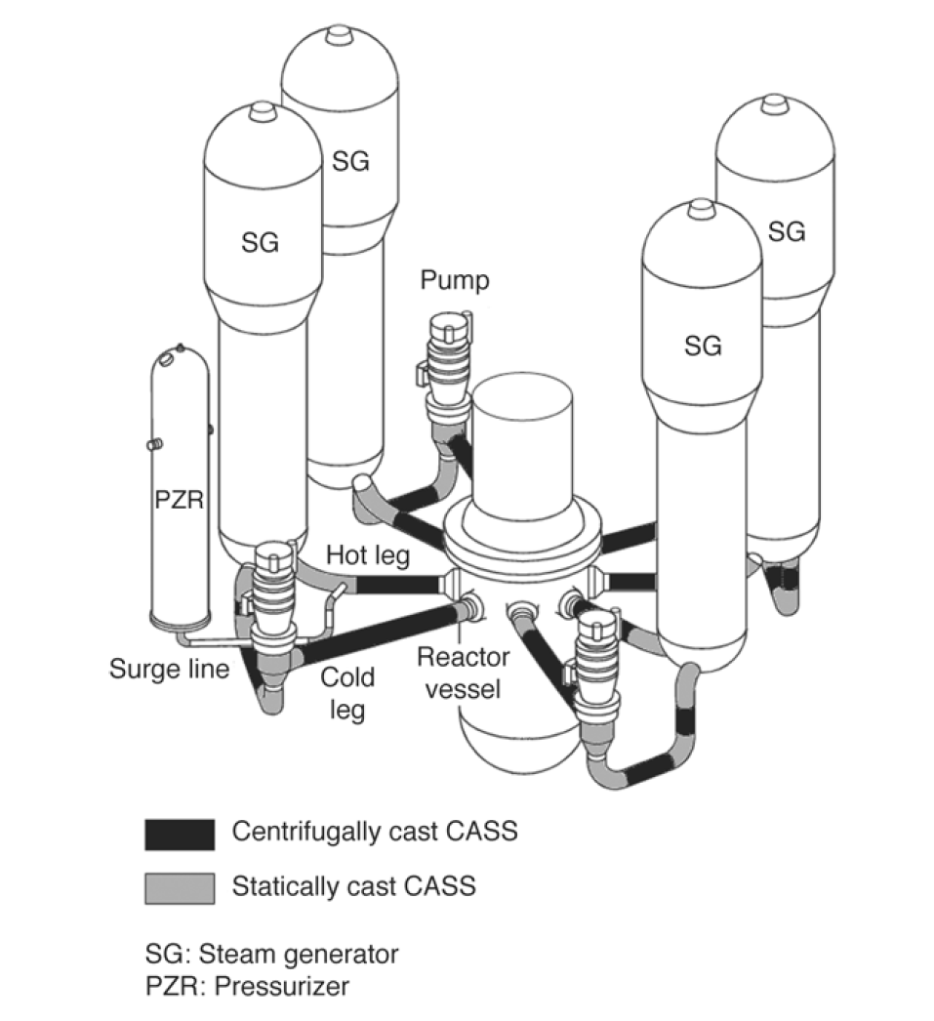
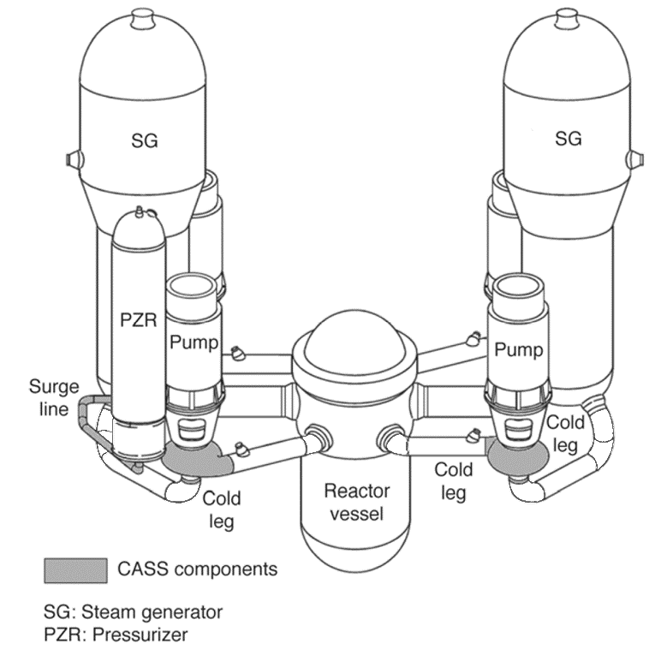
CASS Piping Locations
B&W plants include CASS safe ends at pump suction and discharge
Westinghouse CASS Locations
Combustion Engineering CASS Locations
(in operating CE PWRs)
CASS also used at CE plants currently operating in the U.S. for safe ends adjacent to the reactor coolant pump suction and discharge and for various safe ends at branch connections
Figures from: Nondestructive Evaluation: Flaw Tolerance Evaluation of Thermally Aged Cast Austenitic Stainless Steel Piping, EPRI, Palo Alto, CA: 2009. 1019128.

Slide 5
CASS Thermal Aging
CASS is subject to thermal aging effects when exposed to high temperatures for an extended period of time
  Saturation of thermal aging effects is reached after tens of years at ~608°F (320°C) per NUREG/CR-4513 R2 relations
Thermal aging increases material strength and decreases fracture toughness
The extent of thermal aging is correlated to the delta-ferrite (δ-ferrite) content of the cast component

Slide 6
Overall Project Objectives
Objective 1 (axial cracking):
  Investigate axial fatigue cracking assuming no benefit of periodic NDE nor online leak detection
    Demonstrate that detection of axial cracks is not necessary to maintain structural and leak tight integrity
Objective 2 (circumferential cracking):
  Investigate circumferential fatigue cracking assuming periodic NDE without a qualified flaw depth-sizing process
    Demonstrate that an alternative flaw evaluation procedure ensures structural and leak tight integrity
This presentation focusses on the results and conclusions obtained for axial cracking. Work to evaluate circumferential cracking is ongoing.

Slide 7
Inputs and Cases

Slide 8
Inputs
Geometry cases:
  Westinghouse (WEC) reactor coolant system (RCS) main loop piping
    WEC 1: 27.5 in. (699 mm) outside diameter, 2.32 in. (59 mm) wall thickness
    WEC 2: 37.59 in. (955 mm) outside diameter, 3.09 in. (78 mm) wall thickness
  Combustion Engineering (CE) surge line
    CE 1: 12.75 in. (324 mm) outside diameter, 1.01 in. (26 mm) wall thickness
    CE 2: 12.75 in. (324 mm) outside diameter, 1.31 in. (33 mm) wall thickness
Transient inputs:
  WEC transients for base load operation are input as described in MRP-393 at the best-estimate frequencies for each transient listed in the text description in MRP-393
  CE transients for base load operation are input as described in the design specification for the pressurizer of one CE plant with a CASS surge line with updates
  Flexible power operations (FPO) transients are modelled by scaling and shifting the pressure and temperature history of plant loading and unloading transients to model the desired power change and ramp rate

Slide 9
Fracture Toughness Inputs
PIPER-CASS includes net section collapse and elastic plastic fracture mechanics stability models
The J-R material toughness in PIPER-CASS is based on sampling of Charpy Impact C_{V} data
  Applied relations from NUREG/CR‑4513 R2 for fully-aged Type CF8M (up to 40% δ-ferrite) to get J-R curve parameters
The variability in the value for the J-R curve at extension of 0.08 inch was calibrated considering the data in MRP-362 R1 Appendix E for fully aged toughness at operating temperature
  Distribution extends beyond the lower bound value recommended by NUREG/CR‑4513 R2

Slide 10
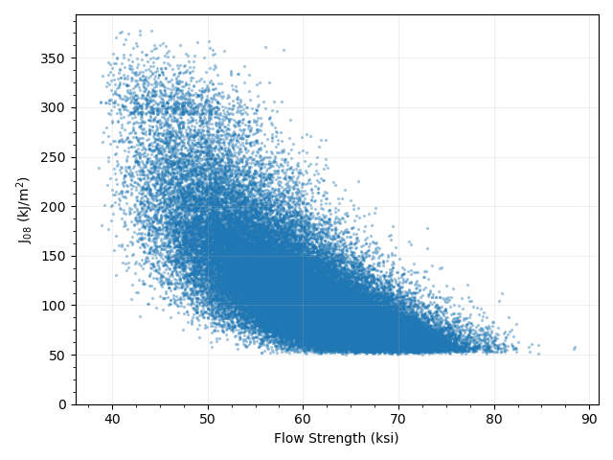
Strength Inputs
Plot shows data from an example base case PFM run (with 50,000 realizations) for fully aged flow strength and toughness at operating temperature with 40% δ-ferrite
Material strength inputs (YS and UTS) based on MRP-362 R1 Appendix E data for fully aged material at ~600°F (~316°C)
PIPER-CASS includes correlations between C_{V} and YS and C_{V} and UTS to obtain the observed correlation between J_{0.08} and strength for the fully aged data at ~600°F (316°C) in MRP-362 R1 Appendix E
In addition, PIPER-CASS cases apply lower bound limits for YS and UTS at 90% of the respective Code minimum values at operating temperature

Slide 11
Other Inputs
Probabilistic fatigue crack growth inputs of xLPR
  ASME Code Cases N-809 and N-809-1 at 70th to 90th percentile of distribution
Other required material inputs from ASME Code, Section II-D
Ramberg-Osgood relationship for stress-strain curve using the same correlation as MRP-362 R1 Appendix A
  Reference stress adjusted per NUREG/CR-6142 for consistency with xLPR

Slide 12
Axial Flaw Cases
Initial flaw assumption at time zero selected to reasonably bound any manufacturing flaws actually present in the piping, as well as the effect of fatigue crack initiation over operating life, with base cases reflecting:
  Five (5) coplanar part-through-wall flaws
  Depth of 25% of the thickness, same as applied in MRP-362 R1 and conservatively deep compared to data for CASS base metal manufacturing flaws crediting preservice radiographic testing showing reasonably bounding depth of 15% through-wall
  Coplanar cracking present over ~20% of the modeled length to aggressively consider the effect of multiple flaw initiation
  Initial length of each individual flaw based on 6:1 aspect ratio (2c/a = 6)
One case starts with an initial through-wall flaw at the critical flaw length and grows backward, resulting in a flaw size distribution representing flaw size needed to cause rupture after 80 years of growth for the worst sampled material condition
Sensitivity cases include:
  Assumed initial flaw depth and length
  Material properties (unaged CASS), and crack growth model parameters
  Weld residual stress
  Flexible power operations (FPO), and severity of transients (e.g., heatup and cooldown rate)
    FPO modeled as increased frequency of loading and unloading, with different ramp rates and power changes

Slide 13
Acceptance Criteria
Consider cumulative conditional probability of rupture for a single weld location
  Conditional on transient occurrence for a given Service Level loading
PIPER-CASS applies the same acceptance criteria as MRP-362, Rev. 1
  MRP-362, Rev. 1 provides the technical basis for Code Case N-838, which is conditionally approved by the US NRC (with conditions unrelated to the PFM acceptance criteria)
  MRP-362, Rev. 1 assesses the failure probabilities implied by the deterministic flaw evaluation procedure of ASME Section XI for allowable circumferential flaw sizes and assuming limit load failure given probabilistically distributed material flow strength
  Resultant marginal probability of rupture is 10⁻⁶ for each Service Level and represents the acceptable risk of a LOCA when leaving a piping flaw in service
Service Level | Probability of Occurrence | Conditional Rupture Probability
A | 1.0 | 10⁻⁶
B | 0.1 | 10⁻⁵
C | < 10⁻² | 10⁻⁴
D | < 10⁻² | 10⁻⁴

Slide 14
Results and Conclusions for Axial Flaw Analysis

Slide 15
Base Cases
No ruptures occurred in any base case at any service level with 9.6 million realizations (≤ 10⁻⁷ probability of rupture)
No leakage occurred in any base case with initial part-through-wall flaws
On average, 25% deep flaws grew to less than 30% deep
  Axial flaw growth in CE surge line driven by surges (loading and unloading)
    Thermal gradient stress higher for greater thickness, t
  Axial flaw growth in WEC main loop piping driven by transients with large rise times and large pressure changes (heatup/cooldown) as well as by abrupt power changes (trips)
    Pressure stress higher for larger R_{i}/t
CE 1
R_{i}/t = 5.3
CE 2
R_{i}/t = 3.9
WEC 1
R_{i}/t = 4.9
WEC 2
R_{i}/t = 5.1
“Representative depth growth” is the average of the total flaw growth divided by the initial quantity of cracks

Slide 16
Key Sensitivity Cases on Growth
WEC Case E (100°F/hr heatup and cooldown) and Case F (design basis transient frequency) also increase growth
Growth rate of through-wall flaw in WEC main loop piping is modest
  At the 99.9th percentile, “reverse growth” case grows smaller by 0.91 inch (23 mm) to 9.8 inch (248 mm) in length over 80 years
Cases modeling FPO (Case H & I) result in more growth than base load operation
  For CE surge line, FPO sensitivities grow faster due to increased transient occurrence; ramp rate is not a significant factor
  For WEC main loop, increased ramp rate is a significant factor
WEC cases with 80 years of FPO did not result in ruptures
CE cases show 10 years of FPO after 60 years of base load operation (Cases H & I) maintains an acceptably low rupture probability
  For CE surge line piping, FPO cases conservatively assumed insurge and outsurge events to occur with each change in power level

Slide 17
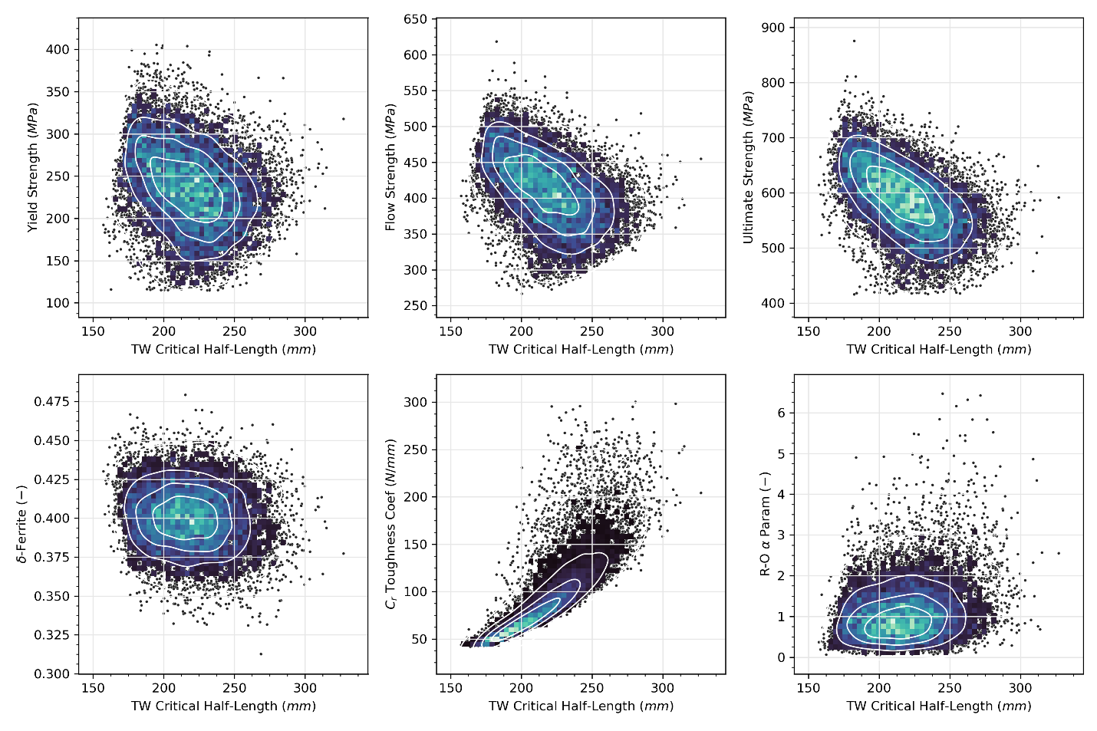
Additional Results
Material toughness (see C_{r} coefficient at right) is strongly correlated with critical crack size
  EPFM stability criterion is limiting versus net section collapse (NSC)
  Point loci also reflect correlation applied to reflect aged CASS having increased strength and degraded toughness
Convergence studies on time step for flaw growth and on number of realizations for rupture frequency were applied to ensure adequate convergence of PFM results
  δ-Ferrite variability is the assumed aleatory uncertainty in actual δ-ferrite when the nominal is at the limiting 40%

Slide 18
Conclusions for Axial Flaws
Available PFM modeling results show that periodic examination to detect axially oriented flaws is unnecessary to ensure pipe structural and leak tight integrity for the following cases:
  WEC main loop piping in both base load PWRs and PWRs operating under flexible power operation (FPO)
  CE surge lines in base load PWRs
Fatigue crack growth for 80 years is modeled to bound the concerns for both fatigue crack initiation and manufacturing flaws
For WEC main loop piping:
  The analyses show a benefit for significantly reduced fatigue crack growth when the power ramp rate is limited to less than 0.5% per minute for routine loading and unloading operation
For CE surge lines:
  The analyses show a benefit for significantly reduced fatigue crack growth when insurge and outsurge events are reduced in frequency
  Under FPO, there is an increased concern for fatigue crack growth due to the potential for a large number of insurge/outsurge transients to be triggered by FPO power shifts

Slide 19

Questions/Comments/Feedback

