Slide 1
Use of the xLPR Code for Developing LOCA Frequency Estimates
Overview and Key Analysis Results
Nate Glunt and Craig Harrington, EPRI
Markus Burkardt and Gideon Schmidt, DEI
ISPMNA
November 1-3, 2022
Leicester, UK

Slide 2
Outline
Background
  NUREG-1829 & Scope
  Previous xLPR studies
  Additional xLPR analysis cases
Summary of xLPR analysis cases
  Summary of base cases & sensitivity cases
  Output quantities of interest
Key Results
  LOCA frequency compared to NUREG-1829
  Time between detectable leakage and rupture
Conclusions

Slide 3
Background
NUREG-1829, Vol. 1 estimates Loss-of-Coolant Accident (LOCA) frequencies
  Evaluated the technical adequacy of redefining the design-basis break size (largest pipe break to which 10 CFR 50.46 applies) to a smaller size
  Estimated LOCA frequencies through an expert elicitation process
As part of research into an alternative fuel licensing approach to fuel fragmentation, relocation, and dispersal (FFRD), it was suggested to apply xLPR to:
  Evaluate probability of LOCAs as a function of line size
  Evaluate probability that leakage would be detected in sufficient time prior to piping rupture
  Validate NUREG-1829 frequency estimates for use in high burnup fuel licensing

Slide 4
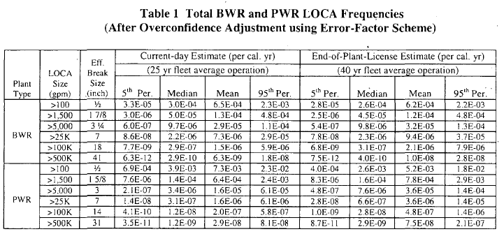
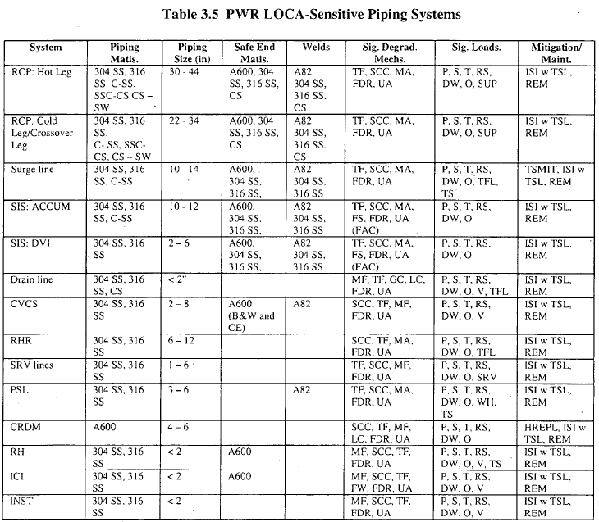
Scope
NUREG-1829 gives estimates of LOCA frequencies based on expert elicitation (Table 1)
The expert elicitation considered LOCA-sensitive piping systems and associated degradation mechanisms (Table 3.5)
The goal of this work is to analyze:
  Rupture probability and time between detectable leakage and rupture
  Over the range of piping systems and line sizes from NUREG-1829
  Focused on piping welds with > NPS 6 (> DN 150) line size
xLPR analysis work:
  Leveraged prior work where possible
  Was supplemented with additional xLPR analysis cases as needed to cover remaining scope

Slide 5
Previous xLPR Studies
xLPR analyses have recently been published by the US NRC in the context of LBB analyses for Alloy 82/182 dissimilar metal butt welds in PWR piping systems:
  TLR-RES/DE/REB-2021-09 (ML21217A088)
    Referred to herein as “xLPR piping system analysis”
    Documented xLPR analysis of representative reactor vessel outlet and inlet nozzle welds in a Westinghouse four-loop PWR
    Includes extensive set of sensitivity studies
  TLR-RES/DE/REB-2021-14 R1 (ML22088A006)
    Referred to herein as “xLPR generalization study”
    Documented xLPR analysis of other piping systems containing Alloy 82/182 dissimilar metal piping butt welds which had received prior LBB approvals from the NRC staff
    Includes reduced set of sensitivity studies per analyzed component, as informed by “xLPR piping system analysis”

Slide 6
Additional xLPR Analysis Cases
Prior studies were supplemented with additional xLPR analysis cases
  Safety Injection System
  Residual Heat Removal System
Focus of welds selected for evaluation:
  Genericized representative weld within portion of the line exposed to reactor coolant system normal operating conditions (pressure, temperature)
Remaining lines listed in NUREG-1829 were not evaluated due to non-applicable geometries or
≤ NPS 6 (≤ DN 150) line size
Included in previously executed xLPR studies
Included in this effort
Non-applicable geometry to xLPR or ≤ NPS 6 (≤ DN 150) line size
Included in this effort
Non-applicable geometry to xLPR or ≤ NPS 6 (≤ DN 150) line size

Slide 7
Summary of Base Cases
Study | Piping System Analysis |  | Generalization Study |  |  |  | New analyses (this effort)
NUREG-1829 Line/System | RCP: Hot Leg | RCP: Cold Leg/Crossover Leg | RCP Hot Leg | RCP: Cold Leg | Surge Line | Safety Injection (Accumulator) | Safety Injection (Accumulator) | Residual Heat Removal
Weld Analyzed | RVON | RVIN | RVON, SGIN | RCP Inlet/Outlet, SGON | PZR Surge Nozzle, CE HL Branch Line DMW | CE CL Branch Line DMW | CE safety injection/ accumulator DMW | Genericized RHR Piping System Weld
Fatigue Crack Growth | No | No | No | No | No | No | No | Yes
PWSCC Crack Growth | Yes | Yes | Yes | Yes | Yes | Yes | Yes | No
Initial Flaws | No | No | No | No | No | No | Yes | Yes
Axial/Circ Flaws | Circ | Circ | Both | Both | Both | Both | Both | Both
Seismic Occurrences | No | No | No | No | No | No | Yes | Yes
Mitigation | No (RVON); Yes (SGIN) | No | No | No | No | No | No | No
ISI/LRD | No | No | Yes | Yes | Yes | Yes | ISI + LRD not credited, but included | ISI + LRD not credited, but included

Slide 8
Summary of Sensitivity Cases
Legend
 | Sensitivity case included
Study | Piping System Analysis |  | Generalization Study |  |  |  | New analyses (this effort)
NUREG-1829 Line/System | RCP: Hot Leg | RCP: Cold Leg/Crossover Leg | RCP Hot Leg | RCP: Cold Leg | Surge Line | Safety Injection (Accumulator) | Safety Injection (Accumulator) | Residual Heat Removal
Initiation
WRS
Earthquake
Normal Operating Thermal Loads
LRD/ISI
Mitigation
Fatigue
Initial Flaw Size
Multiple Initial Flaws
Geometry
Other | axial cracks, hydrogen |  |  |  |  |  | WRS & initiation combined | Transients

Slide 9
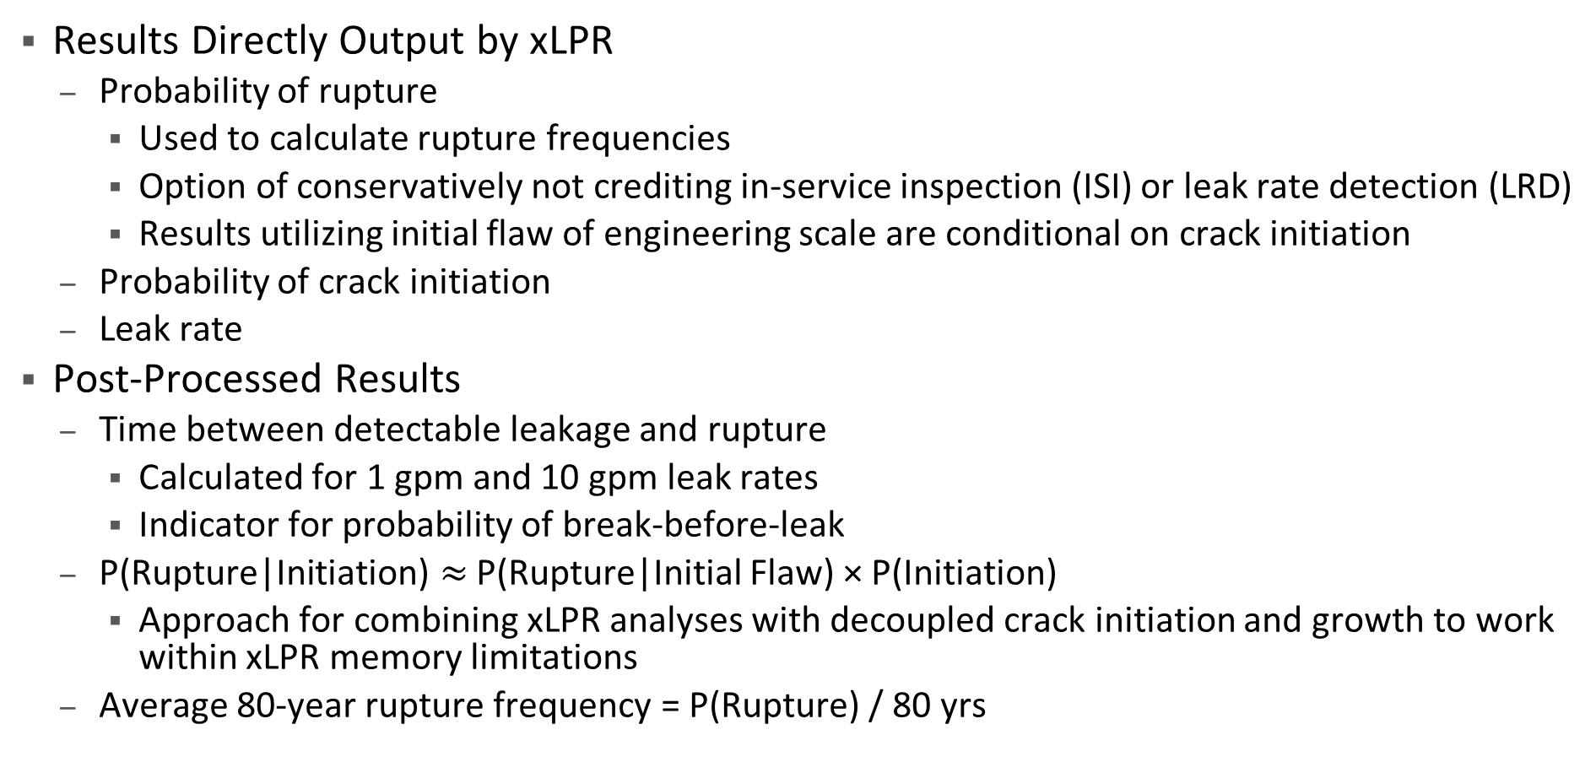
Output Quantities of Interest
Results Directly Output by xLPR
  Probability of rupture
    Used to calculate rupture frequencies
    Option of conservatively not crediting in-service inspection (ISI) or leak rate detection (LRD)
    Results utilizing initial flaw of engineering scale are conditional on crack initiation
  Probability of crack initiation
  Leak rate
Post-Processed Results
  Time between detectable leakage and rupture
    Calculated for 1 gpm and 10 gpm leak rates
    Indicator for probability of break-before-leak
  $\text{P}\text{(}\text{Rupture}\text{|}\text{Initiation}\text{)}≈$ P(Rupture|Initial Flaw) × P(Initiation)
    Approach for combining xLPR analyses with decoupled crack initiation and growth to work within xLPR memory limitations
  Average 80-year rupture frequency = P(Rupture) / 80 yrs

Slide 10
LOCA Frequency Compared to NUREG-1829 Table 1
Without Crediting ISI or LRD
xLPR estimated LOCA frequencies are compared to NUREG-1829 without considering ISI or LRD
  Using this approach, the predicted LOCA frequencies are significantly higher than the NUREG-1829 estimates
It is noted that many of the piping system analysis / generalization study xLPR cases considered unmitigated components at high temperatures
  Although some unmitigated components do exist, a notable fraction of components at hot leg temperature and all components at pressurizer temperature are mitigated
Cases with crack growth due to fatigue only showed no leaks or ruptures

Slide 11
LOCA Frequency Compared to NUREG-1829 Table 1
Crediting LRD, Without Crediting ISI
Occurrence of rupture with LRD is 0 for most xLPR cases considered
  Nonzero occurrence of rupture with LRD is shown explicitly
  Ruptures with LRD are due to modeling unrealistic scenarios (e.g., overlay application caused rupture, initial flaw deeper than inlay depth)
For cases where occurrence of rupture ≠ 0 and occurrence of rupture w/ LRD = 0, data are plotted with a 95% upper bound one-sided confidence interval, estimated using a binomial distribution
  Considers number of realizations executed
  Accounts for probability of initiation
When crediting LRD, occurrence of rupture results are on a similar order of magnitude as NUREG-1829 LOCA frequency estimates
  NUREG-1829 considered additional degradation modes
  A review of other potential degradation mechanisms and their influence is being performed

Slide 12
Minimum Time from Detectable Leakage to Rupture
Times from detectable leakage to rupture listed as N/A in the NRC TLRs are not shown.

Slide 13
Mean Time from Detectable Leakage to Rupture
Times from detectable leakage to rupture listed as N/A in the NRC TLRs are not shown.

Slide 14
Conclusions
Cases with crack growth due to only fatigue showed no leaks or ruptures
When crediting LRD (without crediting ISI), occurrence of rupture results are on a similar order of magnitude as NUREG-1829 LOCA frequency estimates
  A review of other potential degradation mechanisms considered in NUREG-1829 and their influence is being performed
Most limiting times from 1 gpm detectable leakage to rupture were for cases modeling unmitigated welds at hot leg or pressurizer temperatures

