Slide 1
PROBABILISTIC LEAK-BEFORE-BREAK EVALUATION OF SMALL LINE DISSIMILAR METAL WELDS USING xLPR
4th International Symposium on Probabilistic Methodologies for Nuclear Applications
November 1-3, 2022, Leicester, UK
C. Harrington, N. Glunt, D.J. Shim
Electric Power Research Institute
N. Cofie, M. Uddin
Structural Integrity Associates, Inc.
Nov 1, 2022

Slide 2
Outline
Background
Objectives
Probabilistic Input and Approach
Case Studies
Summary

Slide 3
Background
To meet GDC-4 requirements, deterministic LBB (SRP 3.6.3) has been applied
SRP 3.6.3 requires that all degradation mechanisms be evaluated to demonstrate they are not potential sources of pipe rupture
Prior to early 2000, only fatigue crack growth was considered for LBB evaluations to address normal operating transient cycles
SRP 3.6.3 requires margins of 10 on leakage and 2 on critical through-wall crack length
PWSCC in PWR DM welds found early 2000 – an active degradation mechanism
PWSCC morphology reduces the LBB margins
MRP-140 – LBB margins were maintained for large diameter piping (>12 inch)

Slide 4
Background (cont’d)
xLPR developed by NRC/EPRI - a PFM software tool to demonstrate the low probability of rupture requirement in GDC-4
Developed under rigorous software QA program
Reports from NRC Office of Regulatory Research - demonstrated extremely low probability of rupture for large diameter piping
Application of LBB to small diameter piping (<6 inch) is challenging
Requires very low leak detection capabilities to meet SRP 3.6.3 margins
Previous study shows LRD of 0.1-0.5 gpm is required for NPS 4 to NPS 6

Slide 5
Objective
Probabilistic evaluation using xLPR for a small diameter piping nozzle with a dissimilar metal (DM) butt weld susceptible to PWSCC
Feasibility study to determine if xLPR can be used to demonstrate LBB acceptance for small diameter piping from a probabilistic viewpoint
Sensitivity studies include
Two different weld residual stress (WRS) profiles
Flaw coalescence (multiple and long surface flaws)
The effect of mitigation by weld overlay (WOL)

Slide 6
Probabilistic Input Parameters (xLPR)
Pipe Dimensions: Representative Spray Nozzle
OD: 143.3 mm (5.64 in)
Thickness: 23.9 mm (0.94 in) (R_{i}/t = 2.0)
Materials: Alloy 82/182, SA-508 CS, 316 SS
Properties from xLPR v2.1 materials library
Loads: Plant specific CE pressurizer spray nozzle
15.5 MPa and 320.5⁰ C
Weld residual stress (WRS): discussed on Slide 7
Realizations: 400-800K
Initial flaw distribution: lognormal distribution
Depth: 1.5 mm median with 1.419 ln(σ)
Length: 4.8mm median with 2.226 ln(σ)
PWSCC Growth Rate: MRP-115
Inspection Scenarios: one inspection every 10 years
POD curves: obtained from xLPR User Manual
Leak rate detection (LRD): discussed on Slide 8
Load | Type | Stress, MPa (ksi)
Internal Pressure | Membrane | 23.27 (3.38)
Crack Face Pressure* | Membrane | 15.51 (2.25)
Deadweight | Membrane | -0.35 (-0.05)
 | Bending | 1.47 (0.21)
Thermal Expansion | Membrane | -0.14 (-0.2)
 | Bending | 7.55 (1.1)
SSE | Membrane | 0.30 (0.04)
 | Bending | 35.99 (5.22)

Slide 7
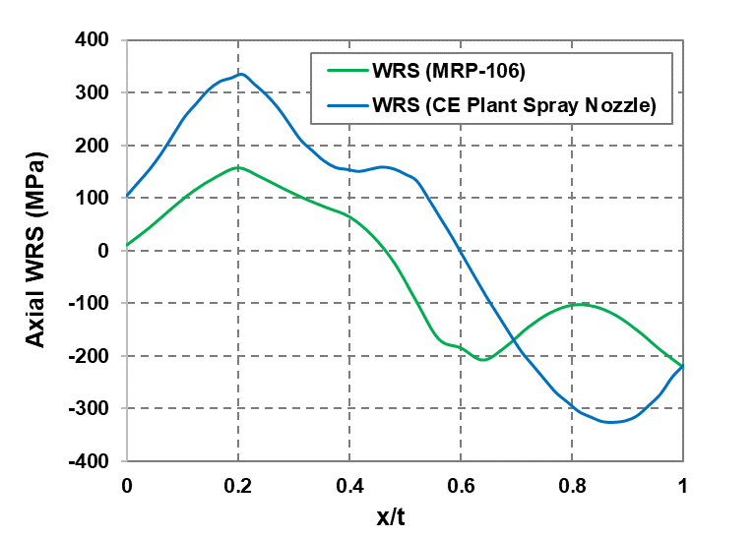
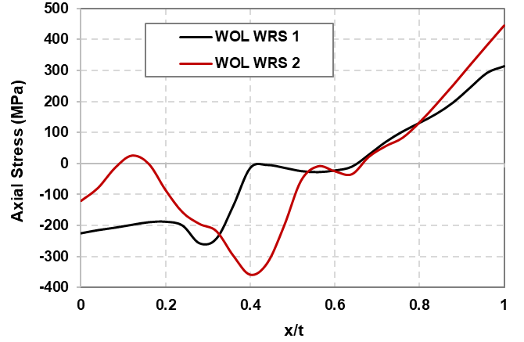
WRS Distributions Applied
Unmitigated WRS
Two unmitigated WRS distributions are used in this study
MRP-106 WRS for 5-in safety relief nozzle (25% OD weld repair)
CE-plant spray nozzle WRS (50% pre-service repair)
The CE plant-specific WRS has higher tensile stresses at the inside surface of the pipe
Mitigated WRS
Two mitigated WRS distributions are used in this study
WOL WRS 1 – stress-free, 50% preservice repair, WOL
WOL WRS 2 – original DMW, 50% preservice repair, WOL
Stress mitigation technique - Weld Overlay (WOL)
Both WRS profiles show compressive residual stress on the inner half of the DM butt weld

Slide 8
Leak Rate Detection (LRD)
Typical LRD in deterministic LBB (SRP 3.6.3) – 1.0 gpm
Lower LRD is required to meet the required LBB margin for small diameter piping
Previous study based on fatigue crack morphology shows LRD of 0.1-0.5 gpm is required for NPS 4 to NPS 6
Several plants were able to justify a leak detection limit of 0.25 gpm
NRC Reg. Guide 1.45, Rev 1 stated that with improvements in leakage monitoring system and data analysis, plants can detect leakage lower than 0.05 gpm
In this study, an LRD range of 0.1-10 gpm is investigated

Slide 9
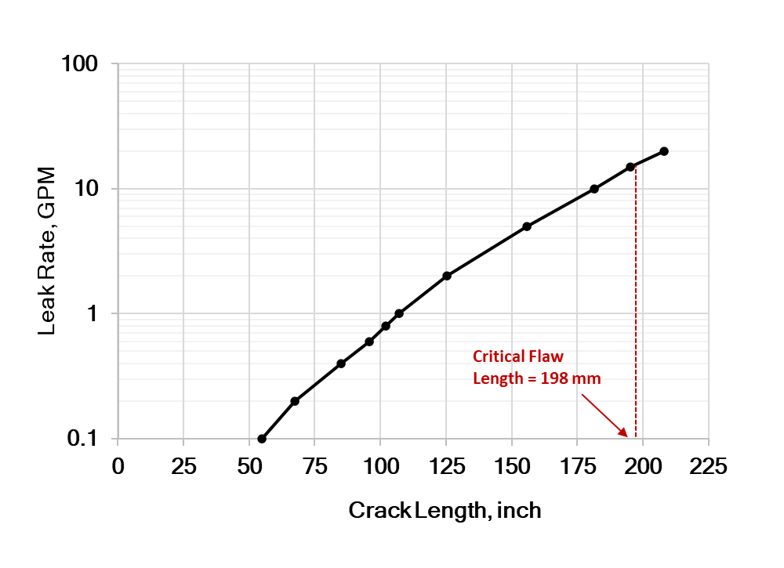
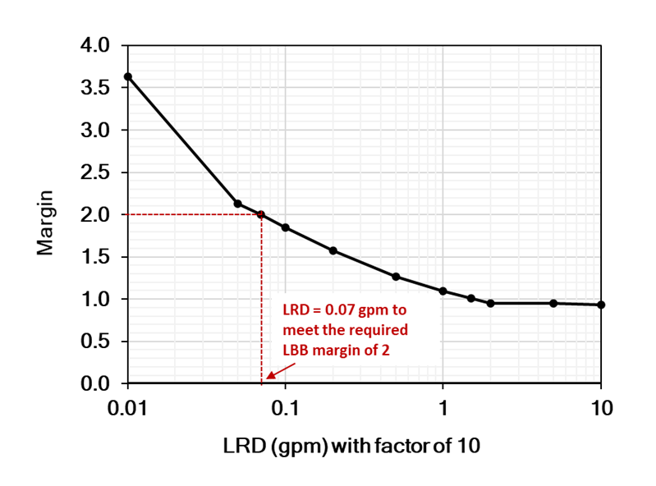
Deterministic LBB Evaluation: SRP 3.6.3
For the subject small diameter DM butt weld, a leak detection capability of 0.07 gpm is required to meet the SRP 3.6.3 margin

Slide 10
Probabilistic Approach using xLPR
Probability of failure of a postulated through-wall crack – analogous to the SRP 3.6.3 approach.
However, realistic case would be to start with a surface crack
Scenario 1
Start with a surface crack
Grow it to a through-wall flaw (all surface cracks may not grow to through-wall cracks)
Grow the though-wall flaw to LRD or rupture
Scenario 2
Start with a surface crack
Grow it to full circumferential crack
Rupture without LRD
P_{f} is the probability of failure
P_{sc} is the probability of surface crack rupture
P_{TWC} is the probability of a through-wall leaking crack
P_{f|TWC} is the conditional probability of failure given a through-wall crack
$P_{f} = P_{TWC} × P_{f|TWC}+P_{SC}$
xLPR direct output

Slide 11
Case Studies
Single surface flaw
Effect of WRS profiles
Effect of mitigations
Multiple and long circumferential surface cracks (180⁰ - 270⁰)
Effect of WRS profiles
Effect of mitigations

Slide 12
Acceptance Criteria for Probabilistic LBB
The Acceptance Group of the xLPR project recommended acceptance criteria for a probabilistic analysis is less than 1E-06 failures per year
This acceptance criteria was also used in recently published two reports from the NRC Office of Regulatory Research
The same acceptance criteria is used in the current work

Slide 13
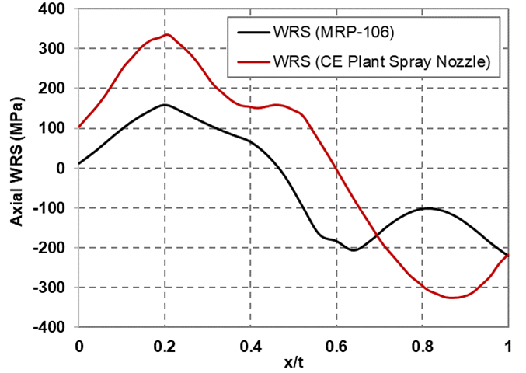
Single Flaw Case: Two WRS Profiles
MRP-106 WRS – P_{TWC} relatively low with relatively high P_{SC}
These cases not captured by deterministic LBB and LRD doesn’t play a significant role due to high P_{sc}
CE Spray Nozzle WRS – P_{TWC} close to 1 which implies P_{SC} is very low
P_{f} is dependent on LRD due to higher through-wall crack ruptures
For LRD 1-5 gpm, all leaks are readily detectable leading to no through-wall crack ruptures
For LRD 10 gpm, timely leak detection is not assured for all leaking cracks leading to some through-wall crack ruptures
LRD (gpm) | Cum. Prob. of Leak, P_{TWC} | Cum. Prob. of Rupture, P_{f} | Cum. Prob. of Surface Crack Rupture, P_{sc} | Cum. Cond. Prob. of Rupture, P_{f|TWC}
MRP-106 WRS distribution
0.1 | 0.631 | 3.33E-04 (266) | 3.33E-04 (266) | N/A
1 | 0.631 | 3.33E-04 (266) | 3.33E-04 (266) | N/A
5 | 0.631 | 3.51E-04 (281) | 3.51E-04 (281) | N/A
10 | 0.631 | 3.74E-04 (299) | 3.51E-04 (281) | 3.65E-05 (18)
CE spray nozzle WRS distribution
0.1 | 0.999 | 1.25E-06 (1) | 1.25E-06 (1) | N/A
1 | 0.999 | 1.25E-06 (1) | 1.25E-06 (1) | N/A
5 | 0.999 | 1.25E-06 (1) | 1.25E-06 (1) | N/A
10 | 0.999 | 8.37E-05 (67) | 1.25E-06 (1) | 8.25E-05 (66)
800,000 realizations
* Numbers in the parenthesis indicate number of failure from 800K simulations

Slide 14
Single Flaw Case: Two WRS Profiles (cont’d)
Per yearly basis and LRD 1-5 gpm
P_{f} for MRP-106 WRS is slightly higher than acceptance criteria (4E-06 vs. 1E-06)
P_{f} for CE spray nozzle WRS is two orders below the acceptance criteria (1.5E-08 vs. 1E-06)
WRS profiles play an important role for small pipe diameter nozzle
Since P_{f} close to acceptance criteria, the low probability of rupture could potentially be demonstrated for the small piping nozzle DM welds
LRD (gpm) | Cum. Prob. of Leak, P_{TWC} | Prob. of Rupture per Year | Cond. Prob. of Rupture per Year, P_{f|TWC}
MRP-106 WRS distribution
0.1 | 0.631 | 4.16E-06 (3) | N/A
1 | 0.631 | 4.16E-06 (3) | N/A
5 | 0.631 | 4.39E-06 (4) | N/A
10 | 0.631 | 4.68E-06 (4) | 4.56E-07
CE spray nozzle WRS distribution
0.1 | 0.999 | 1.56E-08 (0) | N/A
1 | 0.999 | 1.56E-08 (0) | N/A
5 | 0.999 | 1.56E-08 (0) | N/A
10 | 0.999 | 1.05E-06 (1) | 1.03E-06 (1)
* Numbers in the parenthesis indicate number of failure from 800K simulations

Slide 15
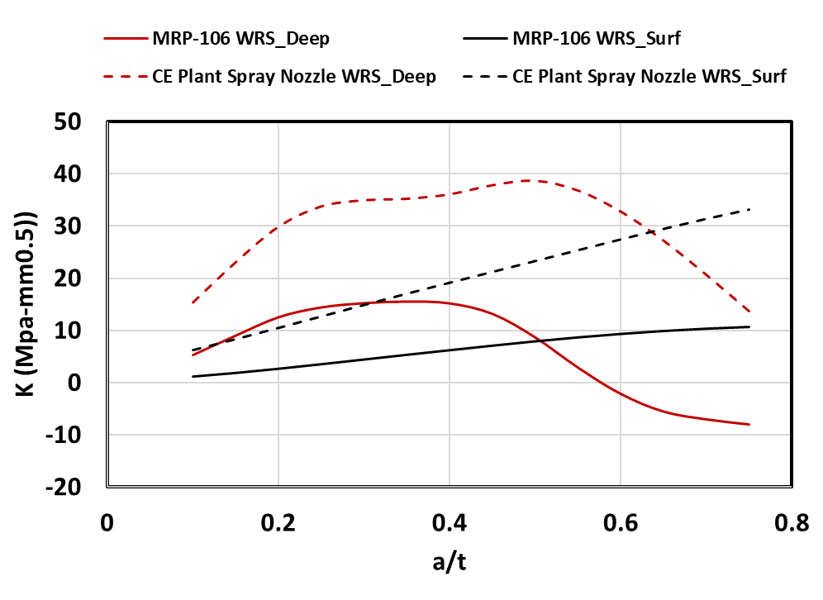
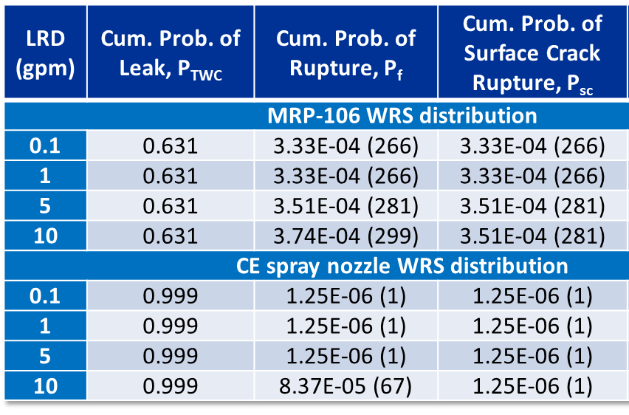
Insight on Surface Crack Ruptures
K values are lower for MRP-106 case
Lower leak probabilities (0.631 vs 0.999)
Higher P_{f} for MRP-106 WRS case mainly due to surface crack ruptures
K_{deep} goes negative – slowing/arresting crack toward depth dir.
K_{surface} stays positive – growing around circumference
Lower P_{f} for CE spray nozzle WRS case – mostly through-wall cracks at 10 gpm LRD
Both K_{deep} and K_{surface} always stay positive
Through-wall crack ruptures tend to only occur when the LRD is high
Leaks are allowed to grow (10 gpm) before detection
Due to surface crack ruptures, the deterministic concept of LBB should be cautiously applied to small diameter piping nozzles with DM Welds Susceptible to PWSCC

Slide 16
Single Flaw with Mitigations
For all LRD cases (1-10 gpm) with 800K realizations
No ruptures occurred when WOL mitigation was applied
Mitigated WRS

Slide 17
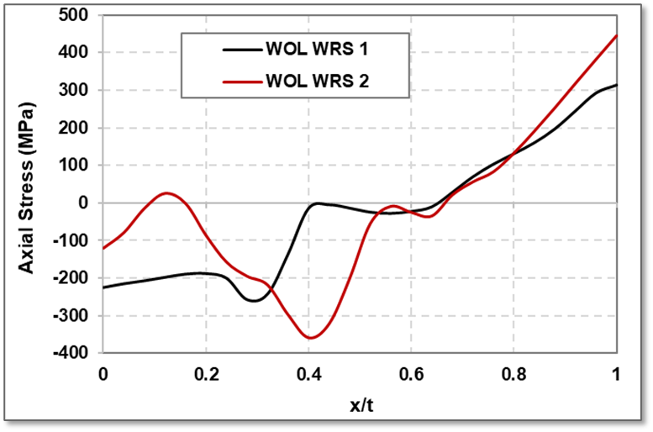
Long Circumferential Surface Cracks
Unmitigated WRS – 180⁰ flaw
MRP-106 WRS case - Failures were by surface crack ruptures
CE spray nozzle WRS case - No failure in 400K realizations
Mitigated WRS
180⁰ - No failures in 400K realizations
270⁰ - P_{f} is two orders below the acceptance criteria – all surface crack ruptures
P_{f} is essentially zero (2E-15) with ISI (LRD has no effect on surface crack ruptures)
Case | Prob. of Leak, P_{TWC} | Prob. of Rupture per Year w/ LRD | Prob. of Rupture per Year w/ LRD & ISI | Prob. of Surface Crack Rupture per Year w/ LRD
Unmitigated WRS
MRP-106 WRS (180°) | 0.91 | 1.09 E-05 (4) | 5.19E-07 (~0) | 1.09E-05 (4)
CE Spray Noz WRS (180°) | 1 | 0 | 0 | 0
Mitigated WRS
WOL WRS-1 (180°) | 0 | 0 | 0 | 0
WOL WRS-2 (180°) | 2.5E-06 | 0 | 0 | 0
WOL WRS-2 (270°) | 0 | 3.13E-08 (~0) | 2.53E-15 (~0) | 3.13E-08 (~0)
LRD – 0.1 gpm
400,000 realizations

Slide 18
Summary
As per the deterministic LBB evaluation (SRP 3.6.3), an LRD of 0.07 gpm is required to meet the SRP 3.6.3 margin whereas probabilistic evaluations using xLPR, a low probability of rupture (<1E-06) can be demonstrated with an LRD as high as 10 gpm.
SRP 3.6.3 is very conservative for small diameter nozzle DM welds
The WRS distribution influences the probability of rupture
One case shows P_{f} close to acceptance criteria
The other case shows P_{f} well below acceptance criteria
For small diameter piping with unmitigated WRS distributions, failures were mainly by surface crack ruptures – against the assumption of through-wall flaw in deterministic LBB
When mitigated by WOL, the probability of rupture is essentially zero for an initial small surface flaw
For 270⁰ long circumferential surface crack,
Mitigated, low LRD and ISI
The probability of rupture is well below the acceptance criteria
More studies are required for general conclusion
Additional small diameter piping nozzles and associated WRS distributions

Slide 19
Backup Slides

Slide 20
Material Properties
Material Property | Probabilistic Parameters
 | Distribution | Alloy 82/182 (Weld) |  | SA-508 CS (Left Pipe) |  | 316 SS (Right Pipe)
 |  | Mean | Std. Dev. | Mean | Std. Dev. | Mean | Std. Dev.
Yield Strength, MPa (ksi) | Lognormal | 316.5 (45.9) | 55.0 (8.0) | 399 (57.9) | 68 (9.9) | 197.1 (28.6) | 54 (7.8)
Ultimate Strength, MPa (ksi) | Lognormal | 542.0 (78.6) | 26.8 (3.9) | 629 (91.2) | 38 (5.5) | 440.4 (63.9) | 67 (9.7)
Elastic Modulus, MPa (ksi) | Normal | 196,800 (28,542) | 29,520 (4,281) | 174,960 (25,376) | 26244 (3,806) | 176,660 (25,622) | 26,490 (3,842)

Slide 21
Long circumferential surface cracks
Case | Cumulative Prob. of Leak, P_{TWC} | Cumulative Prob. of Rupture w/ LRD, P_{f|LRD} | Cumulative Prob. of Rupture w/ LRD & ISI, P_{f|LRD-ISI} | Cumulative Probability of Surface Crack Rupture w/ LRD, P_{sc} | Probability of Rupture per Year w/ LRD | Probability of Rupture per Year w/ LRD & ISI | Probability of Surface Crack Rupture per Year w/ LRD
Unmitigated WRS
MRP-106 WRS (180°) | 0.91 | 8.75E-04 | 4.15E-05 | 8.75E-04 | 1.09 E-05 | 5.19E-07 | 1.09E-05
CE Spray Noz WRS (180°) | 1 | 0 | 0 | 0 | 0 | 0 | 0
Mitigated WRS
WOL WRS-1 (180°) | 0 | 0 | 0 | 0 | 0 | 0 | 0
WOL WRS-2 (180°) | 2.5E-06 | 0 | 0 | 0 | 0 | 0 | 0
WOL WRS-2 (270°) | 0 | 2.50E-06 | 2.02E-13 | 2.50E-06 | 3.13E-08 | 2.53E-15 | 3.13E-08

Slide 22
Single Flaw Case: Two WRS Profiles
LRD (gpm) | Cumulative Prob. of Leak, P_{TWC} | Cumulative Probability of Leak after 80 Years. P_{TWC} | Cumulative Prob. of Rupture, P_{f} | Cumulative Probability of Rupture after 80 Years, P_{f} | Cumulative Prob. of Surface Crack Rupture, P_{sc} | Cumulative Probability of Surface Crack Rupture after 80 Years, P_{sc} | Cumulative Conditional Probability of Rupture, P_{f|TWC} | Probability of Rupture per Year, P_{f} | Conditional Probability of Rupture per Year
MRP-106 WRS distribution
0.1 |  | 0.631 |  | 3.33E-04 (266) |  | 3.33E-04 (266) | N/A | 4.16E-06 (3) | N/A
1 |  | 0.631 |  | 3.33E-04 (266) |  | 3.33E-04 (266) | N/A | 4.16E-06 (3) | N/A
5 |  | 0.631 |  | 3.51E-04 (281) |  | 3.51E-04 (281) | N/A | 4.39E-06 (4) | N/A
10 |  | 0.631 |  | 3.74E-04 (299) |  | 3.51E-04 (281) | 3.65E-05 (18) | 4.68E-06 (4) | 4.56E-07
CE spray nozzle WRS distribution
0.1 |  | 0.999 |  | 1.25E-06 (1) |  | 1.25E-06 (1) | N/A | 1.56E-08 (0) | N/A
1 |  | 0.999 |  | 1.25E-06 (1) |  | 1.25E-06 (1) | N/A | 1.56E-08 (0) | N/A
5 |  | 0.999 |  | 1.25E-06 (1) |  | 1.25E-06 (1) | N/A | 1.56E-08 (0) | N/A
10 |  | 0.999 |  | 8.37E-05 (67) |  | 1.25E-06 (1) | 8.25E-05 (66) | 1.05E-06 (1) | 1.03E-06 (1)
* Numbers in the parenthesis indicate number of failure from 800K simulations

