Slide 1
4th International Symposium on Probabilistic Methodologies for Nuclear Applications, November 1-3, 2022, Leicester, UK
Probabilistic Fracture Analyses of a Reactor Pressure Vessel Outlet Nozzle Weld using the xLPR Code
Matthew Homiack
Materials Engineer
U.S. Nuclear Regulatory Commission
Office of Nuclear Regulatory Research
Division of Engineering
Reactor Engineering Branch
Cédric Sallaberry, Frederick W. Brust, Elizabeth Twombly, and Robert Kurth
Engineering Mechanics Corporation of Columbus
Matthew.Homiack@nrc.gov
+1 (301) 415-2427

Slide 2
Outline
> Tools and regulatory applications
> Quantities of interest
> Analysis case
> Selection of results
> Conclusions
> References
2

Slide 3
Tools and Regulatory Applications
Extremely Low Probability of Rupture (xLPR) Probabilistic Fracture Mechanics Code
Leak-Before-Break (LBB)
Loss-of-Coolant Accident (LOCA) Frequency Estimation
Notes:
The xLPR code is a feature-rich probabilistic code for piping applications developed jointly by the NRC and EPRI.
The NRC staff has been using the xLPR code for:
Probabilistic leak-before-break analysis for 10 CFR Part 50, Appendix A, General Design Criterion 4 compliance
More recently, to investigate possible uses for generating LOCA frequency estimates
Many potential regulatory applications, such as for
Probabilistic risk assessment
Risk-informed alternatives to the emergency core cooling system requirements in 10 CFR 50.46
Evaluate industry proposals to support accident-tolerant fuel licensing

Slide 4
Quantities of Interest
> Probability of crack initiation
> Probability of leak
> Probability of rupture with/without leak detection and inservice inspection
> Probability of small-break (SB), medium-break (MB), and large-break (LB) LOCA by leak rate (LR) or crack-opening area (COA)
> LBB ratio
> LBB time lapse
Notes:
“Out of the box”, the xLPR code can generate numerical estimates for many quantities of interests that can be used to study the performance of nuclear piping components.
Some of the basic outputs include:
Probability of crack initiation
Probability of leak
Probability of rupture with/without leak rate detection and inservice inspection
Probability of small-, medium, and large-break LOCA by leak rate or crack-opening area
The user can also extract interim results from the code to generate other quantities of interest for specific applications.
Some custom quantities of interest that the NRC staff has used include:
Leak-before-break ratio
Leak-before-break time lapse

Slide 5
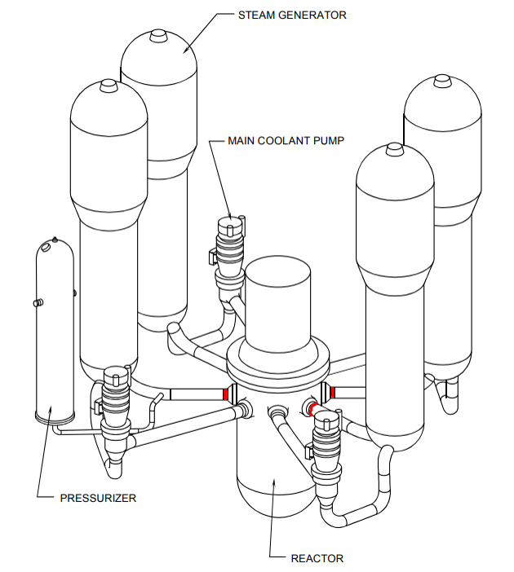
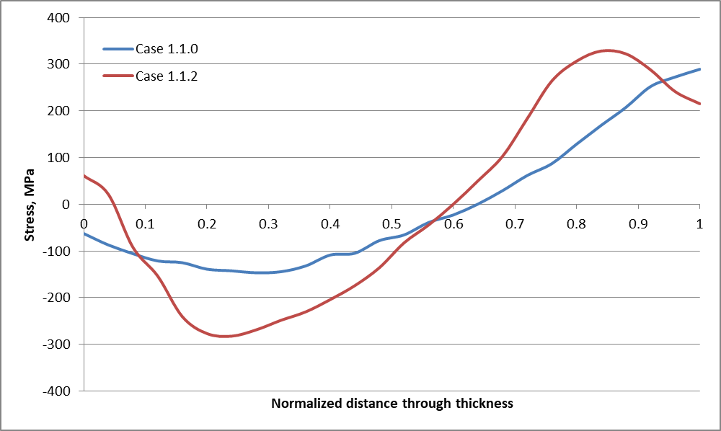
Analysis Case
Welding residual stress (WRS) profiles (Figure 3-35 from TLR-RES/DE/REB-2021-09)
Westinghouse 4-loop reactor pressure vessel outlet nozzle to piping dissimilar metal weld
Notes:
The NRC staff has conducted many analyses for the case shown here: a Westinghouse 4-loop reactor pressure vessel outlet nozzle to piping dissimilar metal weld
(Locations are shown in red on the figure)
Included in the right frame are two potential, mean axial welding residual stress (or WRS) profiles for this weld. We’re showing these as they are an important input to the analyses, as we’ll see on the very next slide.
We are interested in the performance of this weld for over 80 years of operation.

Slide 6
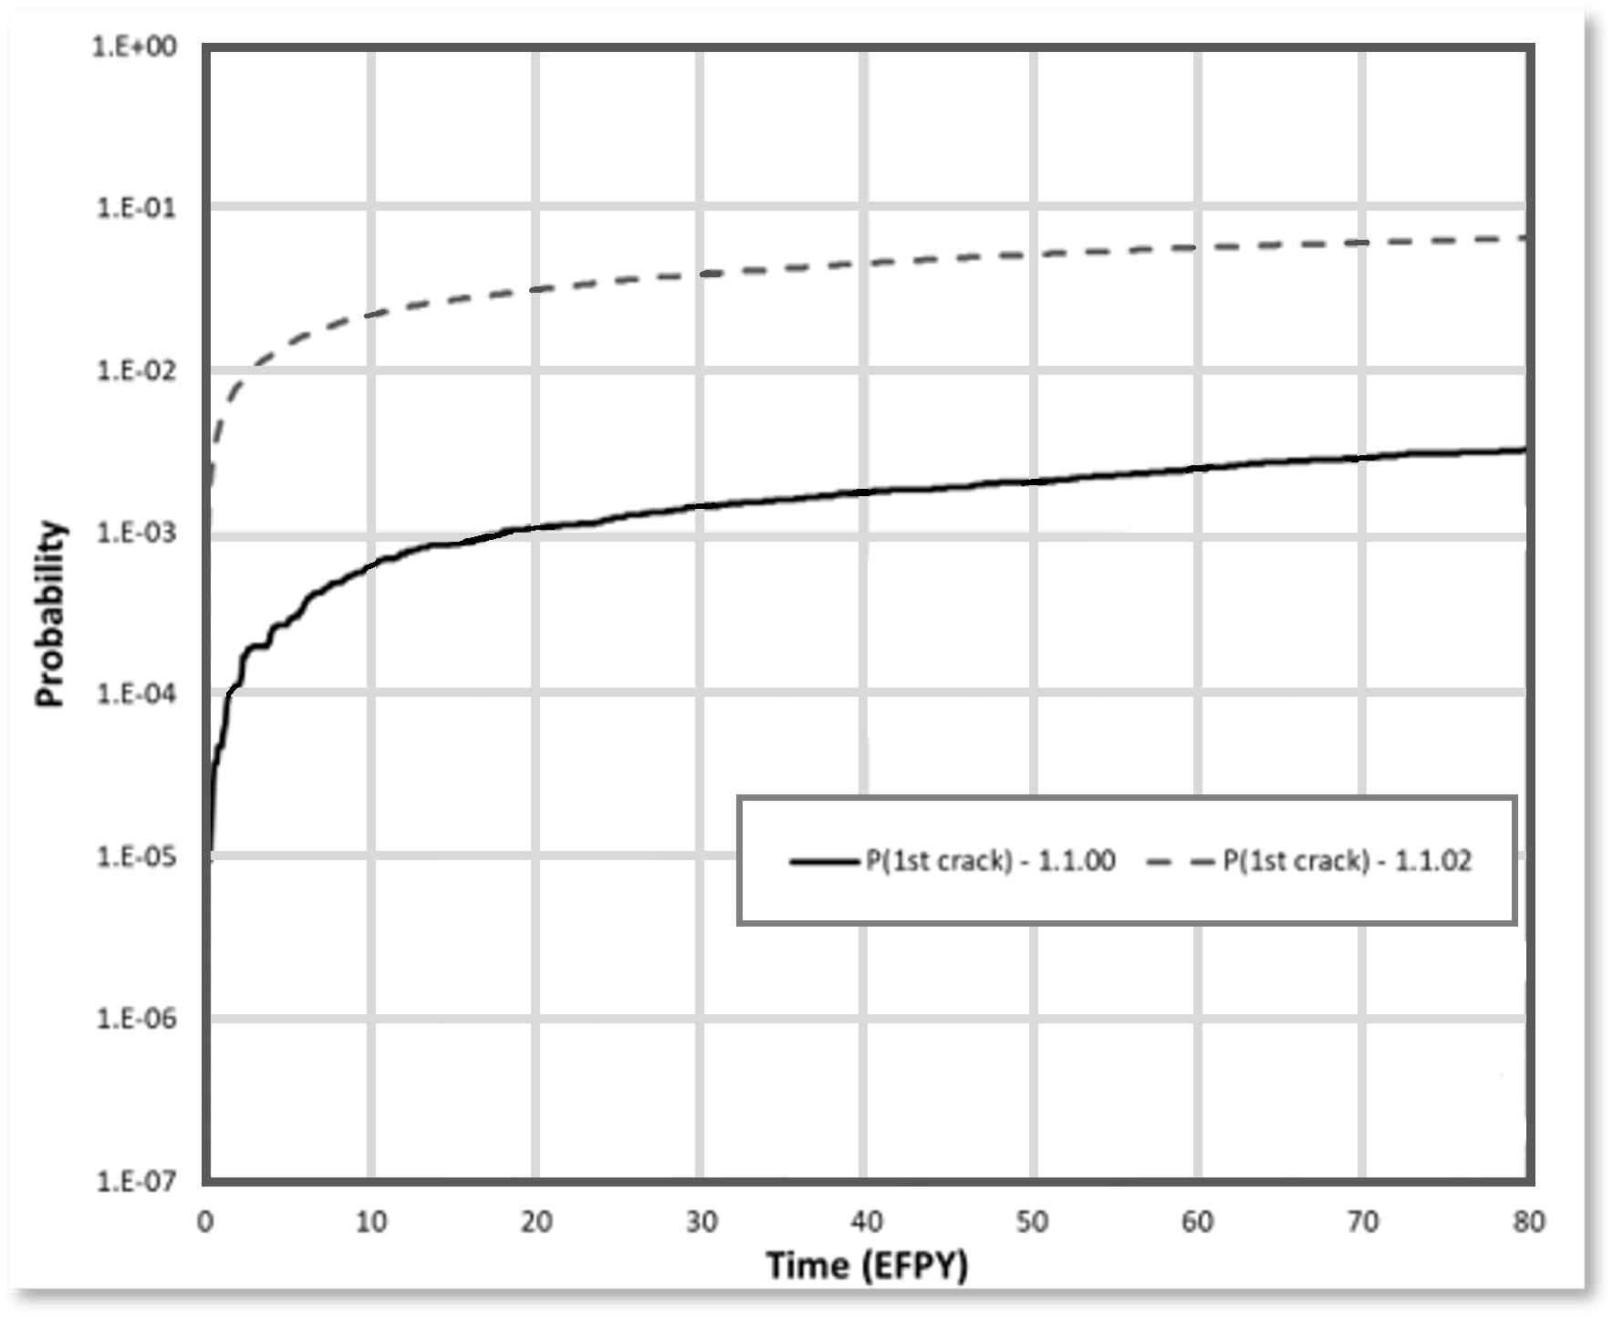
Selection of Results (1/7)
Probability of crack initiation
Higher probability of crack initiation because of the more severe WRS profile
Adapted from Figure 3-39 in TLR-RES/DE/REB-2021-09
Notes:
Let’s start with some probabilistic leak-before-break results.
These were generated using the xLPR crack initiation model and considering both axial and circumferential cracks and hydrogen water chemistry effects.
The first of results shown here is showing a sensitivity study considering the effects of a plausible, but more severe WRS profile, on the probability of crack initiation.
We define “more severe” as being more tensile on the inside diameter, which favors crack initiation.
In this case, the increased severity is the result of the greater distance between the dissimilar metal weld and the adjacent stainless steel piping weld.
The dashed line series – for Case 1.1.2 - shows the probability of crack initiation using the more severe WRS profile
The probability of first crack is about an order of magnitude higher than with the base analysis – Case 1.1.0 – which is shown with the solid line.

Slide 7
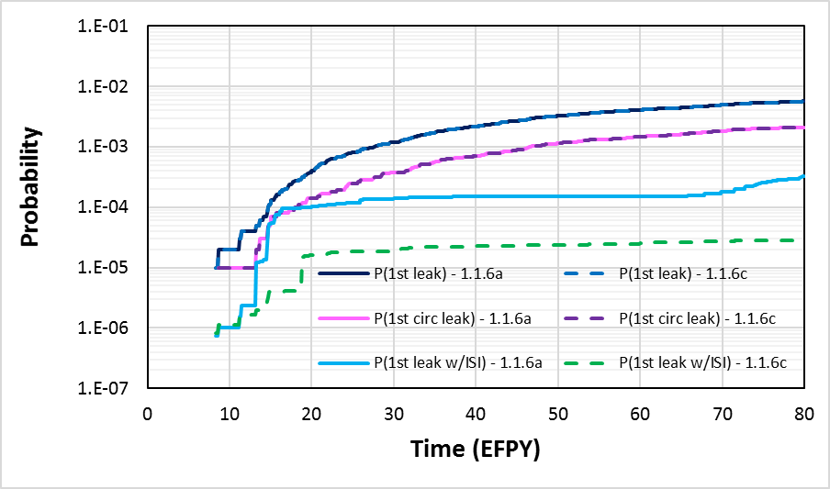
Selection of Results (2/7)
Probability of leak
Inservice inspections reduce the probability of leaks
Figure 3-6 from TLR-RES/DE/REB-2021-14-R1
Notes:
The next plot shows the probability of leak over time for various conditions.
The top-most curve (dark blue) shows the probability of first leak (from all circ. or axial cracks).
The curve just below that (pink) shows the probability of just a circ. crack leak. The delta between the two series then is (approximately) the axial crack contributions. It’s lower, so we know there are some axial cracks that can leak first and might lead to detection by leak rate.
The rest of the curves show the effects of inservice inspection: ever 10-years for Cases 1.1.6a, and every 5-years for Case 1.1.6c. The more frequent inspections reduce probabilities of leakage as expected.
NOTE: This is probably a detail at this stage, but it is not a pure delta. P(circ. leak)+P(axial leak) is likely to be higher than P(all direction leak) since the events are not disjoint.

Slide 8
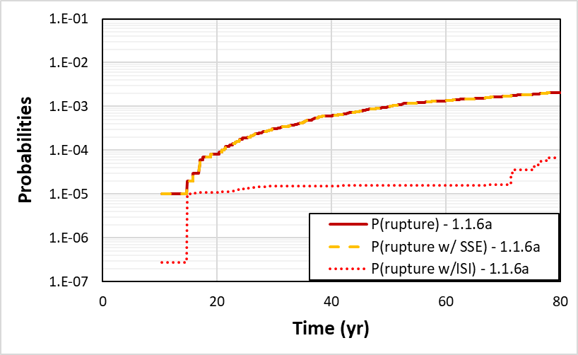
Selection of Results (3/7)
Probability of rupture
Seismic effects contribute negligible risk of failure
Adapted from Figure 3-7 of TLR-RES/DE/REB-2021-14-R1
Notes:
The plot here shows the probability of rupture over time for various conditions.
The basic probability of rupture is shown in red.
Lying nearly on top is the probability of rupture considering a potential safe shutdown earthquake.
The two results are essentially the same, indicating that the seismic effects add a negligible contribution to the failure probability of the component.
These probabilities may seem high at 10^-3. That’s because when we aren’t showing the effects of leak rate detection.
We used the probability of rupture with detection as the decisionmaking metric for our LBB studies (because it is consistent with NRC requirements in General Design Criterion 4).
When leak detection is considered, there were no occurrences of rupture over the full 80 years with a 1 gpm (or 0.063 kg/s) leak rate detection capability.
Finally, in purple, we’re showing the reduced probability of rupture due to inservice inspections every 10 years.

Slide 9
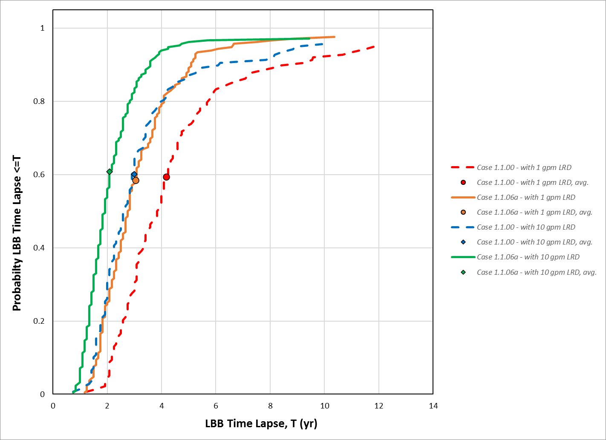
Selection of Results (4/7)
LBB time lapse
About a 3-year operator response time (i.e., time between a 1 gpm detectable leak and rupture)
1 gpm = 0.063 kg/s
10 gpm = 0.63 kg/s
Figure 3-2 from TLR-RES/DE/REB-2021-14-R1
Notes:
This next plot is showing one of the custom outputs we developed to provide insight into leak-before-break behavior: the LBB time lapse.
It’s simply the time between detectable leakage and rupture (if both events occurred in the realization).
This is useful because it shows a distribution of the operator response times to a problem in this weld.
With 1 gpm leak rate detection capability, the mean response time was about 3 years, and the minimum observed was just over a year.
With a more conservative and historically deterministic 10 gpm leak rate detection capability, the mean response time was just over two years.

Slide 10
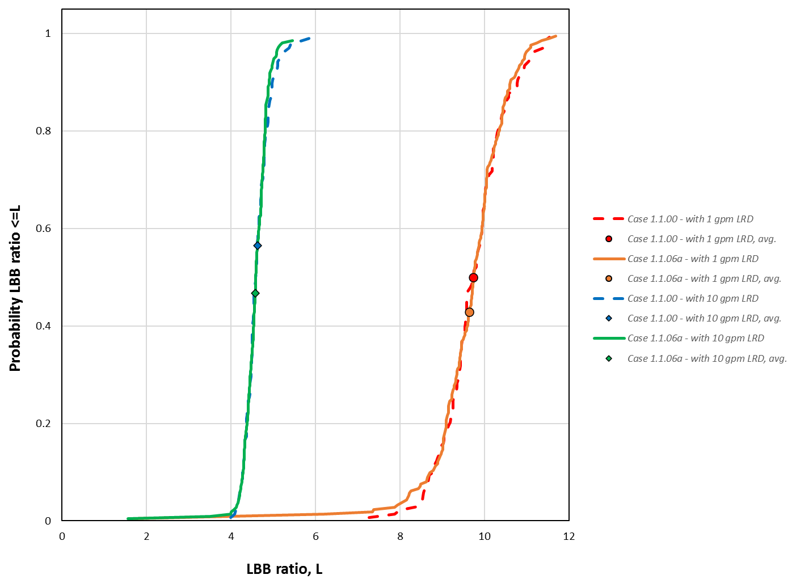
Selection of Results (5/7)
LBB ratio
About a ratio of 10 between critical crack size and leakage crack size using a 1 gpm detectable leak
1 gpm = 0.063 kg/s
10 gpm = 0.63 kg/s
Figure 3-3 from TLR-RES/DE/REB-2021-14-R1
Notes:
The is the last of the leak-before-break results.
This plot is showing another custom output we developed: the LBB ratio.
We included this in our LBB analyses to provide insights on how probabilistic LBB compares with deterministic LBB.
The LBB ratio estimates the ratio between:
(a) the critical crack length at rupture under combined normal operating and non-probabilistically treated seismic loads, and
(b) the length of a crack that results in detectable leakage.
In other words, it is an indicator of how confident you are that you will detect a leak before the pipe breaks. For a ratio $r_{LBB}$, you can state “once I detect the leak, I still need a crack $r_{LBB}$ times bigger to have rupture”
With a 1-gpm leak detection capability, mean LBB ratio was about 10.
With the 10-gpm leak detection capability, it was about 4.5
The deterministic acceptance criterion from NRC Standard Review Plan Section 3.6.3 is 2.0, so we can see from these results that we have large margins against failure (2 to 5 times the acceptance criterion).

Slide 11
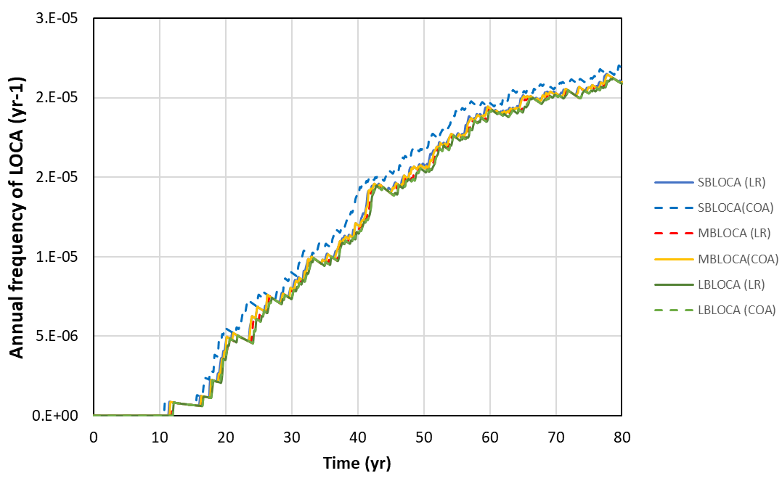
Selection of Results (6/7)
LOCA frequencies without detection
Leakage Detection
Inservice Inspection
LOCA definition has more of an impact than LOCA size
From NRC presentation at June 14, 2022, public meeting
Notes:
In the next couple of slides we’re moving on to a new set of results for LOCA frequency estimation.
The are all standard xLPR code outputs.
Here we are showing the probabilities of small-, medium, and large-break LOCAs defined by either the leak rate or crack-opening area.
These results do not credit any detection.
We can see that there is:
SMALL variation among small-, medium-, and large-break LOCA estimates
MORE variation from the LOCA definition (i.e., LOCA threshold defined by leak rate vs. threshold defined by crack-opening area)
There are two potential causes for this. The leak rate/COA translation is done supposing a circular flaw which may be less accurate for smaller flow/crack. But more importantly, the crack grows quickly once TWC so that the monthly time step sees big jumps in size (and therefore leak rate). Most of the time MBLOCA and LBLOCA will both be reached within a single timestep.

Slide 12
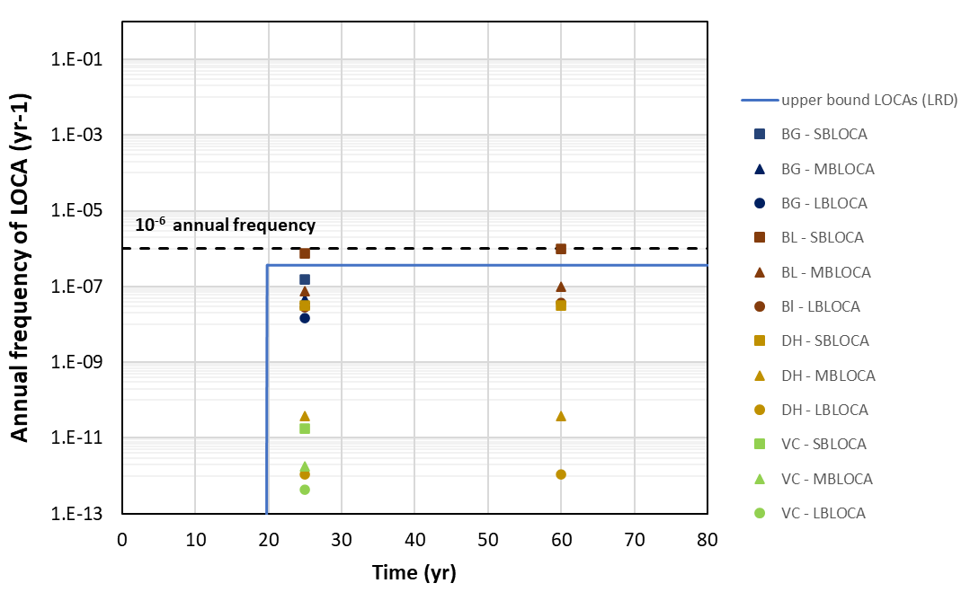
Selection of Results (7/7)
LOCA frequencies with detection
Leakage Detection
Inservice Inspection
Expert elicitation results from NUREG-1829, “Estimating Loss-of-Coolant Accident (LOCA) Frequencies Through the Elicitation Process” (ML082250436)
From NRC presentation at June 14, 2022, public meeting
Notes:
In the final set of results, the blue line shows an upper-bound estimate for when leak detection is considered.
It’s plotted plotting expert elicitation results from NUREG-1829, which was published in 2008.
There are four expert opinions on what the frequencies of the various LOCA definitions would look like at 25 and 60 years of operation. The vertical spread shows the uncertainty among experts at those times.
There were NO LOCA EVENTS in xLPR with a sample size of 100,000 realizations, so an UPPER-BOUND was estimated using “rule of 3” approach (per NUREG/CR-7278, Section 4.3.6.4).
The point here is that xLPR results compare within the range of the experts. We didn't get any results, so this this is just an upper bound for now. We would need to run a bigger sample size to get an estimate of the mean. This was exploratory work, so we were just trying to see what some initial results looked like. Basically, we were trying to answer the question of whether the detailed models available now in xLPR would validate the prior NUREG-1829 expert opinion results. I would say yes based on these result, but more work would be needed (e.g., more samples) to fully confirm.
NOTE: This is a theoretical upper bound and not a calculated value. Because you have seen no occurrence of failure for a sample of size $n$ , then there is 95% of chance that the real probability is lower than $3/n$. This gives us an upper bound on the probability which we have changed into an annual frequency using the estimate at 80 years. Our sample was 100,000 meaning the probability is 1e-5. And the annual frequency is roughly that number divided by 80 (~1.25 x 10 ⁻⁷) Here the rationale is that because the upper bound is almost one order of magnitude lower than the 10⁻⁶ annual frequency limit, there is no need to increase the sample size to have a more accurate estimate.

Slide 13
Conclusions
> The NRC staff is actively using the xLPR code to support risk-informed decision-making
> Detailed probabilistic fracture mechanics models and a nuanced suite of results provide significantly enhanced insights into piping component integrity
> xLPR applications beyond leak-before-break are an emerging area
13

Slide 14
References
VIEW DOCUMENT
TLR-RES/DE/REB-2021-09 Probabilistic Leak-Before-Break Evaluation of Westinghouse Four-Loop Pressurized-Water Reactor Primary Coolant Loop Piping using the Extremely Low Probability of Rupture Code
ML21217A088
VIEW DOCUMENT
PUBLIC MEETING Summary of the June 14, 2022, Public Meeting with EPRI and Stakeholders to Discuss Use of the Extremely Low Probability of Rupture Code for Loss-of-Coolant Accident Frequency Estimates
ML22173A222
VIEW DOCUMENT
TLR-RES/DE/REB-2021-14-R1 Probabilistic Leak-Before-Break Evaluations of Pressurized-Water Reactor Piping Systems using the Extremely Low Probability of Rupture Code
ML22088A006
Notes:
All the results presented here are available in the NRC documents referenced here.

Slide 15
Have Questions or Need Information on xLPR?
xlpr@nrc.gov
xlpr@epri.com

